Slide 1

Medical Inventory Optimization
Presented By
Student Name: R naga Sathyasai Sriphanindra
College Name: Narasaraopeta engineering college
Department: Computer science
Email ID: phanisai109@gmail.com
AICTE Student ID:STU655079c2e3e271699772866

Slide 2
OUTLINE
Problem Statement
Proposed System
System Development Approach
Algorithm & Deployment
Result
Conclusion
Future Scope
References

Slide 3
Problem Statement
Hospitals face challenges in managing large-scale medical inventories, especially with varied drug types, return rates, and cost discrepancies. Manual oversight often leads to overstocking, expiry-related losses, and missed reorder opportunities. A data-driven approach is needed to optimize stock, reduce waste, and improve departmental efficiency.

Slide 4
Proposed Solution
A Python-based system that:
Cleans and preprocesses inventory data
Identifies missing/duplicate records
Visualizes key inventory trends
Applies feature scaling and variance filtering
Helps departments make informed stock-related decisions

Slide 5
System Approach
Language: Python (Pandas, NumPy, Seaborn, Matplotlib, Scikit-learn).
Steps Followed:
Data Loading and Cleaning.
Missing & Duplicate Value Handling.
Visualizations (Bar, Pie, Scatter, Box, Violin).
Normalization using MinMaxScaler.
Feature Selection using VarianceThreshold.

Slide 6
Algorithm & Deployment
Feature Selection: VarianceThreshold to eliminate low-information features
Scaling: MinMaxScaler for numerical normalization
Binning: Cost segmentation into ranges (0–25, 25–50, etc.)
Visualization: Insights via seaborn/matplotlib
Deployment: Local analysis; ready for integration with Flask or Streamlit for frontend/dashboard use

Slide 7
Result
After processing the original dataset of 14,218 rows, approximately 2,196 rows containing missing values or duplicate entries were removed, resulting in a cleaned dataset of 12,022 valid records. Through various visualizations such as bar plots, pie charts, scatter plots, and violin plots, several meaningful insights were uncovered. The analysis revealed that most sales were concentrated in a few departments, with certain specializations and drug categories dominating the distribution. High-cost drugs were often associated with specific formulations like injections and intravenous solutions. Normalization of numerical data using MinMaxScaler helped prepare the dataset for advanced analysis, and feature selection using VarianceThreshold identified columns with little to no variability, streamlining the dataset for modeling. Furthermore, drug cost data was successfully binned into cost ranges, allowing for grouped analysis of pricing trends. Overall, the project provided a clearer understanding of how medical inventory is distributed and consumed, offering a strong foundation for predictive modeling or inventory decision-making.

Slide 8
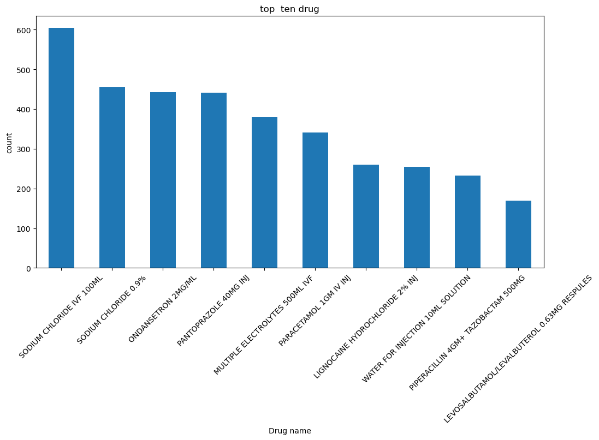
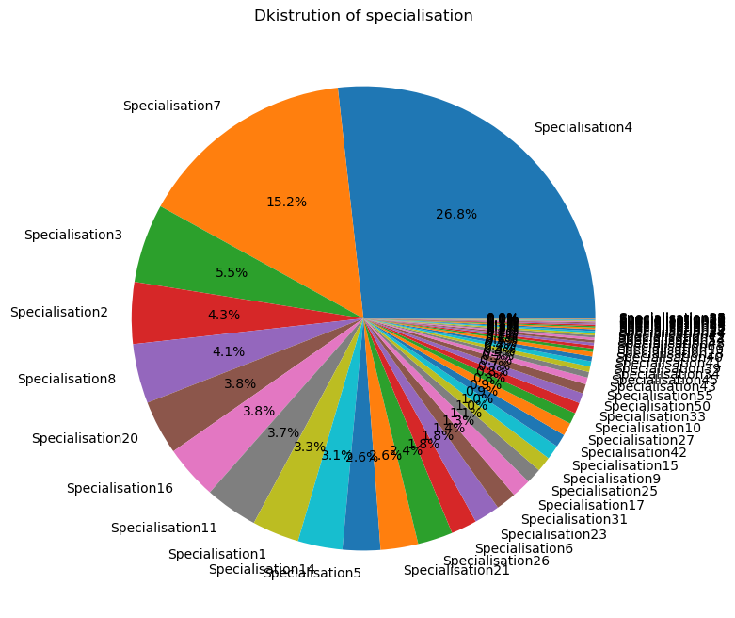
Result

Slide 9
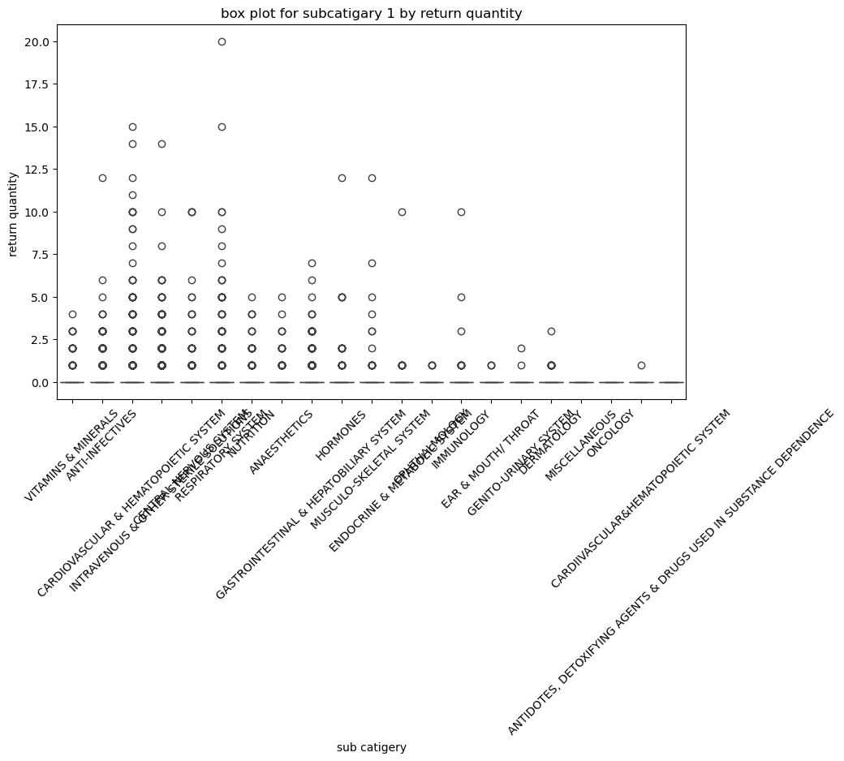
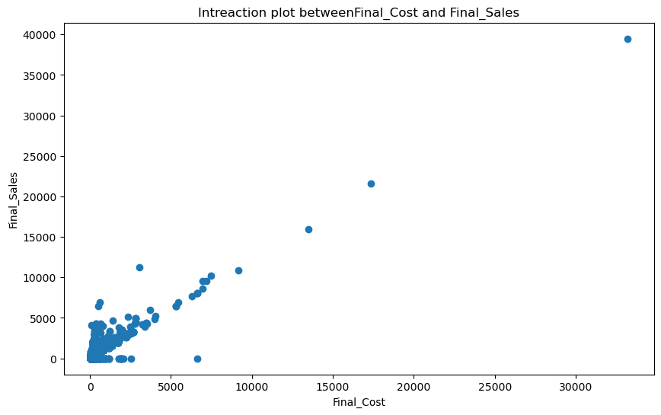
Result

Slide 10
Conclusion
Inventory data can reveal inefficiencies and optimization opportunities
Simple Python tools like Pandas, Seaborn, and Scikit-learn enable powerful analysis
Data-driven insights empower departments to make cost-effective inventory decisions

Slide 11
Future scope
Add demand forcasting using time series models.
Automate alurts for reorder points.
Develops a live dashboard using streamlit.
Integrate with hospital databases folr realtime data.

Slide 12
References
Python Software Foundation. Python Language Reference, version 3.10.
Wes McKinney. Python for Data Analysis: Data Wrangling with Pandas, NumPy, and ipython, 2nd edition.
Scikit-learn Developers. Scikit-learn: Machine Learning in Python. https://scikit-learn.org
Michael Waskom et al. Seaborn: Statistical Data Visualization. https://seaborn.pydata.org
Kaggle. Medical Inventory Optimization Dataset
GitHub Link: https://github.com/Saiphani29/medical-inventory-optimizion

Slide 13
Thank you

