Slide 1
Quizzi…!
Admin module : 20001-CM-005 G. Poojitha
Classes Management module : 20001-CM-051 T. Likitha Reddy
Quizzes Management module : 20001-CM-003 Y. Ankitha
Grading module : 20001-CM-010 B. Anjali

Slide 2
INtroduction
This project is for computerizing the existing manual system and help the examiners to save their valuable time and important data. This project helps in managing the details of every quiz, marks, subjects for a long time and will be easily accessible.

Slide 3
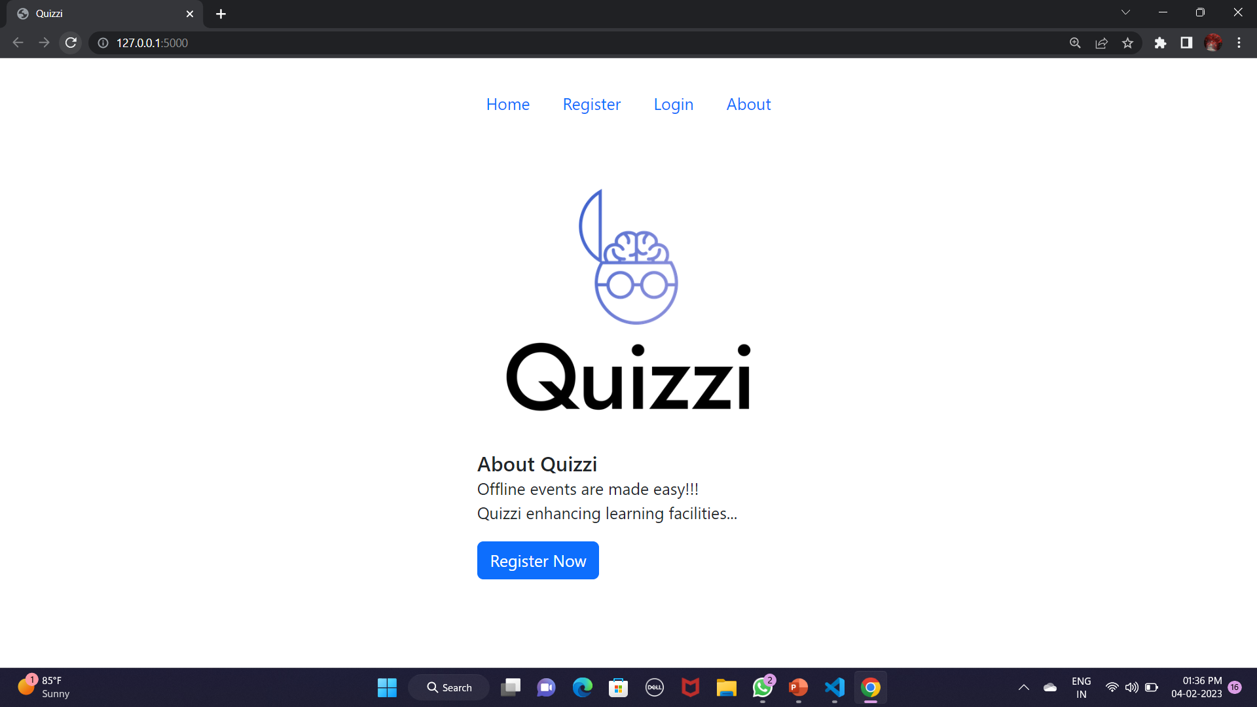
Admin MoDULE:
-New User Registration
(Student/Teacher)
-Existing User Login
-Data Management

Slide 4
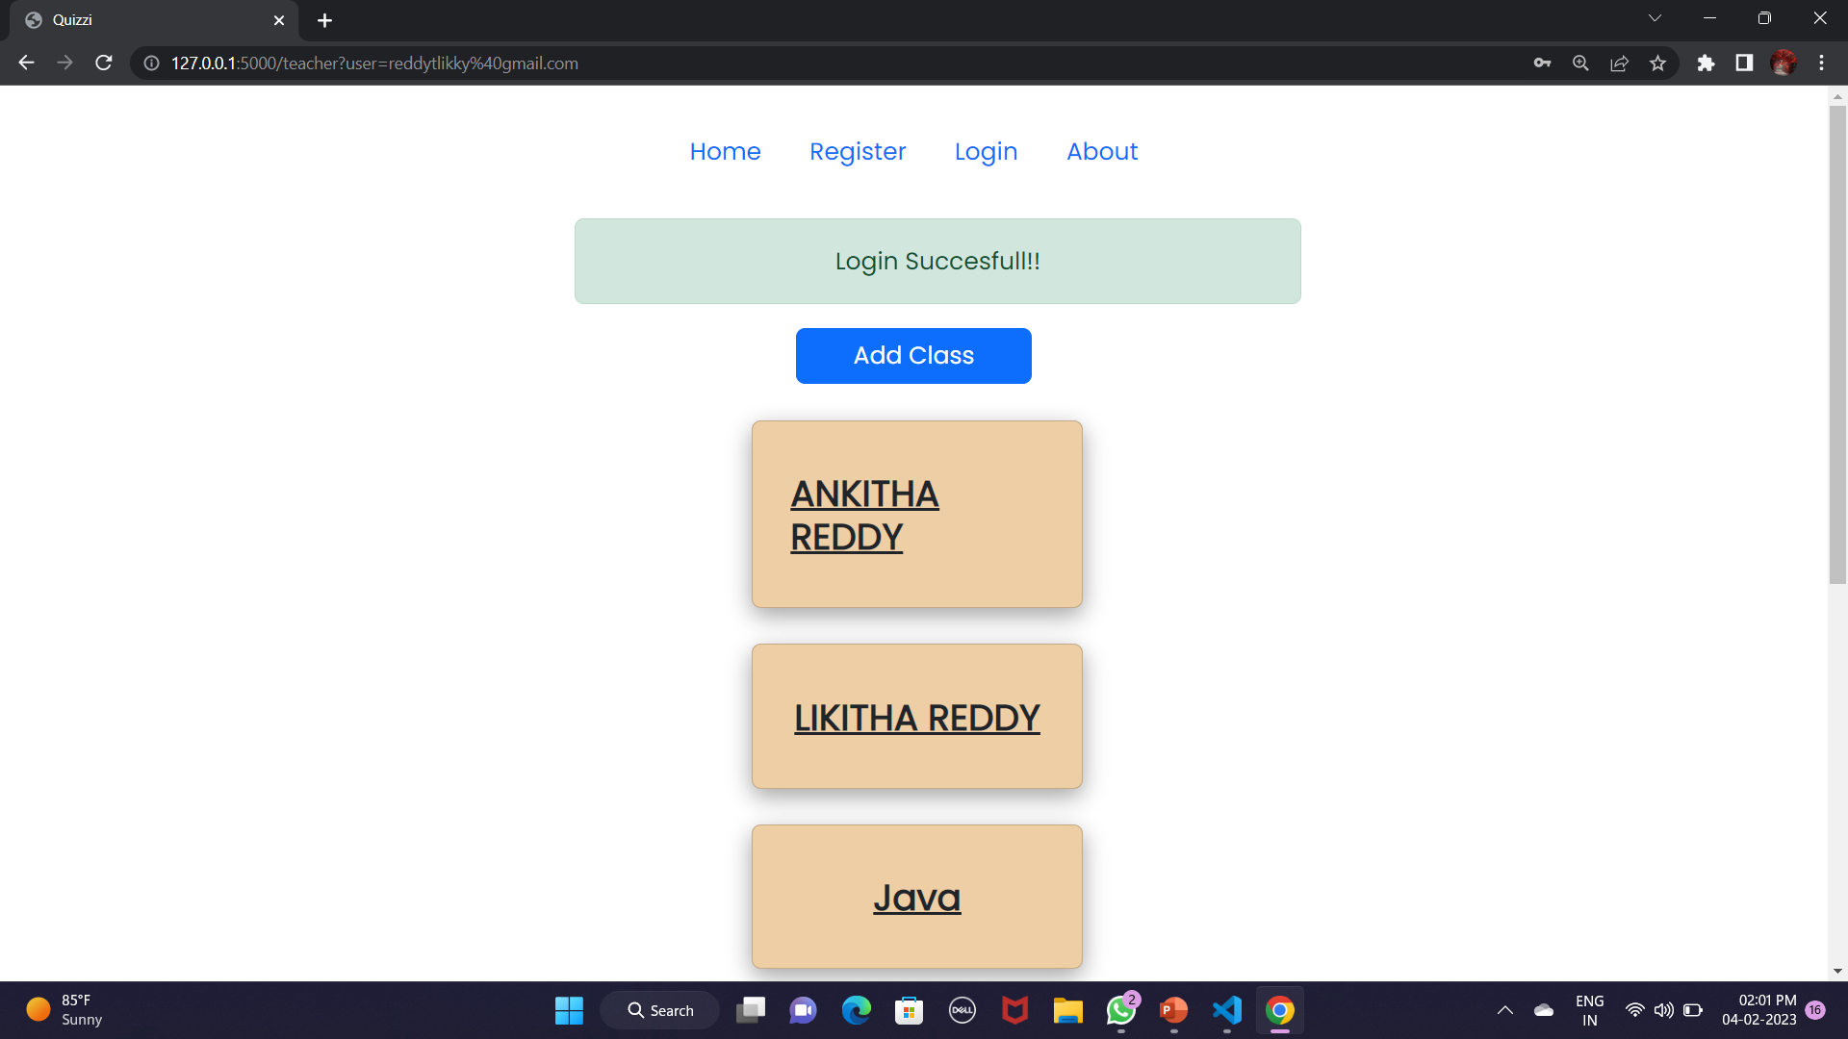
Classes management:
-Creating class
(by teacher)
-Joining classes
(by student)

Slide 5
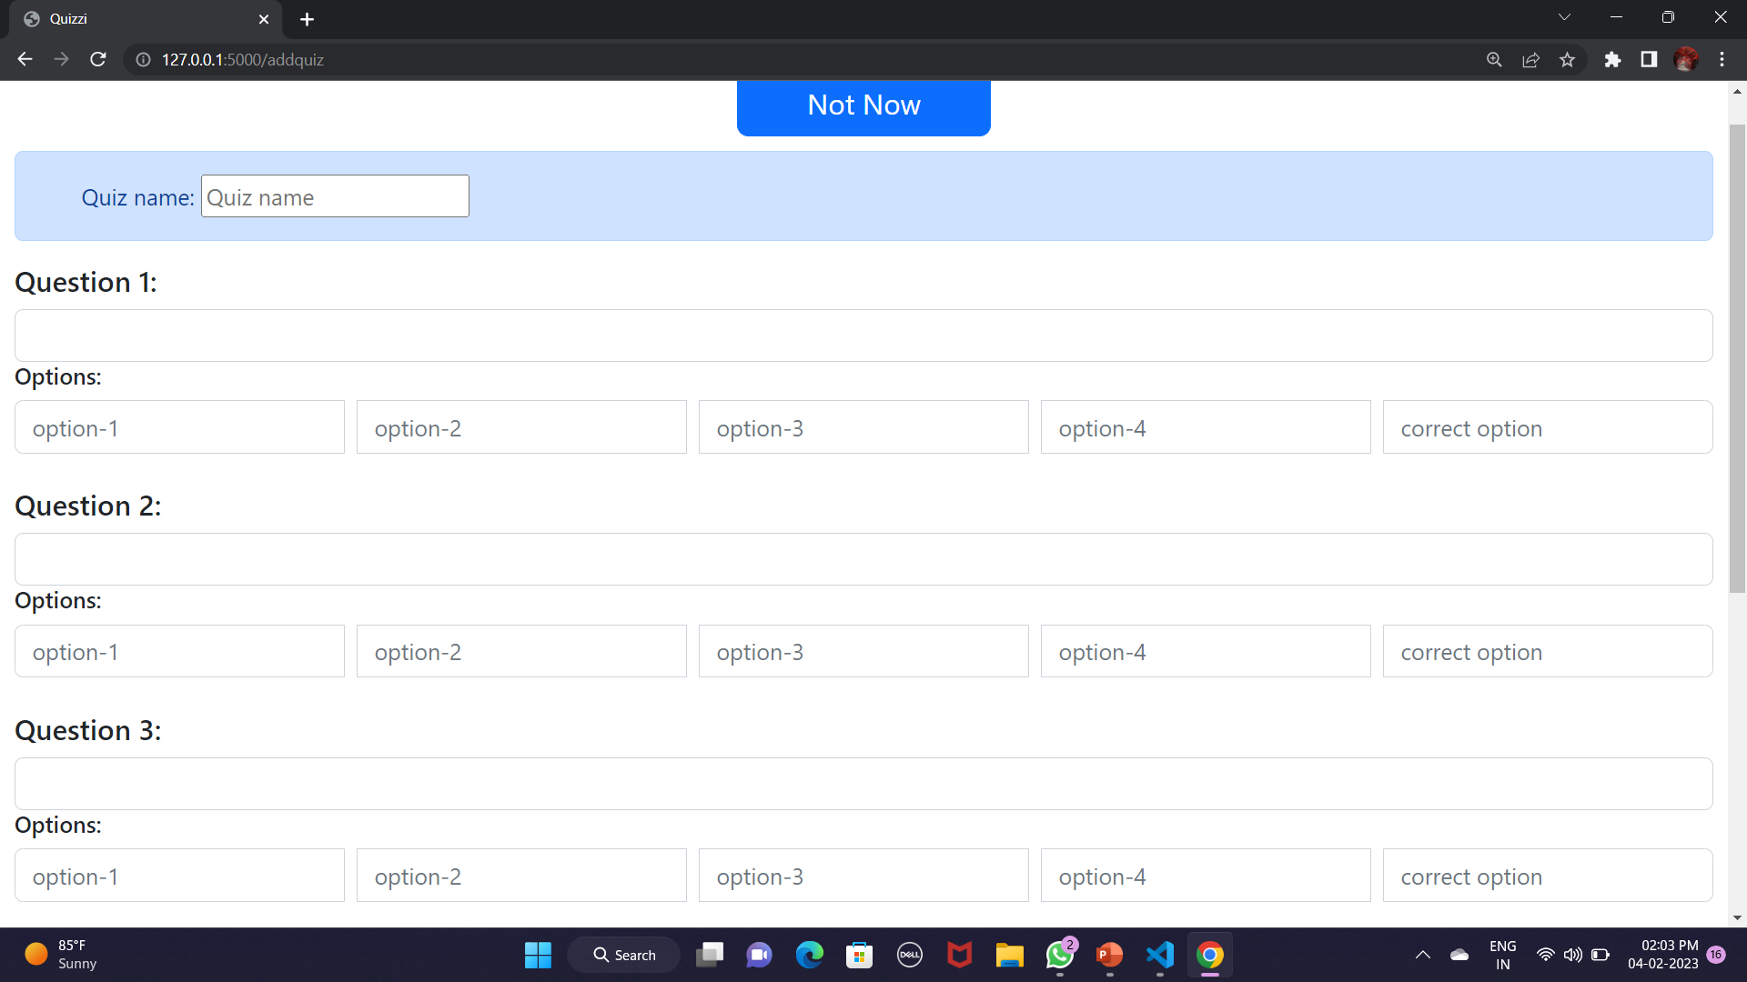
Quizzes management
-Creating Quiz
(by teacher)
-Joining quizzes
(by student)

Slide 6
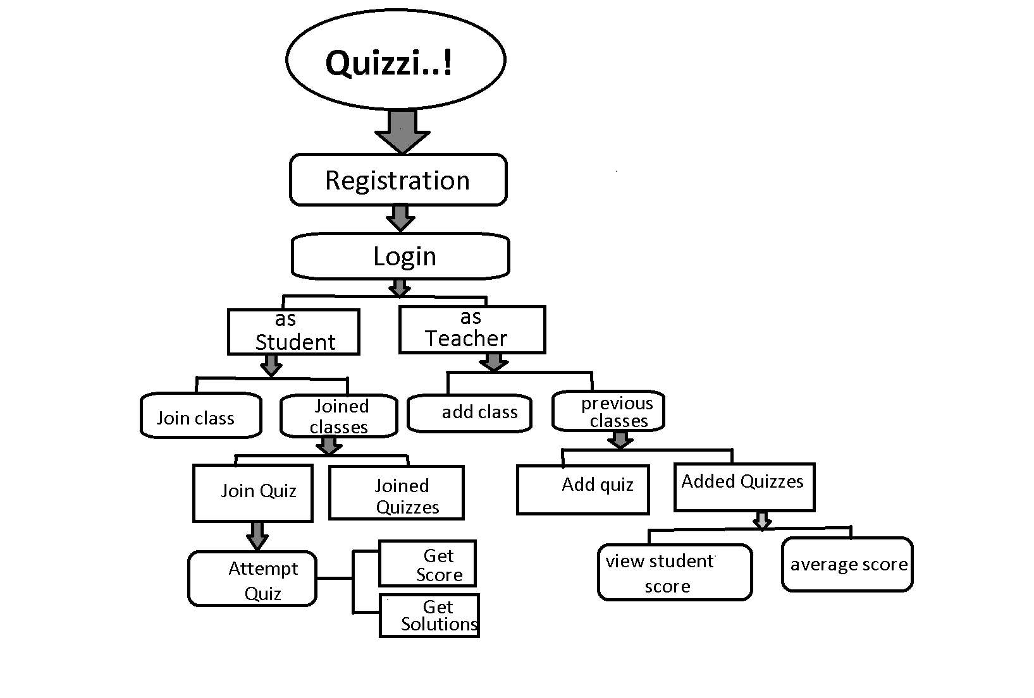
GRADING
-Retrieving Marks
-Score Calculation
(after submitting Quiz)

