Slide 1

Note: The data and information in this document is reflective of a hypothetical situation and client. This document is to be used for KPMG Virtual Internship purposes only.
Sprocket Central Pty Ltd
Data analytics approach

Slide 2
Note: The data and information in this document is reflective of a hypothetical situation and client. This document is to be used for KPMG Virtual Internship purposes only.
Agenda
Introduction
Data Exploration
Model Development
Interpretation

Slide 3
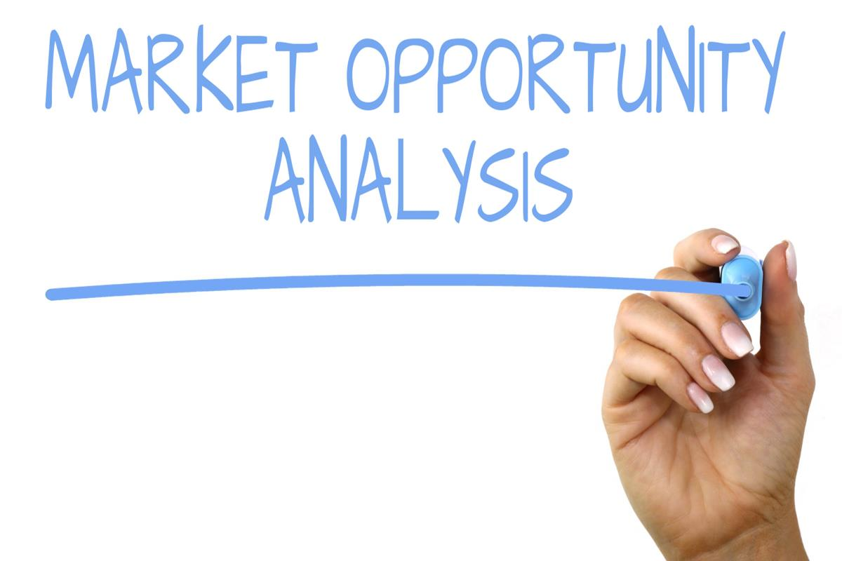
Note: The data and information in this document is reflective of a hypothetical situation and client. This document is to be used for KPMG Virtual Internship purposes only.
Introduction
Analysing the Target Customer Based on Some Key Factors .
From the data that is provided to us , we were able to make some insights in order to build a market strategy for Sprocket Central Pty Ltd which can bring best results for the company in their endeavours. Below are the important areas that we looked into in order to come up with the strategy.
Age distribution
Job industry
Place any supporting images, graphs, data or extra text here.

Slide 4
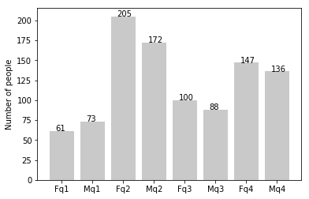
Note: The data and information in this document is reflective of a hypothetical situation and client. This document is to be used for KPMG Virtual Internship purposes only.
Data Exploration
People in the age group of 25 to 48 years are more likely to be a Customer
Data shows that people in the middle age group viz 25 to 48 are more likely to buy the our products
Along with that, Women have slight domination over the women considering the past purchase records
Target the Age group 25 to 48 years

Slide 5
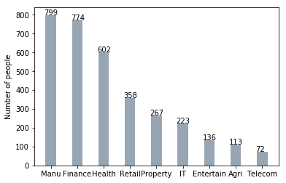
Note: The data and information in this document is reflective of a hypothetical situation and client. This document is to be used for KPMG Virtual Internship purposes only.
Data Exploration
People in the Manufacturing and finance Industry are more likely to be a Customer
Data shows that people in the manufacturing, finance and health industry are majority customers.
These industries combine to be nearly half of the entire bike customer base .
Target the People in Manufacturing, Finance and Heath Industries

Slide 6
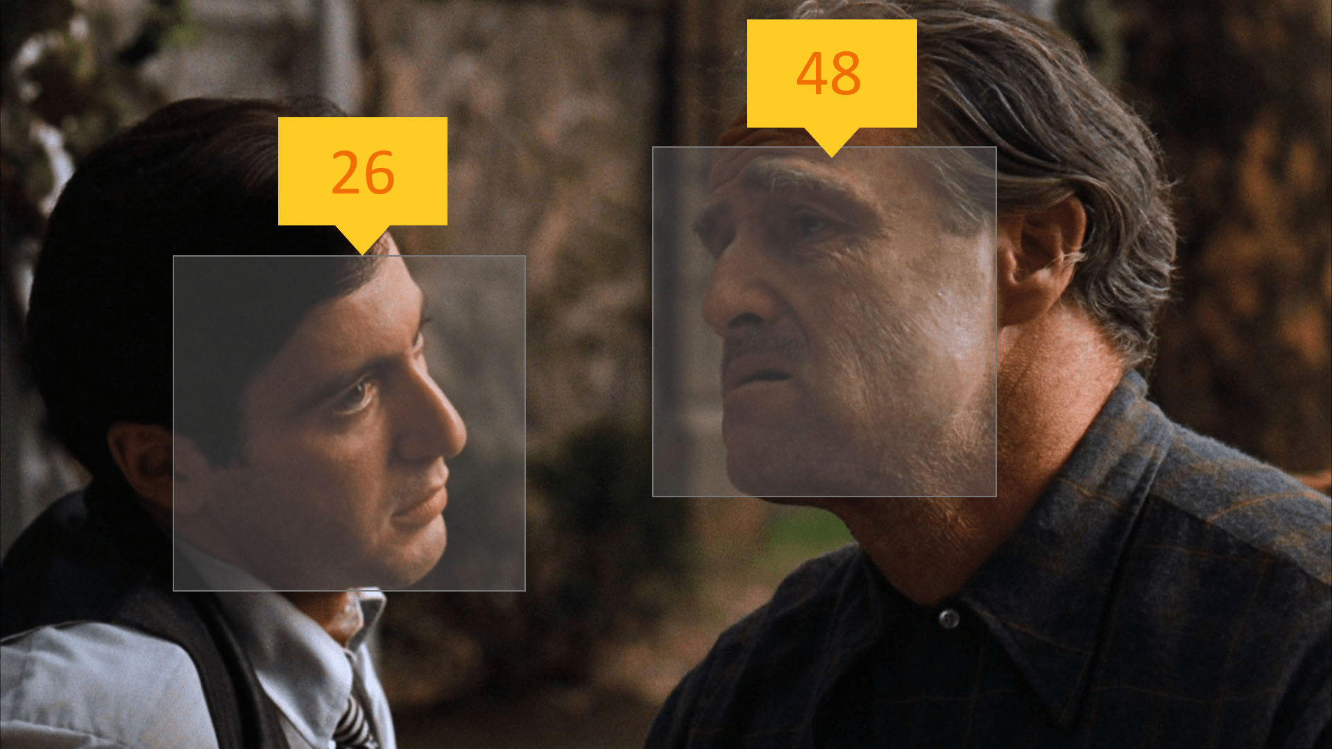
Note: The data and information in this document is reflective of a hypothetical situation and client. This document is to be used for KPMG Virtual Internship purposes only.
Model Development
Build a classification Model which Calculates the likelihood of a given data point of an individual will buy the Sprocket Central Pty Ltd
Products
We Start with the data pre-processing and data cleaning .
Feed the model with the features and train the model on training data and optimise it.
Then test the model with testing data and data from the real world and Deploy it.
Building a Classification Model

