Slide 1
DEMOGRAPHIC_DATA
M SAI PRAKASH REDDY

Slide 2
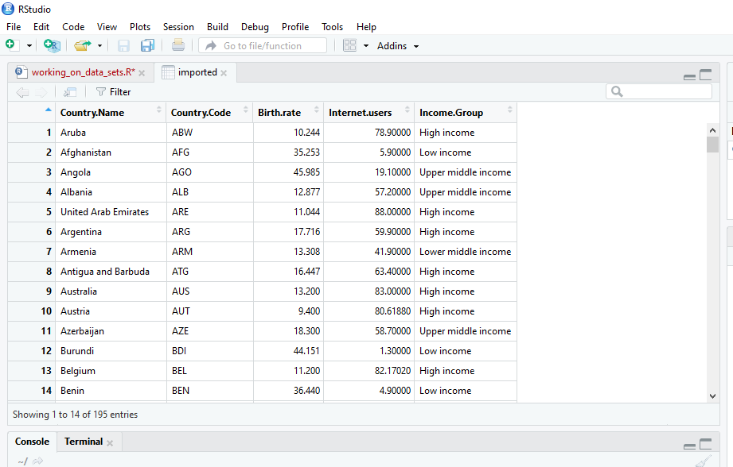
#reading the file imported=read.csv(file.choose()) View(head(imported))
dd

Slide 3
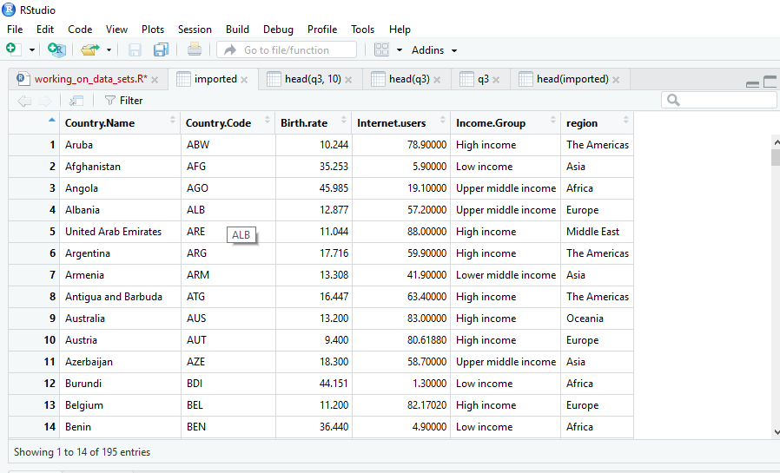
#update the data Regions_2012_Dataset <- c("The Americas","Asia","Africa",………) imported$region=Regions_2012_Dataset

Slide 4
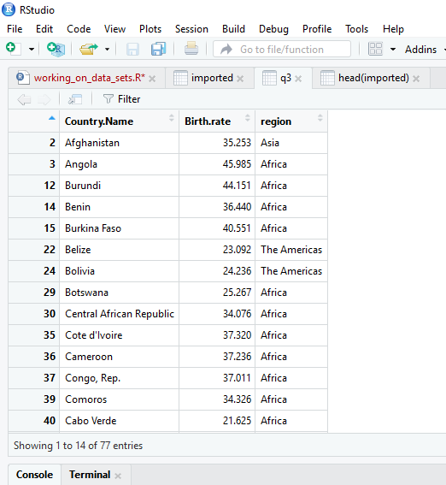
#countries with high birth rate r=imported$Birth.rate > mean(imported$Birth.rate) q3=imported[r,c(1,3,6)] View(q3)

Slide 5
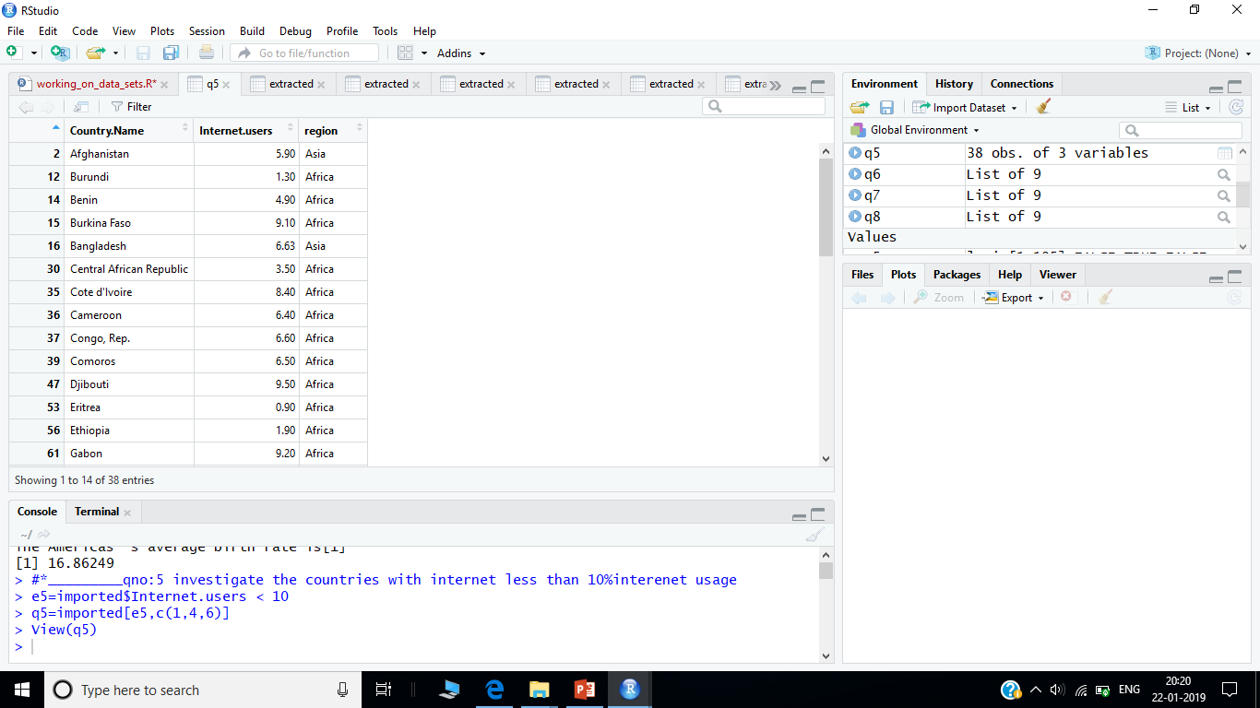
#investigate the countries with internet less than 10%interenet usage e5=imported$Internet.users < 10 q5=imported[e5,c(1,4,6)] View(q5)

Slide 6
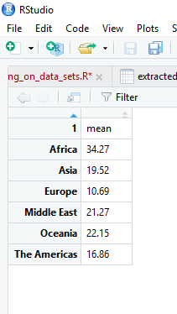
#print the average birth rate of all regions

Slide 7
#bar graph representation of average birth rate and regions q6= qplot(data=his,x=lev,y=extracted,fill=lev)+ geom_col()+xlab("region")+ylab("average birth rate")+ scale_fill_discrete(name = "REGION")

Slide 8
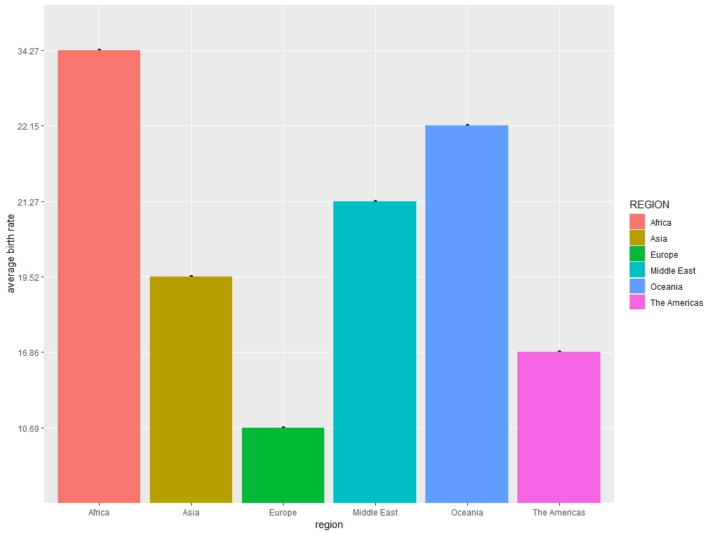

Slide 9
#scatter plot internet and birth rate but use the region that countries belongs to: q7=qplot(data=imported,x=Internet.users,y=Birth.rate,colour=region,size=I(3),shape=I(16))

Slide 10
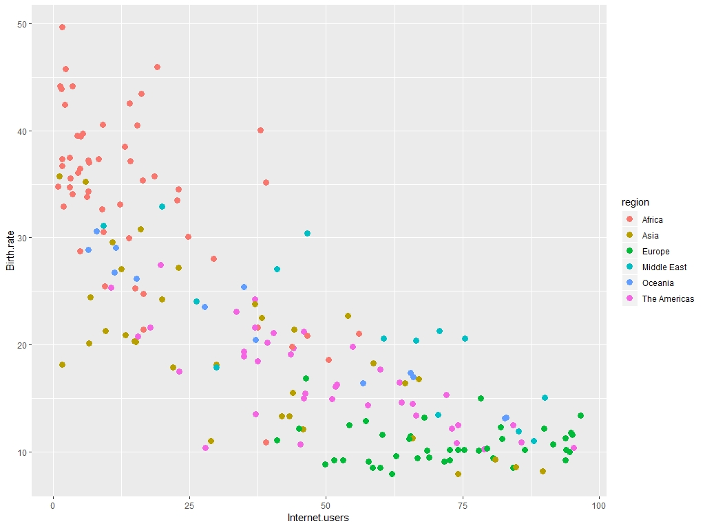

Slide 11
#relating internet and birth rate based on income category q8=qplot(data=imported,x=Internet.users,y=Birth.rate,colour=Income.Group, size=I(4),shape=I(15))

Slide 12
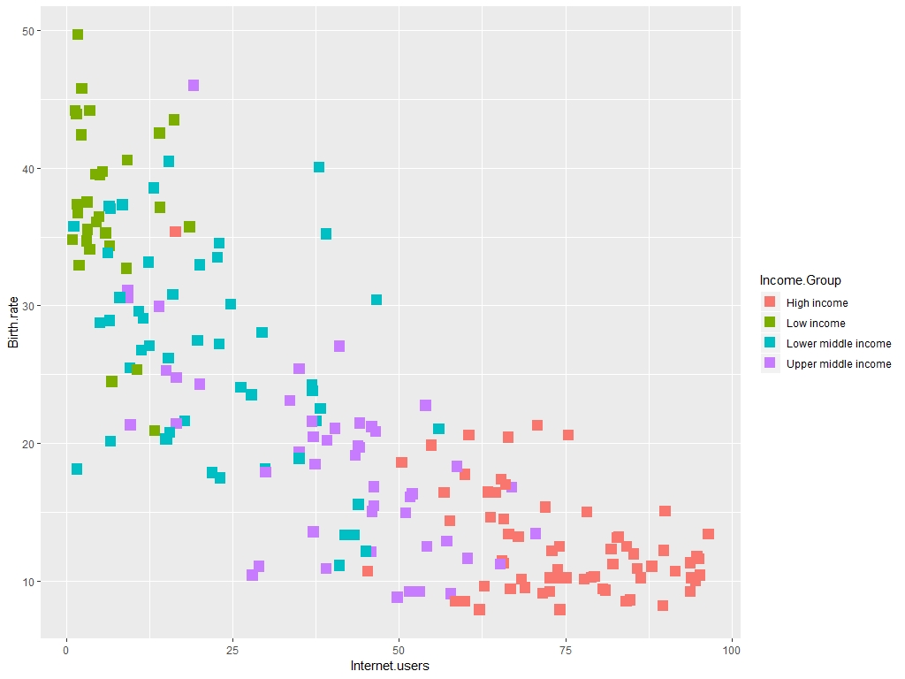

Slide 13
#box plot the internet usage based on the regions p=ggplot(imported,aes(imported$region,Internet.users))+ geom_boxplot()

Slide 14
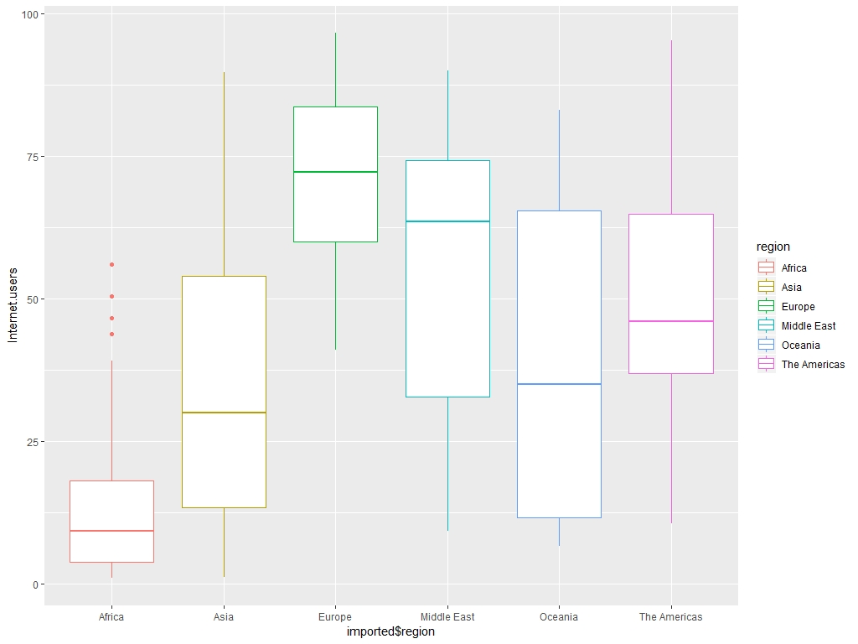

Slide 15
THANK YOU

