Slide 1
E-Commerce Sales & Customer Analytics
Final Data Analytics Capstone Project
Presented By
Dataset
Saipraneeth
Superstore Sales
Tools
Records Analyzed
Python · Power BI
9,994 Transactions

Slide 2
Project Overview & Problem Statement
Project Objective
Problem Statement
1
Sales Performance & Profitability
The business needs a structured analytical framework to understand sales performance, profitability, customer behavior, and regional dynamics — enabling data-driven decisions that improve margins and drive sustainable growth.
Evaluate total and category-level sales revenue, margins, and profitability drivers across the Superstore dataset.
2
Category & Regional Benchmarking
Tools & Technologies
Identify high and low-performing product categories and geographic regions to prioritize investment and corrective action.
Python Stack
BI & Version Control
Pandas · NumPy · Matplotlib · Jupyter Notebook
Power BI · Git · GitHub
3
Customer Segment Analysis
Understand purchasing behavior, segment contribution, and retention patterns across Consumer, Corporate, and Home Office segments.
4
Actionable Recommendations
Translate analytical findings into concrete, data-driven business recommendations for leadership decision-making.

Slide 3
Dataset & Data Preparation
Superstore Sales Dataset
Data Cleaning Process
9,994
01
02
Structural Inspection
Quality Validation
Transactions
Reviewed dataset schema, column data types, and overall structure to establish a cleaning baseline.
Checked for missing values and duplicate records — none found, confirming high dataset integrity.
Total records analyzed
03
04
10
Data Type Conversion
Column Optimization
Converted Order Date and Ship Date columns to proper datetime format for time-series analysis.
Removed the unnecessary Row ID column; validated ranges for Sales, Quantity, and Discount fields.
Key Fields
Sales, Profit, Discount, Region, Segment & more
05
Core fields: Order Date, Customer, Segment, Region, Category, Sub-Category, Sales, Quantity, Discount, Profit
Export Cleaned Dataset
Prepared and saved the final cleaned dataset as input for all downstream analysis and visualization steps.

Slide 4

Exploratory Data Analysis & Key Findings
Analysis Performed
Key Findings
Descriptive Statistics
Dimension | Sales | Profit | Insight
Technology | $836,154 | $145,455 | Strongest category overall
Furniture | $742,000 | $18,451 | Profitability challenge
West Region | $725,458 | $108,418 | Top regional performer
South Region | $391,722 | — | Lowest regional performance
Peak Month | $118,448 | — | November 2017 seasonal spike
Summary metrics across sales, profit, and discount distributions.
Category & Regional Analysis
Revenue and margin decomposition by product category and geographic region.
Customer Segment Analysis
Segment-level contribution to revenue and profitability.
Discount Impact: A –0.219 correlation between discount rate and profit confirms that aggressive discounting materially erodes margins across all categories.
Monthly Trends & Correlation
Time-series sales patterns and discount-to-profit correlation analysis.

Slide 5
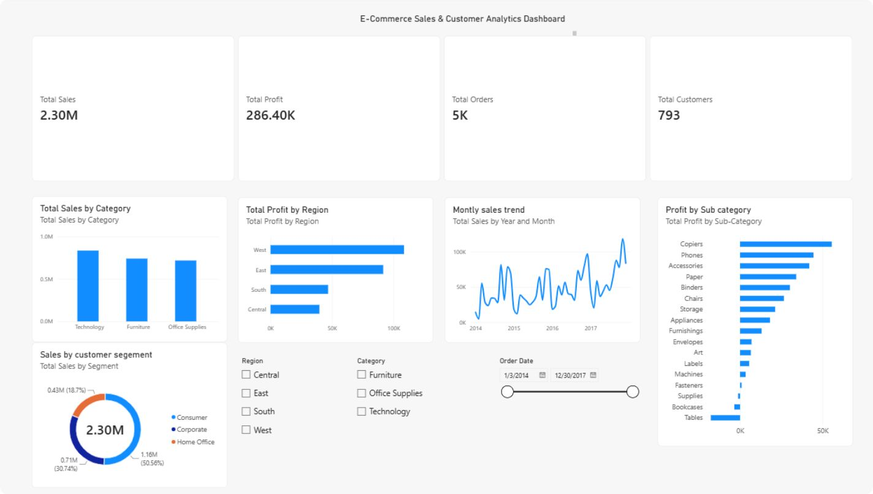
Power BI Sales Analytics Dashboard
Dashboard KPIs
$2.30M
Total Sales
$286K
Total Profit
5K
Total Orders
793
Customers
Visualizations
Sales by Category
Profit by Region
Monthly Sales Trend
Sales by Customer Segment
Profit by Sub-Category
Interactive Filters
Region
Category
Order Date Range

Slide 6
Business Recommendations & Conclusion
Strategic Recommendations
Conclusion
Fix Furniture Profitability
This capstone project demonstrates how Python and Power BI can transform raw e-commerce transaction data into structured, actionable business intelligence.
Key analytical outcomes include:
1
Conduct a thorough review of product costs, pricing structures, and discount strategies in the Furniture category — $742K in sales generating only $18,451 in profit signals a structural margin problem.
Technology and the West Region identified as the primary performance drivers
Furniture profitability and South-region sales flagged as priority improvement areas
Discount policy reform quantified as a direct lever for margin recovery
Invest in the South Region
2
Strengthen targeted marketing and sales initiatives in the South, which generated the lowest regional revenue at $391,722 — a clear opportunity for incremental growth.
Thank You — Questions welcome.
Rationalize Discount Policies
3
Implement data-driven discount guardrails. The –0.219 correlation between discount levels and profit confirms that blanket discounting undermines overall business performance.
Double Down on Technology & Consumer
4
Continue prioritizing Technology ($145K profit) and the Consumer segment as the primary engines of growth — protect and expand these high-performing areas.

Slide 7
Thank You

