Slide 1
Human activity Recognition USING Smartphone
-

Slide 2
Dataset description
We have chosen the dataset from Kaggle.
It consists of recordings of 30 study participants performing activities of daily living (ADL) while carrying a waist-mounted smartphone with embedded inertial sensors.
The objective is to classify activities into one of the six activities i.e. walking, walking upstairs, walking downstairs, sitting, standing and laying.
The dataset has been randomly partitioned into two sets, where 70% of the volunteers were selected for generating the training data and the rest 30% for the test data.
The sensor acceleration signal, which has gravitational and body motion components, was separated using a Butterworth low-pass filter into body acceleration and gravity.

Slide 3
Attribute information
For each record in the dataset the following is provided:
Triaxial acceleration from the accelerometer (total acceleration) and the estimated body acceleration.
Triaxial Angular velocity from gyroscope.
A 561-feature vector with time and frequency domain variables.
An activity label.
An identifier of the subject who carried out the experiment.

Slide 4
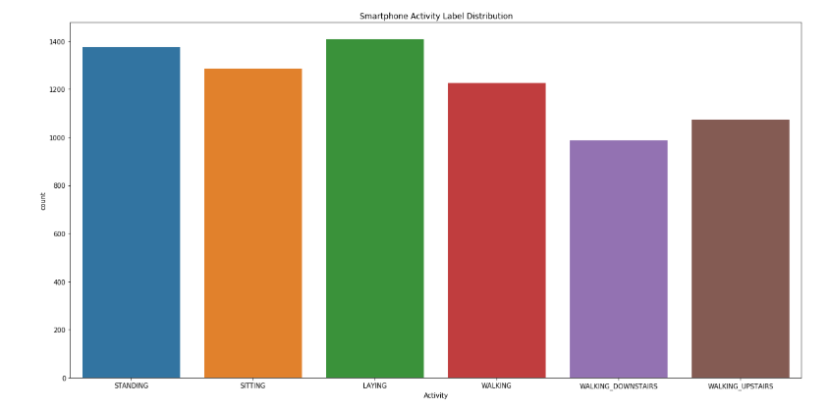
Smart Phone activity label distribution

Slide 5
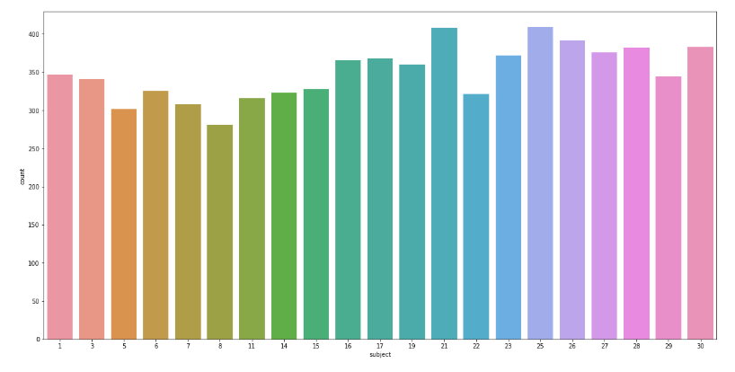

Slide 6
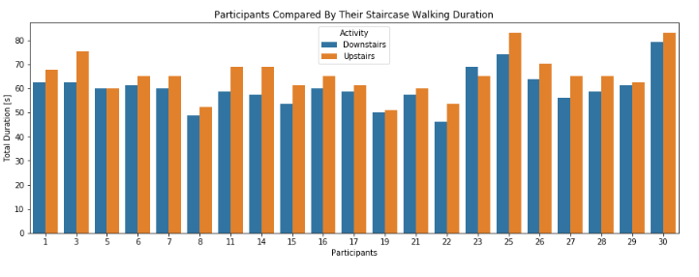
Participants compared by their staircase walking duration.

Slide 7
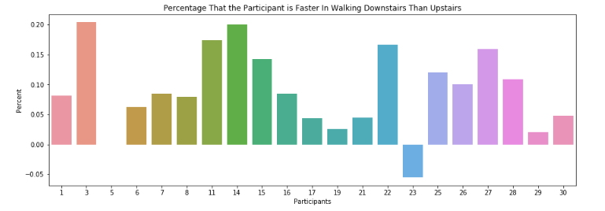
Plot of upstairs downstairs ratio

Slide 8
Models Used
Base Classification Models:
1.SVM
2. K-Nearest Neighbor
3. Naïve Bayes
4.Decision Tree.

Slide 9
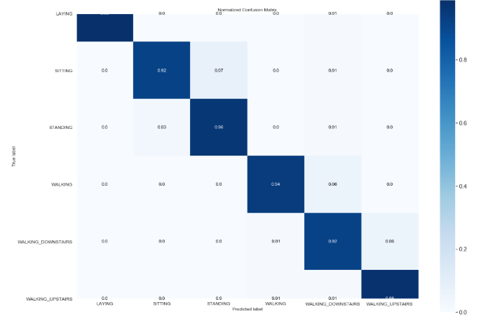
SVM model
Kernel used : rbf, radial
Accuracy : 0.95

Slide 10
K-Nearest neighbour model
Total n_neigbours used are 5
Accuracy obtained for this model is 0.90

Slide 11
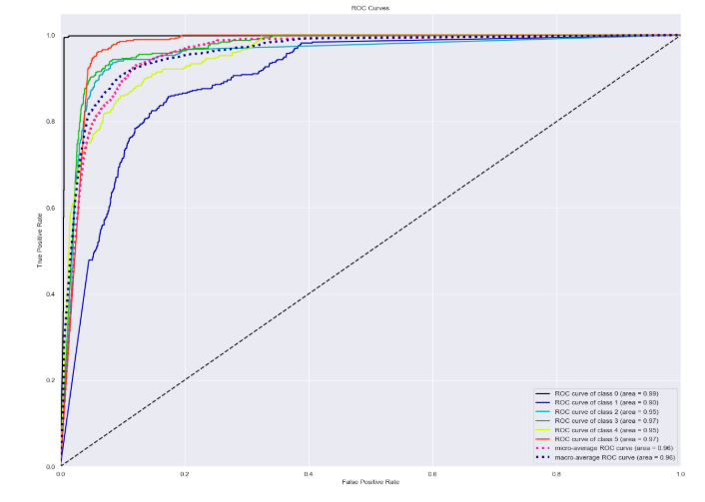
Naïve Bayes Model.
NB is a powerful, learning-free, non-parametric approach for image classification because it avoids vector quantization step, and the use of image-to-class comparisons, yielding good generalization.
Accuracy: 0.78

Slide 12
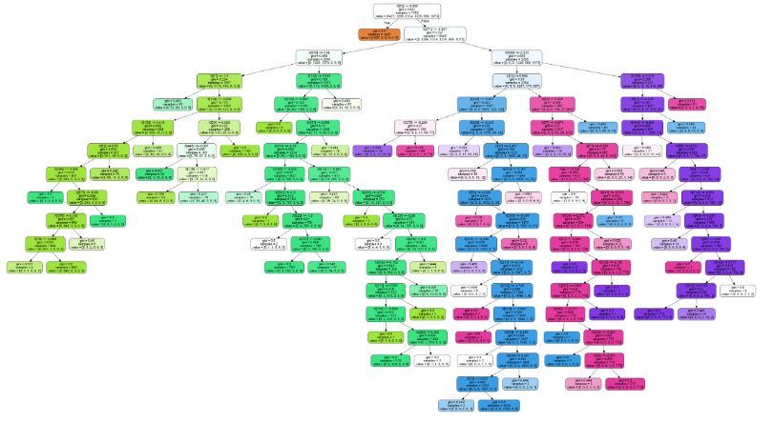
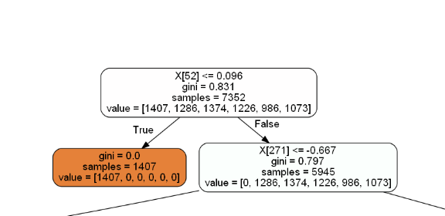
Decision tree model
Gini Impurity Measure
Minimum Sample Split is 100
Accuracy Obtained for this model is 0.84.

Slide 13
Artificial Neural Networks (ann)
We used artificial neural networks to recognize correlations and hidden patterns in our data and also to classify the data and to continuously learn and improve over time.
We added four layers in the neural network including 2 hidden layers, an input layer and the output layer.
Each layer helped in minimizing the error/cost function by learning different aspects about the data and as a result we obtained increased accuracy.

Slide 14
Attributes of ann
Classifier used: Sequential
Kernel initializer : uniform
Activation functions used:
Relu: used in the input, first hidden and the second hidden layer
Sigmoid: used in the output layer
Optimizer : Adam
Loss: binary cross entropy
Number of epochs: 100 , batch size: 10
Test accuracy we obtained: 0.98

Slide 15
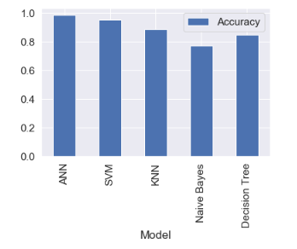
Model Comparison

Slide 16
Conclusion
Comparing the base models that we applied, SVM performed the best and achieved highest accuracy amongst all three i.e 95%
We developed a deep learning model and applied ANN. It was the best fit for our dataset because the accuracy increased to 98%

