Slide 1
DATA ANALYTICS PROJECT
Customer Shopping Behavior Analysis
An end-to-end analysis of 3,900 transactions across product categories — using Python, MySQL, and Power BI to uncover spending patterns, customer segments, and strategic growth opportunities.

Slide 2
WHAT DATA DID I WORK WITH?
Dataset at a Glance
3,900
18
Transactions
Features
Rows in dataset
Columns analyzed
37
$59.76
Missing Values
Avg. Purchase
In Review Rating only
Mean transaction value
Features span demographics (Age, Gender, Location, Subscription), purchase details (Category, Amount, Season), and behavior signals (Discount, Promo Code, Frequency, Review Rating, Shipping Type).

Slide 3

WHAT TOOLS DID I USE?
End-to-End Analysis Pipeline
Python
Power BI
Clean data, engineer features, bin age_group
Interactive dashboard with filters and charts
MySQL
Recommendations
Load cleaned data, run 10 business queries
Deliver actionable business insights
Missing Review Ratings were imputed using the median rating per product category. Columns standardized to snake_case. promo_code_used dropped as redundant with discount_applied. Cleaned data loaded into PostgreSQL for SQL analysis.

Slide 4
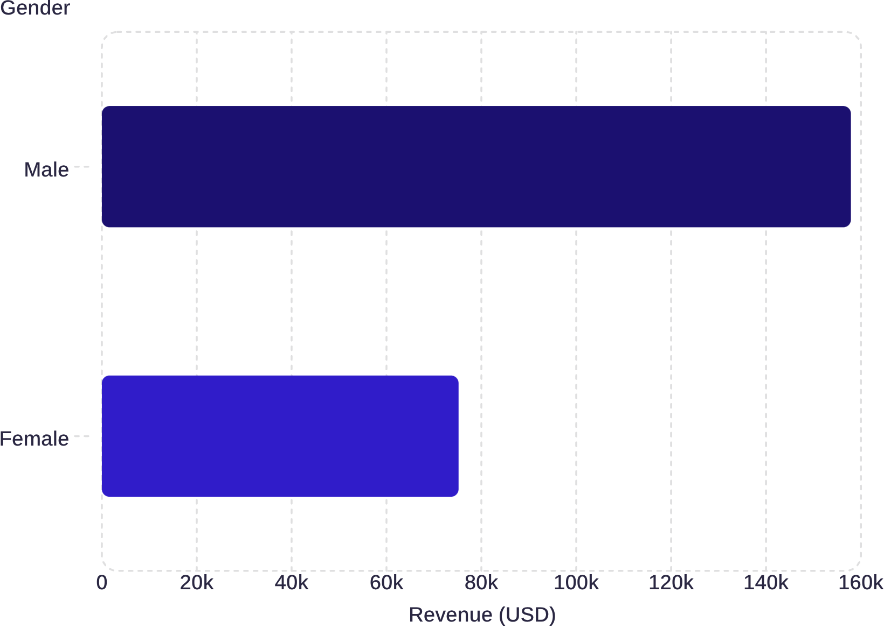
WHAT DID I DISCOVER?
Revenue & Customer Segmentation
Key Findings
Male customers generated 2.1× more revenue than female customers
839 high-spenders used discounts but still spent above the $59.76 average
Segmentation: Loyal 3,116 | Returning 701 | New 83 customers

Slide 5
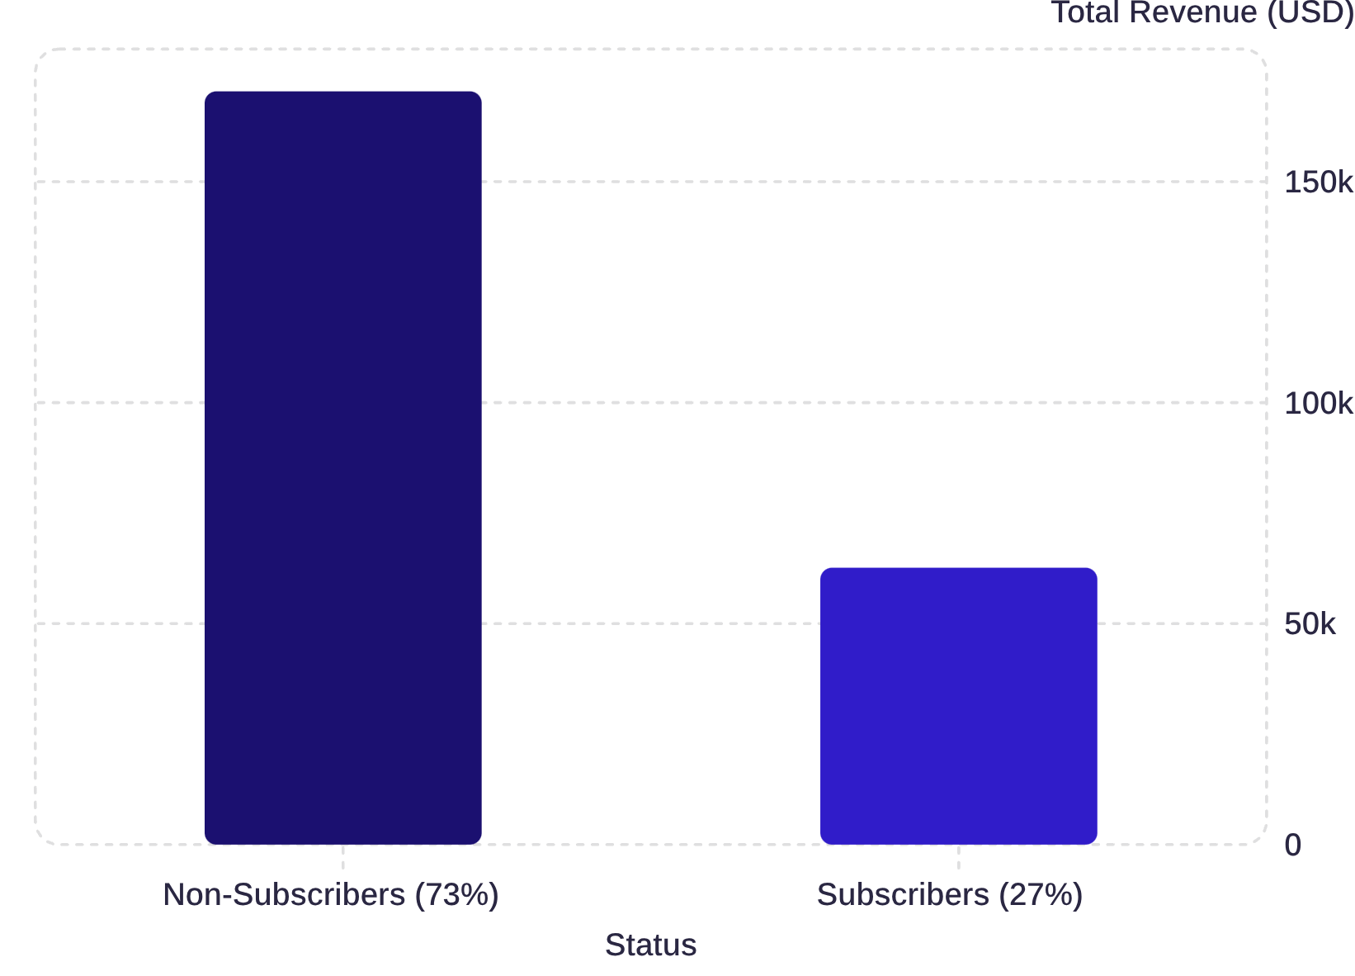

WHAT DID I DISCOVER?
Subscription Behavior Insights
Subscribers vs. Non-Subscribers
What the Data Shows
Subscribers have nearly identical avg. spend ($59.49 vs. $59.87)
Only 27% subscribed — a major untapped revenue opportunity
Of customers with >5 purchases, 958 are subscribed vs. 2,518 who are not
Repeat buyers are not converting to subscriptions at scale — a clear retention gap.

Slide 6
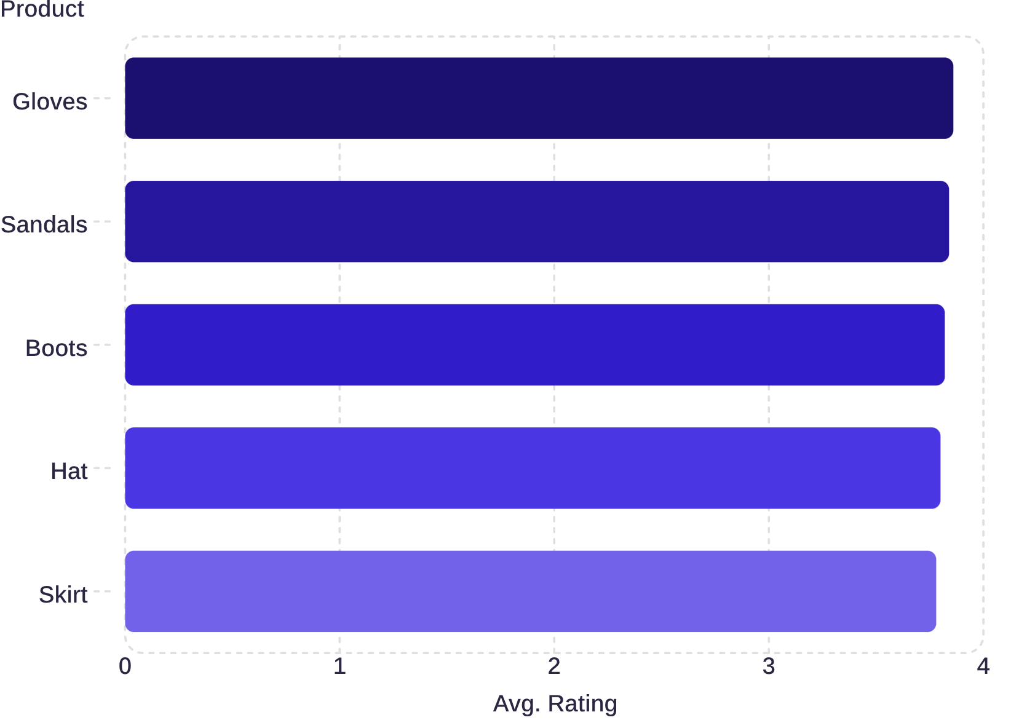
WHAT DID I DISCOVER?
Product Performance & Discount Dependency
Top 5 Products by Avg. Review Rating
Highest Discount Dependency
Product
Discount Rate
Hat
50.00%
Sneakers
49.66%
Coat
49.07%
Sweater
48.17%
Pants
47.37%
These 5 products sell at ~50% discount rates — margin risk requiring policy review.

Slide 7
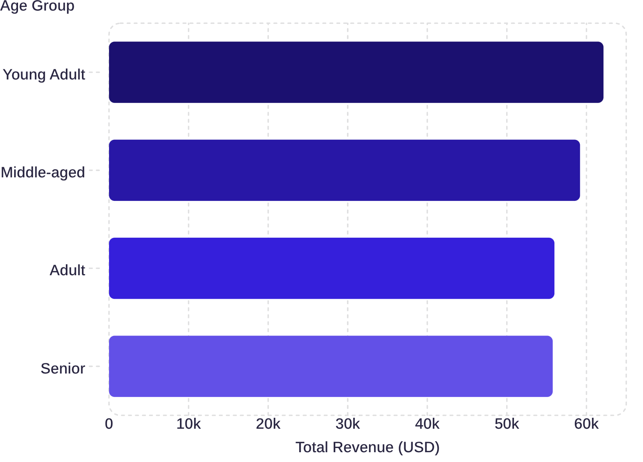

WHAT DID I DISCOVER?
Revenue by Age Group & Shipping Type
Key Observations
Young Adults lead in revenue ($62,143) — highest-value demographic
Revenue is surprisingly balanced across all age groups
Express shipping avg: $60.48 vs. Standard $58.46 — a $2.02 premium
Express shipping users represent a high-intent, higher-spend segment worth targeting.

Slide 8
WHAT DID I DISCOVER?
Top Products by Category
Category
#1 Product
Orders
#2 Product
Orders
Clothing
Blouse
171
Pants
171
Accessories
Jewelry
171
Sunglasses
161
Outerwear
Jacket
163
Coat
161
Footwear
Sandals
160
Shoes
150
Clothing dominates with 1,737 orders (44% of total). Footwear and Outerwear show strong performance with Sandals (160) and Jackets (163) leading their categories.

Slide 9
WHAT TOOLS DID I USE?
Power BI Dashboard
An interactive Customer Behavior Dashboard with filters for Subscription Status, Gender, Category, and Shipping Type — enabling drill-down exploration of all key metrics.
3.9K Customers
$59.76 Avg.
Total transaction records
Mean purchase amount
3.75 Avg. Rating
Clothing: $100K
Overall review score
Top revenue category
Additional charts visualize revenue and sales breakdowns by category and age group, with subscription status shown as a donut chart (27% subscribed, 73% not).

Slide 10

WHY DO THE FINDINGS MATTER?
Business Recommendations
Boost Subscriptions
Loyalty Programs
27% subscription rate with near-identical spend — promote exclusive benefits to convert repeat buyers.
3,116 loyal customers identified — reward them to increase lifetime value and referrals.
Review Discount Policy
Targeted Marketing
5 products at ~50% discount rates — balance volume gains against margin erosion.
Focus on Young Adults ($62K revenue) and Express shipping users ($60.48 avg. spend) for highest ROI.

