Slide 1
FINAL PROJECT · DATA SCIENCE
Classical vs. Transformer
Is the modern approach worth its cost?
Comparing TF-IDF and pretrained sentence embeddings for customer complaint classification
Rayyan Ahemad Mohd · Ebelechukwu Chinedu Umezude · Sai Prasad Bandari

Slide 2
THE PROBLEM
Sorting Complaints Automatically
Customer support teams receive high volumes of complaint tickets that need routing to the right category.
Manual triage is slow and inconsistent. Our goal: automatically classify complaints into 16 categories, using two different NLP approaches.
THE REAL QUESTION
Not “which model scores higher” —
is the modern approach's accuracy gain worth its extra compute cost?

Slide 3
DATASET
1,334 Real Customer Complaints
1,334
16
0
Total complaints
Categories
Missing values
Columns: Complaint (text), Category (target, 16 labels), Urgency (4 levels).
Chosen over larger datasets specifically because embedding generation is the compute bottleneck for the transformer approach — a smaller dataset keeps that step manageable.

Slide 4
“
The transformer approach will beat the classical baseline mainly on rare / semantically overlapping categories — but at a compute cost that may not be justified for the common, easy categories.
OUR HYPOTHESIS

Slide 5
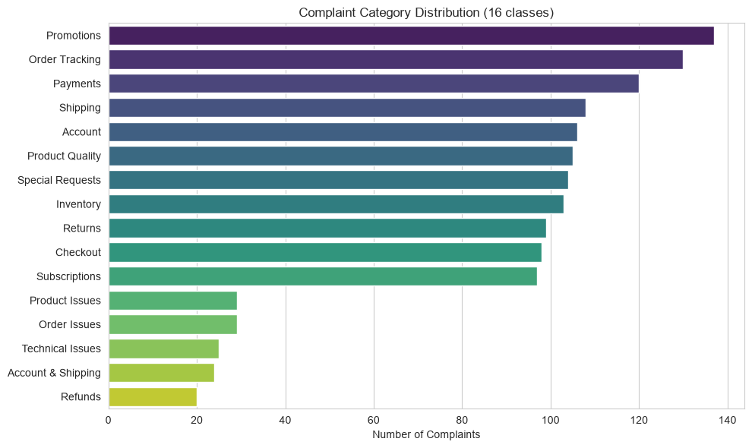
EXPLORATORY ANALYSIS
A Real Class Imbalance
01 6.8x imbalance between the largest category (Promotions, 137) and smallest (Refunds, 20)
02 Category and Urgency are statistically related (χ² = 154.22, p < 0.0001)
03 “Payments” and “Checkout” share 29.8% of their vocabulary — a real overlap case

Slide 6
METHODOLOGY
Two Approaches, One Classifier
CLASSICAL BASELINE
TRANSFORMER APPROACH
TF-IDF
Sentence Embeddings
Word-count features
Matches exact words
From course toolkit
Pretrained meaning-vectors
Matches semantic meaning
Research component
Both feed into the SAME Logistic Regression classifier — isolating the feature method as the only variable

Slide 7
METHOD DECISIONS
What Makes This a Fair Test
01 One shared 80/20 stratified split, random_state=42 — identical rows used by both notebooks
02 All 16 categories kept unmerged — preserves the rare-class phenomenon under study
03 Macro F1 as the primary metric — treats every category equally, unlike plain accuracy
04 Compute cost tracked alongside accuracy — time, memory, model size

Slide 8
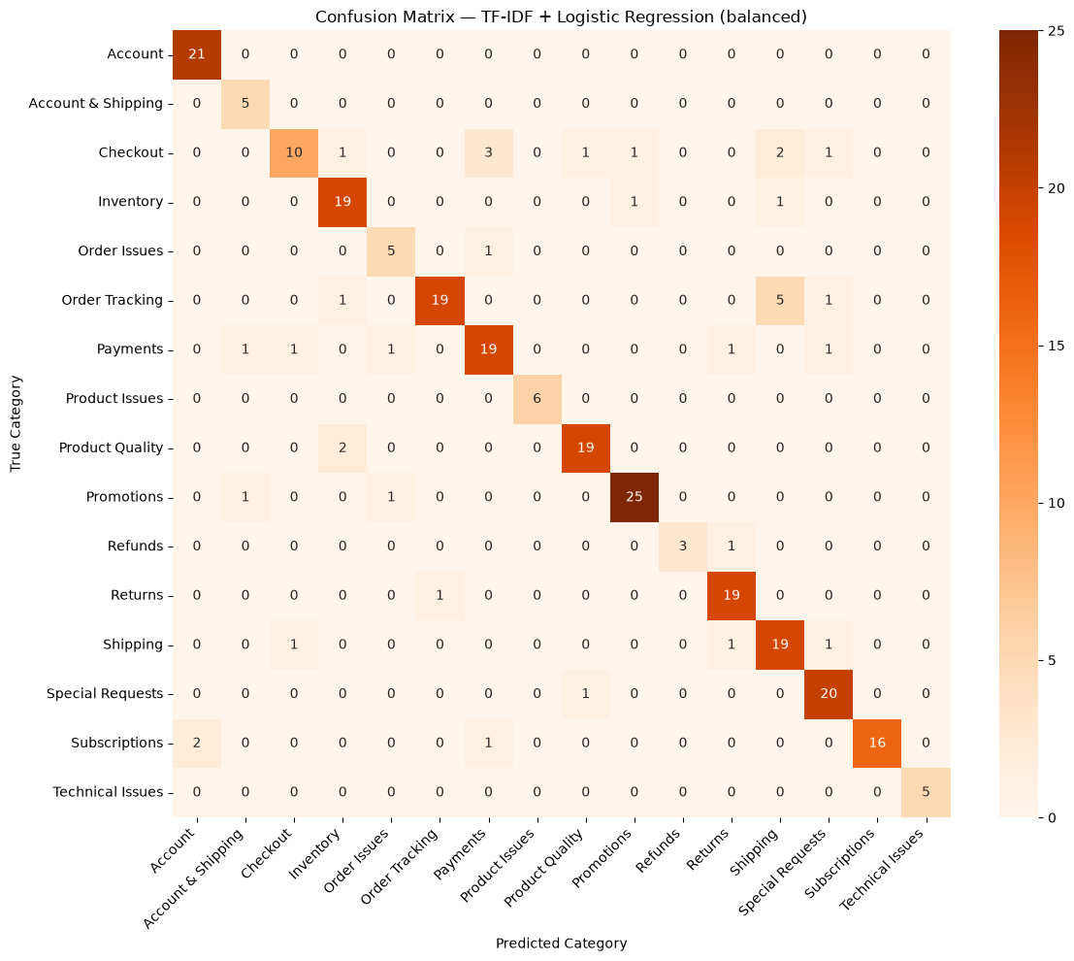
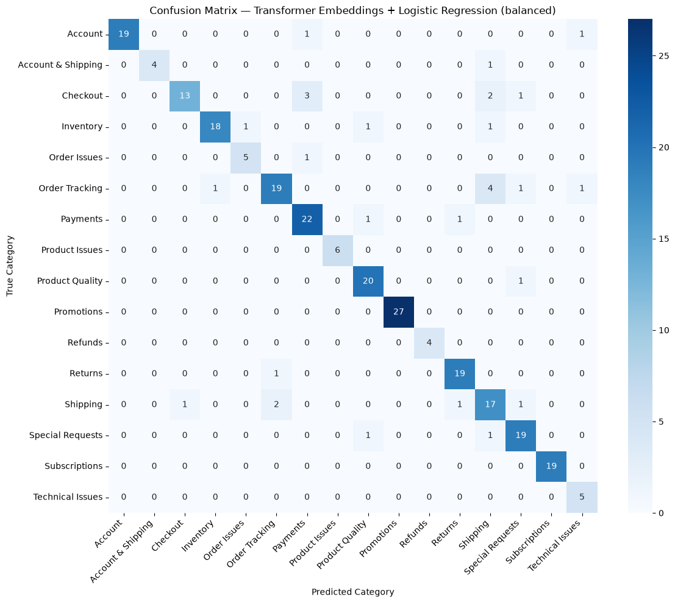
RESULTS
Head-to-Head
TF-IDF
Transformer
Accuracy
0.861
0.881
Macro F1
0.866
0.889

Slide 9
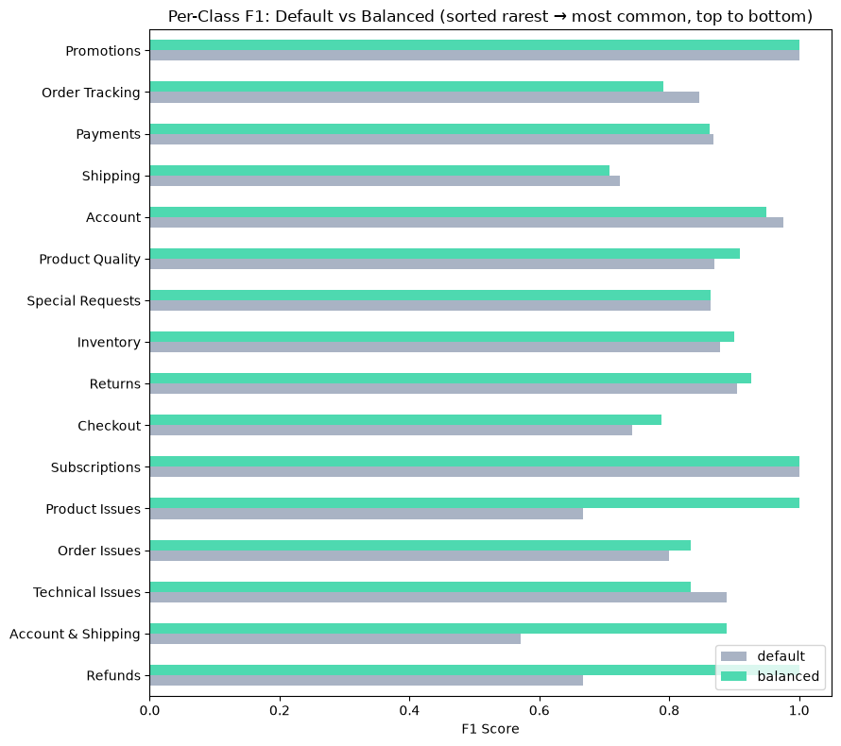
IMBALANCE HANDLING
class_weight='balanced' Actually Works

Slide 10
CONCLUSION
Answering the Hypothesis
01 Class weighting helps rare categories in BOTH approaches — a data/classifier property, not unique to embeddings
02 Transformer wins on macro F1 (+0.023), but the margin is modest relative to an order-of-magnitude increase in compute cost
03 Verdict: worth it for lower-volume, accuracy-critical use cases; TF-IDF remains preferable for high-volume, latency-sensitive deployment

Slide 11
Questions?
Classical vs. Transformer: Complaint Classification

