Slide 1
UrbanAI
Intelligent Smart City Infrastructure Optimization Platform
A Comprehensive DSA-Driven Solution for Urban Management
Team Members
2500030104 - PeddiReddy Chaitanya Raj 2500030107 - Perla Jyothika
2500030135 - Gurrala Srishanth 2500030138 - Raja Hithesh
Mentor: DR. SK. Razia

Slide 2
Problem Statement
🌆 Managing large-scale urban infrastructure assets efficiently — roads, traffic signals, utility networks, and public facilities.
🚦 Real-time traffic data analysis for congestion detection, density calculation, and urban mobility optimization.
🗺️ Complex road network connectivity analysis to identify disconnected regions, optimize routes, and reduce emergency response times.
📊 Handling massive city datasets with fast search and priority-based resource allocation.
📋 Scheduling city maintenance projects and allocating limited budget/resources across competing infrastructure needs.
Challenge: How can Data Structures & Algorithms optimize every layer of smart city operations at scale?
UrbanAI | Smart City Infrastructure Optimization Platform

Slide 3
Abstract
UrbanAI is a comprehensive smart city infrastructure optimization platform built using Java, leveraging advanced Data Structures and Algorithms to address real-world urban management challenges. The platform integrates five core DSA modules covering balanced search trees (AVL Trees), multiway indexing (Fenwick Tree), graph algorithms (BFS, DFS), shortest path optimization (Dijkstra, Floyd-Warshall), and greedy/DP optimization techniques (Activity Selection, Fractional Knapsack, 0/1 Knapsack, Edit Distance). Each module is applied to a specific urban scenario—infrastructure asset management, traffic analytics, road network analysis, emergency routing, maintenance scheduling, and citizen service prioritization. UrbanAI demonstrates how theoretical DSA concepts translate into practical, scalable solutions for smart city operations.
Key Highlights
✓ PostgreSQL integration for persistent data storage across all modules
✓ Console-based interactive menu system for real-time demo of each algorithm
✓ 15+ distinct DSA implementations, each mapped to a smart city use case
✓ Modular architecture (5 modules) following object-oriented design principles
✓ End-to-end flow from data input → algorithm processing → output visualization
UrbanAI | Smart City Infrastructure Optimization Platform

Slide 4
Software & Hardware Requirements
💻 Software Stack
🖥️ Hardware Requirements
• Java JDK 11+ (Primary Development)
• PostgreSQL 15+ (Database Server)
• PostgreSQL JDBC Driver (v42.7.11)
• Visual Studio Code / IntelliJ IDEA (IDE)
• Windows 10/11 (Development Platform)
• pgAdmin 4 (Database Management)
• Git (Version Control)
Programming Language: Java
Database: PostgreSQL (Port 7000)
JDBC for database connectivity
• Processor: Intel Core i5 / AMD Ryzen 5+
• RAM: 8 GB minimum (16 GB recommended)
• Storage: 256 GB SSD (for database & code)
• OS: Windows 10 / 11 (64-bit)
• Network: Localhost (127.0.0.1)
• Display: 1920x1080 resolution
UrbanAI | Smart City Infrastructure Optimization Platform

Slide 5
System Architecture
Multi-layer architecture: UI → Controller → Modules → DAO → Database → Output
LAYER 1: USER INTERFACE (Console Menu + Scanner Input)
LAYER 2: APPLICATION CONTROLLER (Main.java - Switch-Case Dispatcher)
M1: Asset Management
(AVL Tree, BST)
M2: Traffic Analytics
(Fenwick Tree)
M3: Graph Analysis
(BFS, DFS)
M4: Shortest Path
(Dijkstra, Floyd)
M6: Greedy & DP
(ActSel, FracKnap,
01Knap, EditDist)
LAYER 4: DATA ACCESS (AssetDAO, TrafficDAO - JDBC Prepared Statements)
LAYER 5: PERSISTENCE (PostgreSQL - urbanai_db → UrbanAI_Assets, UrbanAI_Traffic Tables)
Asset.java
(ID, Name, Loc, Type)
TrafficRecord.java
(RoadID, VehicleCount)
LAYER 7: OUTPUT (Console Display - Route Maps, Traffic Analytics, Maintenance Schedule, Priority Rankings)

Slide 6
Module 1: Trees & Balanced Search Structures
Infrastructure Asset Management using AVL Tree
📋 DSA Techniques Used
❓ Why These Data Structures?
1. BST — Index assets by AssetID for O(log n) search
2. AVL Tree — Self-balancing BST (balance factor: -1,0,1)
3. In-order Traversal — Sorted asset reports
4. Rotations (LL/RR/LR/RL) — Auto-rebalancing
• Asset IDs are numeric → ideal for BST indexing
• AVL prevents O(n) degradation → guaranteed O(log n)
• In-order traversal → sorted output with zero extra cost
• Real-time lookups for emergency asset dispatch
📊 Algorithm Flow Diagram — AVL Tree Insertion & Search
🔍 Search Path
STEP 1: User enters Asset details
(AssetID, Name, Location, Type)
searchAsset(id)
BST while-loop compare node
STEP 2: Asset object created
new Asset(id, name, loc, type)
Found in AVL Tree?
Return Asset object
STEP 3: avlTree.insert(asset) called
Compares assetId with current node
Not found?
Fallback → PostgreSQL search
Balance
|BF| > 1?
YES → Rotations
(LL / RR / LR / RL)
Display: Asset Details
OR 'Asset Not Found'
NO → Tree balanced → Node height updated
AssetDAO → PostgreSQL INSERT | Display Assets (In-order Traversal)
UrbanAI | Smart City Infrastructure Optimization Platform

Slide 7
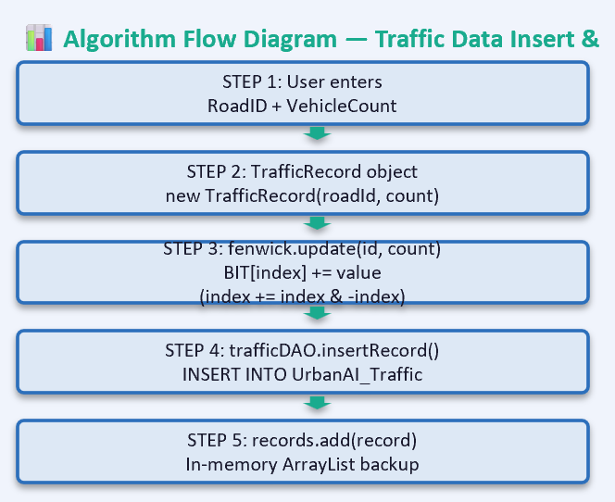
Module 2: Range Query Structures
Traffic Density Analytics using Fenwick Tree
📋 DSA Techniques Used
❓ Why These Data Structures?
1. Fenwick Tree (BIT) — Cumulative traffic stats O(log n)
2. Bit Ops — i += i & (-i) for prefix sum updates
3. Fenwick range query = prefix(R) - prefix(L-1)
• RoadID ordering → natural for range queries
• Real-time aggregation needs O(log n), not O(n)
• Avoids full table scans on 1000+ road segments
UrbanAI | Smart City Infrastructure Optimization Platform

Slide 8
Module 3: Graph Algorithms for City Networks
Road Network Analysis: BFS & DFS for Route Planning
📋 DSA Techniques Used
❓ Why These Algorithms?
1. Graph (Adj List) — roads=edges, nodes=intersections
2. BFS — Shortest path routing (Queue-based)
3. DFS — Region detection (Stack/Recursion)
• Roads = edges, Intersections = vertices → City is a Graph!
• BFS → fastest emergency vehicle route (shortest path)
• DFS → detect disconnected neighborhoods (cycle detection)
📊 Step-by-Step Algorithm Flows — How Each Algorithm Processes the City Road Network
🌊 BFS — Emergency Route Planning
🌀 DFS — Infrastructure Region Detection
STEP 1: Build adjacency list of road network
Intersections (nodes) connected by roads (edges) — 6 nodes, 5 edges
STEP 1: Use same graph (adjacency list)
6 intersections, 5 roads — model city zones as connected graph
STEP 2: Initialize Queue with start intersection
Mark visited → enqueue node 0 (Emergency HQ), dequeue → visit neighbors
STEP 2: Initialize Stack with start node
Push 0 → mark visited → explore deep along each branch before backtracking
STEP 3: Dequeue each node → visit all unvisited neighbors
Enqueue them → repeat until queue is empty → shortest path found!
STEP 3: Recursively visit first unvisited neighbor
Go deep 0→1→3→5, backtrack, then explore 2→4 → covers all nodes
STEP 4: Output traversal + shortest path to every node
Route: 0→1→3→5 = fastest emergency response route ✅
STEP 4: Output traversal order + connected regions
Detect disconnected zones → plan new roads to connect them 🛣️
UrbanAI | Smart City Infrastructure Optimization Platform

Slide 9
Module 4a: Shortest Path Optimization — Dijkstra
Emergency Routes & Fastest Path Analysis
📋 Techniques
❓ Why?
1. Dijkstra — Single-source shortest path (positive weights)
2. Floyd-Warshall → next slide for all-pairs analysis
• Dijkstra: fastest emergency route with positive edge weights
• Efficient O((V+E) log V) with priority queue
📊 Step-by-Step Flow — Dijkstra Single-Source Shortest Path
▶ DIJKSTRA: Find Emergency Route (Single-Source Shortest Path)
STEP 1: Initialize graph[5][5] with adjacency matrix of 5 city locations
Set dist[0]=0 (starting location), all other distances = INFINITY, visited[] = false
STEP 2: Find unvisited node with smallest distance
minDistance() scans for minimum dist[] value among unvisited nodes
STEP 3: Relax all neighboring edges of selected node
if(dist[u] + edge_weight < dist[v]) → update dist[v] with shorter path
STEP 4: Repeat until all nodes visited
Output — Emergency distances: Location 0:0, 1:3, 2:2, 3:8, 4:10 (shortest routes from HQ)
UrbanAI | Smart City Infrastructure Optimization Platform — Part 1 of 2

Slide 10
Module 4b: Shortest Path Optimization — Floyd-Warshall
City Distance Matrix for All-Pairs Urban Planning
📋 Techniques
❓ Why?
3. Floyd-Warshall — All-pairs shortest path (V³ dynamic prog)
• Floyd-Warshall: complete city distance reference table
• One matrix shows shortest path between EVERY pair of locations
📊 Step-by-Step Flow — Floyd-Warshall All-Pairs Shortest Path
▶ FLOYD-WARSHALL: Generate City Distance Matrix (All-Pairs)
STEP 1: Create 4×4 adjacency matrix graph[4][4] for 4 city zones
Set INF where no direct edge exists, 0 on diagonal (distance to self)
STEP 2: Copy graph → dist[][] matrix
Initialize dist[i][j] = graph[i][j] for all i,j — this is our starting distance table
STEP 3: Triple nested loop — for k in 0..3: for i in 0..3: for j in 0..3:
if(dist[i][k]+dist[k][j] < dist[i][j]) → update with shorter path via k
STEP 4: Output all-pairs shortest distance matrix
0 5 8 9 | INF 0 3 4 | INF INF 0 1 | INF INF INF 0
UrbanAI | Smart City Infrastructure Optimization Platform — Part 2 of 2

Slide 11
Module 6a: Greedy Algorithms — Activity Selection & Fractional Knapsack
📋 Techniques
❓ Why Greedy?
1. Activity Selection (Greedy) — Max maintenance tasks
2. Fractional Knapsack (Greedy) — Partial resource allocation
3. 0/1 Knapsack + Edit Distance → next slide
• Activity Selection: earliest finish → max tasks scheduled
• Fractional Knapsack: divisible resources → optimal greedy
📊 Step-by-Step — Activity Selection (Left) + Fractional Knapsack (Right)
▶ ACTIVITY SELECTION: Schedule Max Maintenance Tasks (Greedy)
▶ FRACTIONAL KNAPSACK: Allocate Resources Optimally (Greedy)
STEP 1: Input 4 maintenance tasks (start, finish)
RoadRepair(8,10), PaintBridge(9,11), CleanPark(10,12), InspectDrain(11,13)
STEP 1: Input resources (value, weight, capacity=20)
Asphalt(50,10), Paint(30,5), Concrete(40,8), Steel(20,4)
STEP 2: Create 3 parallel arrays (name, start, finish)
Bubble sort by finish time (ascending) — earliest finish first
STEP 2: Calculate value/weight ratio — sort descending
Paint(6.0), Asphalt(5.0), Concrete(5.0), Steel(5.0)
STEP 3: Select first task (earliest finish)
For each next task: if start ≥ last_finish → select it (greedy pick)
STEP 3: Take full items while capacity remains
Then take fraction of next item (partial weight × value)
STEP 4: Output: Max non-overlapping tasks scheduled
RoadRepair(8-10) + CleanPark(10-12) = 2 / 4 tasks done ✅
STEP 4: Output: Max utility = 105.0
Paint 5 full + Asphalt 10 full + Concrete 5 partial (62.5%)
UrbanAI | Smart City Infrastructure Optimization Platform — Part 1 of 2

Slide 12
Module 6b: Dynamic Programming — 0/1 Knapsack & Edit Distance
📋 Techniques
❓ Why Dynamic Programming?
3. 0/1 Knapsack (DP) — Discrete project budgeting
4. Edit Distance (DP) — Service request text correction
• 0/1 Knapsack: each project is select/skip → optimal substructure
• Edit Distance: minimum operations needed → overlapping subproblems
📊 Step-by-Step — 0/1 Knapsack DP (Left) + Edit Distance (Right)
▶ 0/1 KNAPSACK (DP): Select Best Projects Within Budget
▶ EDIT DISTANCE (DP): Auto-Correct Service Request Text
STEP 1: Define 4 projects (cost, value), budget=5
RoadExpansion(5,10), BridgeRepair(3,6), ParkUpgrade(2,4), DrainageFix(4,8)
STEP 1: User typed: 'Fix strt lite' (with typos)
Compare against 5 valid categories in UrbanAI database
STEP 2: Build DP[n+1][budget+1] table
Initialize row 0 & col 0 = 0 — dp[i][w] = max value for i projects, w budget
STEP 2: Build DP[m+1][n+1] cost matrix for each pair
Initialize: dp[i][0]=i (delete all), dp[0][j]=j (insert all)
STEP 3: For each project i and budget w:
if cost ≤ w: dp[i][w]=max(dp[i-1][w], value[i]+dp[i-1][w-cost[i]])
else: dp[i][w] = dp[i-1][w]
STEP 3: For each cell: min of 3 operations
Insert = dp[i][j-1]+1, Delete = dp[i-1][j]+1, Replace = dp[i-1][j-1]+1(0 if match)
STEP 4: Backtrack DP table → optimal set
Selected: RoadExpansion(cost=5,val=10) → Total Value = 10 ✅
STEP 4: Find minimum distance across all categories
'Fix strt lite' → 'Fix Street Light' (Dist=5) ← closest match ✅
0/1 Knapsack: O(n×W) | Edit Distance: O(m×n)
UrbanAI | Smart City Infrastructure Optimization Platform — Part 2 of 2

Slide 13
Complete Program Flow — Main.java
End-to-end execution flow from startup to exit
START
main()
Initialize AssetManager
(AVL Tree + PostgreSQL)
Initialize TrafficManager
(FenwickTree + PostgreSQL)
Initialize Graph
(6 vertices, + BFS/DFS)
Init Dijkstra &
Floyd-Warshall objects
Init Greedy/DP Objects
(ActivitySelection, FractionalKnapsack, Knapsack01, EditDistance)
INFINITE LOOP → Display Menu → Read User Choice (Scanner)
Cases 1-3
Trees & Assets
Cases 4-7
Traffic Analytics
Cases 8-9
Graph Algorithms
Cases 10-11
Shortest Path
Cases 12-15
Greedy & DP
Case 0
Exit
↩ Loop back to Menu Display
Execute Algorithm → Console Output (Results, Reports, Routes, Analytics) → Return to Menu
Case 0: → System.exit(0) → Program Terminates
UrbanAI | Smart City Infrastructure Optimization Platform

Slide 14
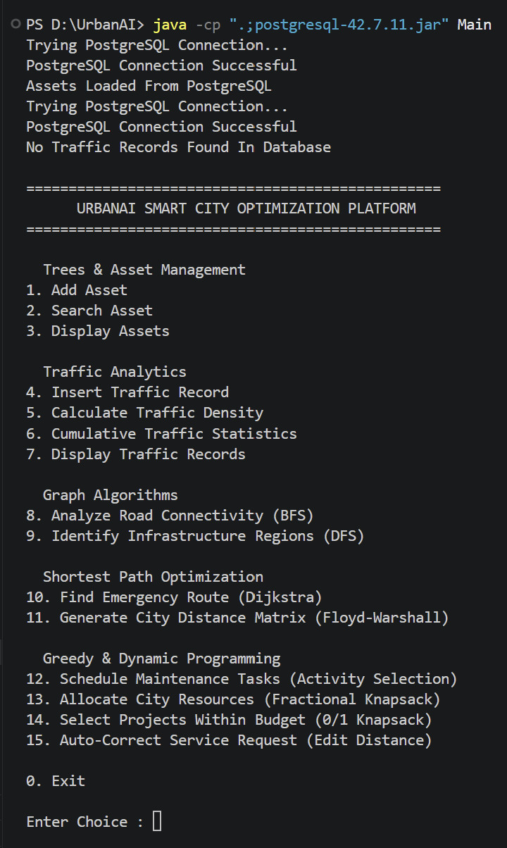

Slide 15
Conclusion
✓ UrbanAI successfully demonstrates 15+ Data Structure & Algorithm implementations mapped to real-world smart city scenarios — bridging the gap between theoretical DSA concepts and practical urban management.
✓ The modular architecture (5 CO-aligned modules) with PostgreSQL integration showcases production-ready software engineering practices — database persistence, OOP design, and menu-driven interaction.
✓ Performance is optimized at every layer: AVL Trees for O(log n) asset search, Fenwick Trees for O(log n) traffic analytics, Graph algorithms for network optimization, and Greedy/DP for resource allocation.
✓ The platform is extensible — new algorithms (B-Trees, A* Search, Trie-based geo-indexing) can be added as new modules without disrupting existing functionality.
✓ UrbanAI proves that mastering Data Structures & Algorithms is the foundation for building intelligent, scalable, and responsive urban infrastructure systems.

