Slide 1
COMPARISION & ANALYSIS
OF PCA AND LDA FOR
ADULT AND WINE DATASETS

Slide 2
DATASETS :
Adult Data Set: Obtained from 1994 Census database. It’s a ‘Census Income’ Dataset
Goal: is to predict whether a person earns more or less than 50k per year.
Wine Data Set: This contains white wine dataset variants of the Portuguese “Vinho Verde” wine
Goal: is to determine the quality of the wine

Slide 3
Methods Used:
Principal Component Analysis
Linear Discriminant Analysis
Random Forest
Support Vector Machines
Logistic Regression

Slide 4
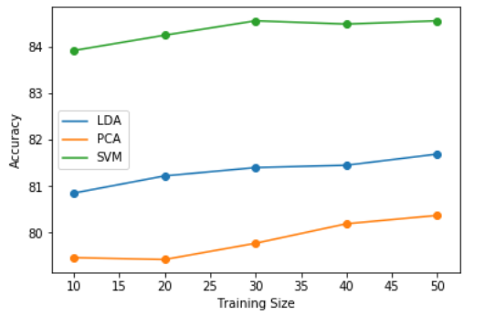
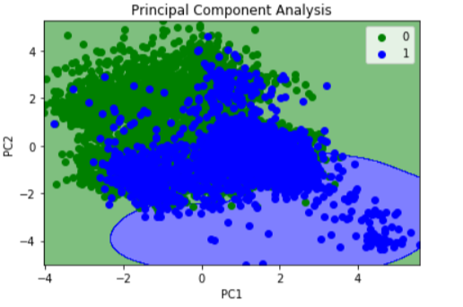
Adult Data set PCA and LDA with SVM:
PCA(no.of principal components) | 10 Percent Training | 20 Percent Training | 30 Percent Training | 40 Percent Training | 50 Percent Training
1 | 79.46 | 79.42 | 79.77 | 79.42 | 79.66
2 | 79.89 | 80.03 | 71.24 | 80.19 | 80.37
3 | 80.43 | 80.16 | 71.91 | 80.4 | 79.66
4 | 80.37 | 80.47 | 74.33 | 80.35 | 80.18
5 | 80.32 | 80.16 | 74.54 | 79.37 | 78.99
6 | 79.05 | 79.33 | 74.76 | 79.33 | 78.32
7 | 76.96 | 76.62 | 70.8 | 77.44 | 72.36
8 | 73.73 | 72.85 | 70.64 | 76.32 | 71.88
9 | 72.84 | 77.42 | 70.35 | 78.94 | 75.39
LDA( components) | 10 Percent Training | 20 Percent Training | 30 Percent Training | 40 Percent Training | 50 Percent Training
1 | 80.85 | 81.22 | 81.4 | 81.45 | 81.69
Without PCA/LDA | 10 Percent Training | 20 Percent Training | 30 Percent Training | 40 Percent Training | 50 Percent Training
- | 83.92 | 84.25 | 84.56 | 84.49 | 84.56

Slide 5
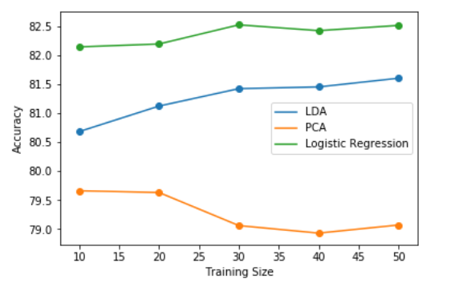
Adult Data set PCA and LDA with Logistic Regression:
PCA( principal components) | 10 Percent Training | 20 Percent Training | 30 Percent Training | 40 Percent Training | 50 Percent Training
1 | 78.63 | 78.72 | 79.06 | 78.93 | 79.07
2 | 79.66 | 79.63 | 73.72 | 79.81 | 79.95
3 | 80.24 | 80 | 73.45 | 79.98 | 79.75
4 | 80.49 | 80.24 | 74.4 | 80.07 | 80.17
5 | 80.48 | 80.36 | 74.2 | 80.17 | 80.09
6 | 80.53 | 80.34 | 74.2 | 80.05 | 80.25
7 | 79.63 | 80.49 | 74.21 | 80.31 | 80.4
8 | 78.62 | 80.46 | 74.43 | 80.24 | 81.3
9 | 78 | 80.58 | 73.28 | 78.96 | 75.3
LDA( principal components) | 10 Percent Training | 20 Percent Training | 30 Percent Training | 40 Percent Training | 50 Percent Training
1 | 80.68 | 81.12 | 81.42 | 81.45 | 81.67
Without PCA/LDA | 10 Percent Training | 20 Percent Training | 30 Percent Training | 40 Percent Training | 50 Percent Training
- | 82.14 | 82.19 | 82.52 | 82.42 | 82.51

Slide 6
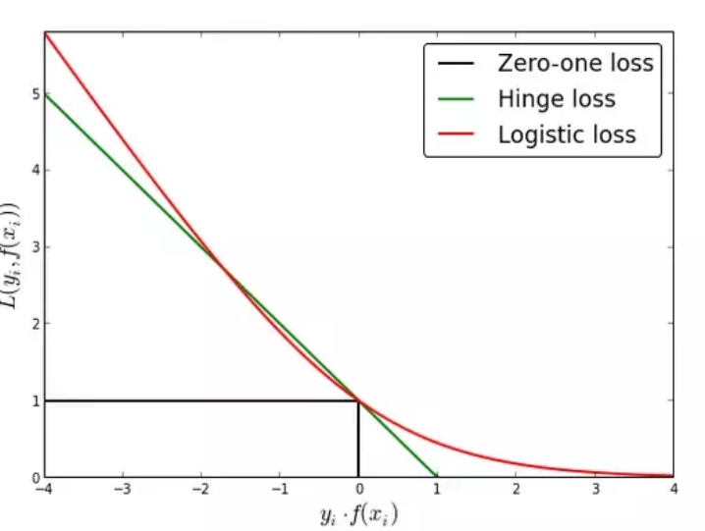
SVM Computational time for adult dataset
LR Computational time for adult dataset
Training size | PCA Comp time | LDA Comp time
10 | 2s | 1s
20 | 3.2s | 3s
30 | 7s | 5s
40 | 9s | 8s
50 | 12s | 10s
Training size | PCA Comp time | LDA Comp time
10 | 50ms | 60ms
20 | 80ms | 70ms
30 | 80ms | 70ms
40 | 70ms | 70ms
50 | 80ms | 80ms
Variance(LR):
array([1.])-- LDA
array([0.14688882, 0.10124581, 0.07937771, 0.0787837 , 0.07784919, 0.07326981, 0.06930219, 0.06818312, 0.06567671]) --PCA

Slide 7
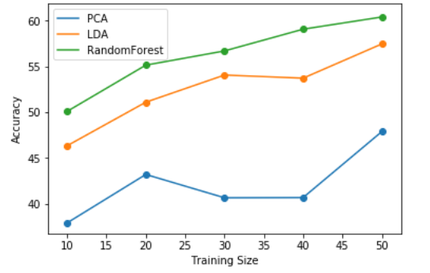
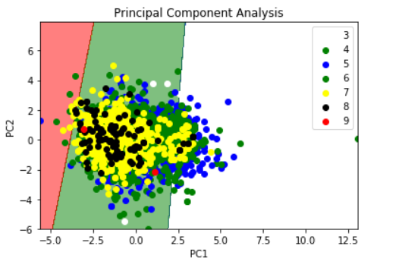
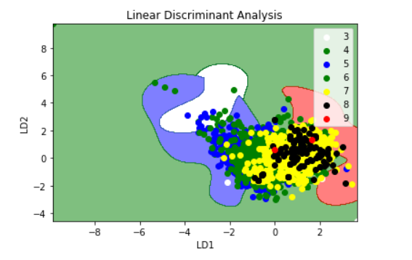
Wine Data set PCA and LDA with Random Forest:
PCA( principal components) | 10 Percent Training | 20 Percent Training | 30 Percent Training | 40 Percent Training | 50 Percent Training
1 | 36.01 | 37.07 | 36 | 35.69 | 37
2 | 37.94 | 37.48 | 40.68 | 40.7 | 42.26
3 | 37.83 | 40.12 | 39.39 | 38.24 | 47.89
4 | 40 | 43.22 | 39.86 | 39.67 | 44.22
5 | 40.78 | 44.6 | 39.39 | 39.16 | 41.89
6 | 42.05 | 44.55 | 39.74 | 39.6 | 41.85
7 | 42.95 | 43.63 | 39.69 | 40.7 | 42.2
8 | 38.73 | 44.22 | 38.96 | 39.67 | 41.36
9 | 44.02 | 44.5 | 40.12 | 41.27 | 45.4
LDA | 10 Percent Training | 20 Percent Training | 30 Percent Training | 40 Percent Training | 50 Percent Training
1 | 44.38 | 44.83 | 48.29 | 50.28 | 50.46
2 | 46.35 | 51.1 | 52.28 | 53.72 | 54.7
3 | 47.51 | 52.15 | 54.06 | 55.73 | 57.45
4 | 49.92 | 51.59 | 53.97 | 55.49 | 57.53
5 | 49.42 | 54.14 | 55.03 | 57.5 | 59.86
6 | 50.71 | 53.4 | 55 | 58.3 | 59.16
Without PCA/LDA | 10 Percent Training | 20 Percent Training | 30 Percent Training | 40 Percent Training | 50 Percent Training
- | 50.1 | 55.14 | 56.69 | 59.06 | 60.39

Slide 8
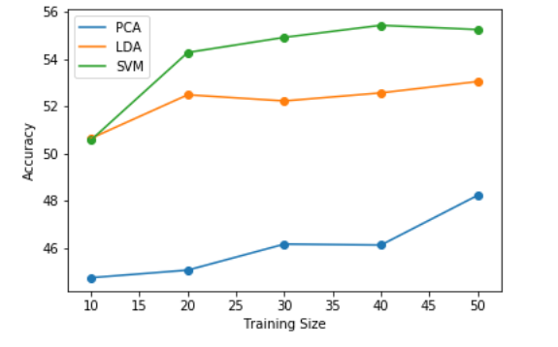
Wine Data set PCA and LDA with SVM:
LDA | 10 Percent Training | 20 Percent Training | 30 Percent Training | 40 Percent Training | 50 Percent Training
1 | 50.64 | 52.48 | 52.22 | 52.56 | 53.04
2 | 50.39 | 52.56 | 51.73 | 52.56 | 52.55
3 | 51.39 | 52.56 | 52.69 | 53.75 | 53.63
4 | 52.18 | 53.1 | 52.78 | 52.97 | 53.65
5 | 50.69 | 53.66 | 53.51 | 53.62 | 54.67
6 | 50.66 | 53.91 | 54.24 | 53.62 | 54.75
PCA( principal components) | 10 Percent Training | 20 Percent Training | 30 Percent Training | 40 Percent Training | 50 Percent Training
1 | 44.74 | 45.06 | 44.79 | 44.94 | 43.77
2 | 45.13 | 44.09 | 46.16 | 46.12 | 45.4
3 | 43.41 | 45.26 | 42.08 | 42.32 | 48.22
4 | 42.02 | 47.92 | 42.34 | 42.46 | 47.65
5 | 42.43 | 47 | 41.32 | 41.3 | 46
6 | 44.09 | 47.3 | 41.49 | 41.98 | 45.4
7 | 42.66 | 46.56 | 41.9 | 42.49 | 46.14
8 | 42.86 | 48.12 | 41.11 | 42.36 | 45.9
9 | 45.92 | 49 | 41.79 | 42.46 | 46.63
Without PCA/LDA | 10 Percent Training | 20 Percent Training | 30 Percent Training | 40 Percent Training | 50 Percent Training
- | 50.57 | 54.27 | 54.91 | 54.42 | 55.24

Slide 9
RF Computational time for Wine dataset
SVM Computational time for Wine dataset
Training size | PCA Comp time | LDA Comp time
10 | 11ms | 8ms
20 | 21ms | 17ms
30 | 46ms | 28ms
40 | 48ms | 45ms
50 | 62ms | 61ms
Training size | PCA Comp time | LDA Comp time
10 | 5ms | 6ms
20 | 8ms | 7ms
30 | 8ms | 7ms
40 | 7ms | 7ms
50 | 8ms | 8ms
Variance(SVM):
PCA:
array([0.29150946, 0.15005073, 0.11275551, 0.09377092, 0.08247013, 0.08064444, 0.06998011, 0.05275973, 0.03699221])
LDA:
array([0.82557932, 0.11139449, 0.03122631, 0.02057139, 0.0086628 , 0.00256569])

Slide 10
Conclusion:
In Adult Dataset, LDA/PCA has 2 sided story
But if we compare the classifiers Logistic Regression is better than SVM because of computational time
In case of Wine Dataset, LDA works better for SVM and Random forest because of accuracy and also it's computational time
But if we compare classifiers Random Forest is better because of accuracy as well as it's computational time.

