Slide 1
ANALYSIS ON K-MEANS AND HIERARCHICAL CLUSTERING

Slide 2
DATASETS :
KEGG Metabolic pathways
Contains 54000 samples with 24 attributes
RSSI Readings Data Set
Contains 6700 samples with 15 attributes
Goal : is to group the data points into meaningful clusters

Slide 3
Methods Used:
K- means Clustering
Hierarchical Clustering
Principal Component Analysis
Davies-Bouldin's Index
Partition Coefficient Index
Silhouette Index

Slide 4
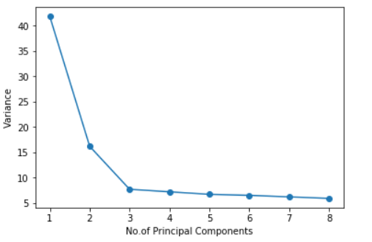
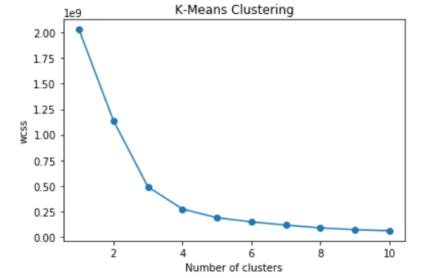
KEGG METABOLIC DATASET WITH K-MEANS
Elbow Method:

Slide 5
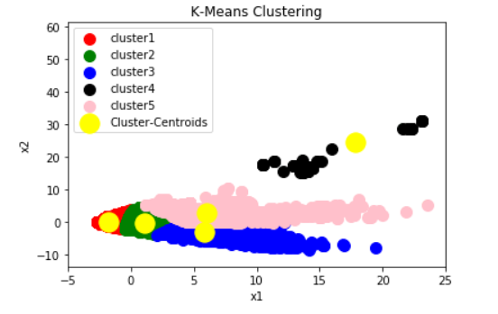
Indexes:
C | 2 | 3 | 4 | 5 | 6 | 7 | 8 | 9 | 10
DB | 0.82 | 0.98 | 0.75 | 0.76 | 0.77 | 0.79 | 0.77 | 0.79 | 0.77
PC | 0.6 | 0.68 | 0.72 | 0.73 | 0.61 | 0.57 | 0.52 | 0.53 | 0.51
Silhouette | 0.59 | 0.46 | 0.52 | 0.6 | 0.53 | 0.49 | 0.5 | 0.45 | 0.48
Scatter Plot:
Number of data points in each cluster:
C​ | 0​ | 1​ | 2​ | 3​ | 4​
5​ | 15136​ | 31814​ | 3649​ | 2746​ | 68​

Slide 6
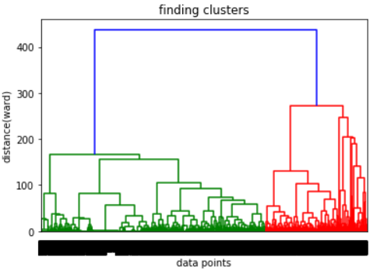
KEGG METABOLIC DATASET WITH HIERARCHICAL CLUSTERING
Dendrogram:

Slide 7
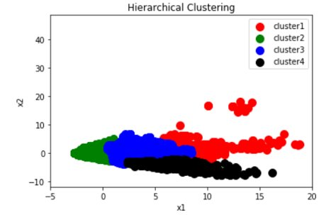
Indexes:
C | 2 | 3 | 4 | 5 | 6 | 7 | 8 | 9 | 10
DB | 0.86 | 0.85 | 0.72 | 0.74 | 0.75 | 0.77 | 0.75 | 0.77 | 0.76
PC | 0.6 | 0.71 | 0.68 | 0.69 | 0.61 | 0.57 | 0.52 | 0.53 | 0.51
Silhouette | 0.55 | 0.56 | 0.58 | 0.57 | 0.54 | 0.49 | 0.47 | 0.43 | 0.41
Scatter Plot:
Number of data points in each cluster:
C​ | 0​ | 1​ | 2​ | 3​
4​ | 5568​ | 24840​ | 14023​ | 8982​

Slide 8
Time Comparison Between K-means and Hierarchical Clustering
 | K-means | Hierarchical
Time taken(seconds) | 47 | 248

Slide 9
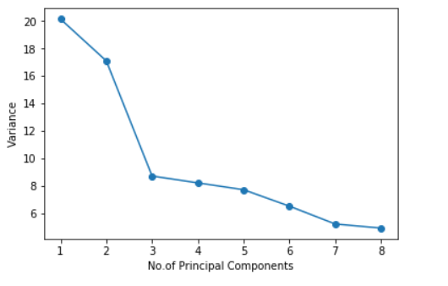
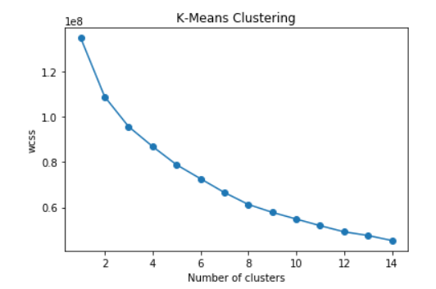
RSSI READINGS WITH K-MEANS
Elbow Method:

Slide 10
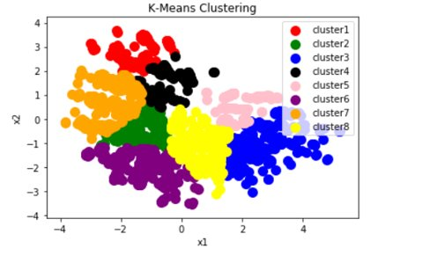
Indexes:
C | 2 | 3 | 4 | 5 | 6 | 7 | 8 | 9 | 10
DB | 0.95 | 0.87 | 0.9 | 0.899 | 0.83 | 0.89 | 0.836 | 0.833 | 0.82
PC | 0.72 | 0.75 | 0.76 | 0.74 | 0.76 | 0.78 | 0.84 | 0.83 | 0.79
Silhouette | 0.41 | 0.421` | 0.427 | 0.39 | 0.41 | 0.429 | 0.48 | 0.44 | 0.447
Scatter Plot:
Number of data points in each cluster:
C​ | 0​ | 1​ | 2​ | 3​ | 4​ | 5​ | 6​ | 7​
8​ | 1027​ | 808​ | 622​ | 729​ | 509​ | 266​ | 515​ | 715​

Slide 11
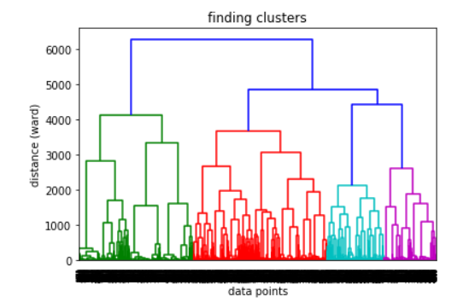
RSSI READINGS WITH K-MEANS
Dendrogram:

Slide 12
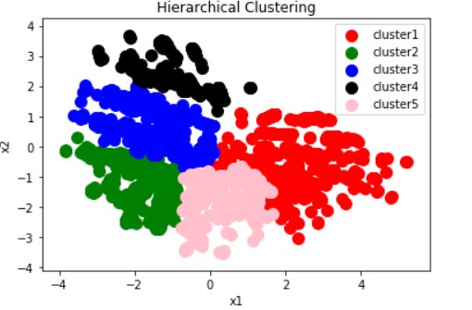
Indexes:
C | 2 | 3 | 4 | 5 | 6 | 7 | 8 | 9 | 10
DB | 0.95 | 0.82 | 0.77 | 0.71 | 0.87 | 0.914 | 0.94 | 0.917 | 1.03
PC | 0.772 | 0.73 | 0.778 | 0.78 | 0.74 | 0.73 | 0.69 | 0.65 | 0.61
Silhouette | 0.41 | 0.44 | 0.42 | 0.45 | 0.46 | 0.421 | 0.41 | 0.39 | 0.36
Scatter Plot:
Number of data points in each cluster:
C | 0 | 1 | 2 | 3 | 4
5 | 1152 | 1251 | 947 | 912 | 929

Slide 13
Time Comparison Between K-means and Hierarchical Clustering
​ | K-means​ | Hierarchical​
Time taken(seconds)​ | 4 | 22

Slide 14
Conclusion:
K- means and Hierarchical Clustering have been performed on two datasets
The optimal value of 'k' I.e., number of clusters is calculated using several methods like Elbow,Indexes for K-means and Dendogram,Indexes for Hierarchical.
For larger data sets, K-means take lesser time to compute than Hierarchical clustering.

