Slide 1
Analysis on Adult and Wine using Ensemble Methods

Slide 2
Methods Used:
Extra Trees Classifier - Feature Selection
Voting Classifier
Bagging Tree Classifier
Random Forest
Ada Boost
Gradient Boosting
XGBoost
Logistic Regression
Support Vector Machines

Slide 3
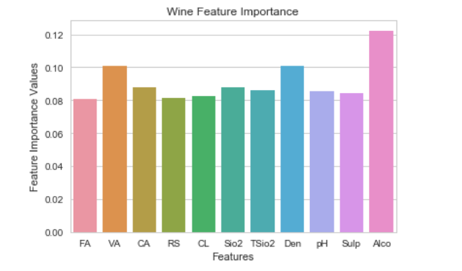
Feature Selection Wine:
Volatile Acidity, Density and Alcohol - Top 3 Feature Importance

Slide 4
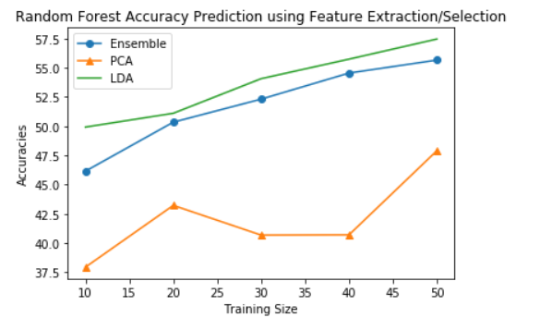
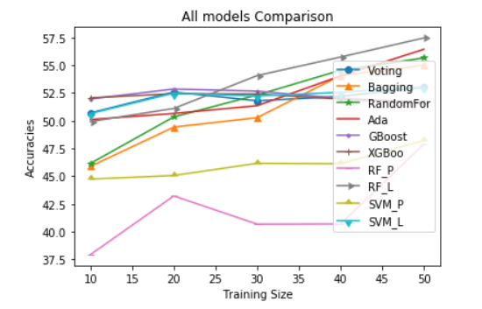
Accuracy vs Training Size Plots

Slide 5
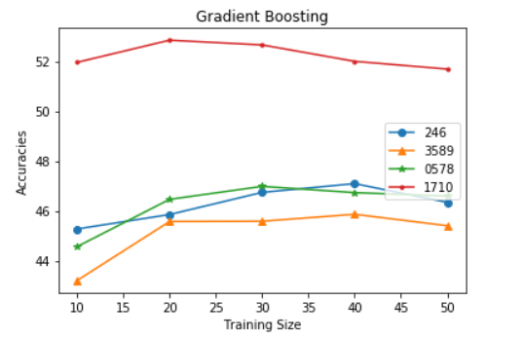
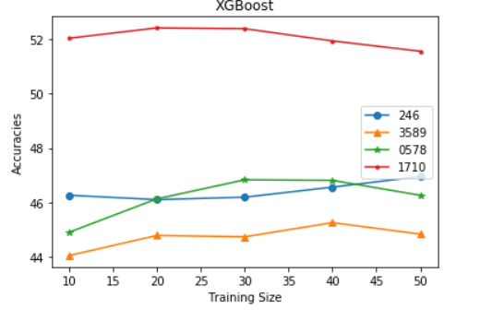
Analysis Using Other Feature Importance Components

Slide 6
Advantages:
Unlike LDA and PCA, we can actually select features that gives highest Feature Importance.
Provides best accuracies most of the times.
Computional Time will be pretty much lesser when we have huge data sets.

Slide 7
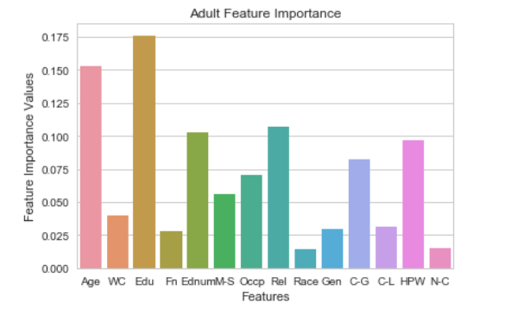
Feature Selection Wine:
Age,Education,Education num & Relationship- Top 4 Feature Importance

Slide 8
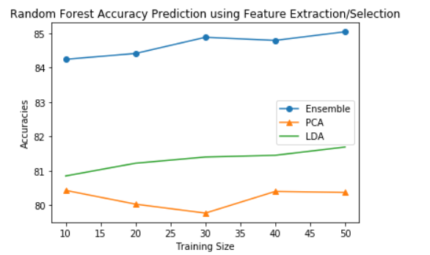
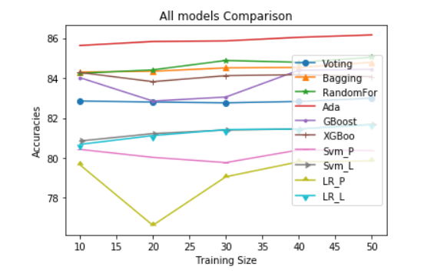
Accuracy vs Training Size Plots

Slide 9
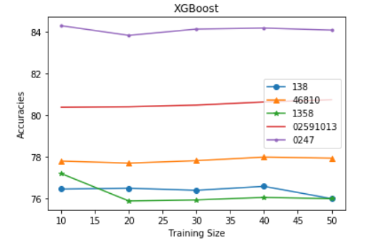
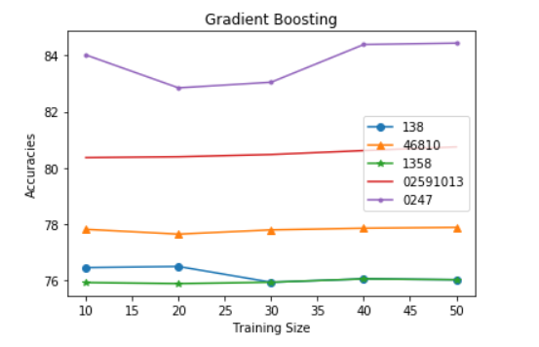
Analysis Using Other Feature Importance Components

Slide 10
Conclusion:
These methods can produce very good results when dealing with Large Data sets.
Faster and Provide better results when compared to other Algorithms
The Major challenge would be choosing correct Ensembler method for given problem.

