Slide 1

Natural Language SQL Query Agent -Dr . Ch Mallikarjuna Rao ,Professor of CSE Dept
GOKARAJU RANGARAJU INSTITUTE OF ENGINEERING AND TECHNOLOGY
Department of Computer Science and Engineering
Major Project Phase-2 Review - 3
Prathivada Chakradhar -20241A05M4
Reddybattula Sravan Reddy -20241A05M8
Prathapani Abhinay -20241A05M3
Sannilla Pavan Kumar -20241A05N1

Slide 2
GOKARAJU RANGARAJU INSTITUTE OF ENGINEERING AND TECHNOLOGY
Department of Computer Science and Engineering
Major Project Phase-2 Review - 3
ABSTRACT
NLP-powered systems streamline the process of querying databases by enabling users to express their requests in everyday language. This effectively bridges the gap between human communication and SQL, opening up database querying to non-technical individuals. The system works by interpreting user intent, extracting SQL commands, formulating and running queries, and presenting the results in a format that aligns with natural language. This iterative approach allows users to provide clarifications as needed, facilitating accurate information retrieval without necessitating extensive SQL expertise or familiarity with database schemas.

Slide 3
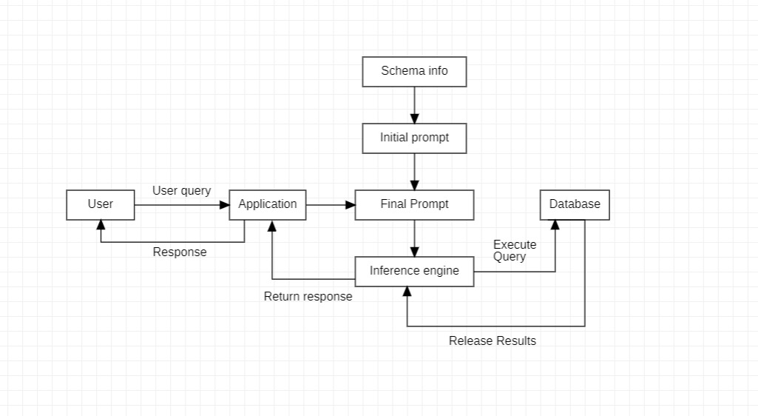
GOKARAJU RANGARAJU INSTITUTE OF ENGINEERING AND TECHNOLOGY
Department of Computer Science and Engineering
Major Project Phase-2 Review - 3
Architecture

Slide 4
GOKARAJU RANGARAJU INSTITUTE OF ENGINEERING AND TECHNOLOGY
Department of Computer Science and Engineering
Major Project Phase-2 Review - 3
Architecture
The architecture illustrates the operational sequence of Project, outlining the interaction between a user, a database, and an application. The workflow commences with the user submitting a natural language query alongside the database file. This input is interpreted by the application as a prompt. Using this prompt, the application proceeds to formulate a corresponding SQL query. Following query generation, the application executes it on the database, retrieving relevant data. Finally, the output response is presented to the user, completing the communication loop.

Slide 5
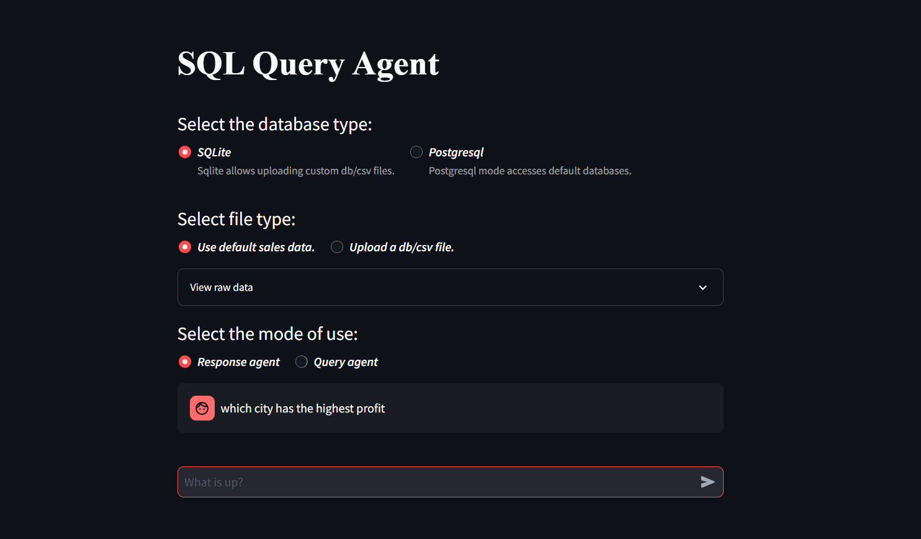
GOKARAJU RANGARAJU INSTITUTE OF ENGINEERING AND TECHNOLOGY
Department of Computer Science and Engineering
Major Project Phase-2 Review - 3
GUI

Slide 6
GOKARAJU RANGARAJU INSTITUTE OF ENGINEERING AND TECHNOLOGY
Department of Computer Science and Engineering
Major Project Phase-2 Review - 3
The interface is developed using Streamlit. It is a free and open-source Python framework, facilitates the creation of attractive and interactive web applications without the need for extensive web development knowledge. Unlike conventional web frameworks, Streamlit simplifies UI development by allowing users to build data science apps with minimal Python code. It offers various widgets and functions for creating interactive elements like buttons, sliders, and text inputs. By seamlessly integrating data science code from libraries such as Pandas, NumPy, and Matplotlib, Streamlit enables developers to quickly create shareable web apps. The interface offers different operational modes, database types, and formats, enhancing usability. Additionally, it provides both the original record or response and a human-readable answer, enriching the user experience.

Slide 7
GOKARAJU RANGARAJU INSTITUTE OF ENGINEERING AND TECHNOLOGY
Department of Computer Science and Engineering
Major Project Phase-2 Review - 3
Result Analysis
After conducting an exhaustive evaluation on the spider dataset, our NLP-to-SQL agent has demonstrated an impressive accuracy rate of approximately 80%, marking a significant stride in the fusion of natural language processing and structured query language. This achievement is a testament to our team's relentless dedication to mastering the intricacies of both NLP and SQL principles, as well as our innovative approach in developing sophisticated algorithms and robust error-handling mechanisms. As we chart our course forward, our commitment remains unwavering: to continue refining and enhancing our agent's capabilities, thereby pushing the boundaries of human-computer interaction and empowering users with unparalleled access to actionable insights and streamlined data manipulation tools.

Slide 8
GOKARAJU RANGARAJU INSTITUTE OF ENGINEERING AND TECHNOLOGY
Department of Computer Science and Engineering
Major Project Phase-2 Review - 3
Question : Which year has most number of concerts?
Gold_sql : SELECT YEAR FROM concert GROUP BY YEAR ORDER BY count(*) DESC LIMIT 1;
Hard pred :
SELECT Year, COUNT(*) AS num_concerts FROM concert GROUP BY Year ORDER BY num_concerts DESC LIMIT 1;
Analysis :
The error in application query is not a syntactic one, but rather a semantic redundancy. The query is essentially performing the same operation as the actual query but with additional SELECT fields, resulting in redundant information retrieval.
Question : How much does the youngest dog weigh?
Gold_sql : SELECT weight FROM pets ORDER BY pet_age LIMIT 1;
Hard pred :
SELECT MIN(weight) FROM Pets WHERE PetType = 'Dog' AND pet_age = (SELECT MIN(pet_age) FROM Pets WHERE PetType = 'Dog');

Slide 9
GOKARAJU RANGARAJU INSTITUTE OF ENGINEERING AND TECHNOLOGY
Department of Computer Science and Engineering
Major Project Phase-2 Review - 3
The potential error in the application query is that it might produce inaccurate results if there are multiple dogs with the same minimum age. This could lead to the query retrieving the weight of the youngest dog among them, but not necessarily the weight of the youngest dog overall.
Analysis :
Question : What is the model of the car with the smallest amount of horsepower?
Gold_sql :
Hard pred :
SELECT T1.Model FROM CAR_NAMES AS T1 JOIN CARS_DATA AS T2 ON T1.MakeId = T2.Id ORDER BY T2.horsepower ASC LIMIT 1;
SELECT Model FROM car_names WHERE MakeId = ( SELECT MakeId FROM cars_data ORDER BY CAST(Horsepower AS INTEGER) LIMIT 1 )
Analysis :
The error in system generated query is the use of the subquery within the WHERE clause, which may result in returning more than one row if there are multiple records in the car_names table with the MakeId returned by the subquery. This could lead to unexpected or inaccurate results.

Slide 10
GOKARAJU RANGARAJU INSTITUTE OF ENGINEERING AND TECHNOLOGY
Department of Computer Science and Engineering
Major Project Phase-2 Review - 3
Publication status
Review Paper:
The paper is entitled as ‘’Review Paper On Text-To-SQL Generation Systems’’ is published on 21st Feb,2024 in IJCRT.

Slide 11
GOKARAJU RANGARAJU INSTITUTE OF ENGINEERING AND TECHNOLOGY
Department of Computer Science and Engineering
Major Project Phase-2 Review - 3
Conclusion:
The main purpose of the system is facilitating users such as, business analysts, data scientists, decision-makers, and nontechnical users to retrieve and analyze data directly from databases, enabling them to make data-driven decisions in a more efficient manner. The approach establishes a conversational loop, allowing users to iteratively refine their queries based on initial results and retrieve relevant information.

Slide 12
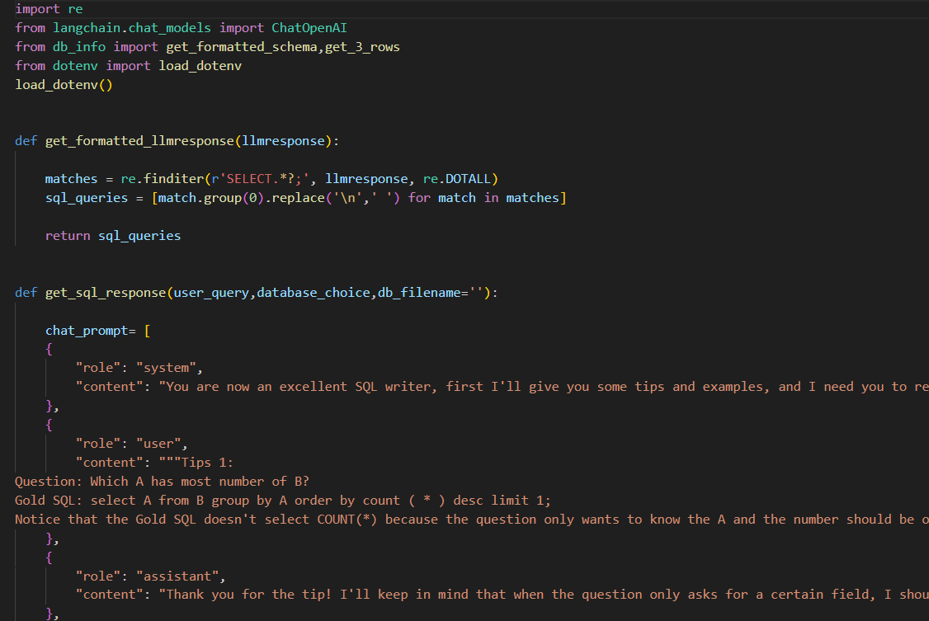
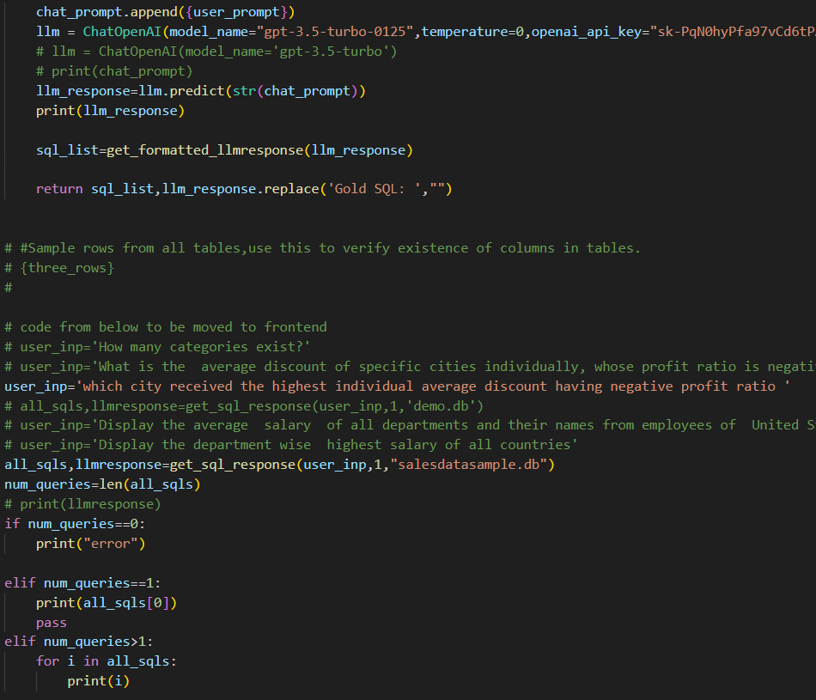
GOKARAJU RANGARAJU INSTITUTE OF ENGINEERING AND TECHNOLOGY
Department of Computer Science and Engineering
Major Project Phase-2 Review - 3
Snapshots:

Slide 13
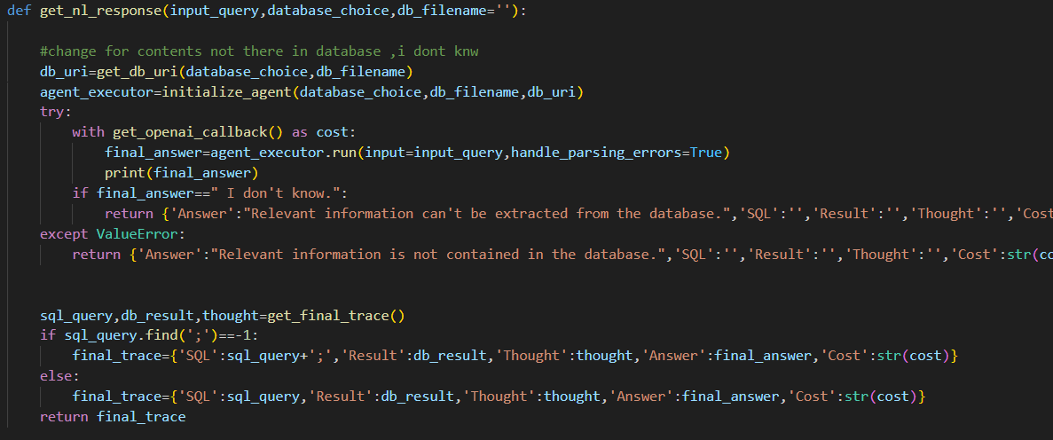
GOKARAJU RANGARAJU INSTITUTE OF ENGINEERING AND TECHNOLOGY
Department of Computer Science and Engineering
Major Project Phase-2 Review - 3

Slide 14
GOKARAJU RANGARAJU INSTITUTE OF ENGINEERING AND TECHNOLOGY
Department of Computer Science and Engineering
Major Project Phase-2 Review - 3
Proof for Publication:
Review Paper:
Paper ID : IJCRT2402540
Registration ID : 251618
Reference link:Review Paper on Text-to-SQL Generation Systems

Slide 15
Thank You Any Queries Please?
GOKARAJU RANGARAJU INSTITUTE OF ENGINEERING AND TECHNOLOGY
Department of Computer Science and Engineering
Major Project Phase-2 Review - 3

