Slide 1

Progress Review
Name: Vishwa Patwari
Designation : Design Engineer , Sevya Multimedia Technologies

Slide 2
Launch Lab Training
Phase-1 :
Concepts learned:
Digital design fundamentals
Logic gates, flip-flops, timing basics
RC circuit behavior
UNIX for design workflows
CMOS & MOSFET fundamentals

Slide 3
RTL Design and Simulation
Phase-2 :
Verilog Exercises: Applied various coding styles for combinational and sequential circuits using always blocks.
Logic Implementation: Designed Basic Finite State Machines (FSM) and performed simulation and debugging.
Architecture Study: Analyzed the architecture of pulpissimo and pulpino.

Slide 4
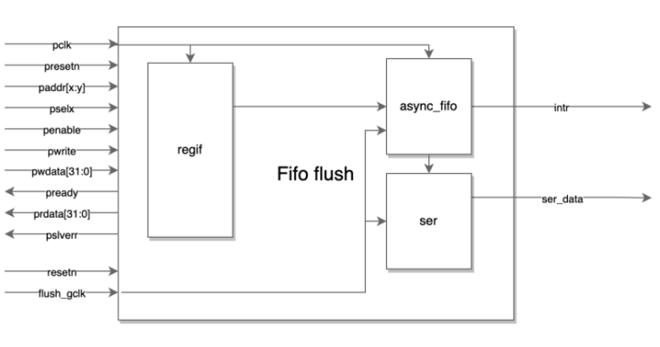
IP Development: FIFO Flush
Design Components
Register Interface: Utilized regif for APB registers.
Data Management: Integrated async_fifo for multi-clock domain handling and a serializer for data output.
Technical Features
Interface: Features a 32-bit APB interface.
Key Concepts: Focused on Clock Domain Crossing (CDC), FIFO control, and interrupts.

Slide 5
Current Project: AXI-FDI Bridge
Phase -3 : Protocol Conversion
Scope: Developing a bridge for AXI to FDI (UCIe-based) conversion.
Functionality: Implementing Packetization, Depacketization, and Clock Domain Crossing (CDC).
Architecture and Performance Flow:
TX Path follows AXI → FIFO → Packetizer → FDI;
RX Path follows FDI → Depacketizer → AXI.
Timing: Operating at 500 MHz (AXI domain) and 625 MHz (FDI domain).

Slide 6
Onboarding checklist
✔ Teams
✔ Outlook
⬜ SharePoint
⬜ Jira
⬜ Confluence
✔ Unix
✔ ETX
⬜ TSMC Training

Slide 7
THANK YOU..

