Slide 1
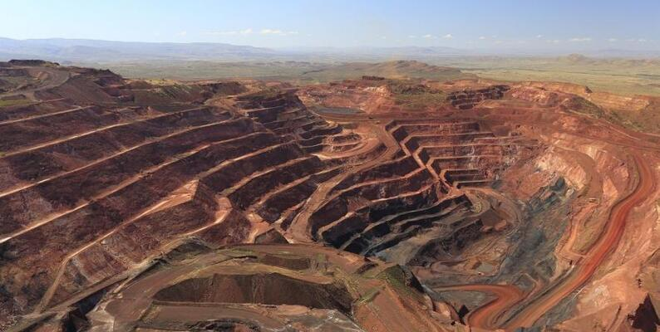
IRON KAGGLE
CHALLENGE

Slide 2
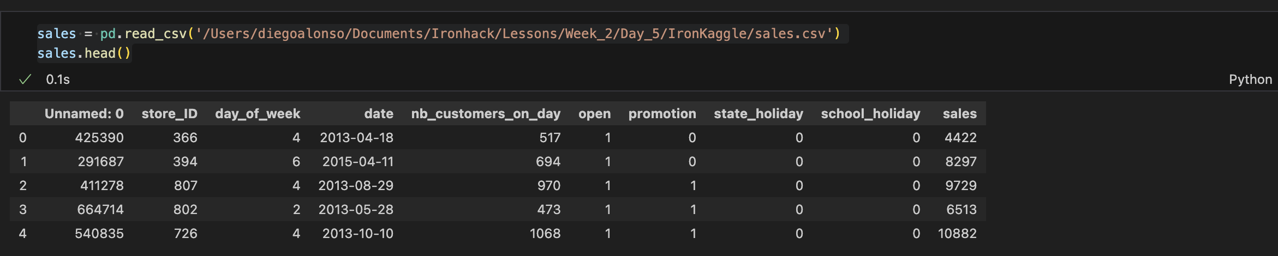
What we did…
1. We saw what we had

Slide 3
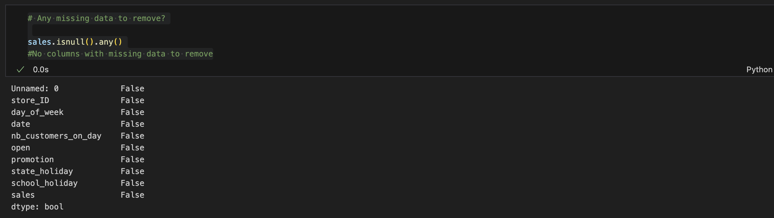
What we did…
2. Was there something missing?
👍

Slide 4
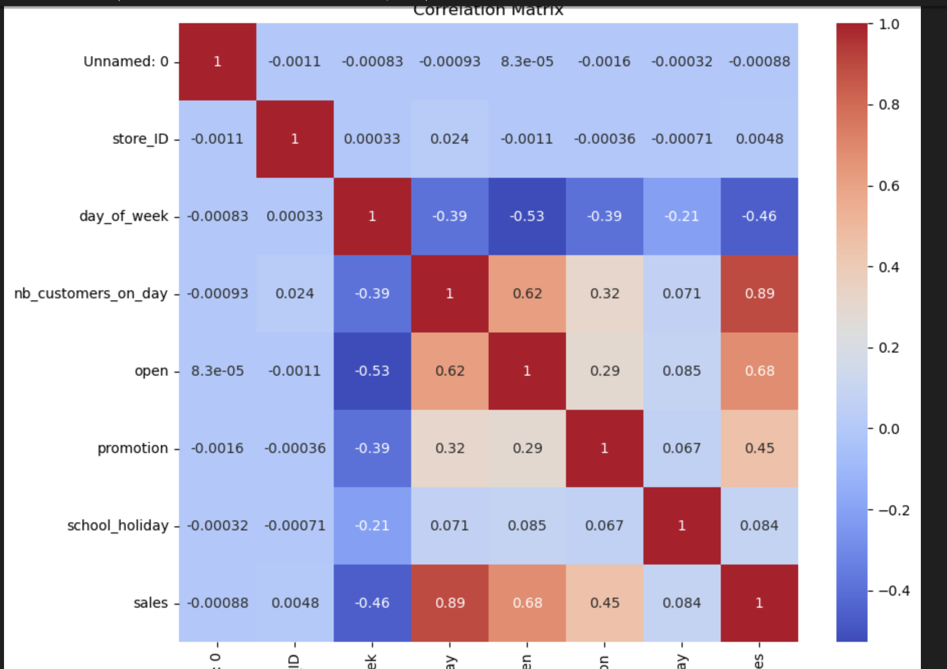
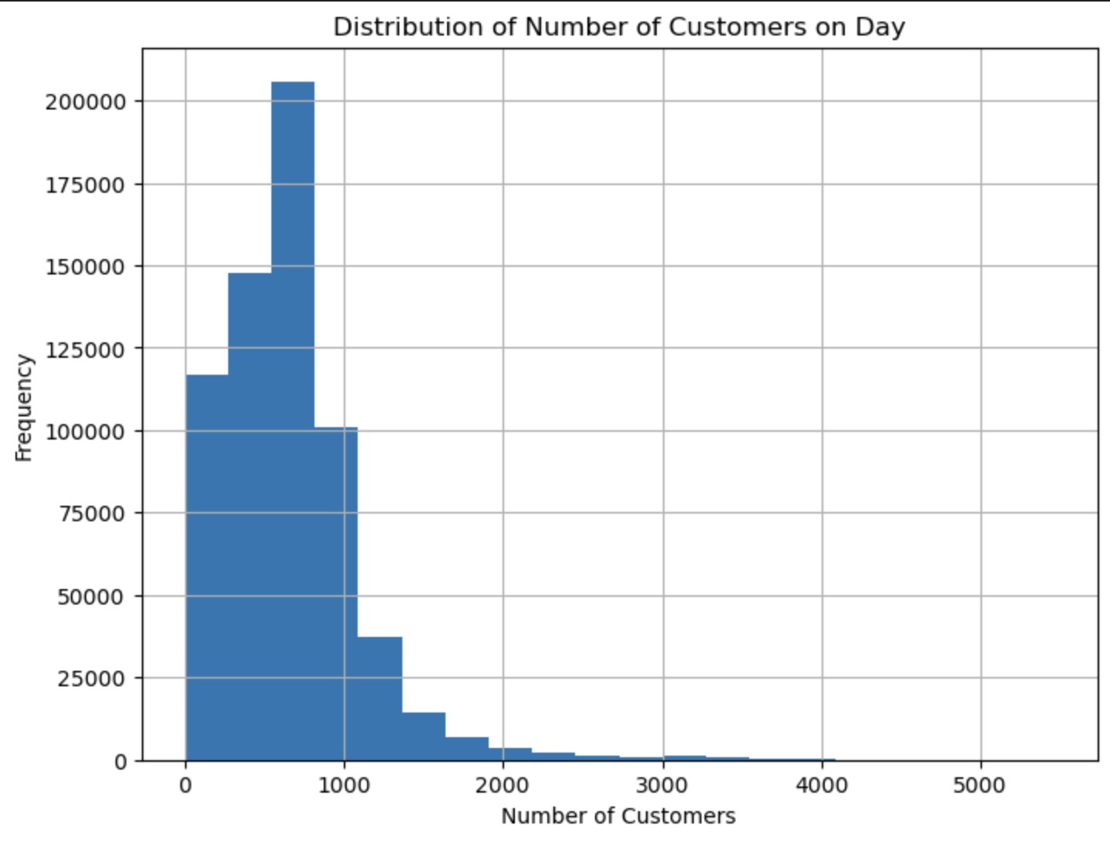
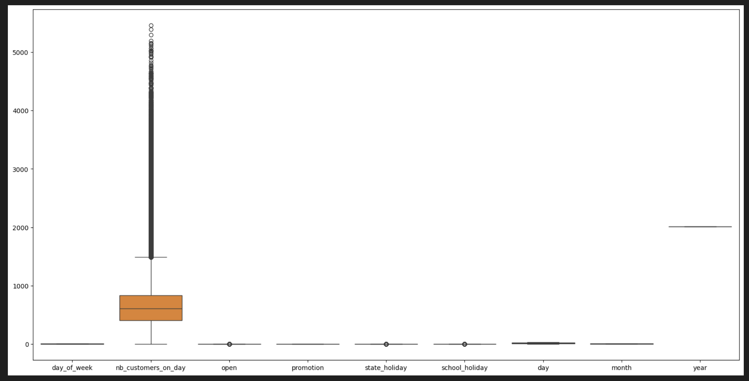
What we did…
3. Anything else?
89% of sales seemed to be explained by the number of customers
But number of customers was positively skewed…
… and out of range.

Slide 5
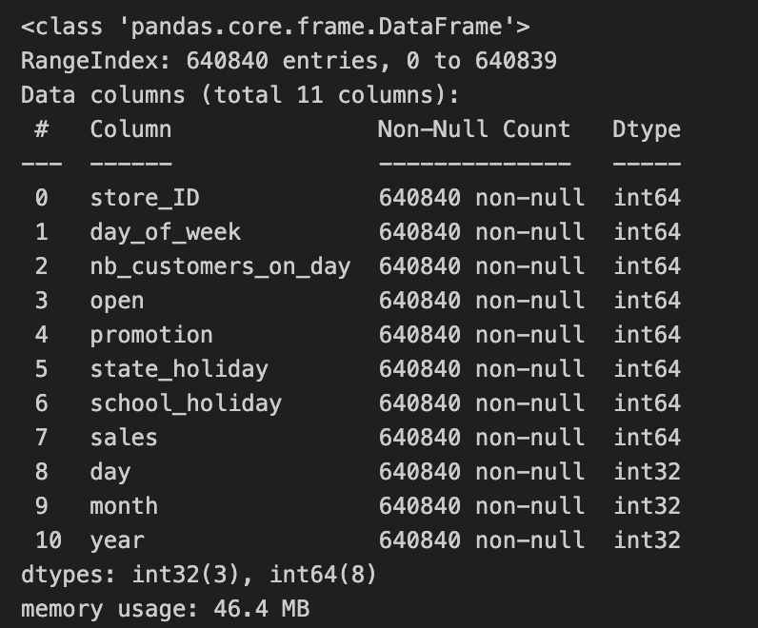
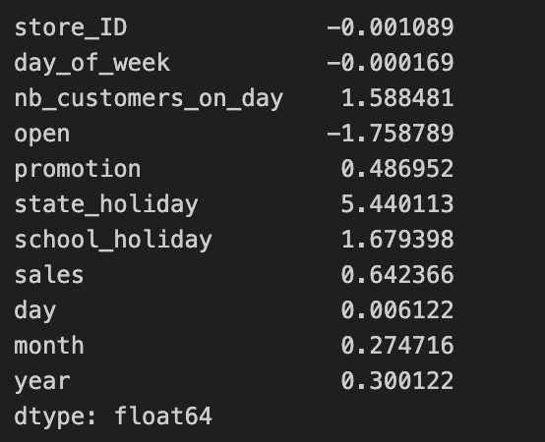
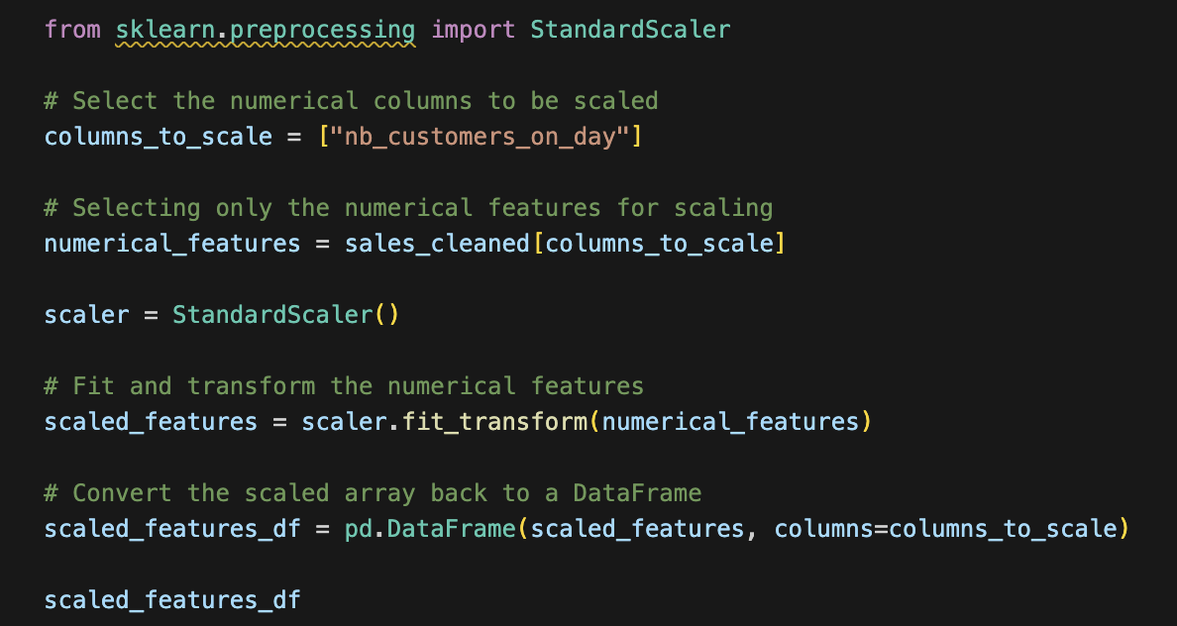
What we did…
4. We fixed the problems and standardize the data.
👍
👍
👍
Now all data was categorical
We erased the columns that we didn’t want and now everything was categorical
We standardized the data.

Slide 6
What we did…
4. We tested the models
Linear Regression
Decision Tree
Random Forest
Random Forest
R2 90,28%
R2 85,22%
R2 94,62%
R2 87,95%

Slide 7
What we did…
4. We tested the models
👍
Linear Regression
Decision Tree
Random Forest
Random Forest
R2 90,28%
R2 85,22%
R2 94,62%
R2 87,95%

Slide 8
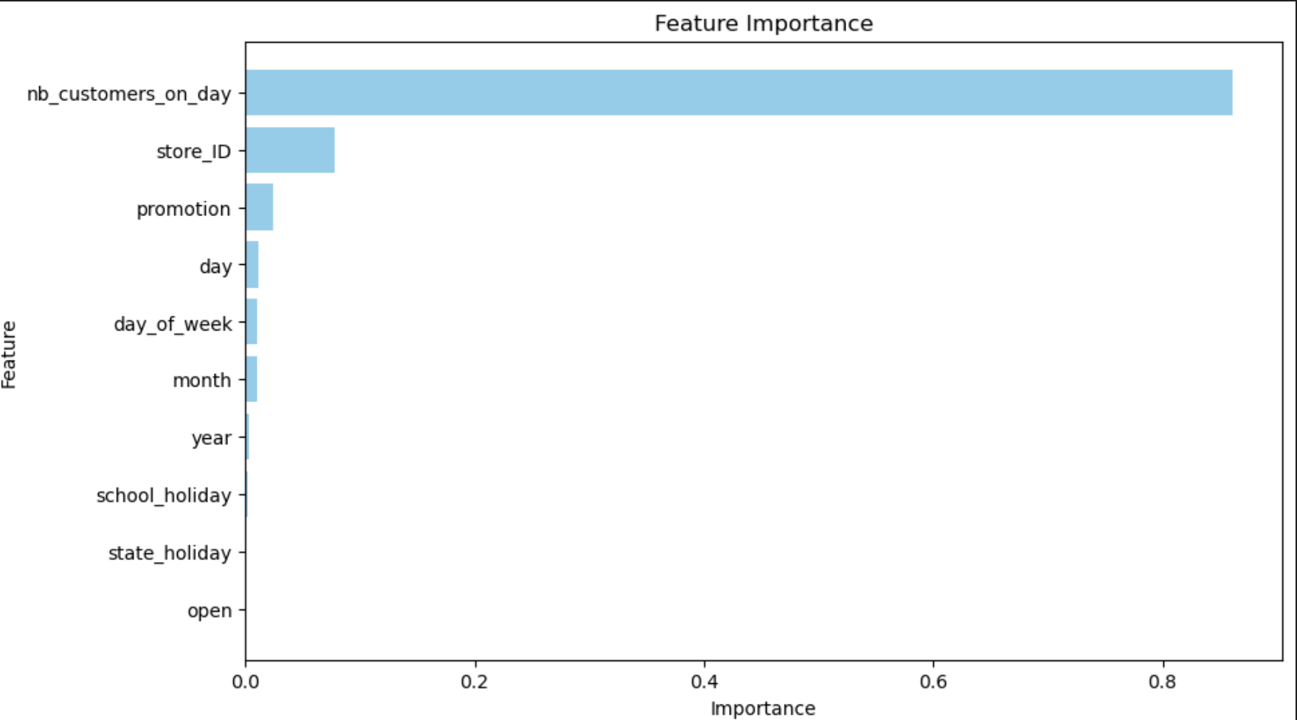
What we did…
5. We looked at the feature importance

Slide 9
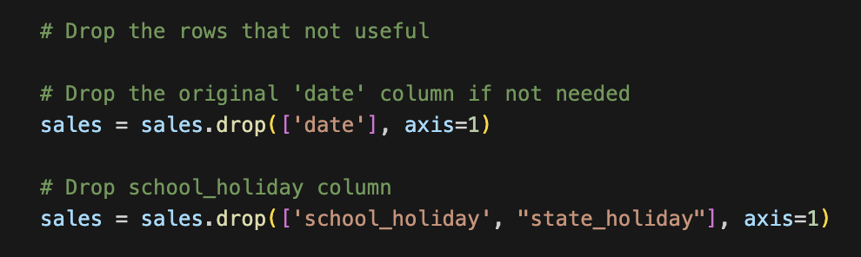
What we did…
6. We erased some columns

Slide 10
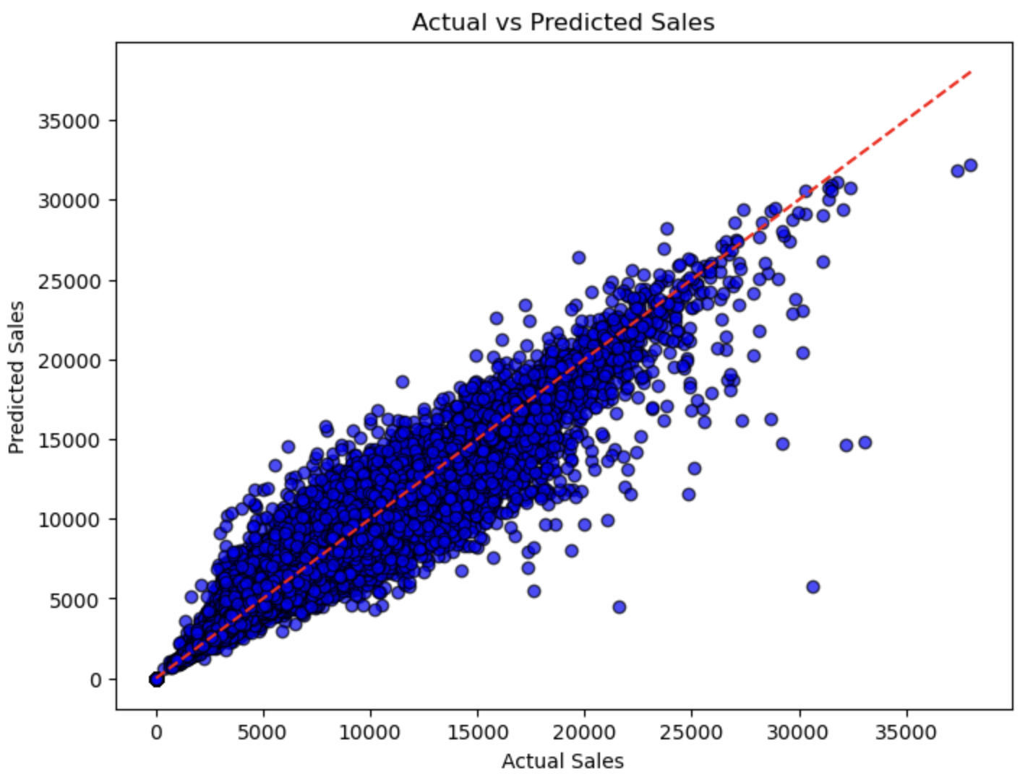
What we did…
7. The model was looking good

Slide 11
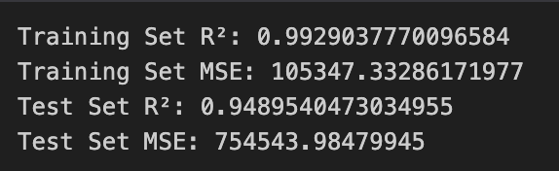
What we did…
8. And not overfitted

Slide 12
What we did…
9. We tried to improve the model

Slide 13
What we did…
But we ran out of time ☹

