Slide 1
Restaurant Management System Tableau - Data Visualisations
File created on: 4/22/2022 5:10:51 PM

Slide 2
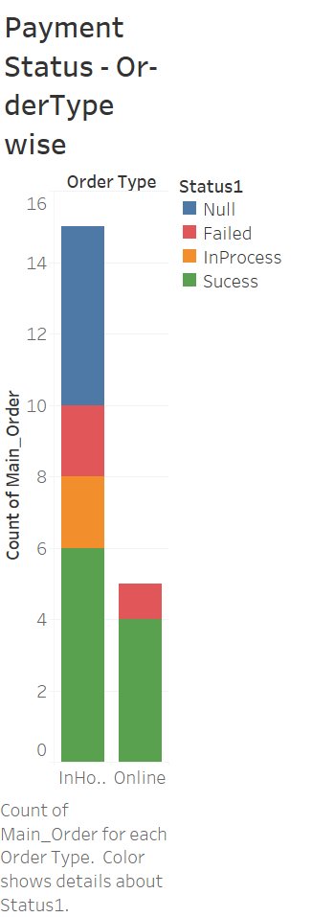

Slide 3
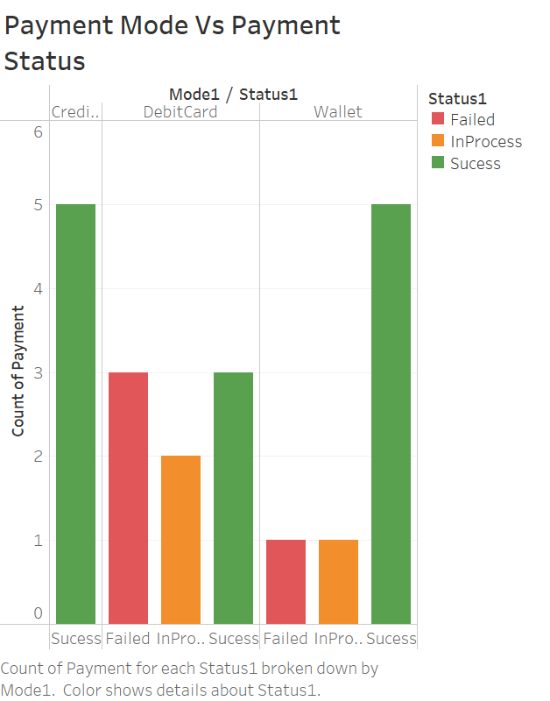

Slide 4
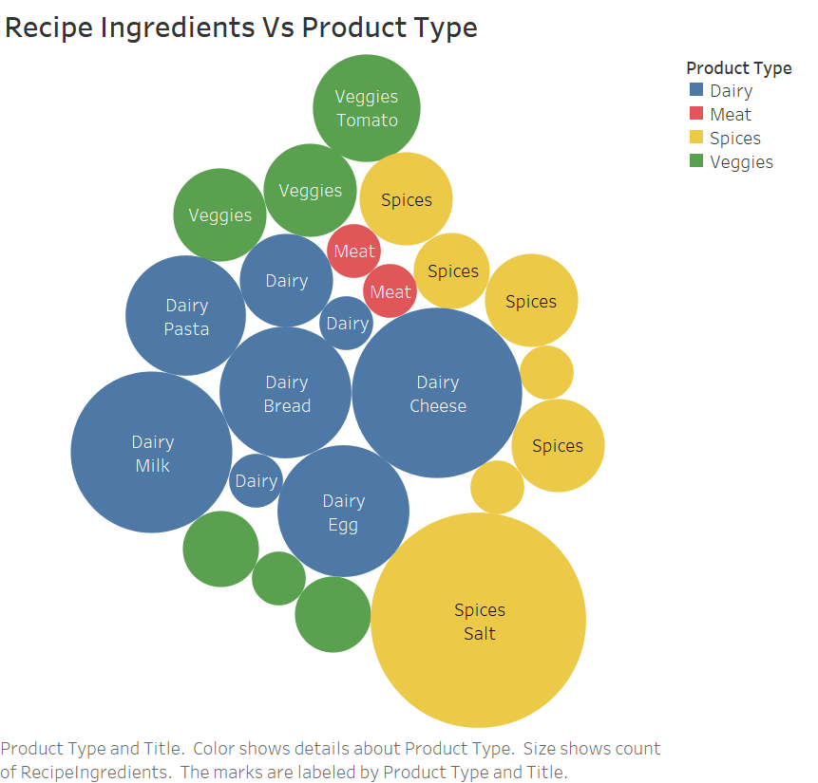

Slide 5
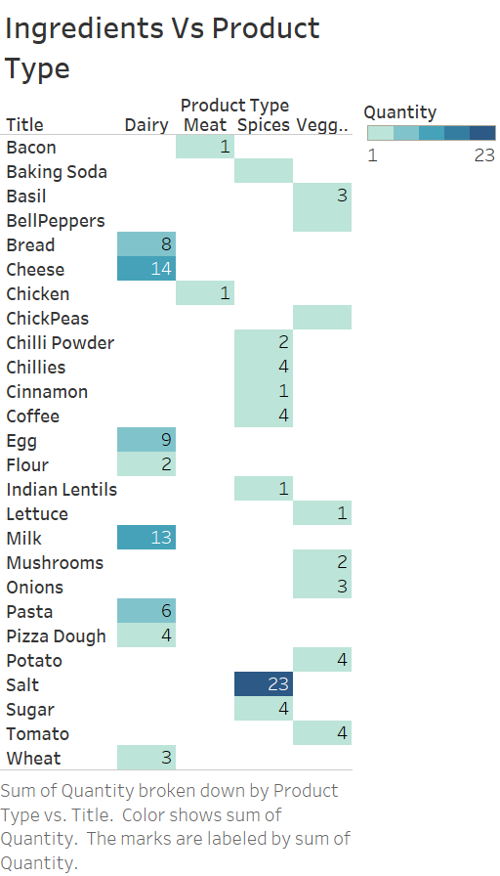

Slide 6
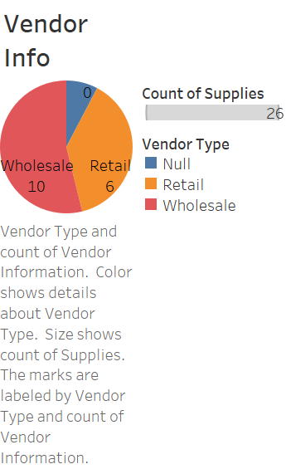

Slide 7
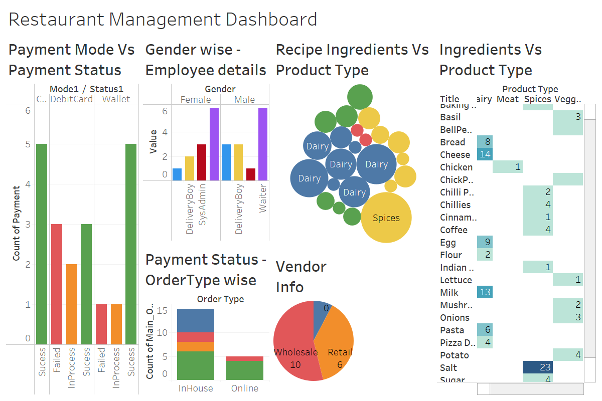

Slide 8
