Slide 1

Study of Molybdenum-carbide based material for electro-catalytic application
by Sairaj Raman Kumar Chowdhary
under the supervision of:
Prof. Shantanu K Behera

Slide 2
Polymer Derived Ceramics(PDC's)
PDC's are unique class of materials that are synthesised from pre-ceramic polymers(PCPs).These polymers are typically OrganoSilicon compounds, often containing elements like Silicon, Carbon, Nitrogen in their structure.
The process of creating polymer-derived ceramics involves carefully designed synthesis routes where the pre-ceramic polymers undergo controlled heating in an inert atmosphere or vacuum.
Polysilazanes(a preceramic precursor) are characterized by silicon (Si) and nitrogen (N) atoms in their structure. The Si–N bonds of polysilazanes offer the excellent thermal and chemical stability, high durability, and increased corrosion resistance in polymeric and ceramized states.
Polysilazanes are often used as precursors to prepare high-temperature resistant SiCN coatings and fibres, which are very stable ceramic compounds at high temperatures.
The use of PDC-based materials as supports for catalytic reactions offers advantages to the reaction media like higher specific surface area, porosity, improved mechanical strength, and thermal stability.

Slide 3
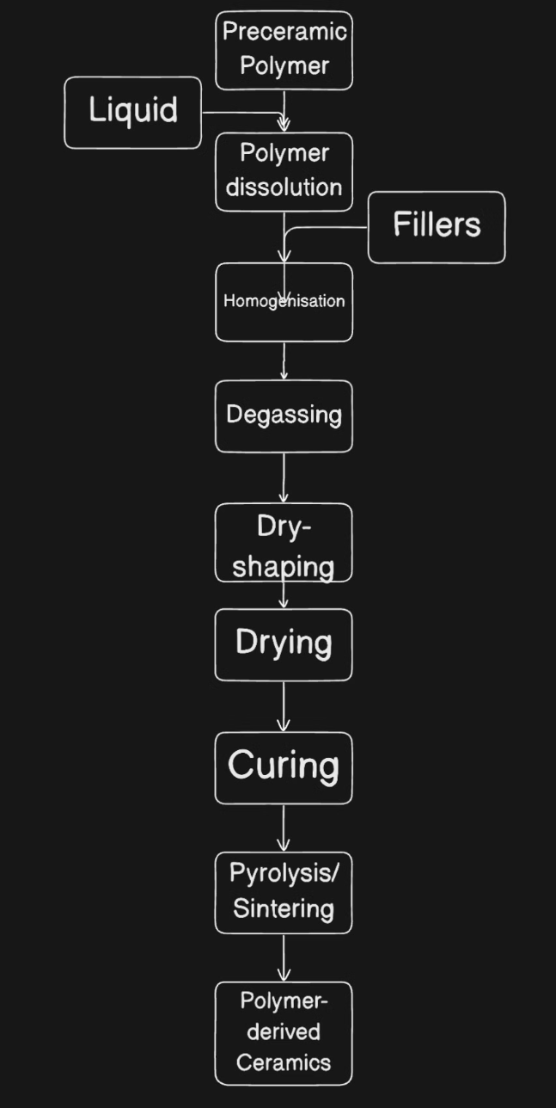
POLYMER DERIVED CERAMIC ROUTE

Slide 4
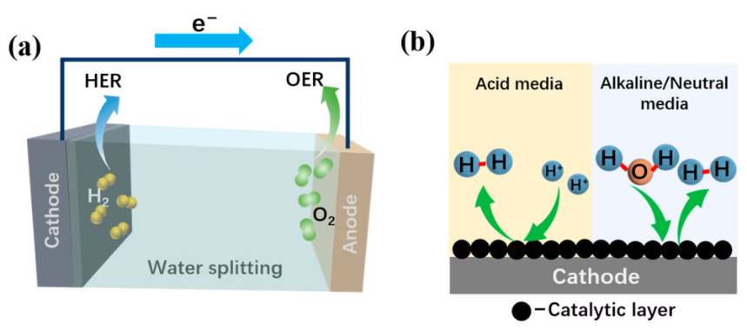
Molybdenum carbide-based materials for Hydrogen Evolution and Oxygen Evolution.
The core electrochemical reactions including hydrogen evolution reaction (HER), oxygen evolution reaction (OER) in these devices determine the energy conversion efficiency
Molybdenum carbide stands out due to the Pt-like d-band electronic structure, and great progresses have been made in the field of energy conversion and storage.
The unique electronic structure and high conductivity of molybdenum carbide make it not only capable of serving as a support for other active centres, but also capable of adjusting the electronic structure of other components to synergistically enhance the oxygen evolution reaction(OER).
The traditional synthesis methods of molybdenum carbide usually require high temperatures and complex processes, and the prepared molybdenum carbide has a large particle size and poor conductivity.
OER: 2H2O → O2 + 4e− + 4H+
HER: 4H+ → 4e− + 2H2
Overall: 2H2O → O2 + 2H2

Slide 5

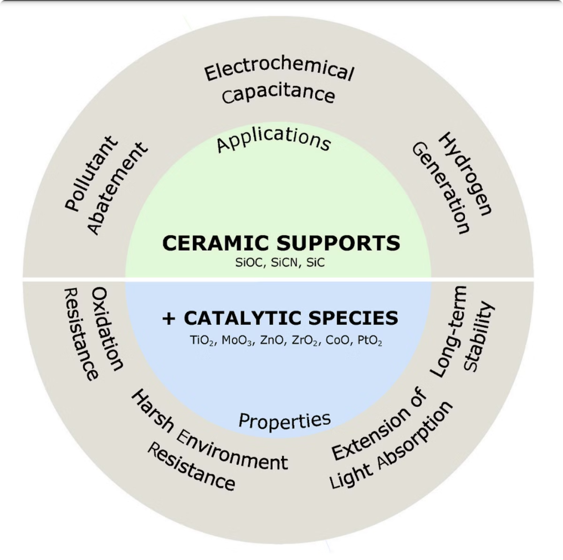
SiCO and SiCN Polymer derived Ceramics:
Composition: SiCN contains nitrogen in addition to silicon and carbon, while SiOC includes oxygen along with silicon and carbon.
Properties: SiCN typically exhibits higher thermal stability and better mechanical properties compared to SiOC, which may offer enhanced chemical resistance and lower density.
Applications: SiCN is often used in high-temperature applications and as a protective coating, whereas SiOC is favoured for its photocatalytic properties and as a support material in catalytic processes.
Advanced Si-based ceramics such as silicon oxicarbide (SiOC), silicon carbonitride (SiCN) have properties with a wide range of industrial applications such as oil and gas production, aluminum manufacturing, chemical industry, and assembling of solar cells

Slide 6
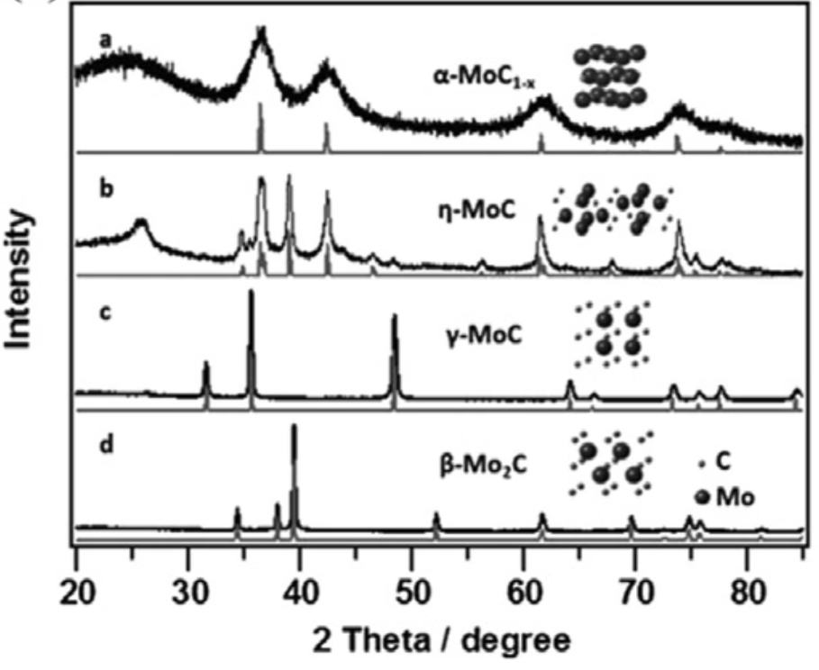
XRD patterns of various molybdenum carbide
HER performance was measured in 0.1 M perchloric acid (HClO4), and the results showed a HER catalytic activity of α-MoC1-X < η-MoC ≪ γ-MoC< β-Mo2C

Slide 7
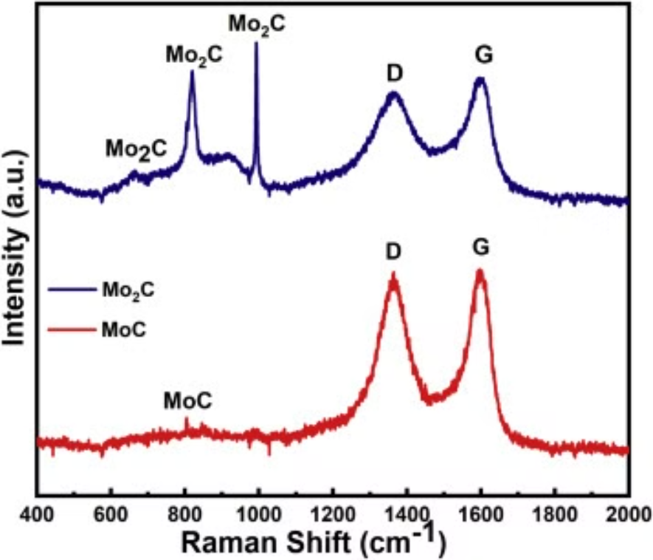
Raman Spectroscopy
The three characteristic peaks positioned at 663, 820, and 992/cm can be attributed to the Mo2C phase which was observed in XRD results.The D band corresponds to the vibration of sp3-hybridized carbon atoms and G band refers to the sp2 hybridized carbon type structure. The ratio of the intensity of the D and G band was calculated to be ~0.93 and ~0.85 for Mo2C and MoC indicates the higher crystallinity of graphitic carbon within MoC than Mo2C.

Slide 8
Future work: Cross-linking of Polymer precursor and Pyrolyze it. And its structural, microstructural and electrochemical behaviour of resulting nanocomposite need to be investigated.
To make an electrode with active material to use it as a working electrode.

Slide 9
References:
https://www.sciencedirect.com/science/article/pii/S1387181121005618
https://www.sciencedirect.com/science/article/pii/S2468519420301713

