Slide 1
Predicting Customer Churn at ConnectTel
An end-to-end machine learning pipeline: data exploration → models → explainability → retention strategy
Machine Learning Engineering Internship Project · Sairaj Salunke
Notes:
Introduce the project: ConnectTel is losing revenue to churn. The goal was a model that flags at-risk customers early, explains why, and turns that into a retention plan.

Slide 2
The problem: 1 in 4 customers is leaving
7,043
26.5%
2.8 : 1
customers in the IBM Telco dataset
churned (cancelled their subscription)
retained-to-churned ratio (imbalanced classes)
Goal: rank every customer by churn risk so the retention team can intervene before they cancel.
Why not accuracy? predicting "nobody churns" is already 73% accurate and useless. We optimise ROC-AUC and inspect precision vs recall instead.
Notes:
Acquiring a customer costs more than keeping one. With only about a quarter of customers churning, accuracy is misleading, so the project optimises ranking quality (ROC-AUC) and looks at precision and recall.

Slide 3
Approach: a four-phase pipeline
1
2
3
4
Explore & engineer
Baseline models
Boost & tune
Explain & act
EDA, hypothesis tests, 6 new features, one-hot encoding + scaling
Logistic Regression + Random Forest, stratified 5-fold cross-validation
XGBoost + LightGBM, GridSearchCV (970 fits), held-out test set
SHAP explanations, risk segments, retention recommendations
Notes:
The project followed the brief's four-week plan. Preprocessing lives inside a scikit-learn Pipeline so cross-validation never leaks information, and the test set was used exactly once.

Slide 4
Contract type is the strongest churn signal
15x more churn on month-to-month than two-year contracts
Fiber optic: 41.9% churn vs 19.0% for DSL
First year: 47% churn in months 0-12 vs 9.5% after four years
Electronic check: 45% churn vs 15-19% for other payment methods
Notes:
Exploratory analysis found contract length, internet type, tenure and payment method all strongly linked to churn. The highest-risk combination is month-to-month fiber customers, who churn at about 55%.

Slide 5
Hypothesis tests confirm the patterns
H1
Fiber users churn more than DSL
H2
Having a partner reduces churn
Supported
Supported*
41.9% vs 19.0%, 2.2x relative risk, p < 0.001
33.0% vs 19.7%, but SHAP later shows it is a proxy for tenure
H3
Month-to-month churns more
Ctrl
Gender is unrelated to churn
Supported
Not significant
Largest effect of all (Cramér's V = 0.41)
26.9% vs 26.2%, p = 0.49
Notes:
Chi-square tests with Cramér's V for effect size. Gender is a control that should not be significant, and it is not. The partner effect is real as a raw association, but disappears in the model once tenure and contract are known.

Slide 6
Six engineered features
TotalChargesPerTenure
ServiceCount
TenureGroup
Average spend per month of tenure
Number of add-on services (0-7)
0-12m / 13-24m / 25-48m / 49-72m buckets
HasProtection
HasStreaming
IsAutoPay
Any security, backup, device or support service
Streaming TV or movies
Automatic bank or card payment
Honest finding: TotalChargesPerTenure turned out to duplicate MonthlyCharges (r = 1.00), and the tree models learn the other features from raw columns. The features helped most in understanding the data.
Notes:
The brief asked for at least three engineered features; six were built. One honest result: the ratio feature is almost identical to MonthlyCharges in this dataset, which was checked and documented.

Slide 7
After tuning, every model reaches AUC ≈ 0.85
Untuned boosters overfit (train AUC ≈ 1.0) and lost to Logistic Regression
Tuning fixed overfitting by choosing simpler models: the best XGBoost uses depth-2 trees
All models plateau at ≈ 0.85, the information ceiling of this dataset
Notes:
194 hyperparameter combinations times 5 folds. XGBoost was selected on cross-validated AUC, not on the test set, to keep the test result honest.

Slide 8
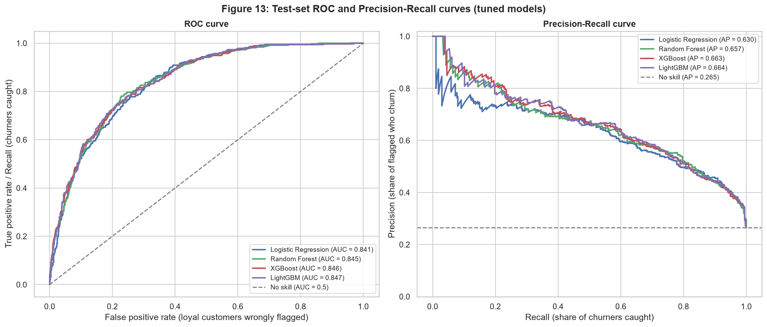
Final model: XGBoost generalises to unseen data
0.846
test ROC-AUC (95% CI 0.824-0.867)
0.850
cross-validated AUC, so no overfitting
1,409
test customers, used exactly once
Notes:
The three tree models are statistically tied on the test set. The boosted models keep higher precision among the very highest-risk customers, which matters for a budget-limited campaign.

Slide 9
Targeting by risk turns a loss into a profit
66%
of churners reached while contacting only 30% of customers
2.2x
more churners reached than random targeting
Threshold 0.65 chosen to maximise value. Assumes a $100 offer, 30% save rate and 12 months of revenue per saved customer (illustrative).
Notes:
The decision threshold was chosen on out-of-fold training predictions to maximise campaign value, then applied unchanged to the test set. The cost assumptions are illustrative and can be replaced with real figures.

Slide 10
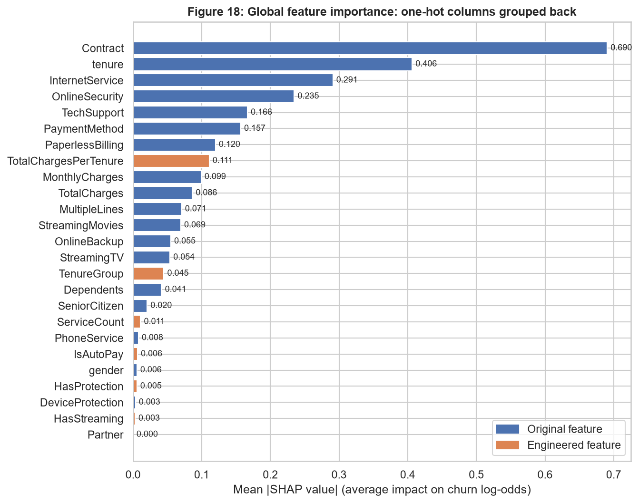
Contract, not price, is the biggest churn driver
7x
Contract's SHAP impact vs MonthlyCharges (3.3x vs all price features)
Month-to-month multiplies churn odds by 1.6, while a two-year contract cuts them to 0.28x
Price only adds risk on bills above about $90
Partner gets zero attribution: a proxy, not a cause
Notes:
SHAP answers the brief's key question directly. Contract type has about seven times the impact of the monthly charge. A blanket price cut would address the smaller problem; longer contracts address the bigger one.

Slide 11
Who is at risk: month-to-month fiber customers
2,004
customers flagged (28.5% of the base)
81%
of them are month-to-month fiber customers
$1.9M
annual revenue in the flagged group
Notes:
Every customer was scored without leakage: out-of-fold scores for training customers, test scores for test customers. The flagged group is highly concentrated, which makes the retention strategy simple to target.

Slide 12
Recommendations
De-risked*
Contract-conversion offer
77%
1
Discounted 1-year contract for flagged month-to-month customers, fiber first
Fiber protection bundle
46%
2
Online Security + Tech Support free for 6 months
Auto-pay incentive
24%
3
Small credit for switching from electronic check
First-year onboarding
-
4
Check-ins at months 1, 3 and 6 for new customers
*Share of high-risk test customers the model no longer flags after the change. Model-based estimate, to be confirmed with an A/B test.
Notes:
Contract conversion is by far the strongest lever. Also recommended: investigate the fiber product itself, since fiber churns more even after controlling for price, and avoid blanket price cuts.

Slide 13
Conclusion & next steps
XGBoost flags at-risk customers with AUC 0.85 and explains every score with SHAP
Lock in month-to-month fiber customers with longer contracts and protection bundles
Next: A/B-test the offers, add usage and support data, and score customers monthly
Notes:
Summarise: the model works, the drivers are clear, and the recommendations are actionable. Main limitation: the lever estimates are model-based and need an experiment to confirm.

