Slide 1
Linked List in Data
Structure
By
PRATHIMA G

Slide 2
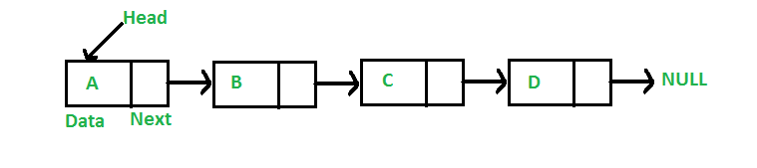
Linked List
◆ Like arrays, Linked List is a linear data structure. Unlike arrays, linked list elements are not stored at contiguous location; the elements are linked using pointers.
◆ Why Linked List?
Arrays can be used to store linear data of similar types, but arrays have following limitations.
The size of the arrays is fixed: So we must know the upper limit on the number of elements in advance. Also, generally, the allocated memory is equal to the upper limit irrespective of the usage.
Inserting a new element in an array of elements is expensive, because room has to be created for the new elements and to create room existing elements
have to shifted.
2

Slide 3
For example, in a system if we maintain a sorted list of IDs in an array id[].
id[] = [1000, 1010, 1050, 2000, 2040].
And if we want to insert a new ID 1005, then to maintain the sorted order, we have to move all the elements after 1000 (excluding 1000).
Deletion is also expensive with arrays until unless some special techniques are used.
For example, to delete 1010 in id[], everything after 1010 has to
be moved.

Slide 4
Advantages Linked List over arrays
Dynamic size
Ease of insertion/deletion
Drawbacks of Linked List:
Random access is not allowed. We have to access elements sequentially starting from the first node. So we cannot do binary search with linked lists.
Extra memory space for a pointer is required with each
element of the list.

Slide 5
Representation of Linked List in C:
A linked list is represented by a pointer to the first node of the linked list.
The first node is called head. If the linked list is empty, then value of head is NULL.
Each node in a list consists of at least two parts:
data
pointer to the next node
Data
Address of Next Node
In C, we can represent a node using structures. Below is an example of a linked list node with an integer data.
In C#/Java, LinkedList can be represented as a class and a Node as a separate class. The LinkedList class contains a reference of Node class type.
Write C Program to Create Linked List.
Data Data
Data Address of Next Node
Address of Next Node Address of Next Node
40
2000
50
3000
60 NULL
5
Address of Head Node
0x1000
0x2000
0x3000
Address of Last Node is NULL

Slide 6
Implementation of Linked List –
Structure is used to define a node.
Node is Collection of Data and Address to Next Node.
Address of Next Node can be Stored in pointer type variable.
Ex.
Memory Allocation for node using malloc()
typedef struct node
{
int data;
struct node *next;
}node;
It is Self Referential Structure in C.
Function-
node *p;
p=(node *)malloc(sizeof(node));
p->data=40;
p->next=NULL;
data
Next address
40
NULL
p
It is Assumed that, type of data stored in each node is of integer type.
In C Programming, Memory can be acquired through use of standard library functions malloc() and calloc() from stdlib.h header file.
To Free Memory aquired, free(address) function is used.

Slide 7
// A simple C program to introduce a linked list
#include<stdio.h>
head->data = 1; //assign data in first node
#include<stdlib.h> //calloc/malloc/free
head->next = second; // Link first node with the second node
struct Node
{
int data;
struct Node *next;
};
/* data has been assigned to data part of first block (block pointed by head). And next pointer of first block points
second. So they both are linked.
to
head
|
|
+---+---+
second
|
|
+----+----+
third
|
|
+-----+----+
// Program to create a simple linked
// list with 3 nodes
int main()
{
struct Node* head = NULL; struct Node* second = NULL; struct Node* third = NULL;
| 1 | o----->| #
| # |
|
# | # |
+---+---+ +----+----+
+-----+----+
*/
second->data = 2; //assign data to second node
second->next = third; // Link second node with the third node
third->data = 3; //assign data to third node
third->next = NULL;
// allocate 3 nodes in the heap
head = (struct Node*)malloc(sizeof(struct Node)); second = (struct Node*)malloc(sizeof(struct Node));
third = (struct Node*)malloc(sizeof(struct Node));
return 0;
}

Slide 8
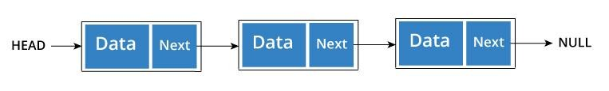
Types of Linked List
There are three common types of Linked List.
◆ Singly Linked List
◆ Doubly Linked List
◆ Circular Linked List
Singly Linked List
◆ It is the most common. Each node has data and a pointer to the next node.
typedef struct node
{
int data;
struct node *next;
Node Representation
in singly Linked List
}node;
8

Slide 9
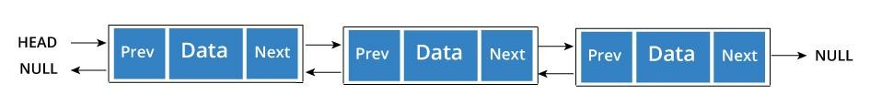
Doubly Linked List
◆ We add a pointer to the previous node in a doubly linked list. Thus, we can go in either direction: forward or backward.
typedef struct node
{
int data;
struct node *next; struct node *prev;
}node;
Node Representation in doubly Linked List
9

Slide 10
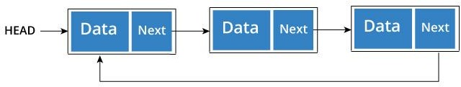
Circular Linked List
◆ A circular linked list is a variation of linked list in which the last element is linked to the first element. This forms a circular loop.
typedef struct node
{
int data;
struct node *next;
}node;
Node Representation in Circular Linked List
A circular linked list can be either singly linked or doubly linked.
for Circular singly linked list, next pointer of last item points to the first item
In Circular doubly linked list, prev pointer of first item points to last item10 as well.

Slide 11
Basic Linked List Operations
We can treat linked list as an abstract data type and perform following basic
operations.
Creating Linked List
Traversing Linked List
Printing Linked List
Counting Number of Nodes in Linked List
Searching Element in Linked List
Concatenating two Linked List
Inserting element into Linked List (Start, end and Specific Position)
Deleting elements from Linked List (Start, End and Specific Position)
And Many more operations.
11

Slide 12
1. Creating Linked List
Linked List is Created using Dynamic Memory Allocation
In Following Create Function is Used to Create the Linked List. It return address of Memory block reserved with size node to main function.
Variable HEAD, head, p are having storage class as node *. It can store address of node that has been created dynamically.
sizeof(node) indicates storage requirement to store a node.
malloc(sizeof(node)) returns the address of allocated memory block and it is
assigned to variable head;
If head==NULL, it means memory block not reserved hence linked list empty.
Type casting operator (node *) used before malloc tells memory block of size node.
Write a c program to create Linked list with user defined no of nodes.
12

Slide 13
typedef struct node
{
int data;
struct node *next;
}node;
node *create (int n);
void main()
{
int n, i;
node *HEAD;
clrscr();
HEAD->next=NULL;
// Create Node using structure
node *create(int n)
{
node *p, *head;
int i;
head=(node *)malloc(sizeof(node)); head->next=NULL;
printf(“\n\t Enter Data1:”);
scanf(“%d”,&(head->data));
p=head;
// For Remaining Nodes
for(i=1;i<n;i++)
{
// 1st node
// Main Function
p->next=(node *)malloc(sizeof(node)); p=p->next;
printf(“\n\t Enter Data%d:”,i+1); scanf(“%d”,&(p->data));
p->next=NULL;
// Linked List Empty
printf(“\n\t No. of Items:”); scanf(“%d”,&n); HEAD=create(n);
printf(“\n\t LL Created from Address : %u”, HEAD); getch();
}
return head;
}
13
}

Slide 14
2. Traversing Linked List
40
2000
50
3000
60
NULL
HEAD= 0x1000 0x2000 0x3000
Address of Last Node is NULL
Traversal of Linked list always starts with First Node.
Initially pointer type variable is assigned to First Node(HEAD).
p= HEAD;
In order to travel linked list in the forward direction, pointer is traversed through all the nodes.
Stop at node where address for next gets as NULL.
p=HEAD;
while(p!=NULL) p=p->next;
14

Slide 15
3. Counting Number of Nodes in Linked List
40
2000
50
3000
60
NULL
HEAD= 0x1000 0x2000 0x3000
Address of Last Node is NULL
Take 1 variable, initialize to 0 (ex. count=0)
Traverse the linked list from start node to last node and for each node do
count++.
int count (node *p)
{
int count=0; while(p!=NULL)
{
count=count+1; p=p->next;
}
return(count);
15
}

Slide 16
4. Print all the Nodes from List
40
2000
50
3000
60
NULL
HEAD= 0x1000 0x2000 0x3000
Address of Last Node is NULL
Traverse the linked list from start node to last node and print each node.
Below function traverse entire linked list and while traversing it prints integer
data stored in the node.
void print(node *p)
{
while(p!=NULL)
{
printf(“<- %d ->”,p->data); p=p->next;
}
}
16

Slide 17
5. Search Node in Linked List
40
2000
50
3000
60
NULL
HEAD= 0x1000 0x2000 0x3000
Address of Last Node is NULL
In order to search an element in linked list, we start traversing the from first node.
Traversal ends with success if element found(1), if not it ends with failure (0).
Below function search the entire linked list for specific element, if it is found it returns 1 else 0.
int search(node *p, int x)
{
while(p!=NULL)
{
if(p->data==x) return(1);
p=p->next;
}
return(0);
}
17

Slide 18
6. Concatenating two Linked Lists.
HEAD1
HEAD2
40
2000
50
3000
60
NULL
40
2000
50
3000
60
NULL
1000
2000
Linked List1
3000
3500
2500
Linked List 2
1500
Lets Assume 2 linked list with 2 different heads- HEAD1 and HEAD2
If First Linked List is Empty, return HEAD2
If Second Linked List is Empty, return HEAD1
Store the address of HEAD1 in Pointer variable, say p.
Start Traversing first linked list and go to last node whose address field is NULL and Replace that NULL as HEAD2.
Return HEAD1
HEAD
40
2000
50
3000
60
3500
40
2000
50
3000
60
NULL
1000
2000
3000
3500
2500
18
1500
Concatenated Linked List

Slide 19
HEAD1
HEAD2
40
2000
50
3000
60
NULL
40
2000
50
3000
60
NULL
1000
2000
Linked List1
3000
3500
2500
Linked List 2
1500
node *concatenate(node *head1, node * head2)
{
node *p; if(HEAD1==NULL)
return HEAD2;
if(HEAD2==NULL)
return HEAD1; p=HEAD1;
while(p!=NULL)
p=p->next;
p->next=HEAD2;
return HEAD1;
}
19

Slide 20
7. Insertion into Linked List
HEAD=1000
2000
3000
40
2000
50
3000
60
NULL
Insertion of new item, say x into Linked List has following 3 situations:
Insertion at the front of Linked List (Before First Node)
Insertion at the end of Linked List (After Last Node)
Insertion at Specific Position (Middle) of Linked List
1. Algorithm for Placing new item at the front (Beginning) of Linked List
Obtain a space for New Node
Assign data to data field of new node
Set the next field of new node to HEAD / Beginning of linked list.
set New HEAD as address of new node
20

Slide 21
1. Algorithm for Placing new item at the front (Beginning) of Linked List
HEAD=0500
0500 1000
2000
3000
X
1000
40
2000
50
3000
60
NULL
node *insert_beg(node *head, int x)
{
node *p;
p=(node *)malloc(sizeof(node)); p->data=x;
p->next=head;
head=p; return head;
}
21

Slide 22
2. Algorithm for Placing new item at the end of Linked List
1. Obtain a space for New Node. Take node *p, *q; p= (node *)malloc(sizeof(node));
Assign data to data field of new node
Set the next field to NULL.
If head==NULL, return p.
p->data=x;
p->next=NULL;
5. Else do q=head and Traverse the list to last node copy q=p; and return head;
node *insert_end(node *head, int x)
{
node *p, *q;
p=(node *)malloc(sizeof(node)); p->data=x;
p->next=NULL; if(head==NULL);
return p;
q=head;
while(q!=NULL)
{
q=q->next;
}
q->next=p; return head;
}
22

Slide 23
3. Algorithm for Placing new item at given specific location of Linked List
1. Obtain a space for New Node. Take node *p, *q; p= (node *)malloc(sizeof(node));
Assign data to data field of new node
Set the next field to NULL.
p->data=x;
P->next=NULL;
Set q= head and go to Position a pointer to loc-1 node using q pointer.
Set p->next= q->next
Set q->next=p;
Stop
node *insert_loc(node *head, int x, int loc)
for(i=1;i<(loc-1);i++)
{
if(q!=NULL)
q=q->next;
}
p->next=q->next;
q->next=p; return head;
{ node *p, *q; int i;
p=(node *)malloc(sizeof(node));
p->data=x;
p->next=NULL; q=head;
23
}

Slide 24
8. Deletion of item from Linked List
HEAD=1000
2000
3000
40
2000
50
3000
60
NULL
deletion of item is even easier than insertion, as only one pointer needs to change. It
has following 3 situations:
Deletion the first item
Deleting the Last Item
Deleting from the Middle of List
1. Algorithm for Deleting First Item from Linked List
Store the address of First Node(HEAD) into Pointer variable, say p
Move HEAD to the Next Node
Free the node whose address is stored in pointer p.
set New HEAD as address of new node
24

Slide 25
1. Algorithm for Deleting First Item from Linked List
HEAD=0500
0500 1000
2000
3000
X
1000
40
2000
50
3000
60
NULL
node *delete_beg(node *head, int x)
{
node *p; if(x==head->data) {
p=head;
head=head->next; free(p);
}
return head;
}
// x item to be deleted
25

Slide 26
2. Algorithm for Deleting Middle Node from Linked List
HEAD=0500
0500 1000
2000
3000
X
1000
40
2000
50
3000
60
NULL
Store the address of preceding node into Pointer variable, say p. Node to be
deleted is marked as key node, say q.
Store the Address of Key node in pointer variable, say q so that it can be freed later on.
Mark the Successor of Key node as a successor of the node pointed by p.
Free q.
26

Slide 27
3. Algorithm for Last Node from Linked List
HEAD=0500
0500 1000
2000
3000
X
1000
40
2000
50
3000
60
NULL
1. If the First node itself is last node then make the linked list empty.
If(head->next==NULL)
q=q->next;
}
Delete the last node. p=q->next;
free(p);
q->next=NULL;
Stop
{ free(head);
HEAD=NULL; goto step 4;
}
2. Otherwise, position pointer q on second
last node.
q=head;
while(q->next!=NULL)
{
27

Slide 28

Circular Linked List
Circular Linked List is a variation of Linked list, in which last node is connected back to first node.
Both Singly Linked List and Doubly Linked List can be made into a circular linked list.
Queue Data Structure can be implemented using Circular Linked lIst.
Singly Linked List as Circular
In singly linked list, the next pointer of the last node points to the first node.

Slide 29

Doubly Linked List as Circular
In doubly linked list, the next pointer of the last node points to the first node and the previous pointer of the first node points to the last node making the circular in both directions.
As per the above illustration, following are the important points to be considered.
The last node's next field points to the first node of the list in both cases of singly as well as doubly linked list.
The first node's previous points to the last node of the list in case of doubly linked list.

Slide 30
Basic Operations on Circular Linked List
Following are the important operations supported by a circular list.
insert − Inserts an element at the start of the list.
delete − Deletes an element from the start of the list.
display − Displays the list.

Slide 31
Create Circular Linked List
#include<stdio.h> #include<conio.h> typedef struct cnode
{
int data;
struct cnode *next;
}cnode;
cnode *insert_cll_end(cnode *h);
cnode *create_cll(int n); void display_cll(cnode *h); void main()
{
cnode *HEAD; int n,i;
clrscr();
printf("\n\t Enter Number of Nodes:"); scanf("%d",&n);
HEAD=create_cll(n);
printf("\n\tCircular linked list is created with start= %u",HEAD);
getch(); display_cll(HEAD); getch();
HEAD=insert_cll_end(HEAD); getch();
display_cll(HEAD);
getch();
}
31

Slide 32
cnode *create_cll(int n)
{
int i;
cnode *h,*p; // creating 1st node h=(cnode *)malloc(sizeof(cnode)); printf("\n\t Enter Data1:"); scanf("%d",&(h->data));
h->next=h; p=h;
for(i=1;i<n;i++) // For reminaing Nodes;
{
p->next=(cnode
*)malloc(sizeof(cnode));
p=p->next;
printf("\n\t Enter Data%d:",i+1); scanf("%d",&(p->data));
p->next=h;
}
return h;
}
void display_cll(cnode *h)
{
cnode*p; p=h;
printf("\n");
while(p->next!=h)
{
printf("\t%d(%u):%u",p->data,p,p->next); p=p->next;
}
printf("\t%d(%u):%u",p->data,p,p->next);
}
32

Slide 33
cnode *insert_cll_end(cnode *h)
{
cnode *p; p=h;
while(p->next!=h)
{
p=p->next;
}
p->next=(cnode *)malloc(sizeof(cnode)); p=p->next;
printf("\n\t Enter Data to insert at end:");
scanf("%d",&(p->data)); p->next=h;
return h;
}
33

Slide 34

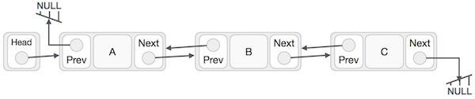
Doubly Linked List
In Singly Linked list, we can easily move in the direction of link.
Finding a node, preceding any node is time consuming process. The only way to find preceding node is by starting at beginning of the list.
Solution is Doubly Linked List.
Each node has two address fields, one to point address of next element and one to point address of previous element.
Node is Doubly Linked list has 3 fields
data, prev and next

Slide 35
Doubly Linked List
Advantages of DLL over SLL
A DLL can be traversed in both forward and backward direction.
The delete operation in DLL is more efficient if pointer to the node to be deleted is given. In DLL, to delete a node, pointer to the previous node is needed. To get this previous node, sometimes the list is traversed. In DLL, we can get the previous node using previous pointer.
Disadvantages of DLL over SLL
Every node of DLL Require extra space for an previous pointer.
All operations require an extra pointer previous to be maintained. For example, in insertion, we need to modify previous pointers together with next pointers.
http://www.sitcoe.org.in

Slide 36

Doubly Linked List
☀ In double linked list, the first node must be always pointed by head.
☀ Always the previous field of the first node must be NULL.
☀ Always the next field of the last node must be NULL.
Node Representation –
typedef struct dnode
{
int data;
struct node *prev; struct node *next;
}dnode;
36

Slide 37
Doubly Linked List
Operations
In a double linked list, we perform the following operations...
◆ Insertion
◆ Deletion
◆ Display
Insertion
In a double linked list, the insertion operation can be performed in three ways as follows...
◆ Inserting At Beginning of the list
◆ Inserting At End of the list
◆ Inserting At Specific location in the list

Slide 38
Doubly Linked List
Inserting At Beginning of the list
We can use the following steps to insert a new node at beginning of the double linked list...
◆ Step 1: Create a newNode with given value and newNode → previous
as NULL.
◆ Step 2: Check whether list is Empty (head == NULL)
◆ Step 3: If it is Empty then, assign NULL to newNode → next and
newNode to head.
◆ Step 4: If it is not Empty then, assign head to newNode → next and
newNode to head.

Slide 39
Doubly Linked List
Inserting At End of the list
We can use the following steps to insert a new node at end of the double linked list...
◆ Step 1: Create a newNode with given value and newNode → next as NULL.
◆ Step 2: Check whether list is Empty (head == NULL)
◆ Step 3: If it is Empty, then assign NULL to newNode → previous and
newNode to head.
◆ Step 4: If it is not Empty, then, define a node pointer temp and initialize with head.
◆ Step 5: Keep moving the temp to its next node until it reaches to the last node in the list (until temp → next is equal to NULL).
◆ Step 6: Assign newNode to temp → next and temp to newNode → previous.

Slide 40
Doubly Linked List
Inserting At Specific location in the list (After a Node)
We can use the following steps to insert a new node after a node in the double linked list...
◆ Step 1: Create a newNode with given value.
◆ Step 2: Check whether list is Empty (head == NULL)
◆ Step 3: If it is Empty then, assign NULL to newNode → previous & newNode → next and
newNode to head.
◆ Step 4: If it is not Empty then, define two node pointers temp1 & temp2 and initialize
temp1 with head.
◆ Step 5: Keep moving the temp1 to its next node until it reaches to the node after which we want to insert the newNode (until temp1 → data is equal to location, here location is the node value after which we want to insert the newNode).
◆ Step 6: Every time check whether temp1 is reached to the last node. If it is reached to the last node then display 'Given node is not found in the list!!! Insertion not possible!!!' and terminate the function. Otherwise move the temp1 to next node.
◆ Step 7: Assign temp1 → next to temp2, newNode to temp1 → next, temp1 to newNode
→ previous, temp2 to newNode → next and newNode to temp2 → previous.

Slide 41
Doubly Linked List
Deletion
In a double linked list, the deletion operation can be performed in three ways as follows...
◆ Deleting from Beginning of the list
◆ Deleting from End of the list
◆ Deleting a Specific Node
Deleting from Beginning of the list
◆ We can use the following steps to delete a node from beginning of the double linked list...
◆ Step 1: Check whether list is Empty (head == NULL)
◆ Step 2: If it is Empty then, display 'List is Empty!!! Deletion is not possible' and
terminate the function.
◆ Step 3: If it is not Empty then, define a Node pointer 'temp' and initialize with head.
◆ Step 4: Check whether list is having only one node (temp → previous is equal to temp →
next)
◆ Step 5: If it is TRUE, then set head to NULL and delete temp (Setting Empty list conditions)
◆ Step 6: If it is FALSE, then assign temp → next to head, NULL to head → previous and
41

Slide 42
Doubly Linked List
Deleting from End of the list
We can use the following steps to delete a node from end of the double linked list...
◆ Step 1: Check whether list is Empty (head == NULL)
◆ Step 2: If it is Empty, then display 'List is Empty!!! Deletion is not possible' and
terminate the function.
◆ Step 3: If it is not Empty then, define a Node pointer 'temp' and initialize with
head.
◆ Step 4: Check whether list has only one Node (temp → previous and temp →
next both are NULL)
◆ Step 5: If it is TRUE, then assign NULL to head and delete temp. And terminate from the function. (Setting Empty list condition)
◆ Step 6: If it is FALSE, then keep moving temp until it reaches to the last node in the list. (until temp → next is equal to NULL)
◆ Step 7: Assign NULL to temp → previous → next and delete temp⁴² .

Slide 43
Doubly Linked List
Deleting a Specific Node from the list
We can use the following steps to delete a specific node from the double linked list...
◆ Step 1: Check whether list is Empty (head == NULL)
◆ Step 2: If it is Empty then, display 'List is Empty!!! Deletion is not possible' and terminate the function.
◆ Step 3: If it is not Empty, then define a Node pointer 'temp' and initialize with head.
◆ Step 4: Keep moving the temp until it reaches to the exact node to be deleted or to the last node.
◆ Step 5: If it is reached to the last node, then display 'Given node not found in the list! Deletion not possible!!!' and terminate the fuction.
◆ Step 6: If it is reached to the exact node which we want to delete, then check whether list is having only one node or not

Slide 44

Doubly Linked List
Step 7: If list has only one node and that is the node which is to be deleted then set head to NULL and delete temp (free(temp)).
Step 8: If list contains multiple nodes, then check whether temp is the first node in the list (temp == head).
Step 9: If temp is the first node, then move the head to the next node (head = head → next), set head of previous to NULL (head → previous = NULL) and delete temp.
Step 10: If temp is not the first node, then check whether it is the last node in the list (temp
→ next == NULL).
Step 11: If temp is the last node then set temp of previous of next to NULL (temp → previous
→ next = NULL) and delete temp (free(temp)).
Step 12: If temp is not the first node and not the last node, then set temp of previous of next to temp of next (temp → previous → next = temp → next), temp of next of previous to temp of previous (temp → next → previous = temp → previous) and delete temp (free(temp)).

Slide 45
Doubly Linked List
Displaying a Double Linked List
We can use the following steps to display the elements of a double linked list...
◆ Step 1: Check whether list is Empty (head == NULL)
◆ Step 2: If it is Empty, then display 'List is Empty!!!' and terminate the function.
◆ Step 3: If it is not Empty, then define a Node pointer 'temp' and initialize with head.
◆ Step 4: Display 'NULL <--- '.
◆ Step 5: Keep displaying temp → data with an arrow (<===>) until temp reaches to the
last node
◆ Step 6: Finally, display temp → data with arrow pointing to NULL (temp → data ---> NULL).

Slide 46

Applications of Linked List
Linked list are frequently used to implement other data structures like tree, graphs and heaps.
Linked can be used to create dynamic stack and queue which can grow and shrink at run time.
Linked list can used to store and process the polynomials.
Coefficient and power stored as data and link pointer points to next term in the polynomial.
Linked list are normally implemented using pointers. Some Languages does not support pointer like Visual Basic, Fortran etc. In these Array is used to implement LL.
46

Slide 47
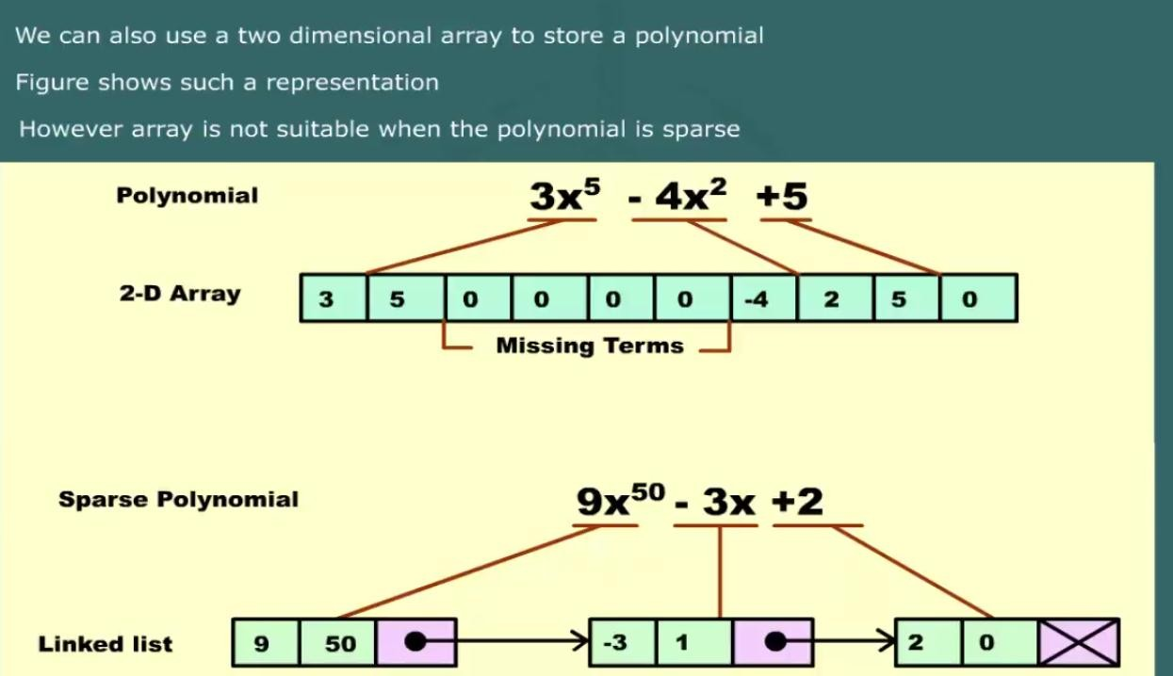
Applications of Linked List
47
http://www.sitcoe.org.in

Slide 48
How to Implement Stack using Linked List
The major problem with the stack implemented using array is, it works only for fixed number of data values.
That means the amount of data must be specified at the beginning of the implementation itself.
Stack implemented using array is not suitable, when we don't know the size of data which we are going to use.
A stack data structure can be implemented by using linked list data structure. The stack
implemented using linked list can work for unlimited number of values.
That means, stack implemented using linked list works for variable size of data. So, there is no need to fix the size at the beginning of the implementation.
The Stack implemented using linked list can organize as many data values as we want.
http://www.sitcoe.org.in

Slide 49
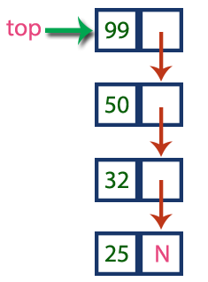
How to Implement Stack using Linked List
In linked list implementation of a stack, every new element is inserted as 'top' element. That means every newly inserted element is pointed by 'top'.
Whenever we want to remove an element from the stack, simply remove the node which is pointed by 'top' by moving 'top' to its next node in the list.
The next field of the first element must be always NULL.
In above example, the last inserted node is 99 and the first inserted node is 25.
The order of elements inserted is 25, 32,50 and 99.
http://www.sitcoe.org.in

Slide 50
How to Implement Stack using Linked List
Operations
To implement stack using linked list, we need to set the following things before implementing actual operations.
◆ Step 1: Include all the header files which are used in the program. And
declare all the user defined functions.
◆ Step 2: Define a 'Node' structure with two members data and next.
◆ Step 3: Define a Node pointer 'top' and set it to NULL.
◆ Step 4: Implement the main method by displaying Menu with list of operations and make suitable function calls in the main method.
http://www.sitcoe.org.in

Slide 51
How to Implement Stack using Linked List
push(value) - Inserting an element into the Stack
We can use the following steps to insert a new node into the stack...
◆ Step 1: Create a newNode with given value.
◆ Step 2: Check whether stack is Empty (top == NULL)
◆ Step 3: If it is Empty, then set newNode → next = NULL.
◆ Step 4: If it is Not Empty, then set newNode → next = top.
◆ Step 5: Finally, set top = newNode.
pop() - Deleting an Element from a Stack
We can use the following steps to delete a node from the stack...
◆ Step 1: Check whether stack is Empty (top == NULL).
◆ Step 2: If it is Empty, then display "Stack is Empty!!! Deletion is not possible!!!"
and terminate the function
◆ Step 3: If it is Not Empty, then define a Node pointer 'temp' and set it to 'top'.
◆ Step 4: Then set 'top = top → next'.
◆ Step 7: Finally, delete 'temp' (free(temp)).
51
http://www.sitcoe.org.in

Slide 52
How to Implement Stack using Linked List
display() - Displaying stack of elements
We can use the following steps to display the elements (nodes) of a stack...
◆ Step 1: Check whether stack is Empty (top == NULL).
◆ Step 2: If it is Empty, then display 'Stack is Empty!!!' and terminate the function.
◆ Step 3: If it is Not Empty, then define a Node pointer 'temp' and initialize with top.
◆ Step 4: Display 'temp → data --->' and move it to the next node. Repeat the same until temp reaches to the first node in the stack (temp → next
!= NULL).
◆ Step 4: Finally! Display 'temp → data ---> NULL'.
52
http://www.sitcoe.org.in

Slide 53
How to Implement Stack using Linked List
#include<conio.h> #include<stdio.h> struct Node
{
int data;
struct Node *next;
}*top = NULL; void push(int); void pop(); void display(); void main()
{
int choice, value;
clrscr();
printf("\n:: Stack using Linked List
::\n");
while(1){
printf("\n****** MENU ******\n");
printf("1. Push\n2. Pop\n3. Display\n4. Exit\n"); printf("Enter your choice: "); scanf("%d",&choice);
switch(choice){
case 1: printf("Enter the value to be insert: ");
scanf("%d", &value); push(value);
break;
case 2: pop(); break; case 3: display(); break; case 4: exit(0);
default: printf("\nWrong selection!!!
Please try again!!!\n");
}
}
}
org.in
53
http://www.sitcoe.

Slide 54
How to Implement Stack using Linked List
void push(int value)
{
struct Node *p;
p = (struct Node*)malloc(sizeof(struct Node));
p->data = value; if(top == NULL)
p->next = NULL;
else
p->next = top; top = p;
printf("\nInsertion is Success!!!\n");
}
void pop()
{
if(top == NULL)
{
printf("\nStack is Empty!!!\n");
}
else
{
struct Node *temp = top; printf("\nDeleted element: %d",
temp->data);
top = temp->next; free(temp);
}
}
54
http://www.sitcoe.org.in

Slide 55
void display()
{
if(top == NULL)
printf("\nStack is Empty!!!\n"); else{
struct Node *p = top; while(p->next != NULL){ printf("%d--->",p->data); p = p-> next;
}
printf("%d--->NULL",p->data);
}

Slide 56

How to Implement Queue using Linked List
The major problem with the queue implemented using array is, It will work for only fixed
number of data.
That means, the amount of data must be specified in the beginning itself.
Queue using array is not suitable when we don't know the size of data which we are going to
use. A queue data structure can be implemented using linked list data structure.
The queue which is implemented using linked list can work for unlimited number of values. That means, queue using linked list can work for variable size of data (No need to fix the size at beginning of the implementation).
The Queue implemented using linked list can organize as many data values as we want.
In linked list implementation of a queue, the last inserted node is always pointed by 'rear' and the first node is always pointed by 'front'.
In above example, the last inserted node is 50 and it is pointed by 'rear' and the first inserted node is 10 and it is pointed by 'front'. The order of elements inserted is 10, 15, 22 and 50.

Slide 57
How to Implement Queue using Linked List
Operations
To implement queue using linked list, we need to set the following things before implementing actual operations.
◆ Step 1: Include all the header files which are used in the program. And declare all the
user defined functions.
◆ Step 2: Define a 'Node' structure with two members data and next.
◆ Step 3: Define two Node pointers 'front' and 'rear' and set both to NULL.
◆ Step 4: Implement the main method by displaying Menu of list of operations and make suitable function calls in the main method to perform user selected operation.
enQueue(value) - Inserting an element into the Queue
◆ We can use the following steps to insert a new node into the queue...
◆ Step 1: Create a newNode with given value and set 'newNode → next' to NULL.
◆ Step 2: Check whether queue is Empty (rear == NULL)
◆ Step 3: If it is Empty then, set front = newNode and rear = newNode.
◆ Step 4: If it is Not Empty then, set rear → next = newNode and rear = newNode.

Slide 58
How to Implement Queue using Linked List
deQueue() - Deleting an Element from Queue
We can use the following steps to delete a node from the queue...
◆ Step 1: Check whether queue is Empty (front == NULL).
◆ Step 2: If it is Empty, then display "Queue is Empty!!! Deletion is not possible!!!" and
terminate from the function
◆ Step 3: If it is Not Empty then, define a Node pointer 'temp' and set it to 'front'.
◆ Step 4: Then set 'front = front → next' and delete 'temp' (free(temp)).
display() - Displaying the elements of Queue
We can use the following steps to display the elements (nodes) of a queue...
◆ Step 1: Check whether queue is Empty (front == NULL).
◆ Step 2: If it is Empty then, display 'Queue is Empty!!!' and terminate the function.
◆ Step 3: If it is Not Empty then, define a Node pointer 'temp' and initialize with front.
◆ Step 4: Display 'temp → data --->' and move it to the next node. Repeat the same until 'temp' reaches to 'rear' (temp → next != NULL).
◆ Step 4: Finally! Display 'temp → data ---> NULL'. 58 Do Program

