Slide 1
CompressIt
A file compression program for comparing Huffman and LZW algorithm.
Gitlab: https://gitlab.com/Sairajkodilkar/filecompression.git

Slide 2
Aim
Finding runtime as well as compression ratio of Huffman and LZW algorithm and comparing them
Determining for which data these algorithms are effective.

Slide 3
Huffman Algorithm
A lossless compression algorithm.
Based on the knowledge of source statistics.
Symbol that occur more frequently will have shorter codewords than symbol that occur less frequently.
Canonical Huffman codes for smaller size of compressed file header.

Slide 4
How Huffman encoder works.
Two passes over the file
First pass to count frequency of each character in file.
Builds Huffman tree using heap/priority queue of symbols.
All symbols are the leaves of the Huffman tree, more frequent symbols are closer to the root.
Huffman codes are generated using Huffman tree.
Canonical Huffman codes are generated where code for each symbol depends on count of length of each code.
Writes code length count to the compressed file.
Second pass over the file which actually compresses the file using canonical Huffman code.

Slide 5
How Huffman decoder works
Reads the codelength count from compressed file header.
Generates canonical Huffman code from it
Builds Huffman tree using canonical Huffman code
Read file bit by bit and decodes it by traversing canonical Huffman codes.

Slide 6
Time Complexity of Huffman encoder
Encoder first builds the symbol table which contains the characters with their frequency using first pass on the file which is done in O(n).
then encoder builds the priority queue with the given symbol table Now the time complexity of priority queue is O(ch log(ch)), since ch is constant (256) for algorithm hence we building priority queue can be considered as O(1).
Huffman tree is build using priority queue with O(ch log(ch))
log(ch): for extracting from queue and again for inserting
ch : since above operation is done till queue is empty
But This can also be considered as O(1) since ch is constant.
Traversing the Huffman tree is simply preorder traversal of tree with 256 max nodes, here also time complexity is O(ch) i.e. O(1) as nodes remains constant.
Generation of canonical Huffman tree is done in O(ch) time. hence here time complexity is O(1).
While writing Huffman codes input file is traversed again and corresponding code is outputted to the output file hence time complexity is O(n).
Hence total time complexity of encoder is = O(n) + 4 * O(1) + O(n) = O(n)

Slide 7
Time Complexity ofHuffman Decoder
All steps in encoder are just in different order for decoder Hence time complexity for decoder is also O(n).

Slide 8
LZW algorithm
Dictionary based algorithm.
Once the new pattern is discovered in the input file it is stored with a unique index in the file.
Whenever pattern in the dictionary is found it outputs corresponding 2 byte index to the compressed file.
This algorithm is adaptive to but memory usage is higher than Huffman.

Slide 9
How LZW encoder works
Encoder uses trie data structure to store string with its index.
Initializes the trie with 0 – 256 characters with index 0 – 256.
When reading the file LZW matches the pattern sequentially, when the pattern has a match in dictionary LZW read next character and stops when match is not found, It the outputs last matched pattern index to the compressed file.

Slide 10
How LZW decoder works
Decoder uses Hash table to store string with its index.
Initializes the Hash table with 0 – 256 characters with index 0 – 256.
Reads the 2 byte index from input file, decodes it using hash table.
Adds new entry to the hash table concatenating previously decoded string and first character of newly decoded string.

Slide 11
Time complexity of LZW encoder
In LZW encoder all lines till while loop take constant time, hence time complexity is O(1).
In while loop modified Trie data structure is used. which takes O(1) time to insert and simultaneouly returns the match status. since this operations are done n time hence time complexity of while loop is O(n)
Hence Total time complexity is O(n) = O(1) + O(n).

Slide 12
Time complexity of LZW decoder
In LZW decoder all lines till while loop takes constant time.
In decoder LZW uses hash table for storing strings by key which takes average time of O(m / α) for insert or lookup. where m is total entries in hash table and α is number of slots in hash table. since for worst case lookup and insert both might be done in every iteration hence time complexity is O(n * (m / α)).
Hence total time complexity is O(n * (m / α)) = O(1) + O(n * (m / α))

Slide 13
Data structures
Huffman encoder and decoder both uses binary tree for building Huffman tree and heap for priority queue.
LZW encoder uses modified trie data structure which uses static variable to match the string character by character. This modification helps LZW algorithm as each time new character is read we don’t have to match the string from start. Read DATASTRUCTURE.md for more details
LZW decoder uses hashing with chaining, The average time for such hash table is O(m / α) ,where m is total number entries in hash table.

Slide 14
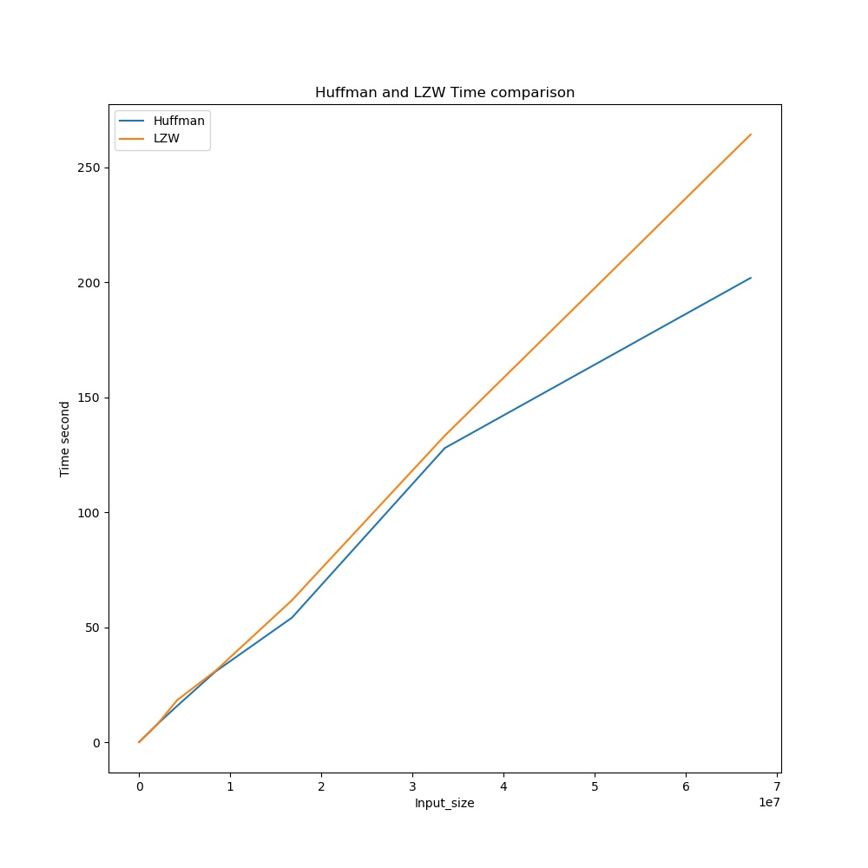
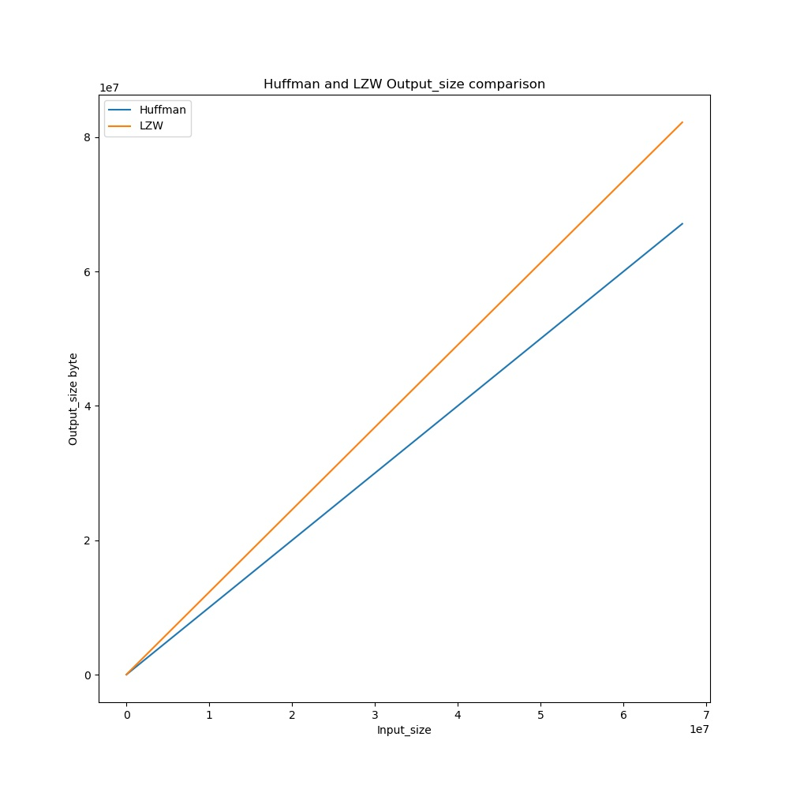
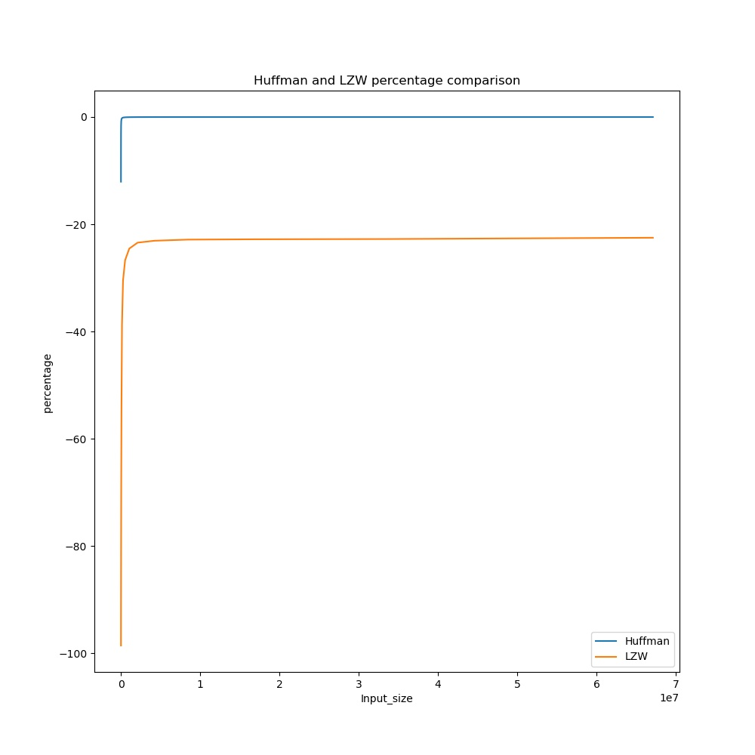
Results for random data

Slide 15
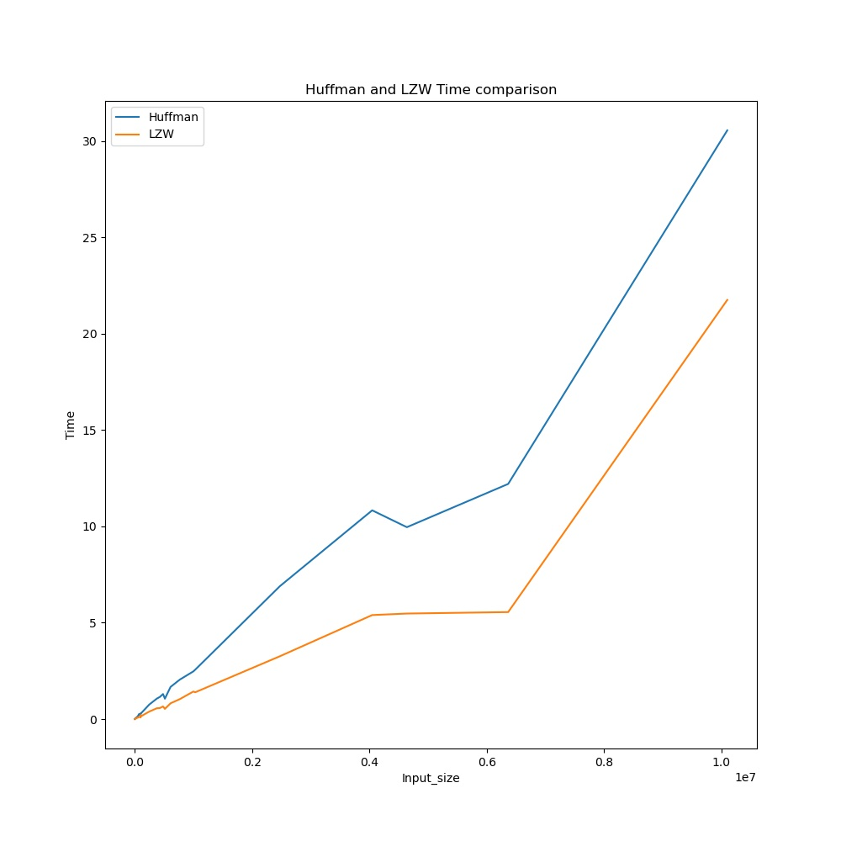
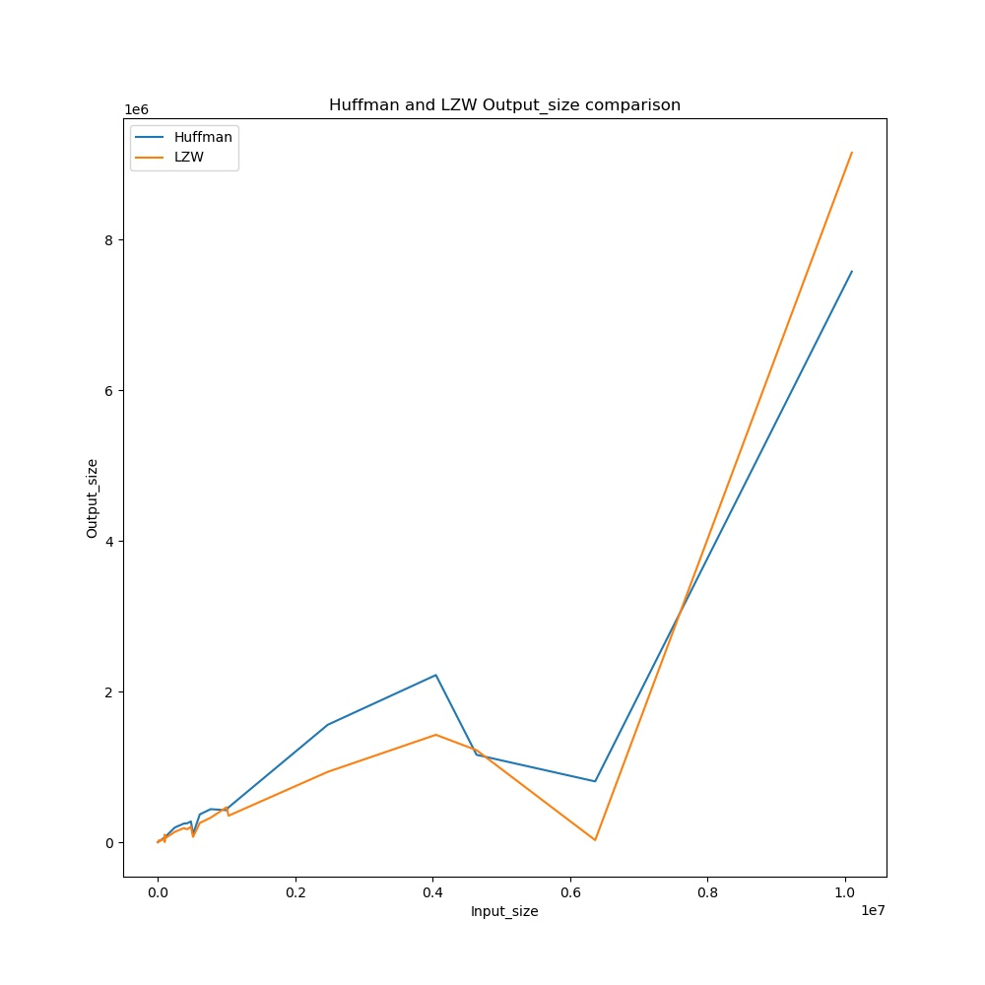
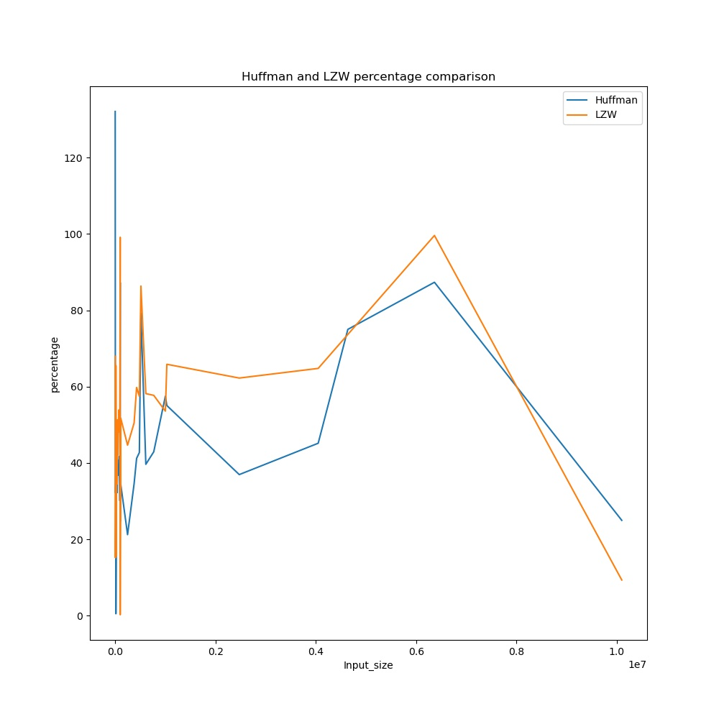
Results for pattern data

Slide 16
Observation
The observation of uncompressed size vs compressed file for both forms of data are completely opposite.
Observations for random data byte files:
For Random data LZW and huffman both expands the file.
Huffman performs better and is faster than LZW.
Percentage of data compressed is negative.
Observations for Pattern data byte files:
Most of the files are better compressed by LZW than Huffman.
LZW turns out be faster than huffman.
Percentage of data compressed reduces as file size increases.

Slide 17
Interpretation
Observation for random data files
1.Why Huffman fails for random data ? Huffman algorithm uses entropy encoding assigning shorter code for frequent characters and longer codes for infrequent character. Since in random data files there is equal probability of each character appearing in the file for which huffman algorithm creates balance [huffman tree] (../DATASTRUCTURE.md). Additionally there is 262 bytes of overhead for huffman algorithm hence filesize increases.
2. Why LZW fails for random data ? LZW is dictionary based compression algorithm. Hence it compresses the file based on pattern previously appeared in the file. Since Random data file has minimal pattern hence it outputs the two bytes codes more frequently.
3.Why Huffman beats LZW in terms of compressed file size for random data ? Huffman assigns nearly equal length codes for each char in the random data file which creates nearly equal size compressed file. But in LZW the output index is fixed which is 2 byte so for every new pattern there is 2 byte output hence as randomness increases file size increases much faster than huffman

Slide 18
Observation for pattern data file
4. Why Huffman works better for pattern data ? As The probablity of bytes occuring in the file is distributed over the large range, meaning some bytes occurs more frequently than the others, Huffman algorithm assigns shorter codes to more frequent bytes resulting in compression.
5. Why LZW works better for pattern data ? In LZW once the new pattern is seen in the file it is logged into dictionary with unique index. This index is outputted to file each time it encounter the pattern. Hence greater the pattern in the file smaller the file will be.
6. Why LZW beats Huffman in terms of compressed file size for pattern data ? In huffman codes are fixed and determined using statistic of source being encoded. Whereas LZW adapts to the data as it reads the file and increases the dictionary size. As LZW reads more data it encodes the longer pattern in the 2 bytes.

Slide 19
7. Why LZW beats Huffman in terms of compress time for pattern data ? In Huffman There needs to be two passes over input file.
First pass to count frequency of bytes in file.
Second pass which actually compresses file.
Whereas In LZW only one pass is required as LZW adapts according to data.
8. Why Huffman compression ratio decreases with increase in file size ? As the file size increases the probability that each byte occurs with same frequency increases which result in less compression of file
9. Why LZW compression ratio decreases with increase in file size ? As the file size increases dictionary of pattern fills up which has maximum of 65536 entries for 2 byte code, After these many amount of entries we are not able to add new pattern into dictionary and compression is decreases, However This problem can easily be solved by using code size longer than 2 bytes, but this will result in decrease in compression ratio for smaller files

Slide 20
Conclusion
From the Given interpretation we can conclude that both algorithm are not useful for random data file but this condition arises rarely in real life since data would always be in some kind of pattern hence in such case LZW would be algorithm of choice as it is faster than huffman and compressed file is also smaller.

