Slide 1
Can we trust the energy numbers?
How the ECRL and 2LAL inverter results were checked
SKY130 tt · ngspice · 1.8 V · 25 fF load · Adiabatic_sweep repository
Notes:
We simulate two adiabatic logic families and report energy per operation. This deck explains, in plain terms, why we believe those energy numbers.

Slide 2
Four questions, four checks
1
2
3
4
Is the logic right?
Is the energy meter right?
Does it follow the physics?
Does it match published work?
Every point is checked before its energy is kept
It gives the textbook answer on circuits we can solve by hand
Energy changes with speed and load the way theory says
Same operating point, close to the published number
All four pass. One script reruns everything in about four minutes.
Notes:
If any one of these fails, the energy numbers mean nothing. We check all four, and the checks run automatically every time.

Slide 3
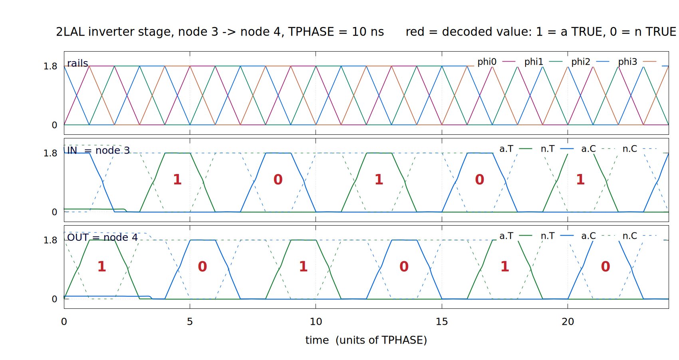
1
Is the logic right?
Checked at every point
An ECRL point is kept only if both outputs reach the rails. A 2LAL point needs all 96 of its checks to pass.
Checked a second way
A separate program reads the raw waveforms and agrees: every stage inverts, 154 of 154 times.
The checks can fail
One 2LAL stage at 10 ns: the output (bottom) is the input (middle) inverted, one phase later. Red digits are read from the waveform.
We broke the circuit on purpose in 6 ways. Every break was caught.
Notes:
Energy from a circuit that computes the wrong answer is worthless, so logic is checked first. One broken circuit, a stage that does not invert, uses exactly the same energy as the correct one (6.29 fJ). Only the logic checks can catch that.

Slide 4
2
Is the energy meter right?
+0.3 %
0.01 %
0.06 %
Static CMOS
Resistor + capacitor
Smaller time steps
Energy per fF of load must be VDD² = 3.240 fJ/fF. We measure 3.250.
A case with an exact answer, driven by our clock ramp. We match it.
4× finer steps and tighter tolerance move no result by more than this.
The numbers are the error of the meter against the known answer. All three are far smaller than any difference we report.
Notes:
Before trusting the meter on adiabatic circuits, we point it at circuits whose answer we already know. Static CMOS must give VDD squared per femtofarad, whatever its parasitics. A resistor and capacitor on our clock ramp has an exact formula.

Slide 5
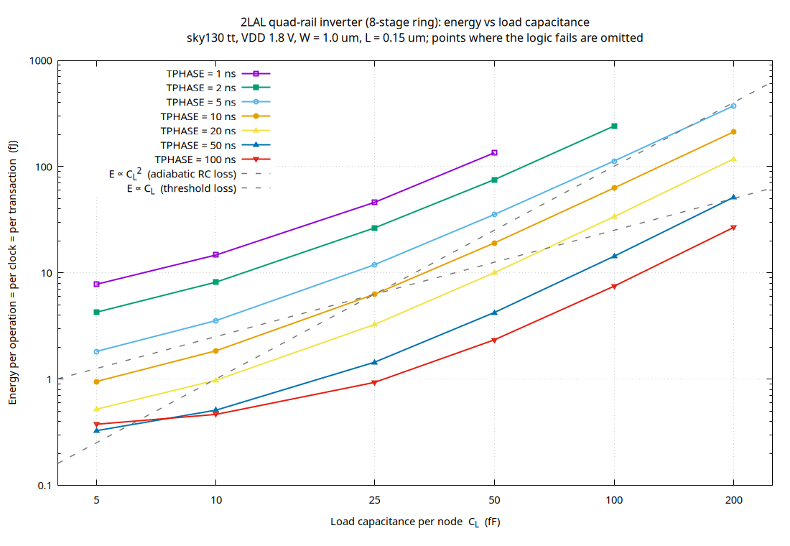
3
Does it follow the physics?
Slower clock, less energy
2LAL energy falls almost as 1/T. Its fixed leftover loss is 0.11 fJ: essentially zero, as a fully adiabatic circuit should be.
ECRL stops improving
It levels off near 15 fJ, the threshold-voltage loss the theory predicts for ECRL.
Bigger load, steeper rise
2LAL energy grows as C². The resistance this implies, 4.54 kΩ, matches the transmission gate measured on its own, 4.92 kΩ.
2LAL energy vs load. Dashed: C and C² slopes.
Notes:
Adiabatic theory makes specific predictions: energy proportional to 1 over T for 2LAL, a fixed floor for ECRL, and C squared growth with load. All three show up, with numbers that agree with separate measurements of the transistors.

Slide 6
4
Does it match published work?
Published
Our circuit
1.17×
6.9 aJ
8.1 aJ
Energy per transistor per clock cycle, for a 2LAL shift register at 1 MHz with a 10 fF load. Different process, same order and close.
Frank et al., ICRC 2020
Sandia 180 nm process
Same operating point
SKY130 process
Our ring at their settings (W = 0.48 µm, L = 0.18 µm) also passes all 96 logic checks. We found no published ECRL or 2LAL result in SKY130 to compare against directly.
Notes:
This is the only published 2LAL energy we found at a stated operating point. Matching it to within 17 percent, in a different process, is strong evidence our 2LAL circuit and meter behave like the real thing.

Slide 7
What the checks caught
The 2LAL chain had a loose end
ECRL measured the wrong cycle
The last stage had nothing after it to reset it. It disturbed the stages we were measuring.
The measured clock cycle had no data change in it, so it missed the loss that happens when the data flips.
Before
After
Before
After
44.05 fJ
0.93 fJ
5.36 fJ
12.46 fJ
at 100 ns: 47× too high
at 100 ns: 2.3× too low
Fix: close the chain into an 8-stage ring.
Fix: change the data every cycle, measure that cycle.
Notes:
Both bugs changed our conclusions. The 2LAL one made the two families look tied; the ECRL one made ECRL look better than it is. Each was found by a check, and each check now runs on every result.

Slide 8
Rerun it yourself
verification/verify_all.sh (about 4 minutes)
Logic checks
Broken-circuit test
Meter and physics
Length and load sweeps
pass at every point
6 of 6 caught
28 of 28 pass
11 of 11 pass
Limits: simulation only, one process corner (tt, 27 °C), inverters only, ideal clock source. The checks show the numbers are right for this setup, not that a chip would behave the same.
Notes:
Anyone can repeat every check with one command. The last line is the honest scope: this verifies the simulation, not silicon.

