Slide 1
S K Y 1 3 0 · n g s p i c e · A D I A B A T I C L O G I C
Adiabatic Logic in SKY130
ECRL and 2LAL
Cell design, an energy-measurement methodology we can defend, and a matched-condition comparison of two adiabatic families
Sairam Kesanapalli
Faculty guide: ______________
Progress review
2
logic families
6
device widths
7
frequency points
84
SPICE sweep runs
Notes:
Opening line: we set out to study adiabatic logic in an open PDK. What we actually built is a measurement methodology, and the methodology is what found the interesting results. Two families, one axis, everything scripted.

Slide 2
OBJECTIVE AND SCOPE
What we set out to do
Design and verify an ECRL inverter in an open PDK. Not a textbook sketch — a netlist in SKY130 that simulates and is correct at both bit values.
Establish an energy metric that can be defended. A number that is small is worthless if we cannot say exactly what operation it is the energy of.
Measure how that energy moves with operating frequency and with device width. These are the two axes the original ECRL paper uses.
Repeat all of it for a second adiabatic family, 2LAL, and compare under matched conditions. Matched meaning every one of seven variables held equal, and checked.
Deliberately out of scope, for now
Multi-gate logic — NAND, NOR, chains
Physical layout and extracted parasitics
Power-clock generator design
Corner and temperature spread beyond tt
Supply and load-capacitance sweeps
Each of these changes the answer, so none of them is quoted as if it had been done.
Status in one sentence
The ECRL baseline is established and validated, the 2LAL cell is reconstructed and validated, and the two are compared under matched conditions. Next is real logic, not just an inverter.
ECRL & 2LAL in SKY130 · progress review
2
Notes:
Stress the second bullet. The single most valuable thing we produced is not a number, it is a definition of what is being measured. The out-of-scope list matters: it stops us over-claiming.

Slide 3
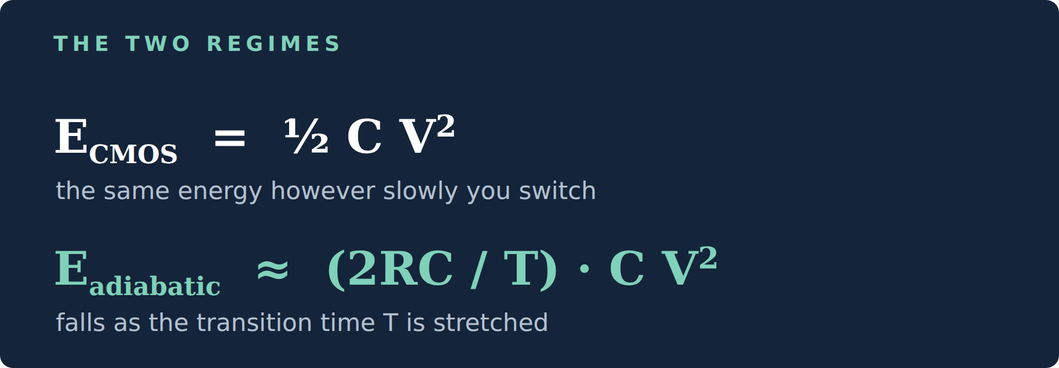
BACKGROUND
Why adiabatic logic, in one slide
Conventional CMOS. Charging a node through a switch from a fixed supply costs ½CV², and it costs that no matter how slowly you do it. The other half is burned to ground on the way back down.
Adiabatic. Drive the node from a supply that ramps instead. Now the loss is roughly (2RC/T)·CV² — it scales as 1/T. Stretch the transition and you dissipate less, and the charge that CMOS would have dumped to ground is drawn back into the clock.
But it does not reach zero. Two floors stop it: the threshold drop the switch cannot recover — in ECRL that is C·|Vtp|²/2 — and leakage, which gets worse the longer you hold the node, so it grows exactly where the RC term shrinks.
Every curve in this deck is that trade being measured: an RC term falling with T, and a leakage term rising with it.
What that means for the graphs
Energy per operation should rise with frequency — the shorter the transition, the less adiabatic it is. That rising trend is the signature we are looking for, and it is the qualitative result the 1996 ECRL paper reports.
The two floors underneath it
Threshold: C·|Vtp|²/2, independent of speed. Leakage: it grows with T, so it fights the RC term from the other side.
ECRL & 2LAL in SKY130 · progress review
3
Notes:
If the faculty asks one question it will be 'why should energy go UP with frequency, when CMOS dynamic power goes up with frequency too but energy PER OPERATION stays flat?' Answer: because in adiabatic logic the per-operation energy itself is a function of transition time. That is the whole point.

Slide 4
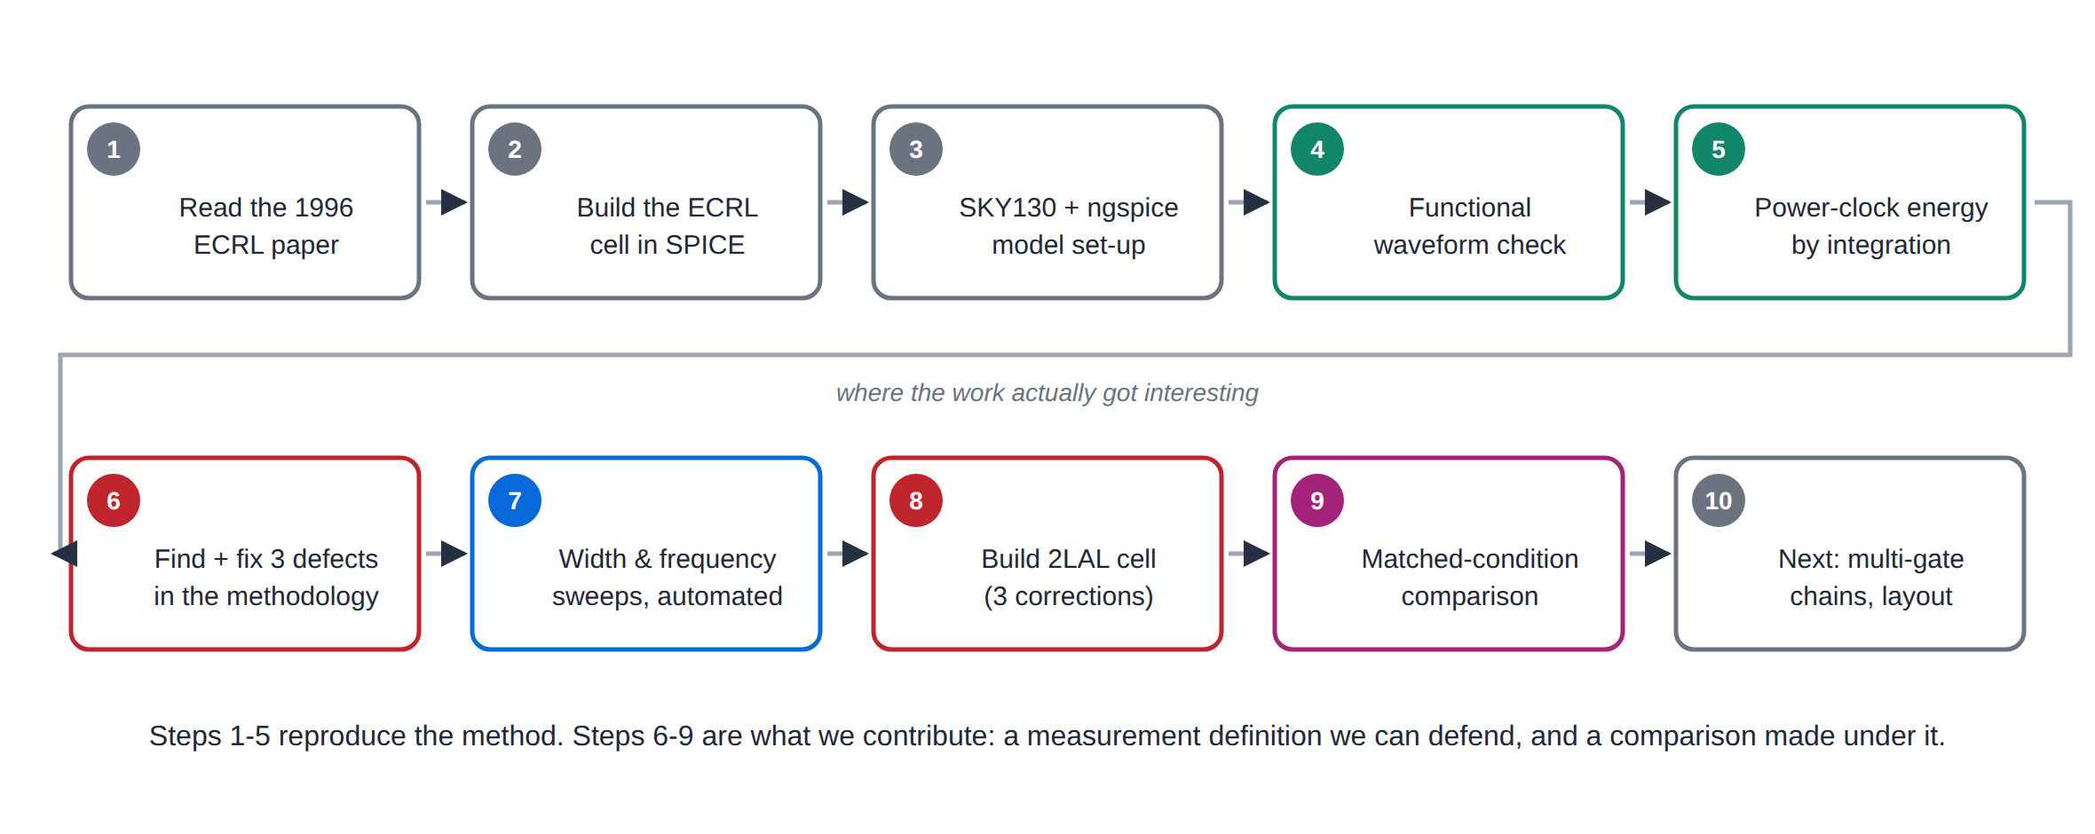
ROADMAP
How the work actually went
Steps 4 to 9 each produced a correction to something we or our sources believed. Those corrections, not the raw energy numbers, are the substance of this review.
ECRL & 2LAL in SKY130 · progress review
4
Notes:
Walk this left to right quickly. Land on step 6: three separate defects in our own measurement methodology, all found by testing assumptions rather than accepting them.

Slide 5
PART I
The ECRL baseline
Cell → setup → functional proof → energy definition → the defect it exposed → sweeps
ECRL & 2LAL in SKY130 · progress review
5
Notes:
Part I is the foundation. Nothing in Part III is worth anything unless Part I is trustworthy.

Slide 6
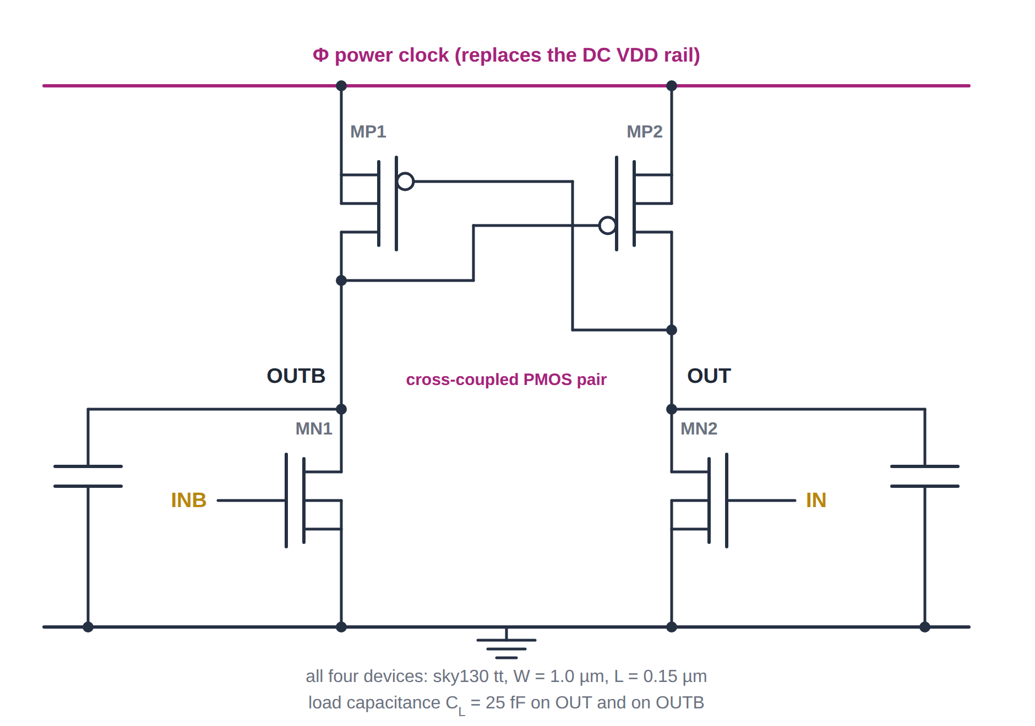
PART I · TOPOLOGY
The ECRL cell: four transistors and no DC supply
Four devices. A cross-coupled PMOS pair sitting on the power clock, and two NMOS pull-downs driven by the differential input.
The clock is the supply. Φ ramps up, the selected output follows it up, Φ ramps back down and pulls the charge back out. There is no rail to dump charge into.
Differential by construction. OUT = NOT IN and OUTB = IN. Exactly one of the two outputs pulses on every cycle, whatever the data is doing.
The cross-coupling is what latches. Each PMOS gate is tied to the opposite output, so once one side rises it holds the other down.
XMP1 OUTB OUT PHI PHI pfet_01v8
XMP2 OUT OUTB PHI PHI pfet_01v8
XMN1 OUTB INB 0 0 nfet_01v8
XMN2 OUT IN 0 0 nfet_01v8
ECRL & 2LAL in SKY130 · progress review
6
Notes:
Point at the crossing in the middle of the schematic. That is the cross-couple. Contrast with a static CMOS inverter: no VDD rail anywhere on this page, and the output is a pulse, not a level.

Slide 7
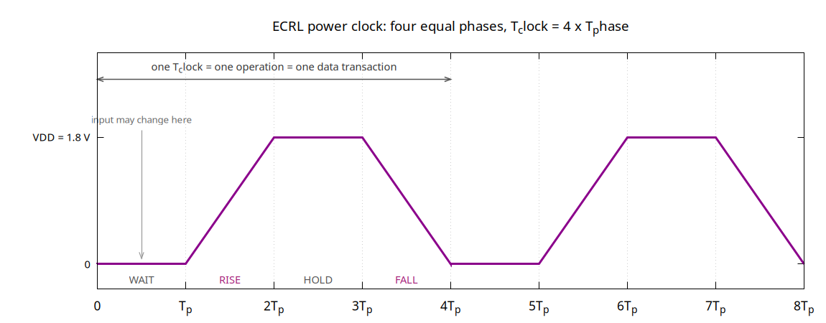
PART I · TIMING
The power clock, and the two frequencies it defines
Two rates, four times apart
Confusing these two is the single easiest way to misread an adiabatic-logic graph, so every plot here says which one it uses.
 | definition | at Tp = 10 ns
f_tr | 1 / Tp | 100 MHz
f_clock | 1 / 4Tp | 25 MHz
f_tr is the transition frequency — the inverse of a single phase. It is the axis the 1996 paper uses, and the default axis in this deck.
f_clock is the power-clock frequency, which is also the operation rate: one new result per T_clock. Every plot here also exists in an f_clock version.
T_clock = 4 · T_phase → f_tr = 4 · f_clock
Why four phases and not two
The wait phase is what lets the input settle before evaluation begins, so the gate never sees a moving input while it is charging. The hold phase is what lets the next stage sample a stable value. Drop either one and the cell stops being adiabatic.
ECRL & 2LAL in SKY130 · progress review
7
Notes:
Be explicit about this before showing any graph. A reviewer who assumes f_clock when we plot f_tr will misread every frequency on our axes by a factor of four. Both versions of every plot are in the repo.

Slide 8
PART I · METHOD
Simulation setup
parameter | value
Technology | SKY130 open PDK, tt corner
Simulator | ngspice 42 / 45.2, batch mode (-b)
Supply VDD | 1.8 V
Channel length L | 0.15 µm, nFET and pFET
Width W | 0.84 / 1.0 / 1.2 / 1.5 / 2.0 / 3.0 µm
Load | 25 fF on every metered output node
Power clock | trapezoid, four equal phases, T_clock = 4·T_phase
T_phase swept | 1, 2, 5, 10, 20, 50, 100 ns
f_transition | 1000 down to 10 MHz
Energy metric | integral of -V_PHI · I_PHI dt, over one full clock period
A units trap worth knowing about
The ngspice-flavoured SKY130 models set .option scale=1.0u, so device widths are written in microns: w=1 means 1 µm. Writing w=1u fails with “could not find a valid modelname”, and the trimmed model files vendored by some repos take metres instead.
Why 25 fF and why these widths
25 fF is a deliberately generous load, chosen so the switched capacitance dominates the device's own parasitics and the comparison between families is about the topology rather than about layout we have not done. 0.84 µm is the SKY130 minimum-ish width; 3.0 µm is far enough out to see the resistive trend flatten.
ECRL & 2LAL in SKY130 · progress review
8
Notes:
The units trap is worth 30 seconds. It is exactly the kind of thing that silently invalidates a comparison: two decks on two model sources with two unit conventions. We found it and moved both decks onto the same models before comparing anything.

Slide 9
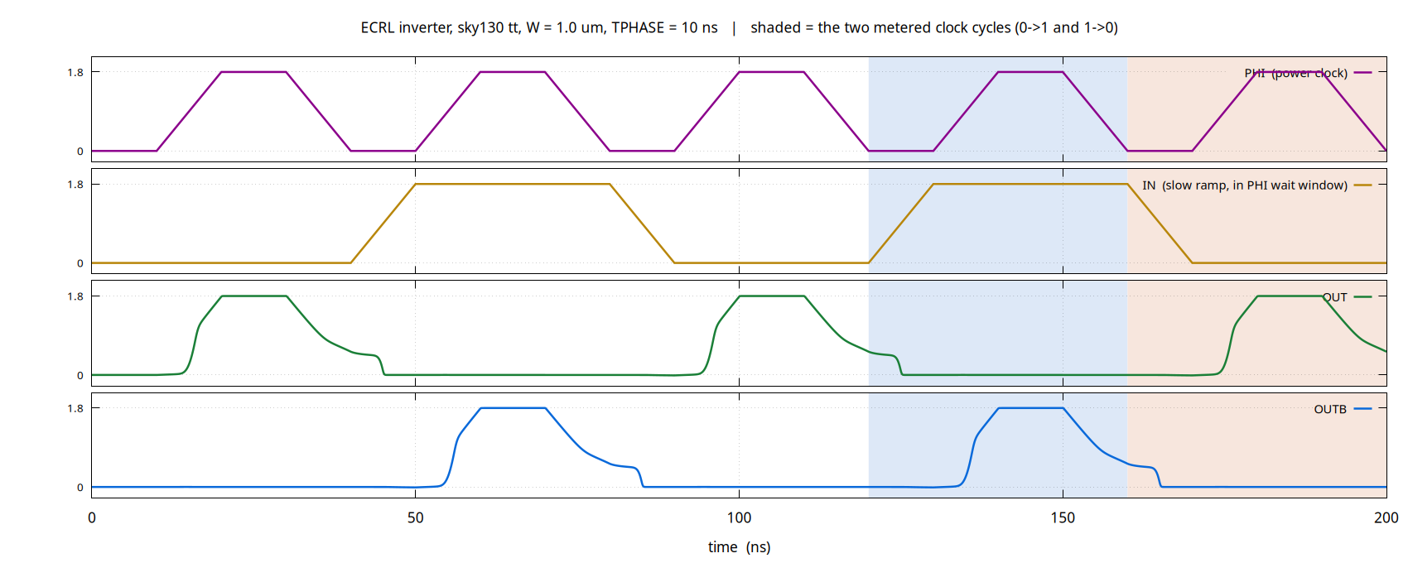
PART I · CORRECTNESS
Functional verification comes before any energy number
IN low → OUT pulses with the clock and OUTB stays down. IN high → the opposite. The input only ever moves inside Φ's wait window, so the gate never evaluates on a moving input.
Checked by .meas sampling mid-hold, at both bit values, at every T_phase in the sweep — not by looking at the picture.
.meas tran OUT_A FIND V(OUT) AT=14.5*TPHASE
.meas tran OUTB_A FIND V(OUTB) AT=14.5*TPHASE
IN=1 -> OUT ~ 0 OUTB ~ 1.8
ECRL & 2LAL in SKY130 · progress review
9
Notes:
Note the small step visible on the falling edge of each output: that is the threshold drop, the charge the pFET cannot recover. It is the C|Vtp|^2/2 floor showing up on the scope trace.

Slide 10
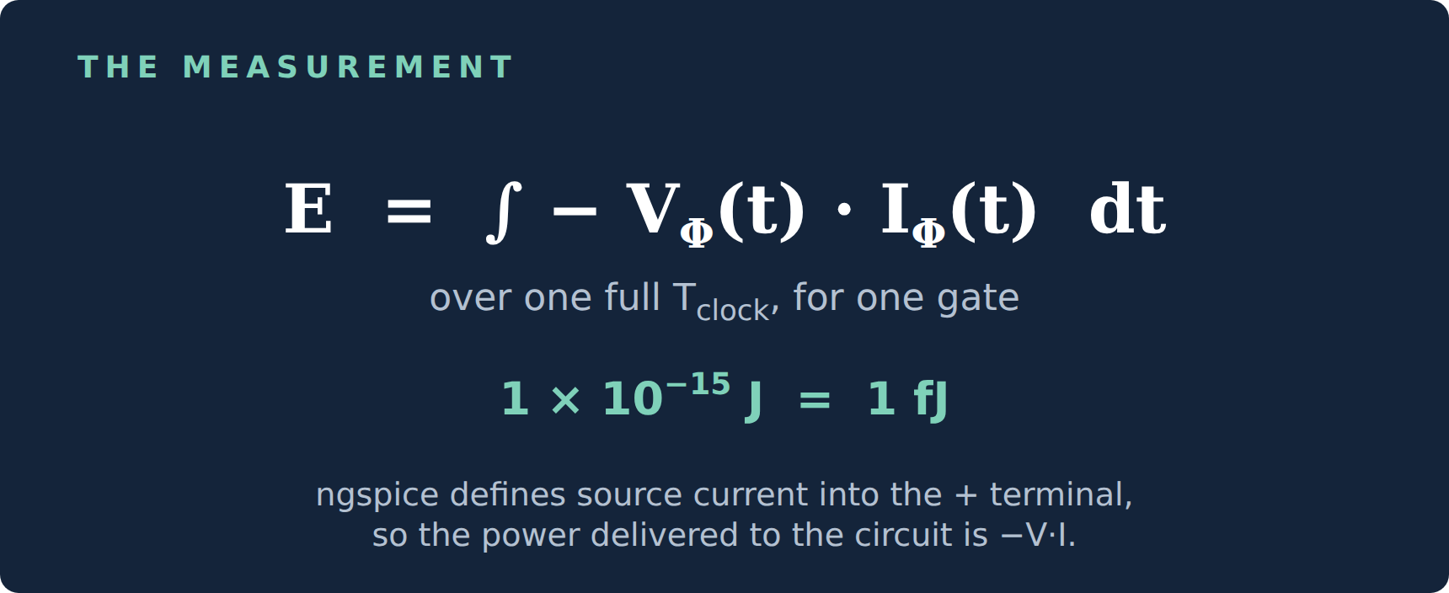
PART I · THE METRIC
How the energy is measured
We do not sample V·I at an instant. We integrate the power the power clock actually delivers, across one complete clock period.
ngspice defines a source's current as flowing into its positive terminal, so the power delivered to the circuit is -V·I. A behavioural source turns that product into a node voltage, which .meas can then integrate.
BPCPOWER PCLK 0 V={-V(PHI)*I(VPHI)}
.meas tran E_A INTEG V(PCLK) FROM={12*TPHASE} TO={16*TPHASE}
.meas tran E_B INTEG V(PCLK) FROM={16*TPHASE} TO={20*TPHASE}
.meas tran E_C PARAM='(E_A+E_B)/2'
* settling check: the same two cycles, two periods earlier
.meas tran E_A0 INTEG V(PCLK) FROM={4*TPHASE} TO={8*TPHASE}
.meas tran E_B0 INTEG V(PCLK) FROM={8*TPHASE} TO={12*TPHASE}
Why integrate, and not just multiply
The clock is a trapezoid and the current is not in phase with it. A point sample of V·I is meaningless here, and an average over the wrong window is worse than meaningless — it looks like a real number. Choosing the window turned out to be the hardest part of this project.
E_A is the cycle in which the data goes 0→1, E_B the cycle in which it goes 1→0, E_C their average. E_A0 and E_B0 repeat the measurement two periods earlier: if they disagree, the circuit has not settled and the run is discarded.
ECRL & 2LAL in SKY130 · progress review
10
Notes:
Lead into the next slide from that last sentence. The window is where the bug was.

Slide 11
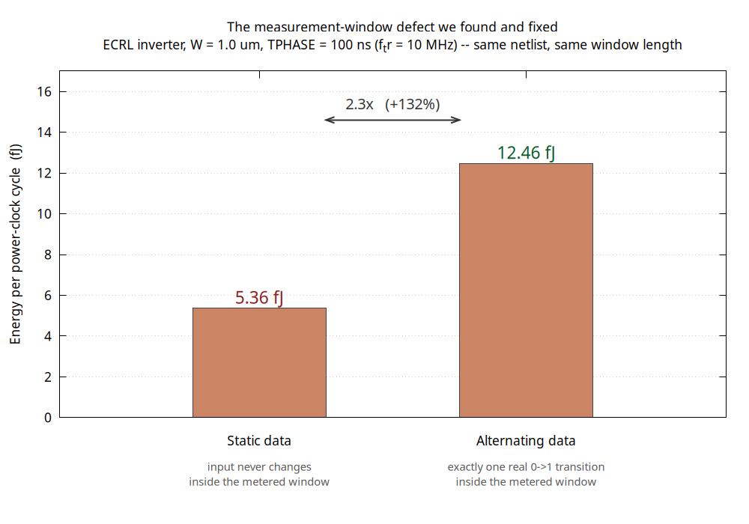
PART I · THE DEFECT WE FOUND
Two suspects, one culprit
Our early ECRL curve looked plausible. We suspected the input edge. We tested both suspects instead of assuming.
Suspect 1 — the input edge. The baseline used a fixed 100 ps input transition whatever T_phase was. At T_phase = 100 ns that edge is a thousand times faster than the clock — precisely what adiabatic operation is supposed to avoid.
Tested: replacing it with a full-phase ramp changed the energy by essentially nothing.
Suspect 2 — the measurement window. The input had already flipped back during the previous cycle, so the metered window contained no data transition at all.
This was the entire gap. The old numbers were the energy of a gate whose input never changes: correct per power cycle, meaningless per data transaction.
The fix, now in every ECRL run
Input ramps over a full phase, inside Φ's wait window · data alternates 1,0,1,0 every cycle · the 0→1 and 1→0 cycles are metered separately · 5.36 → 12.46 fJ at 10 MHz.
ECRL & 2LAL in SKY130 · progress review
11
Notes:
This is the slide to spend time on. It shows the difference between a student who reports a number and one who interrogates it. Also make the point that the fix is reproducible in one command: hold the data static in the new deck and it reproduces the old 5.3622 fJ exactly — which is how we proved that was the cause.

Slide 12
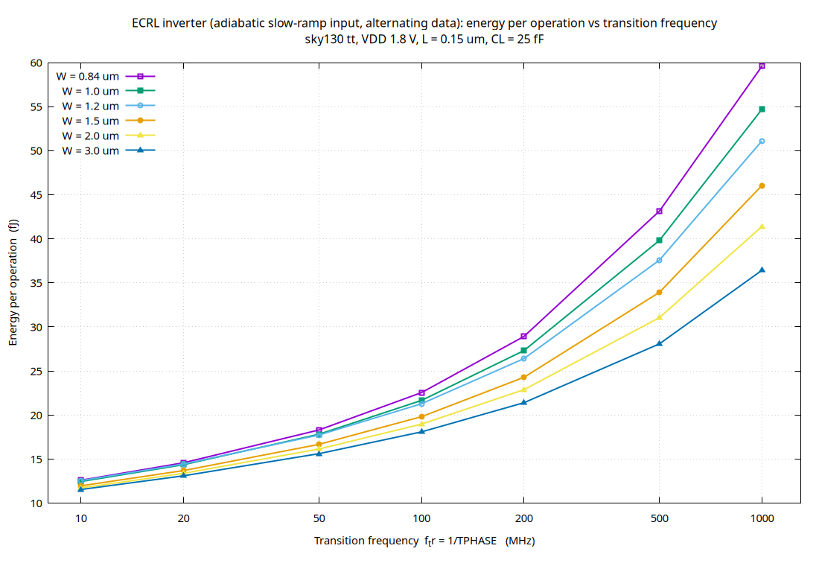
PART I · RESULT
ECRL: energy per operation against frequency
What the curve says
Energy rises monotonically with frequency at every width — the qualitative behaviour the 1996 ECRL paper reports.
At W = 1.0 µm the energy goes 12.46 → 54.69 fJ, a 4.4× rise across a 100× rise in frequency. Sub-linear, as an RC/T loss should be.
It does not extrapolate to zero. The threshold drop and leakage floors are still underneath.
f_tr | E per operation
10 MHz | 12.46 fJ
100 MHz | 21.66 fJ
1000 MHz | 54.69 fJ
W = 1.0 µm column of ecrl_slowramp_sweep.csv
ECRL & 2LAL in SKY130 · progress review
12
Notes:
Say plainly: this reproduces the TREND, not the numbers, of the 1996 paper. The numbers cannot match — different process, different supply, different device. Slide 28 covers that.

Slide 13
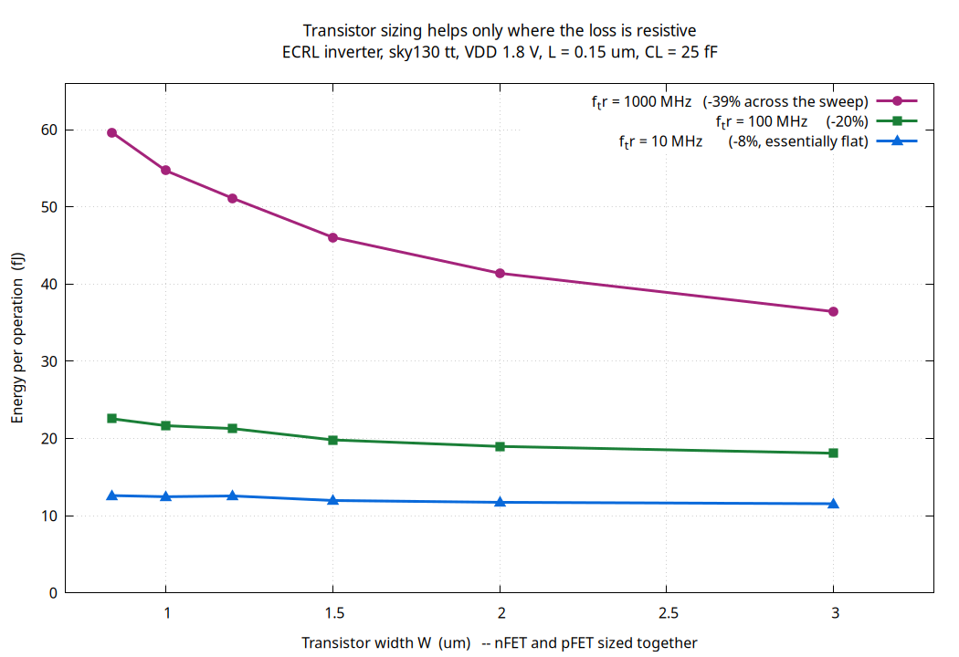
PART I · RESULT
ECRL: sizing only helps where the loss is resistive
Wider devices lower the channel resistance, and the adiabatic loss term is proportional to RC/T. So sizing should buy a lot at short T and almost nothing at long T — and it does.
At 1000 MHz, going 0.84 → 3.0 µm buys 39%.
At 10 MHz, the same change buys 8% — the curve is essentially flat.
A bug we caught, and how
The first version of the width sweep edited .param WNMOS while the transistor instance lines still read w=1, so every point simulated the same device. We noticed because the energies were identical to four significant figures — a sweep that produces no spread is a broken sweep, not a null result. Fixed by rewriting the instance widths; the widths now demonstrably move the answer.
ECRL & 2LAL in SKY130 · progress review
13
Notes:
Good place to make the general point: a result that looks too clean should be treated as a suspected bug until proven otherwise. Six identical numbers is not physics.

Slide 14
PART II
2LAL, and three things we had to correct
The cell is not 4 transistors · a logic 0 is not a pulse · inversion is not a wire crossing
ECRL & 2LAL in SKY130 · progress review
14
Notes:
Each of these three was believed by someone — by us, by our advice, or by the obvious reading of the literature — and each was wrong in a way that still simulates and still looks plausible if you only test one bit value.

Slide 15
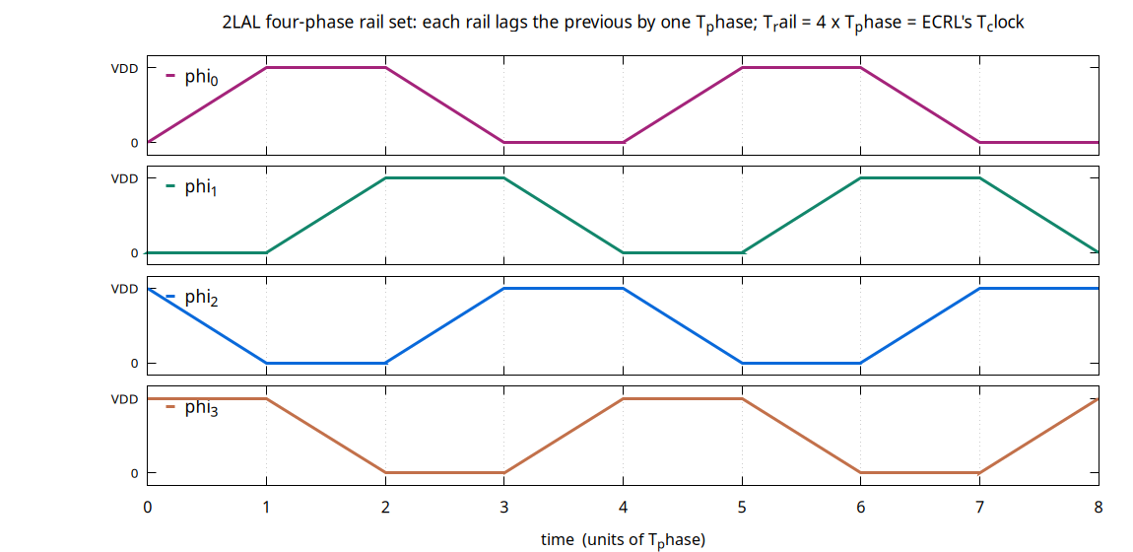
PART II · BACKGROUND
What 2LAL is
Two-Level Adiabatic Logic
Frank et al. Data is carried dual-rail; the logic itself is done with transmission gates driven by a four-phase trapezoidal rail set rather than by a single power clock.
A pair rests at FALSE. A dual-rail pair (T, C) sits at (0, VDD) when idle.
A TRUE is a pulse. The T rail pulses up on phi_t while C is pulled down by the antiphase rail.
Activity is data-independent. A column always has one sub-chain carrying a TRUE, so it pulses every period, like ECRL.
Each stage is clocked one phase tick later than the one before it. T_rail = 4·T_phase — the same period as ECRL's T_clock, which is exactly what lets both families sit on one axis.
Where our cell came from
Reconstructed from Frank's slides, a DeBenedictis technical report, and the PHAS2 cell in the 4lc repository. We have not seen Figure 2 of the source paper.
ECRL & 2LAL in SKY130 · progress review
15
Notes:
Be upfront that the cell is a reconstruction. It is self-consistent and it simulates correctly at both bit values, but if the faculty can point us at Figure 2 of the paper we would like to check it against the primary source.

Slide 16
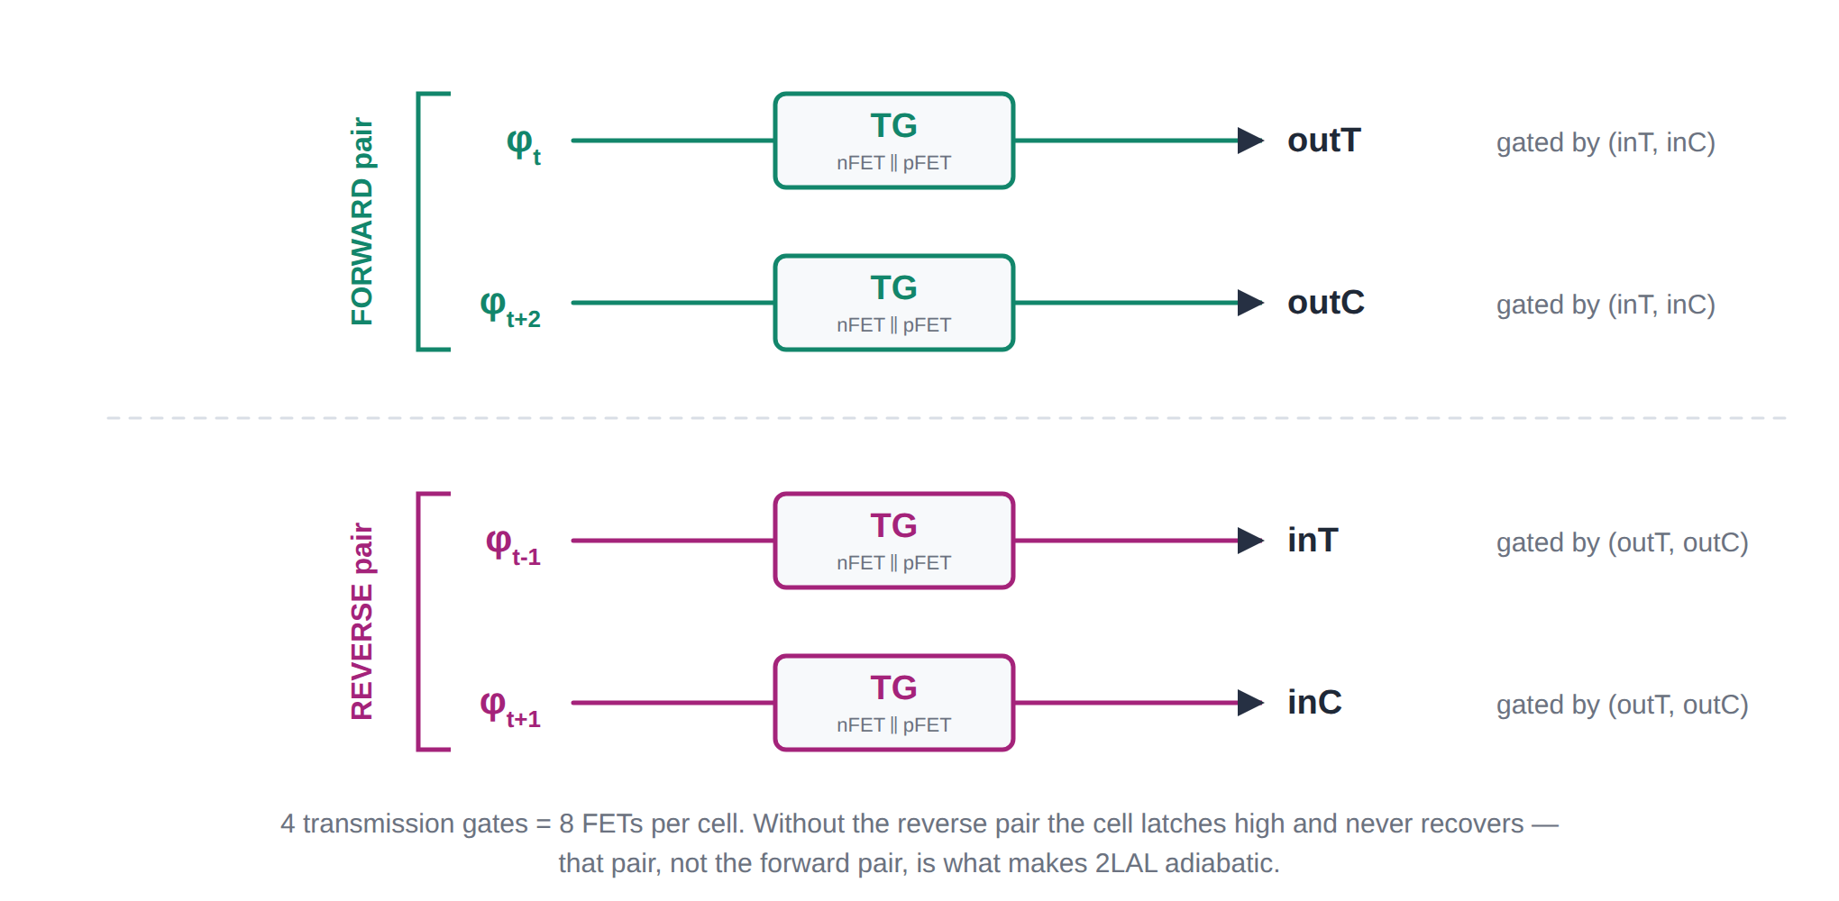
PART II · CORRECTION
Correction 1: the cell is eight transistors, not four
What we were told
Four devices per stage: two nFETs and two pFETs. A forward-only 4-transistor cell has no way to pull its own output back down — by the time the clock falls, the input has already retracted and the gate is off.
In simulation every node latched high and stayed there, reporting “1” for both bit values.
What actually works
Eight transistors: the forward pair, plus a reverse pair that restores the previous stage once this stage's output is valid.
That reverse pair recovers the charge the forward pair cannot. It is the entire reason 2LAL is adiabatic — and it is exactly what the 4lc PHAS2 cell has.
ECRL & 2LAL in SKY130 · progress review
16
Notes:
Worth saying: the four-device version is not a strawman, it is what we were advised to build and it is what the obvious reading of the figure suggests. It simulates. It just always returns 1.

Slide 17
PART II · CORRECTION
Correction 2: a logic 0 is the absence of a pulse
A dual-rail 2LAL pair rests at FALSE = (0, VDD). Encoding a 0 as a pulse on the complement rail is the obvious guess, and it is silently wrong.
WRONG — what we first built
0 → pulse the C rail
1 → pulse the T rail
The complement pulse falls while the clock is still high. The pass gate's pFET conducts through that window, and every downstream stage latches a spurious 1.
It looked completely fine — because we had only ever tested the 1 bit.
CORRECT — what actually works
0 → no pulse at all
1 → pulse the T rail
The pair simply stays at rest. Nothing moves, nothing conducts, and nothing downstream is fooled.
Every stage is now checked at both bit values, at every frequency point in the sweep — which is the only reason this was ever caught.
The lesson we are taking from this: a logic family whose FALSE is “do nothing” cannot be validated by testing TRUE.
ECRL & 2LAL in SKY130 · progress review
17
Notes:
This is a nice one to tell as a story. Everything worked. Every waveform looked right. Then we fed it a 0 and the whole chain reported 1.

Slide 18
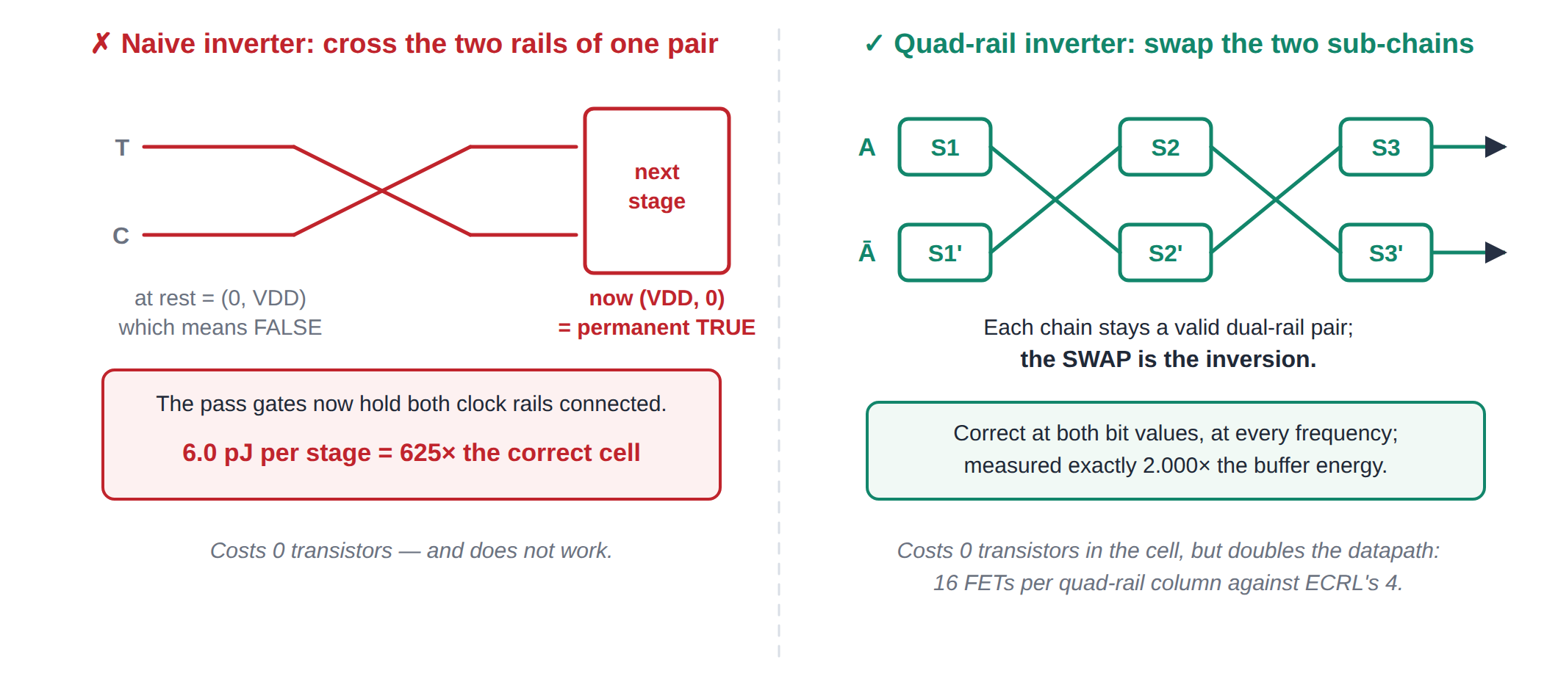
PART II · CORRECTION
Correction 3: inversion is not a wire crossing
Because the rest state (0, VDD) is lopsided between the two rails, crossing them turns “rest” into (VDD, 0) — which the next stage reads as a permanent TRUE. The fix costs no transistors in the cell, but it doubles the datapath.
ECRL & 2LAL in SKY130 · progress review
18
Notes:
In static CMOS, inverting a differential signal really is just swapping the wires, because the rest state is symmetric. In 2LAL it is not symmetric, and that asymmetry is the whole trick. The quad-rail fix is free in transistors per cell but costs 2x the datapath — and we measured exactly 2.000x, which is a good sign the implementation is right.

Slide 19
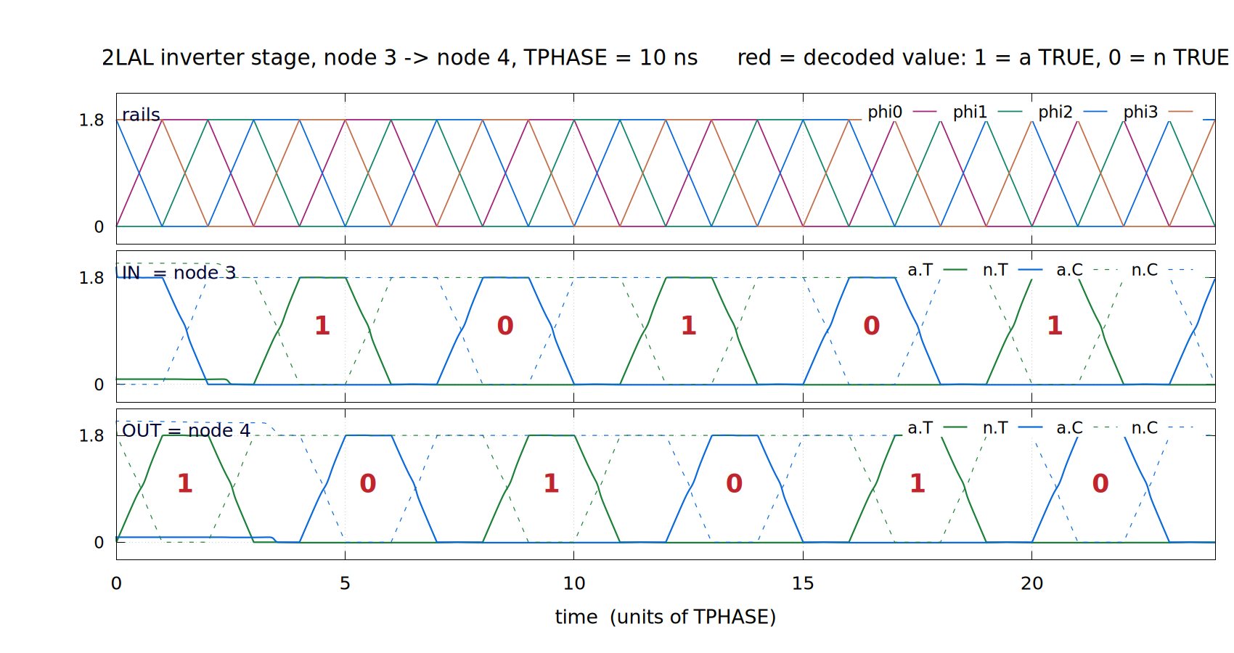
PART II · CORRECTNESS
The quad-rail inverter, checked at the waveform
Checked two independent ways
96 .meas checks in the deck, enforced at all 42 sweep points: every node, both data values; TRUE sub-chain high then back at rest, idle one never moves.
An independent decoder reads every node in every rail period: output = NOT input on 42 / 42 stage transfers at T_phase = 1, 10 and 100 ns, and 154 / 154 over 20 periods at 100 ns.
Constant data holds. Seed the same value twice and every node keeps it: the output follows the data, it does not just toggle.
Can the checks fail? We broke the circuit on purpose
T/C swapped on one stage: 24 of 96 fail. Restore gate removed: 48. Wrong clock phase: 40. One stage made non-inverting: 16, with E_C unchanged at 6.29 fJ, so only the logic checks can see it.
One stage inside the 8-stage ring, T_phase = 10 ns. When node 3 carries a 1 (its a sub-chain pulses), node 4 carries a 0 one T_phase later (its n sub-chain pulses), and the other way round. The idle sub-chain never leaves rest.
ECRL & 2LAL in SKY130 · progress review
19
Notes:
This is the 2LAL counterpart of the ECRL waveform slide. Point at a 1 on node 3 and the 0 that appears on node 4 one tick later. The mutation results are in verification/mutation_report.txt; the non-inverting stage is the one to mention, because its energy is indistinguishable from the correct circuit.

Slide 20
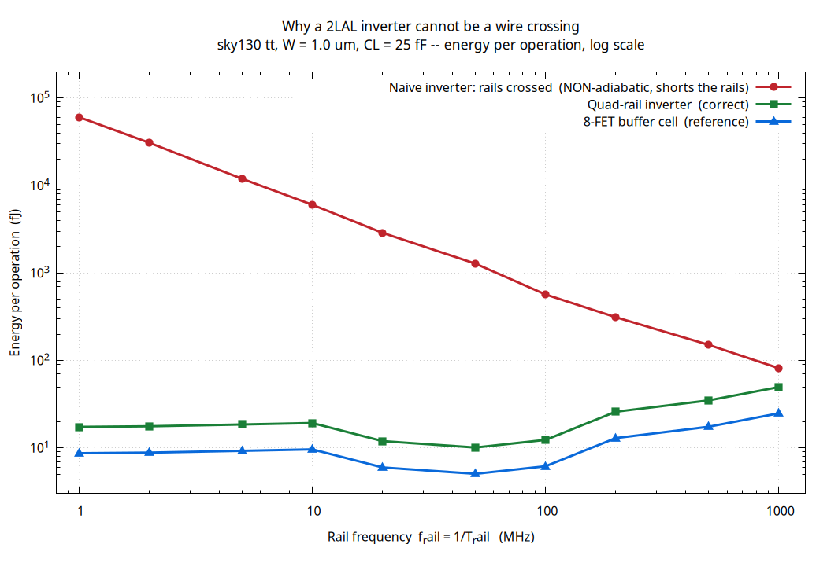
PART II · EVIDENCE
The broken inverter has a measurable signature
Why the red curve slopes downward
A resistive short dissipates V²/R for as long as it is held, so its energy per operation is proportional to the period — it falls as 1/f. That straight 1/f line on a log-log plot is the fingerprint of a non-adiabatic path, and it is nothing like the shape either correct cell produces.
6.0 pJ per stage at 10 MHz — 625× the correct 8-FET buffer cell at the same point.
The two correct curves track each other. The quad-rail inverter sits at exactly 2.000× the buffer, at every frequency — the expected cost of carrying two chains instead of one, and a useful self-check that the implementation is right.
The upturn below ~50 MHz is not leakage. This is the superseded open-chain deck; its unrestored last node inflates slow-clock energy. Slide 20 uses the ring.
ECRL & 2LAL in SKY130 · progress review
20
Notes:
The 2.000x is the strongest single piece of evidence that the quad-rail construction is implemented correctly. If it were wrong in some subtle way, there is no reason it would land on a clean factor of two at every frequency.

Slide 21
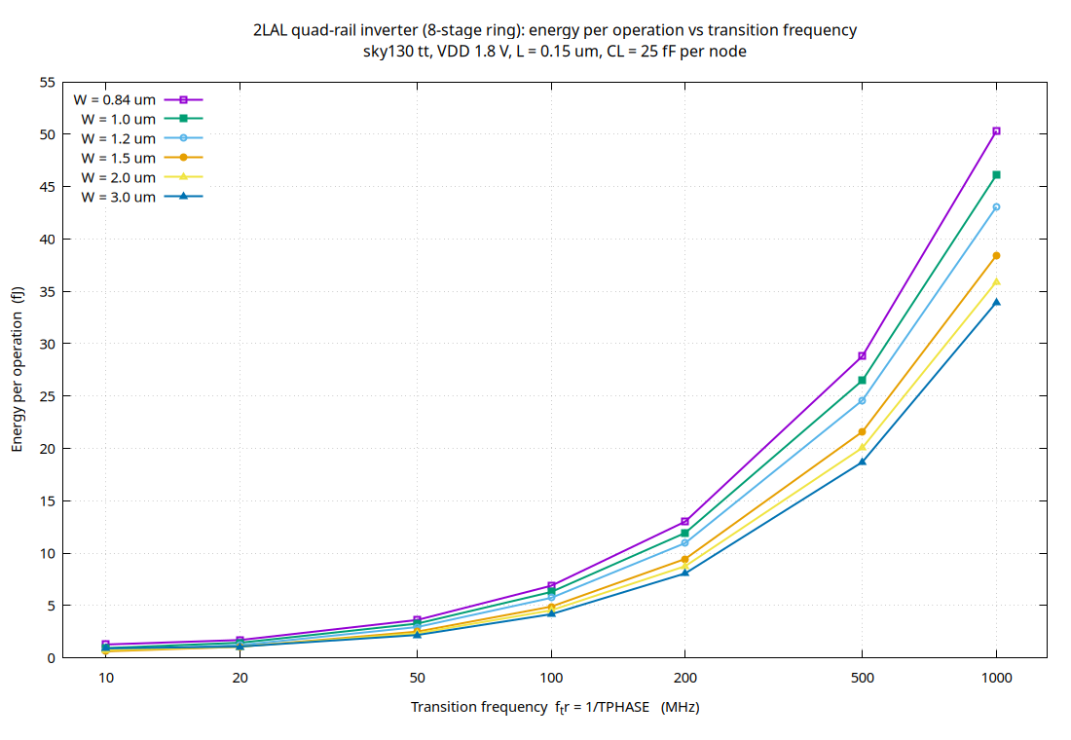
PART II · RESULT
2LAL: energy per operation against frequency
Falls all the way down
No floor in this range: 46.1 fJ at f_tr = 1000 MHz down to 0.93 fJ at 10 MHz (W = 1.0 µm), about 7× per decade.
That is the fully adiabatic signature: only the resistive RC/T loss, with no threshold residue of the kind ECRL keeps.
Wider is better down to 50 MHz. At 1000 MHz, W = 3.0 µm costs 33% less than W = 0.84 µm (33.9 against 50.3 fJ): the pass gates are resistance-limited.
At 10 MHz the widest devices turn back up. W = 1.5 µm is lowest (0.62 fJ), W = 3.0 µm costs 0.90 fJ, consistent with leakage that grows with width.
Design result: in 2LAL, size up for speed, but stop near 1.5 µm for slow clocks.
ECRL & 2LAL in SKY130 · progress review
21
Notes:
This is the 8-stage ring deck. An earlier version of this slide showed a minimum near 100 MHz and a 'leakage floor' below it; both came from the open-chain deck, whose last node was never restored. In both families width helps at high frequency; only 2LAL shows a width optimum at the slow end.

Slide 22
PART III
ECRL against 2LAL
What had to match before the comparison meant anything — and what the comparison actually says
ECRL & 2LAL in SKY130 · progress review
22
Notes:
The comparison is the headline, but the seven matching conditions are what make it defensible. Lead with those.

Slide 23
PART III · FAIRNESS
Seven things had to match
Technology and corner
SKY130 tt, and — after we found they were not — the same model files. The two decks had been on different model sources with different unit conventions.
Supply
1.8 V in both.
Load
25 fF on every metered output node in both.
Device geometry
W and L swept over identical values in both.
Time base
T_phase identical; T_clock = T_rail = 4·T_phase, so one operation means the same interval in both.
Energy definition
the integral of -V·I over one full period, per gate for ECRL and per metered quad-rail column for 2LAL.
Switching activity
Verified equal rather than assumed — we measured the 0→1 and 1→0 cycles separately in both families and they came out identical, so no activity correction was needed.
ECRL & 2LAL in SKY130 · progress review
23
Notes:
The first and the last are the two that took real work. The model-file mismatch would have quietly invalidated everything; the activity check is the one people usually assume rather than measure.

Slide 24
PART III · THE UNIT
What one “operation” means
Per power-clock cycle, per gate. In these decks that is also exactly one data transaction — the two coincide by construction, because we made the data alternate every cycle.
Where this definition came from
It is the same definition that exposed the defect in Part I. The old ECRL sweep was measuring per power cycle with zero data transitions in the window. Per power cycle it was right. Per data transaction it was measuring nothing at all.
 | what is integrated | denominator
ECRL | V(PCLK) over [12·Tp, 16·Tp] = one T_clock | 1 gate × 1 cycle
2LAL | rail energy over four T_rail = 16·Tp | 8 ring columns × 4 periods
Neither family is free when idle.
An ECRL gate pulses OUT or OUTB every cycle regardless of the data. A quad-rail 2LAL column always has exactly one sub-chain carrying a TRUE, so it also pulses every cycle. “Per power cycle” is therefore the honest unit for both — you cannot amortise it away with low data activity.
The one place they would diverge is a plain dual-rail 2LAL buffer, where a FALSE is genuinely free. There you would have to state whether you meant per cycle or per transaction. For the quad-rail inverter, they are the same number.
Axis reminder
The plots use f_tr = 1/T_phase. The operation rate is f_clock = 1/(4·T_phase), four times lower. Energy per operation is plotted against transition frequency — legitimate, but it has to be said out loud. Both versions of every plot are in the repo.
ECRL & 2LAL in SKY130 · progress review
24
Notes:
If a reviewer challenges any single number in this deck, this is the slide that answers it. Same unit on both sides: one gate, one power cycle, one new data value.

Slide 25
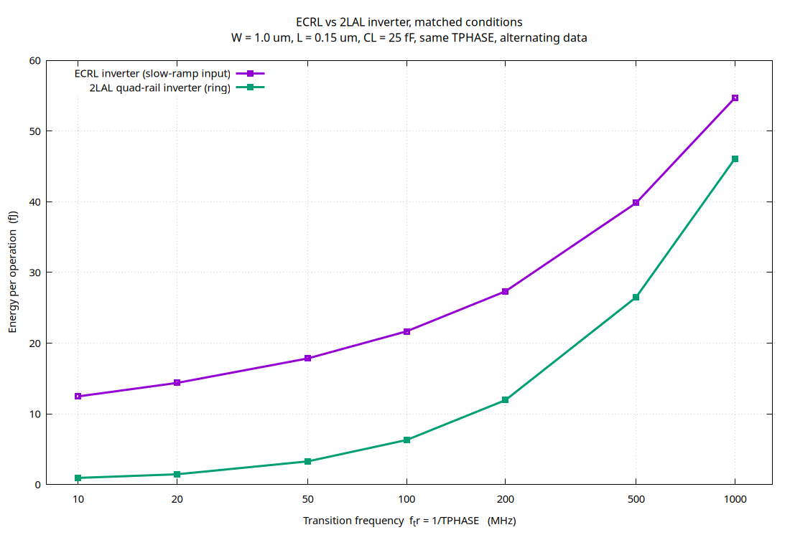
PART III · RESULT
ECRL against 2LAL, matched conditions
Three things to take away
2LAL is lower at every frequency. From 1.19× at 1000 MHz to 13.4× at 10 MHz. At 100 MHz: 21.66 fJ against 6.29 fJ.
The gap widens as the clock slows. ECRL keeps a threshold residue, C·|Vtp|²/2, that speed does not remove; 2LAL keeps falling with T_phase.
2LAL pays in transistors, not energy. 16 per quad-rail column against ECRL's 4, and two 25 fF nodes swung per operation against one.
Fully adiabatic beats quasi-adiabatic on energy, by a margin that grows as the clock slows.
ECRL & 2LAL in SKY130 · progress review
25
Notes:
An earlier version of this slide reported a tie at 100 MHz and an ECRL win at low frequency. Both came from the open-chain 2LAL deck, whose last node was never restored; closing it into a ring removed them. The ordering now matches what quasi- versus fully-adiabatic theory predicts.

Slide 26
PART III · RESULT
The numbers behind that curve
W = 1.0 µm, L = 0.15 µm, C_L = 25 fF, same T_phase, alternating data. Energy per operation, in fJ.
T_phase | f_tr | f_clock | ECRL | 2LAL | outcome
100 ns | 10 MHz | 2.5 MHz | 12.46 | 0.93 | 2LAL by 13.4×
50 ns | 20 MHz | 5 MHz | 14.37 | 1.44 | 2LAL by 10.0×
20 ns | 50 MHz | 12.5 MHz | 17.83 | 3.27 | 2LAL by 5.5×
10 ns | 100 MHz | 25 MHz | 21.66 | 6.29 | 2LAL by 3.4×
5 ns | 200 MHz | 50 MHz | 27.32 | 11.93 | 2LAL by 2.3×
2 ns | 500 MHz | 125 MHz | 39.82 | 26.49 | 2LAL by 1.50×
1 ns | 1000 MHz | 250 MHz | 54.69 | 46.10 | 2LAL by 1.19×
Reading it honestly
2LAL is ahead at every point, and the margin grows steadily as the clock slows. There is no crossover inside 1–1000 MHz; if one exists it lies above 1 GHz, where both are RC-limited.
The caveat to quote with these numbers
The comparison is not capacitance-matched in 2LAL's favour: each 2LAL operation swings two 25 fF nodes (T and C) against one for ECRL, with 16 FETs against 4. 2LAL is ahead despite that.
ECRL & 2LAL in SKY130 · progress review
26
Notes:
Every cell in this table is a row in a CSV that came out of a scripted ngspice run. Slide 27 shows the provenance chain for one of them.

Slide 27
PART III · TRUST
Verification and reproducibility
Nothing is hand-entered. ngspice .meas → sweep shell script → CSV → .dat → gnuplot → PNG. gnuplot draws the graphs; every number in them came out of ngspice.
Worked provenance example. 6.28912e-15 J appears identically in the run log, in the CSV row 1.0,10,…, in the .dat file handed to gnuplot, and as the plotted point. Three independent greps, one number.
A 50× speed-up, checked before it was trusted. A reduced model include loads only the two devices we actually use: 77 s → 1.5 s per run. Verified bit-for-bit against the full PDK .lib at four points — 1.80491e-14 J on both — before being relied on.
Settling and error checks on every run. Each measurement is repeated two periods earlier; a run with no e_c line in the log is an error, not a zero.
CHECKS.md. The repository carries the exact command to re-derive every claim on these slides, including how to reproduce the old 5.3622 fJ figure on purpose to prove what caused it.
Errors we caught in our own review
A fJ/aJ unit slip (a spurious ~1000× for 2LAL), a “625,000×” that should have read 625×, and an open 2LAL chain whose unrestored end inflated its energy up to 47× — fixed by closing it into a ring.
The scripted pipeline
2lal/run_2lal_sweep.sh
ecrl/run_ecrl_slowramp_sweep.sh
plots/make_plots.py
verification/verify_all.sh
CHECKS.md
84 sweep points, no manual editing.
ECRL & 2LAL in SKY130 · progress review
27
Notes:
Offer to run any single point live if they want it. The whole sweep is about three minutes now, and one point is a second and a half.

Slide 28
HONESTY
What we are not claiming
We have not reproduced the 1996 numbers. Moon & Jeong used 1 µm CMOS, Vt ≈ 0.2 V, a 5 V supply, and 5/10 µm devices. Different process, different voltage, different device — the numbers cannot match and should not be expected to.
What we did reproduce is the ECRL topology and the energy-versus-frequency evaluation methodology, in SKY130, and we confirmed the frequency-dependent trend the paper reports.
The 2LAL cell is a reconstruction. Assembled from Frank's slides, a DeBenedictis technical report and the 4lc PHAS2 cell. We have not seen Figure 2 of the source paper. Everything is self-consistent and simulates correctly at both bit values, but it is a reconstruction and we say so.
A single inverter, not a system. No multi-gate logic, no layout, no extracted parasitics, and no power-clock generator — which every adiabatic result quietly assumes is free, and which is not.
THE DEFENSIBLE CLAIM
“We implemented and functionally verified an ECRL inverter in SKY130, established a power-clock energy measurement by integrating source power, found and fixed a defect in our own measurement window, and reproduced the expected trend.
We then reconstructed a working 2LAL quad-rail inverter and compared the two families under seven matched conditions, with the switching-activity match verified rather than assumed.”
Stronger than a number match, and we can defend every clause of it.
ECRL & 2LAL in SKY130 · progress review
28
Notes:
If asked 'so did you match the paper?' — the answer is no, and explaining why not is the better answer. Read the dark box out loud if the question comes.

Slide 29
NEXT STEPS
Where this goes next
Real logic, not just an inverter
NAND and NOR cells and a multi-gate chain in both families. An inverter is the easiest possible case for both, and it may be hiding where they actually differ.
Check the 2LAL cell against the primary source
If Figure 2 of the source paper can be obtained, verify our reconstruction against it rather than against secondary sources.
Separate leakage from the switching term
Measure at zero activity and subtract, so the RC/T term can be isolated. That would pin down where extra width stops helping 2LAL at slow clocks.
The paper's other two axes
Sweep supply voltage and load capacitance, which the 1996 work also varies and we have not.
Layout and extracted parasitics
Move from schematic-level SKY130 to a real cell with extracted parasitics, where the standing-capacitance penalty of 2LAL's 16 transistors will actually show up.
The power-clock generator
Every adiabatic energy figure in the literature, ours included, assumes the trapezoidal clock arrives for free. Costing it is the honest end of this project.
ECRL & 2LAL in SKY130 · progress review
29
Notes:
Lead with the first one if asked what is most important. On the inverter 2LAL wins on energy everywhere; real logic is where the topologies diverge, because a 2LAL gate does logic in the pass network while ECRL does it in the pull-down tree.

Slide 30
SUMMARY
Where the project stands
We did not just simulate an inverter. We built a parameterised methodology for measuring adiabatic energy, found three defects in it, fixed them, and then used it to compare two logic families under conditions we can enumerate and defend.
VERIFIED
ECRL inverter correct at both bit values across every T_phase from 1 ns to 100 ns
DEFINED
Energy per operation = the integral of -V_PHI·I_PHI dt over one T_clock — and a 2.3× defect it exposed in our own earlier numbers
MEASURED
84 scripted sweep points: 2 families × 6 widths × 7 frequencies, fully reproducible
COMPARED
2LAL lower at every frequency: 1.19× at 1000 MHz, 13.4× at 10 MHz
The most valuable output of this phase is not an energy number. It is a measurement definition strict enough that it caught our own mistakes — and a comparison built on top of it that we would be willing to defend line by line.
Everything on these slides is reproducible from the repository with the commands in CHECKS.md.
ECRL & 2LAL in SKY130 · progress review
30
Notes:
Close on the dark box. Then invite questions, and offer to run a point live.

Slide 31
BACKUP
Appendix: the full dataset
Energy per operation in fJ. Rows are transition frequency, columns are device width. From ecrl_slowramp_sweep.csv and 2lal_inverter_sweep.csv.
ECRL inverter, slow-ramp input, alternating data
2LAL quad-rail inverter (8-stage ring)
f_tr | W = 0.84 | W = 1.0 | W = 1.2 | W = 1.5 | W = 2.0 | W = 3.0
10 MHz | 12.61 | 12.46 | 12.56 | 11.97 | 11.73 | 11.55
20 MHz | 14.58 | 14.37 | 14.44 | 13.70 | 13.39 | 13.10
50 MHz | 18.31 | 17.83 | 17.74 | 16.68 | 16.15 | 15.62
100 MHz | 22.55 | 21.66 | 21.28 | 19.81 | 18.97 | 18.09
200 MHz | 28.92 | 27.32 | 26.41 | 24.28 | 22.88 | 21.40
500 MHz | 43.15 | 39.82 | 37.58 | 33.93 | 31.06 | 28.08
1000 MHz | 59.59 | 54.69 | 51.12 | 46.05 | 41.40 | 36.43
f_tr | W = 0.84 | W = 1.0 | W = 1.2 | W = 1.5 | W = 2.0 | W = 3.0
10 MHz | 1.27 | 0.93 | 0.67 | 0.62 | 0.75 | 0.90
20 MHz | 1.70 | 1.44 | 1.22 | 1.06 | 1.06 | 1.08
50 MHz | 3.61 | 3.27 | 2.94 | 2.50 | 2.34 | 2.18
100 MHz | 6.88 | 6.29 | 5.73 | 4.89 | 4.53 | 4.17
200 MHz | 13.01 | 11.93 | 10.96 | 9.44 | 8.75 | 8.06
500 MHz | 28.81 | 26.49 | 24.59 | 21.59 | 20.06 | 18.70
1000 MHz | 50.30 | 46.10 | 43.05 | 38.42 | 35.91 | 33.95
Note the width trend. ECRL improves with width at high frequency and is nearly flat at low frequency. 2LAL improves with width at every frequency down to 50 MHz; at 20 and 10 MHz it bottoms out near W = 1.5 µm and the widest devices cost more again.
All values are E_C, the average of the 0→1 and 1→0 cycles. In both families those two agreed to within the last printed digit, which is why no switching-activity correction was applied.
ECRL & 2LAL in SKY130 · progress review
31
Notes:
Backup slide. Only go here if someone wants the raw grid.

