Slide 1
Finance Management System
TEAM – 4
Ashok kommuru
Deepalakshmi
Deepti Sahu
Sairam Somaraju
Sakthivel

Slide 2
Overview
Finance Management System is a web-based application
Provides Zero Cost EMI facility
Users do not need a credit card
EMI card is issued after registration & verification
Admin verifies documents and activates EMI card

Slide 3
Problem Statement
Existing System Problems
Credit card mandatory for EMI
High interest rates
Limited accessibility
Bank dependency
Proposed Solution
EMI card issued by company
No interest EMI
Simple eligibility & approval
Centralized admin control

Slide 4
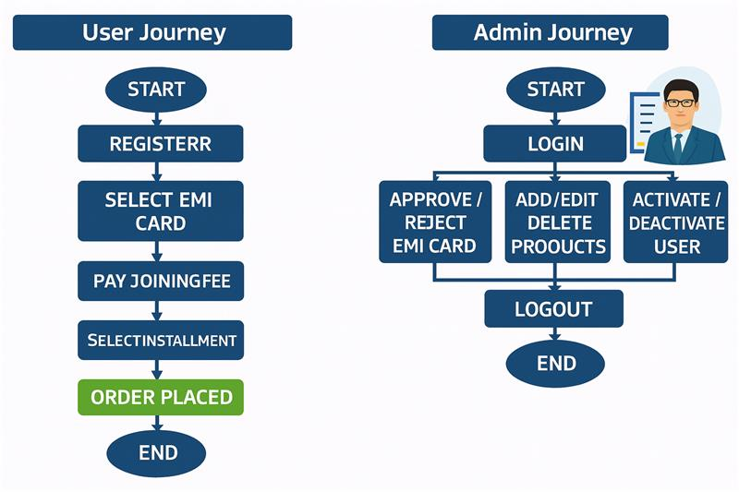
Flow Chart

Slide 5
Technologies Used
Fronted(View layer) Razor View Engin(.cshtml) css(for styling)
Backend ASP.Net MVC - Handles request routing controllers, and business logic ASP.NET Web API - used for data communication and api services
Databases Microsoft SQL Server- Store application data

Slide 6
Data Access Entity Frmaework - DB FirstApproch
Validation & security ModelState Validation - Serverside Validation JSON Serialization & Deserilaization - API data exchange
Tools Visual Studio -IDE GitHub - Source code management

Slide 7
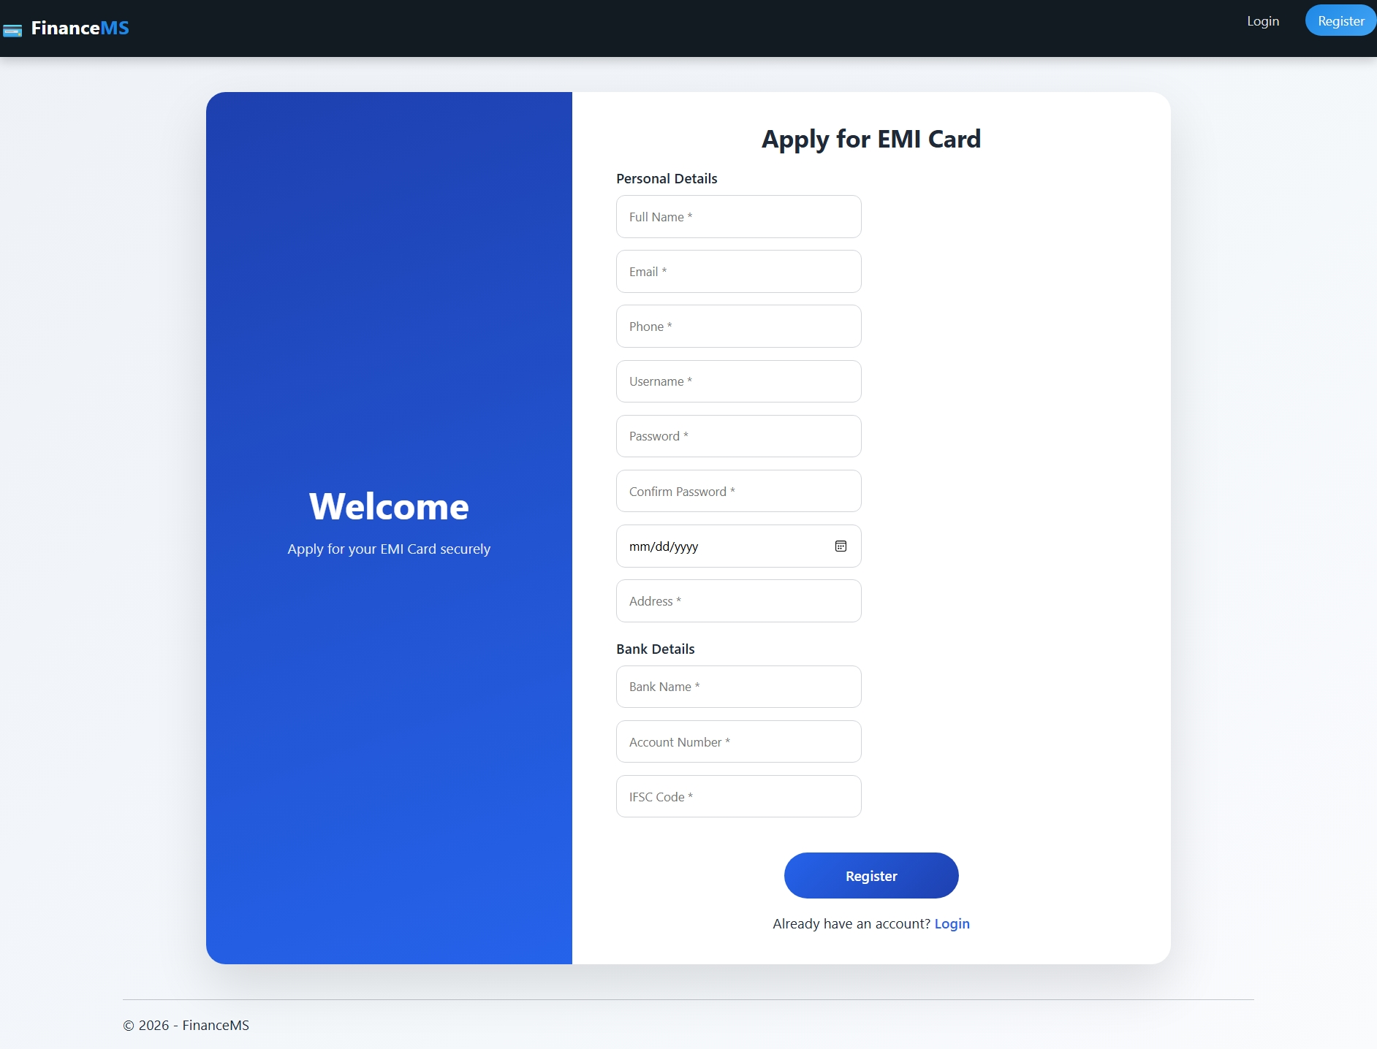
User Register
User opens Register Page
Enters:
Name, Email, Phone
Username & Password
Address
Bank details (Account No, IFSC)
Selects Card Type
Gold Card
Titanium Card
Submits registration form
User status = Pending Approval

Slide 8
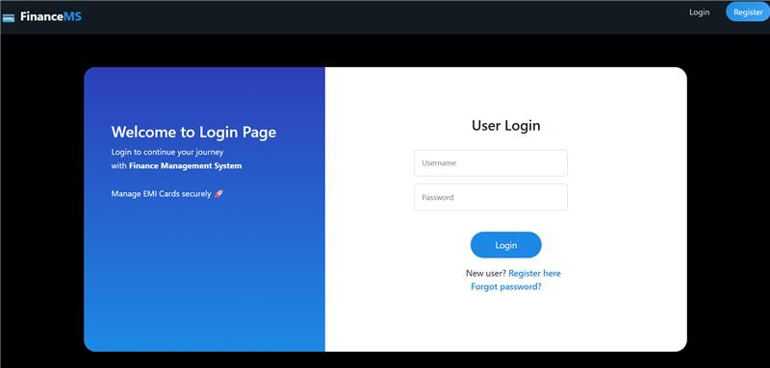
User Login
User enters:
Username
Password
System validates credentials
Login success:
Redirects to User Dashboard
Login failure:
Shows error message
User can login only after Admin approval

Slide 9
Admin Login/Dashboard
Admin Login
Admin logs in using admin credentials
Admin Dashboard
Admin can:
View all registered users
Verify documents
Activate or reject users
Manage products
Monitor EMI transactions

Slide 10
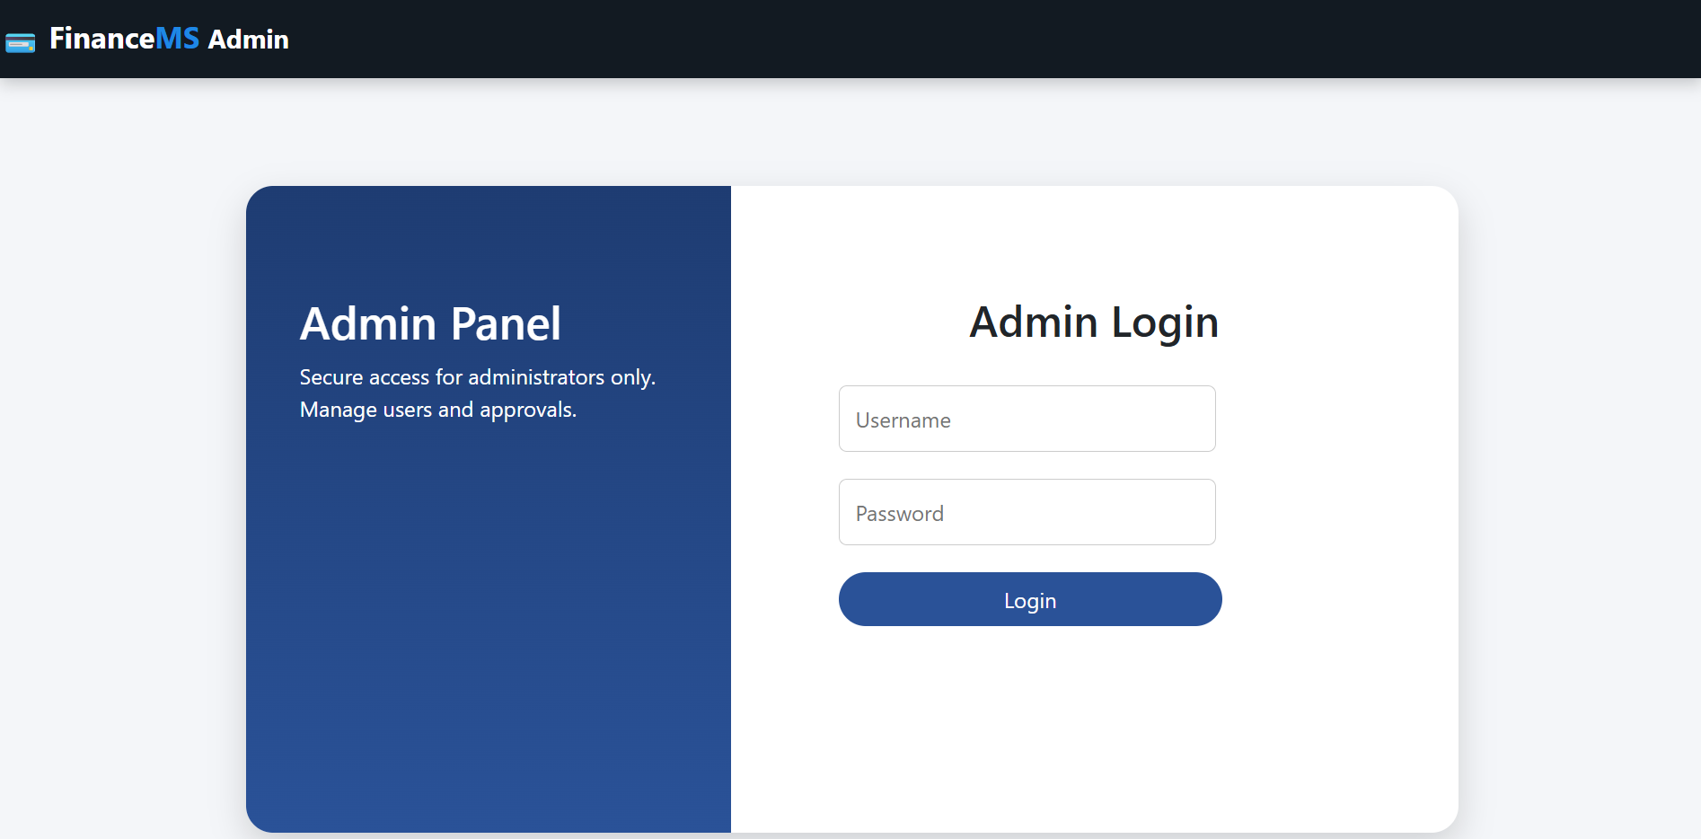
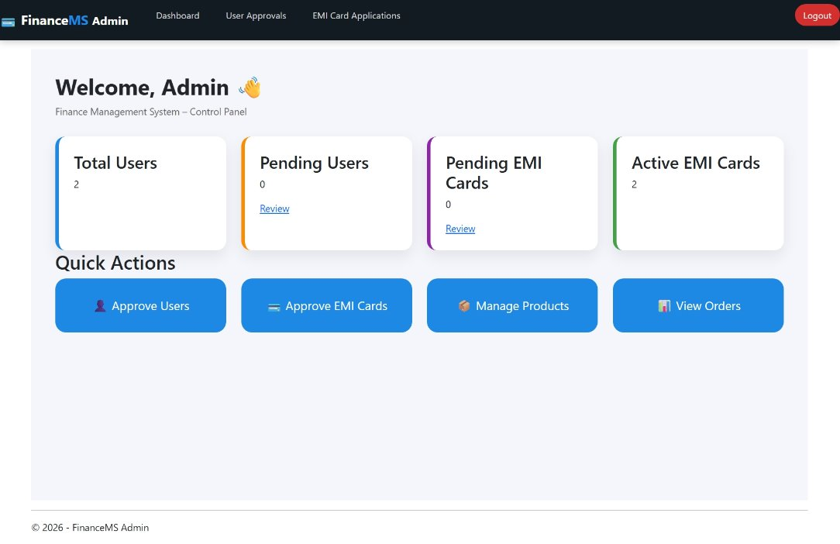
Admin Login/Dashboard

Slide 11
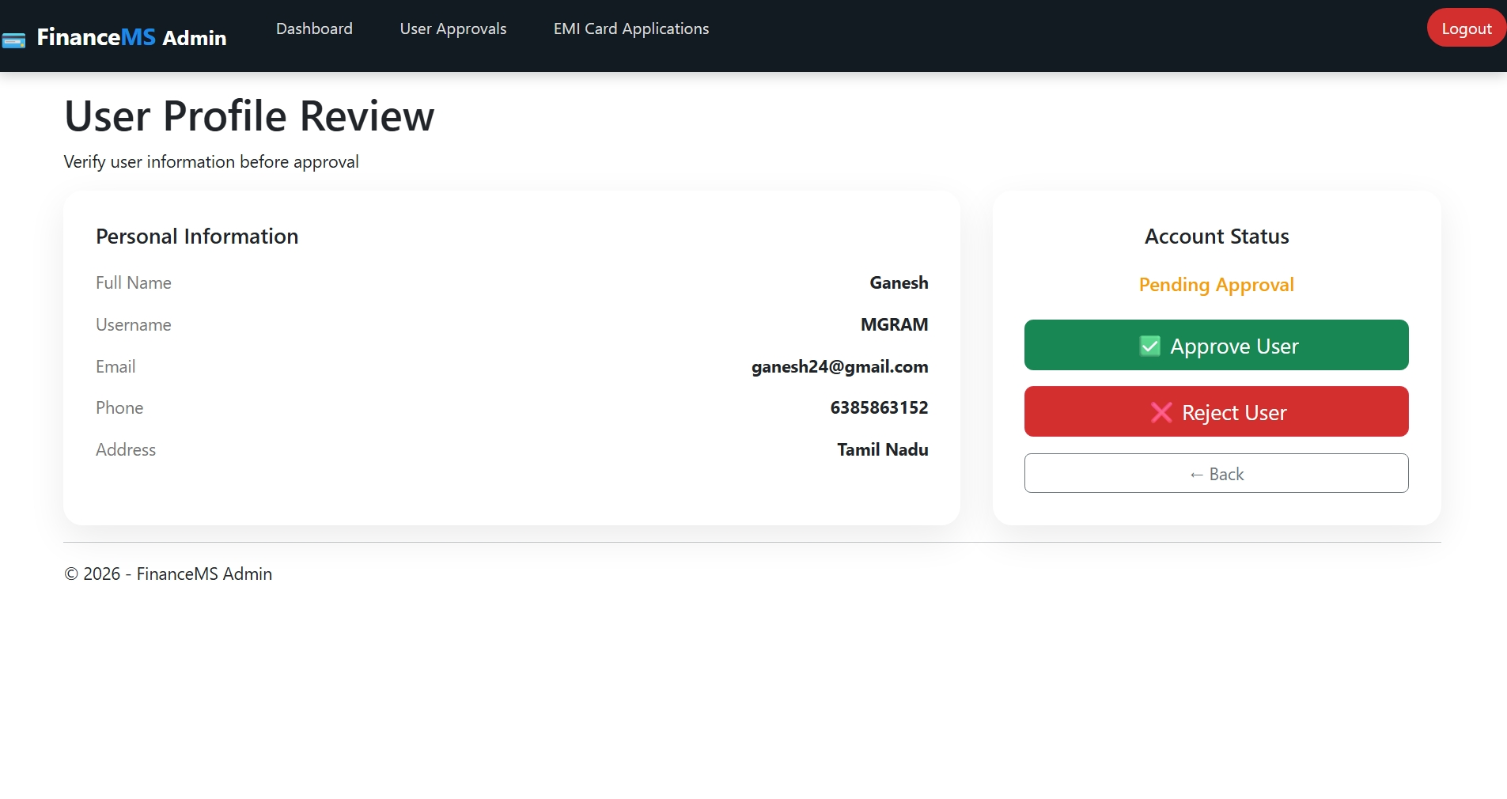
Admin Verification process
Admin checks user documents
Verifies:
Identity
Bank details
Eligibility
Activates user account
EMI card is issued
Card Activation
User pays joining fee
EMI card becomes active

Slide 12
EMI Card Feature
Virtual EMI Card
Card Types:
Gold
Titanium
Card includes:
Card Number
User Name
Validity Period
Credit Limit
Card limit depends on card type

Slide 13
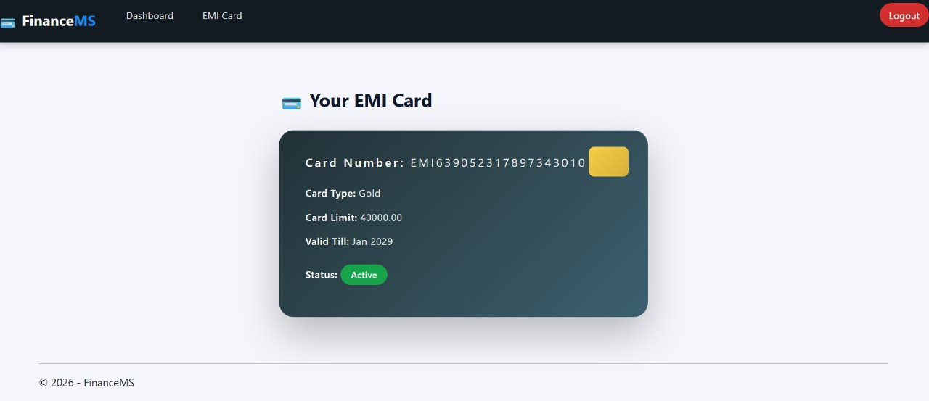
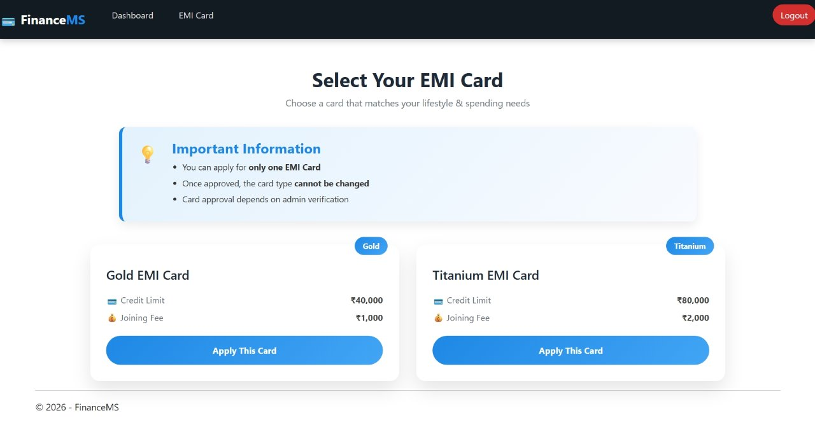
EMI Card Details

Slide 14
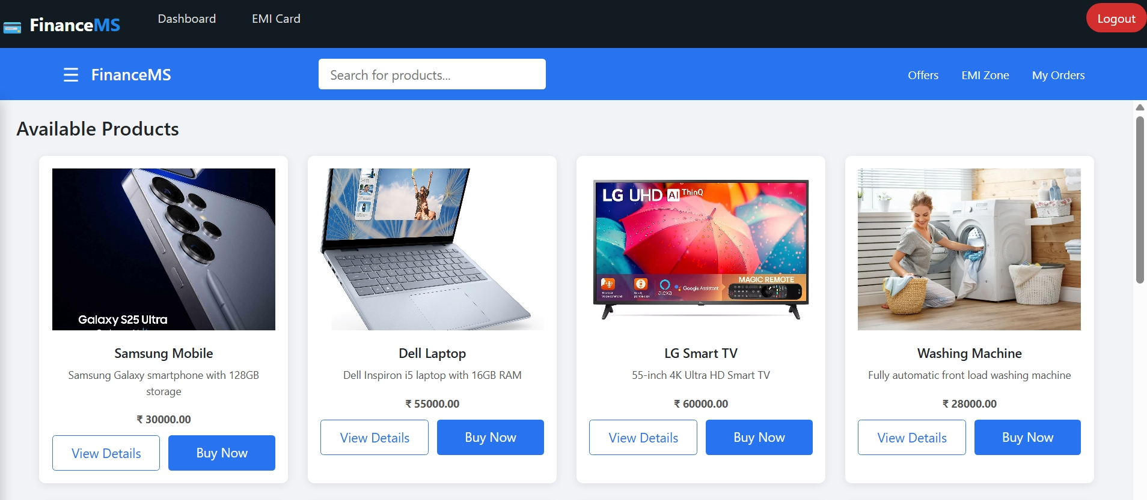
Product List
Product Module
Displays available products
Shows:
Product image
Description
Price
User clicks Buy Now

Slide 15
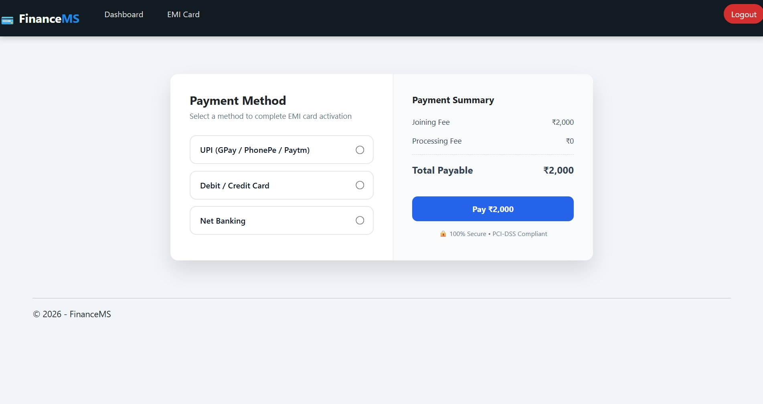
EMI Payment Flow
User selects EMI tenure
Monthly EMI displayed
User clicks Pay Now
EMI deducted from card limit
Payment successful
Pay button disabled for that month
Processing fee added

Slide 16
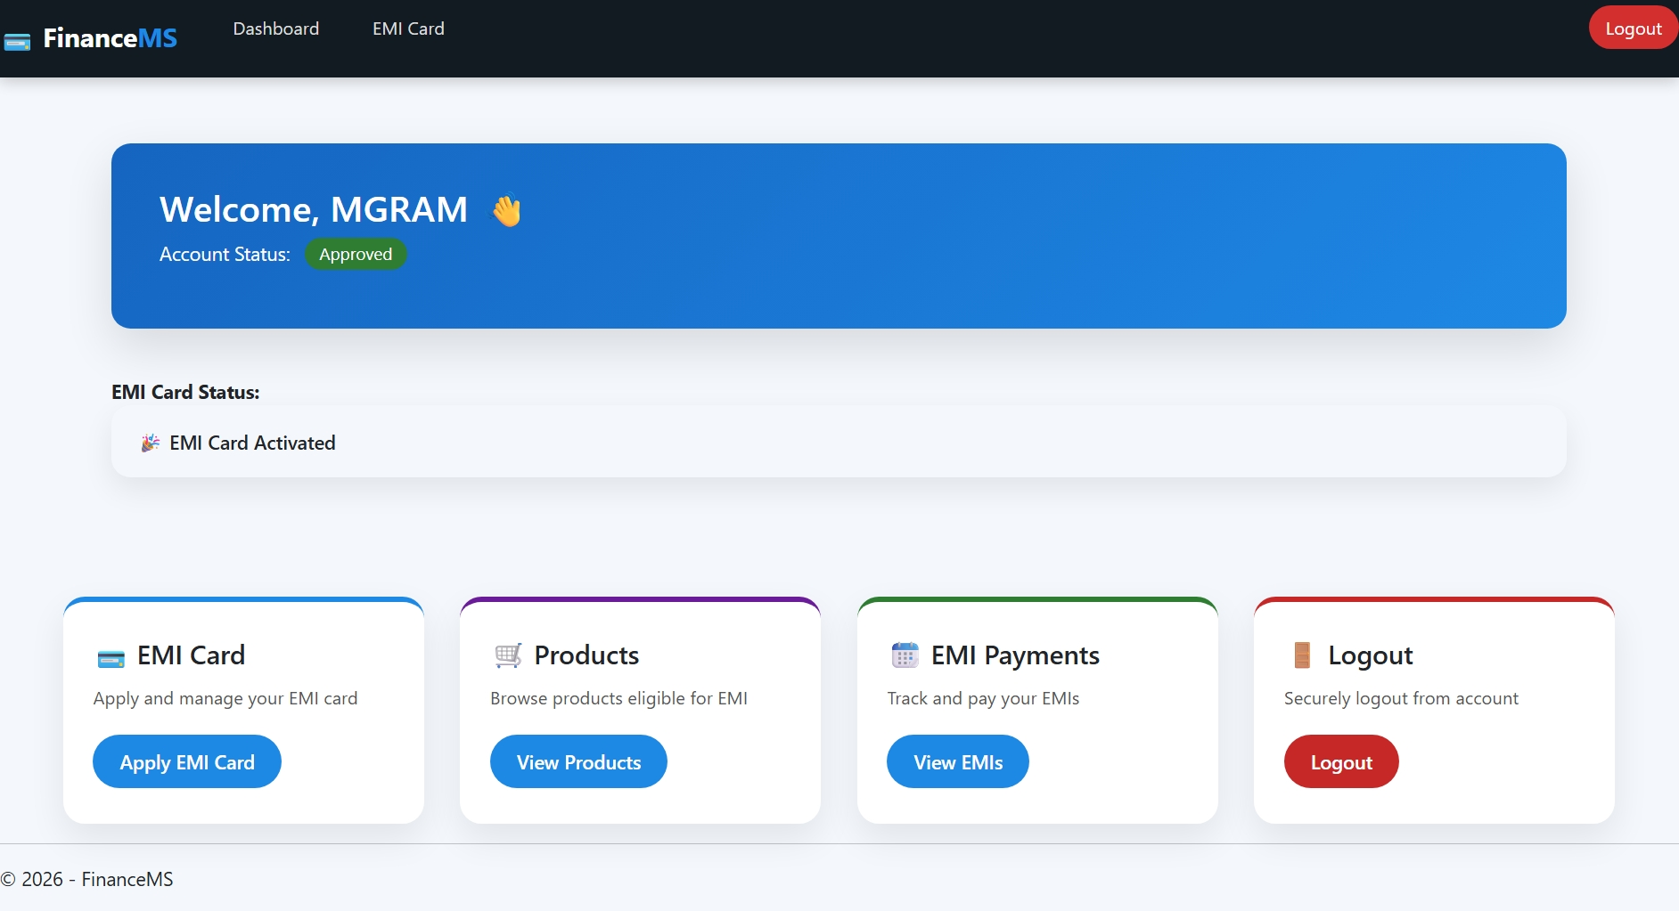
User Dashboard Features
EMI Card details
Total Credit
Used Credit
Remaining Balance
Purchased products list
EMI payment history
Upcoming EMI details
Complete user financial tracking

Slide 17
Conclusion
Secure EMI system
User friendly
No cost EMI
Admin controlled approvals

Slide 18
Thank you

