Slide 1
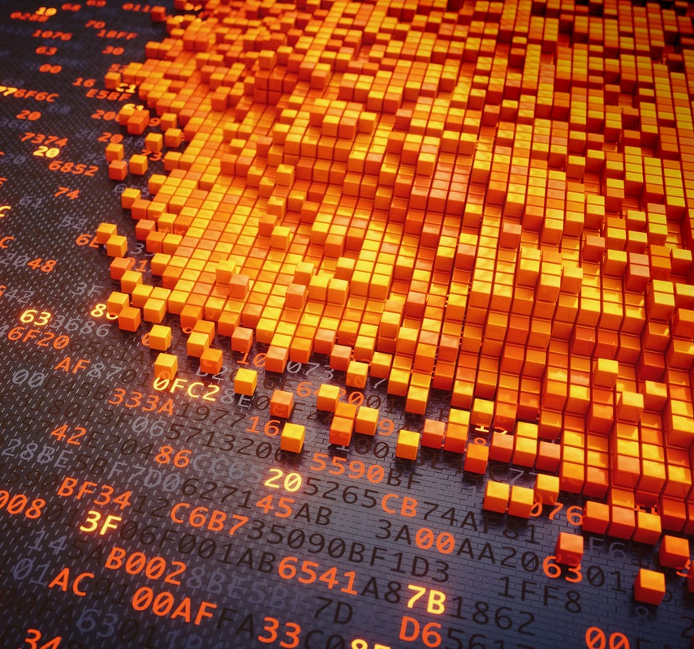
IMAGE STEGANOGRAPHY
USING PYTHON
- SAIRAM M

Slide 2
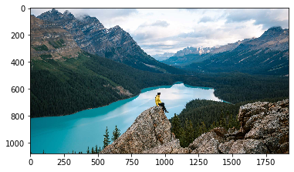
Step 1: Importing libraries and reading the image
import numpy as np
import matplotlib.pyplot as plt
import matplotlib.image as ig
img = ig.imread('img2.jpeg')
plt.imshow(img)
plt.show()
img.shape
img1 = np.array(img)
img1.shape
img1

Slide 3
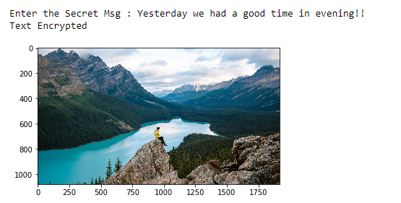
Step 2: 2.1 Creating Dictionary for character and its ASCII values 2.2 Text Encryption
mess = input('Enter the Secret Msg : ')
d = { }
for i in range(255):
d[chr(i)] = i
for v in range (len(mess)):
k = mess[v]
if k in d:
key = d[k]
img2[0][v][0] = key+img2[0][v][0]
print('Text Encrypted')

Slide 4
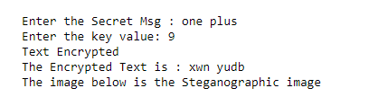
Step 3: Text Encryption using Caesar Cipher Encryption
for i in mess:
if i == " ":
c += i
elif mess.isupper():
c = c + chr(((ord(i) + b - 65) % 26) + 65)
elif mess.islower():
c = c + chr(((ord(i) + b - 97) % 26) + 97)
d = { }
for i in range(255):
d[chr(i)] = i
for v in range (len(c)):
k = c[v]
if k in d:
key = d[k]
img2[0][v][0] = key+img2[0][v][0]
print('Text Encrypted')
print(f"The Encrypted Text is : {c}")

Slide 5
Step 4: Image Comparison
Normal Image
Steganographic Image
While comparing both the image its obvious that there are no major visible changes.
Also the size of the image is same and hence it is not possible to differentiate normal image and Steganographic image

Slide 6
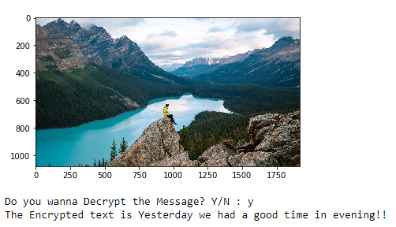
Step 5: Extracting the encrypted text from Steganographic image
o = input('Do you wanna find the Secret message from the image? Y/N : ').lower()
if o == 'y':
pas = input('Enter the passward: ').lower()
if pas == 'nopassword':
lis = []
for j in range (0, imge.shape[1]):
for i in range(0, imge.shape[0]):
for k in range (imge.shape[2]):
r = imge[i][j][k] - imgr[i][j][k]
if r>0:
lis.append(r)
lis
r = ""
for i in range (0, len(lis)):
for j,k in d.items():
if k == lis[i]:
r += j
print(f'The Secret text is {r}')

Slide 7
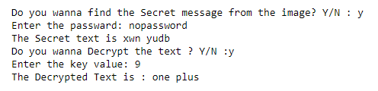
Step 6: Decrypting the text using Caesar cipher decryption
m = input('Do you wanna Decrypt the text ? Y/N :').lower()
if m == 'y':
n = r
b = int(input('Enter the key value: '))
c = ""
for i in n:
if i == " ":
c += i
elif n.isupper():
c = c + chr(((ord(i) - b - 65) % 26) + 65)
elif n.islower():
c = c + chr(((ord(i) - b - 97) % 26) + 97)
print(f"The Decrypted Text is : {c}")
else:
print('Good luck to find the secret msg!!')
else:
print('Incorrect password Access Denied')
else:
print('Good luck to find the secret msg!!')

Slide 8
Alternative Methods:
In this case we have used libraries like matplotlib for reading and writing on image, we can also use cv2 package to manipulate image matrices.
And to access the image matrix we have used numpy arrays to manipulate the numbers in image matrix.
We can also use pandas DataFrame for the same manipulation process by converting the image into an 2D matrix.
Over here we have used the Caesar cipher technique for Encryption and decryption of text we can use any of the alternative cipher for encryption & decryption.
Steganography techniques can be widely used in many form of data like Text, Video, Audio, Network & E-Mail to send encrypted message in a secret way.

Slide 9

THANK YOU !!!

