Slide 1

LINKEDIN JOB RECOMMENDER SYSTEM
Web Scraping Project

Slide 2
Mentor : Madishetti, Rajashekar TEAM INFO :
Shaik Mujahid Shariff
Mohd Ariz Khan
G Sreeram Satya
R. Sairam

Slide 3
Problem Overview :
Job seekers often struggle to find relevant job opportunities that match their skills and preferences, while employers may struggle to identify suitable candidates for their job openings. To address this challenge, a job recommender system can be developed to match job seekers with relevant job openings based on their skills and preferences. Additionally, web scraping from platforms like LinkedIn can provide valuable data on job listings and candidate profiles, enhancing the system's effectiveness.

Slide 4
OBJECTIVES :
Overall, the main objectives of this project are to build an efficient job recommender system using cosine similarity and web scraping from LinkedIn, improve job matching for job seekers, increase recruitment efficiency for employers, and provide valuable insights for business decision making.

Slide 5
Web Scraping :
Web Scraping from LinkedIn
We used web scraping techniques to extract job listings from LinkedIn, a popular professional networking platform. We collected data on job titles, job descriptions, level of experience required, and other relevant information from various job postings. This data was then used as the basis for job recommendations.

Slide 6

Create a web scraping tool using these libraries :
Creating login page and getting jobs page
Heading to jobs page
Changing pages and getting all links of pages
link added to lnk variable, now we are selecting only jobs links and adding them XT variable
Using links to get data from all the pages

Slide 7
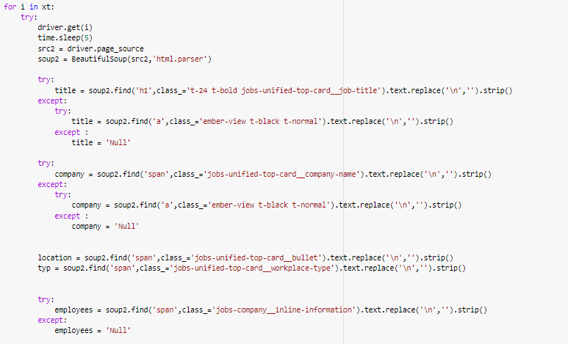

Slide 8
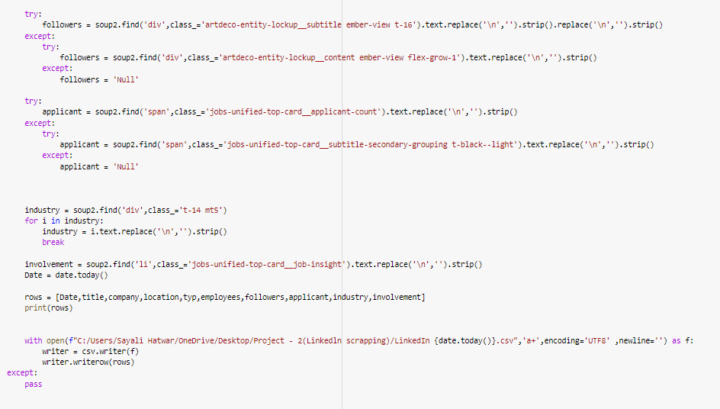

Slide 9
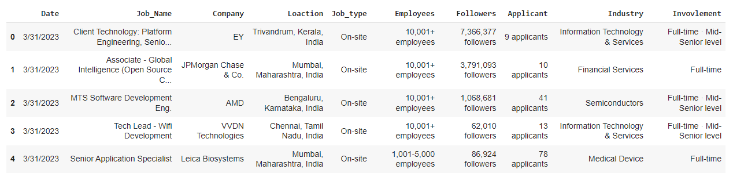
DATA DESCRIPTION :
We scraped the data through LinkedIn job postings.
Dataset contains 1127 rows and 11 columns.
There are some missing/duplicate values in the dataset.
Data Types :
* INT
* STRING

Slide 10
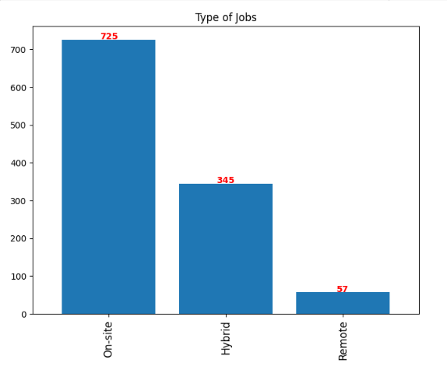
PERFORM EXPLORATORY DATA ANALYSIS :
Bar Graph for Top 3 type of jobs from our dataset
From the visuals, we can say that count of onsite is 725 are comparatively much higher than the other count of hybrid and remote scores.
Hence, from our data we can say most of the employees are highly doing the on-site jobs.

Slide 11
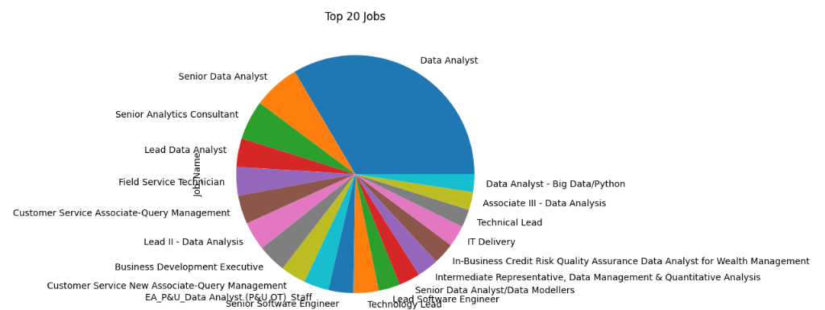
Pie Chart :
From above visuals, we can say that more than 30% of jobs are available for Data Analyst and remaining 70% jobs are like Lead Data Analyst, IT Delivery, Business Development Executive etc.
We have an unequal distribution of data, where we have less no. of other jobs given the companies.
Hence, our dataset is highly imbalanced dataset.

Slide 12
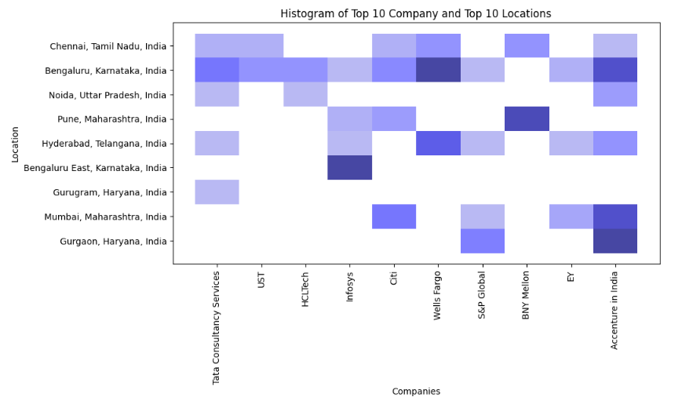
Histogram :
A histogram is a display of statistical information that uses rectangles to show the frequency of data items in successive numerical intervals of equal size. In the most common form of histogram, the independent variable is plotted along the horizontal axis and the dependent variable is plotted along the vertical axis.

Slide 13
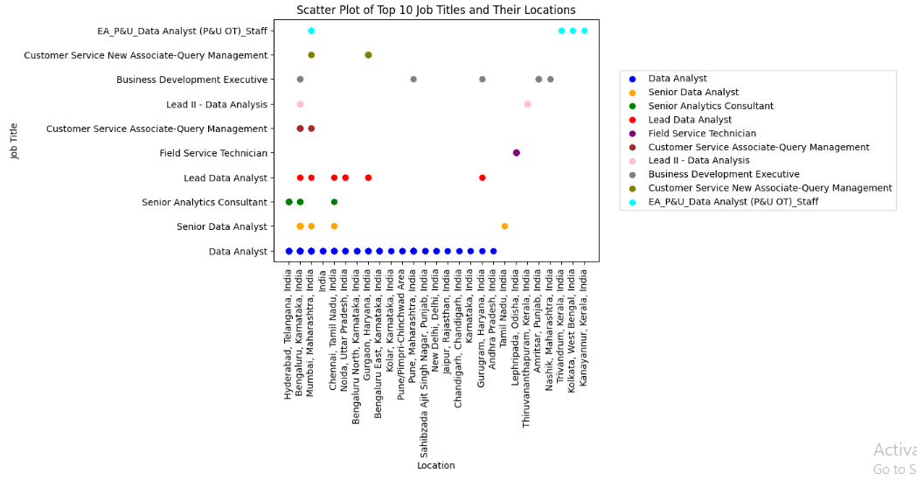
Scatter Plot :
A scatterplot shows the relationship between two quantitative variables measured for the same individuals. The values of one variable appear on the horizontal axis, and the values of the other variable appear on the vertical axis. Everyone in the data appears as a point on the graph.

Slide 14
Text-Cleaning :
Rename columns as according to our comfort and finding if we have any null then filling null values by 0.
Extracting numbers from follower's column and adding a new column which is INT type.
Extracting numbers from applicants from Applicant column adding a new column which is INT type.
Extracting numbers from employees from employees column adding a new column which is INT type.
Extract city, state, and country using regex patterns.
Clean Type of role column to remove any special characters or values. (ex : @, !!!, ----)
Cleaning job type column to remove special characters and adding a new column with the clean titles
Lowercasing all the text data.
Cleaning job title to remove any special characters.
Rearranging the columns as per our needs.

Slide 15
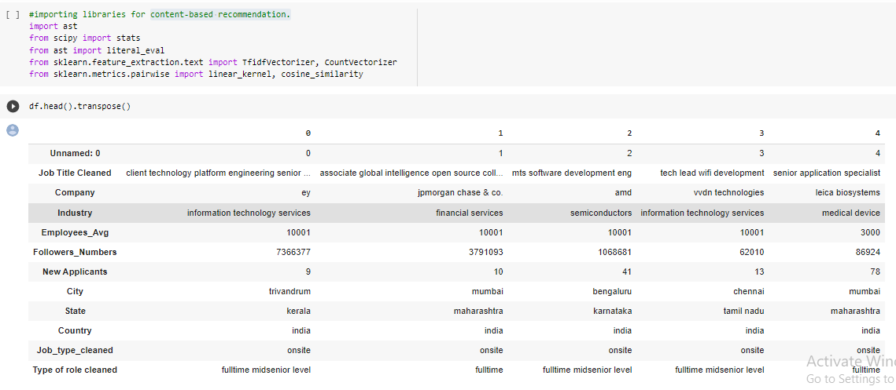
Content-based recommendation :

Slide 16
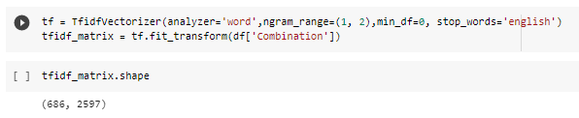
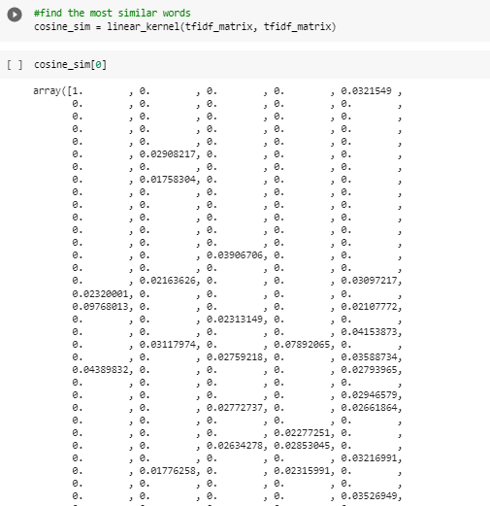
Vectorization :
The process of converting or transforming a data set into a set of Vectors is called Vectorization.

Slide 17
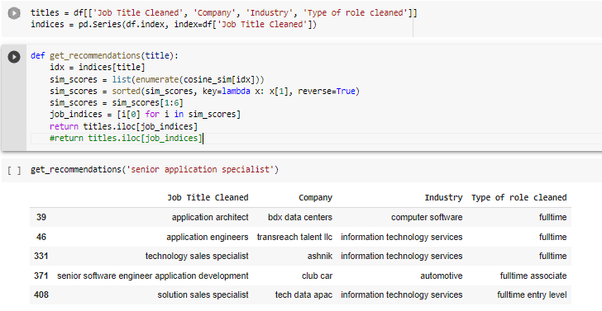
Cosine similarity :
Cosine Similarity: I utilized cosine similarity, a popular measure of similarity between two vectors, to calculate the similarity between job seekers' profiles and job listings. I transformed job seekers' profiles and job listings into vector representations and computed the cosine similarity score to measure the similarity between them.

Slide 18
Model Evaluation :
Job Recommender System: Based on the computed cosine similarity scores, We developed a job recommender system that could recommend relevant job listings to job seekers. The system ranked job listings based on their cosine similarity scores and presented the top-ranked job listings as recommendations to job seekers.
Model Evaluation: We evaluated the performance of the job recommender system using relevant metrics such as precision, recall, and F1 score. We also conducted user testing and obtained feedback from recruitment team members to fine-tune the system and improve its recommendations.

Slide 19
Model Deployment using Cosine Similarity :
Now that we have calculated accuracy score for all the models, we will select the best model i.e. Cosine Similarity to deploy our model locally and globally.

Slide 20

Model Deployment – Locally - Part - 1
Before we deploy our model, we need to load our model in our pickle format from where streamlit will run our main python file.
We use the below code to prepare the .pkl file and save it in our path.
Preparing the python file with our parameters(with all our prediction variables)
Saving the .py and .pkl file in our path so that we can run them locally.
We can deploy the model using anaconda prompt > create a virtual environment > create a folder to store our data files> run that folder using streamlit command.

Slide 21
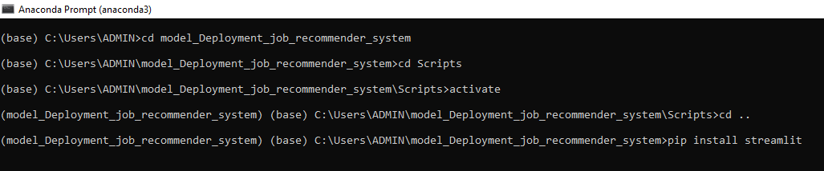
Model Deployment – Locally - Part - 2
Create a virtual environment and data folder in your local disk.
Run the model using streamlit (i.e. streamlit run Project_2.py). Which will create a local page (http://localhost:8501/)

Slide 22
Global Deployment – Part - 1
Here we will deploy our model globally, using GitHub and streamlit.
Below are the steps to follow :
Create a GitHub Account
Upload your data files in GitHub by creating a repository
Upload an additional file named requirements.txt, here you will need to add our libraries that will be required to run your file.
Open streamlit web page > share.streamlit.io
Open/Link your Github account with Streamlit account
Run streamlit/Deploy options to run the data file

Slide 23
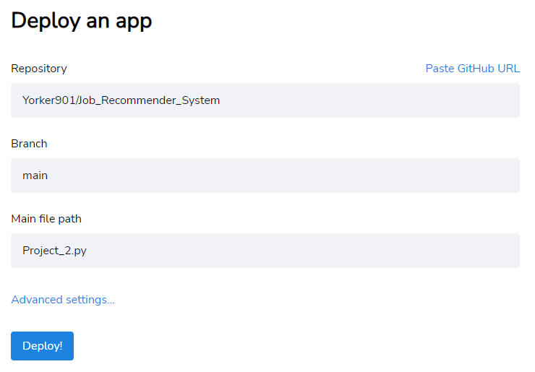
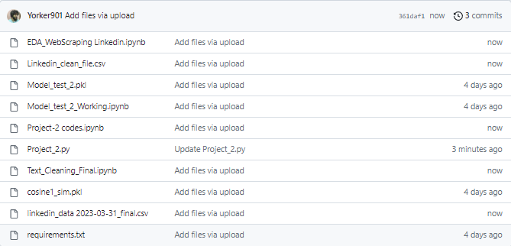
Global Deployment – Part - 2
Once you successfully select the repository>give the branch> .py file for model deployment.
Click Deploy > Your model is successfully deployed.
Model Deployment Link –> Access linkedin_job_recommender_system

Slide 24
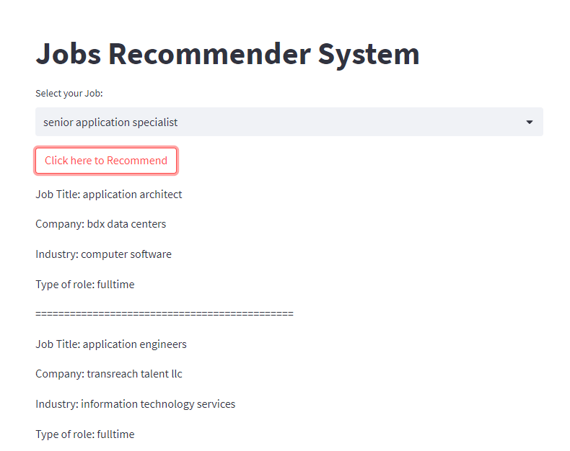

Slide 25
Challenges Faced :
Data Quality: Web scraping data from LinkedIn may pose challenges in terms of data quality. The data obtained from web scraping may contain inconsistencies, errors, or missing values. It could be challenging to clean and preprocess the data to ensure its accuracy and reliability for building a robust job recommender system.
Scalability: LinkedIn has a vast database of job postings, and web scraping a large amount of data could be time-consuming and resource-intensive. Managing and processing large amounts of data may require efficient coding techniques and handling memory constraints to ensure the system's scalability and performance.
Data Privacy and Legal Concerns: Web scraping data from LinkedIn raises potential legal and ethical concerns, as LinkedIn's terms of service may restrict or prohibit scraping their data. Ensuring compliance with relevant laws and regulations, such as data privacy and intellectual property rights, may be a challenge in this project.
Data Variability: Job postings on LinkedIn can vary in their structure, format, and content, making it challenging to extract relevant information consistently. Different job titles, descriptions, and skills may be used in different ways, requiring robust text mining and natural language processing techniques to extract meaningful features.
Recommendation Accuracy: Recommender systems rely on accurate and relevant data to provide meaningful recommendations. However, job postings on LinkedIn may not always accurately represent the skills or preferences of the users. Noise, biases, or incomplete information in the data may affect the accuracy and relevance of the recommendations, and addressing these challenges could be demanding.

Slide 26
Conclusion :
The job recommender system I built using cosine similarity and web scraping from LinkedIn provided significant value to the business by enhancing the job matching process. The system enabled personalized job recommendations to job seekers based on their skills, experience, and preferences, resulting in improved efficiency in finding the most relevant job opportunities. By leveraging data-driven techniques, the system saved time and resources for the recruitment team and increased the quality of job matches. The system also contributed to enhancing candidate experience and engagement by providing relevant and personalized job recommendations. Overall, the job recommender system helped the business in finding the right talent for their job openings and improving the recruitment process.

Slide 27
THANK YOU

