Slide 1

Team Info
Shaik Mujahid Shariff
Mohd Ariz Khan
Sidharth Kumar Sharma
G Sreeram Satya Sandilya
Sairam Ramasamy
Anshu Pyasi
Niranjan Reddy

Slide 2
Introduction
Churn prediction is one of the most popular big data set that are used cases in business. It consists of detecting customers who are likely to leave the company. Churn is a problem for telecom companies because it is more expensive to acquire a new customer than to keep your existing one from leaving the company.
Most of the telecom companies suffer from voluntary churn. Churn rate does have a strong impact on the life time value of the customer because it affects the length of service and also the future revenue for the company.
In this situation the company tries to identify in advance about the customers who are going to churn. Then the company especially for those customers will provide with some special offers. But this approach can bring the company a huge loss if it is not predicted accurately.

Slide 3
Objectives of the Project
To predict Customer churn.
Highlighting the main variables/factors influencing Customer churn.
Using various ML algorithms to build prediction models, evaluate the accuracy for each model and performance of the models.
Finding out the best model for our business case and provide executive summary.

Slide 4
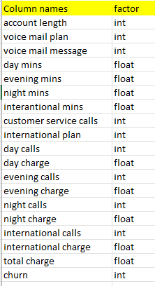
Dataset Description
Source of data is in csv format.
Dataset contains 3,333 rows and 19 columns.
There is no missing values in the dataset given to us.
Churn status is the variable which notifies that the particular customer has churned or not. And we have to develop different models and from that choose the best model which is giving correct prediction to the variable.

Slide 5
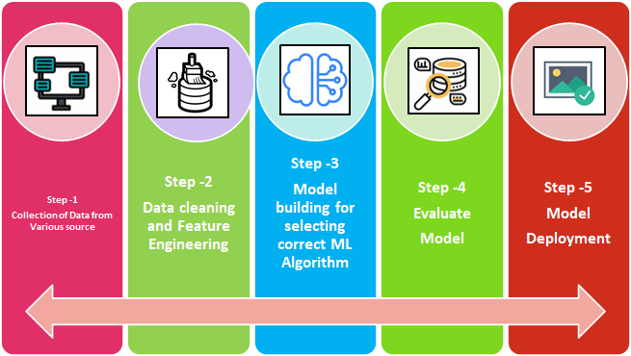
Model Building Steps

Slide 6
Define problem
In this project, we will be addressing customer churn problem of fictitious telecom company. It has provided us the usage pattern of 3,333 customers over a period of a time and also provided us that the particular customer is churned or not.
Utilizing the input data what we got, we have to build a model which can be predicted that the customer is going to be churned or not well in advance.
Perform EDA
We have to perform EDA(Exploratory Data Analysis) to understand the data in better manner and its problem. Understanding how the data and its feature are interrelated and correlated, evaluate the presence of outliers in the data and its effects. We will be using different types of box plots and bar plots so that to understand what are the features which majorly impact on our outcome variable ‘churn’ .

Slide 7
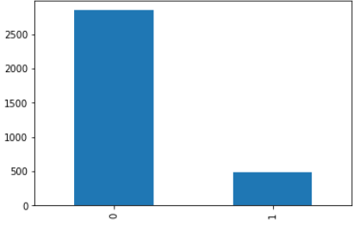
Exploratory Data Analysis (EDA)
Bar Graph
It shows that 85% of the users from the
telecom company will be continuing their
service In the company.
Not Churn =2850
Churn =483

Slide 8
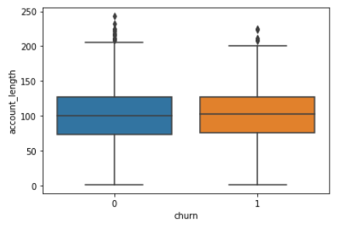
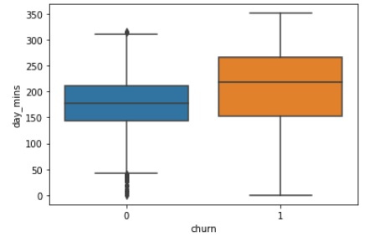
Box Plot
We found that they are outliers in existing data set which means that they are out of the whisker's lengths(Upper & Lower). An outlier is an observation that is numerically distant from the rest of the data.
By applying Boxplot, we can find out that how many outliers are there in the data set.
By doing this we have found that there 230 outliers in the dataset.

Slide 9
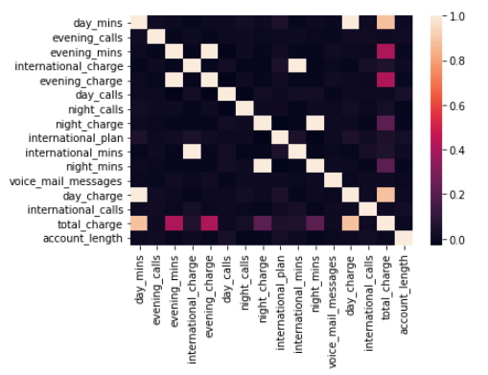
Heat Map
A Heat map is a two-dimensional tabular representation of data with a range of values represented by different colors. Each squares shows the correlation between the variables on each x-axis.
The correlation ranges from -1 to +1.

Slide 10
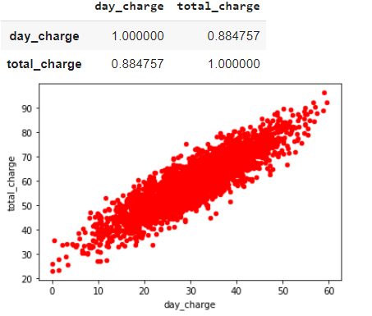
Scatter Plot
It is a chart that shows the relationship between two variables. It determines that whether our X variable is having strong correlation or Weak correlation with our target variable based on that we can choose which of the X variables are highly correlated with our target variable.

Slide 11
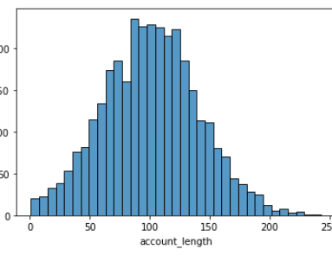
Histogram
It represents the distribution of a continuous variable over a given interval or a period. They are divided into intervals called as ‘bins’. It shows the skewness of the data. It gives the result as our data is in symmetric, Positively skewed and Negatively skewed.

Slide 12
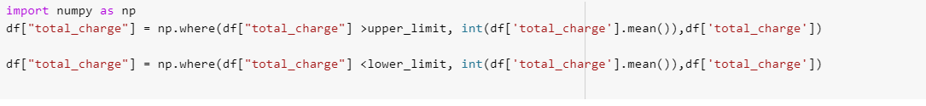
Handling with the Outliers
We have seen that by using boxplot we have found that in our data there 230 outliers and to deal with we have few techniques, and they are as follows:
1.) Trimming- In this technique we remove the outliers totally from our data set.
2.) Capping – In this technique, the outliers are capped at a certain value above the 90th percentile or below 10th percentile.
3.) Mean/Median imputation- As the mean value is highly influenced by the outliers, it is advised to replace the outliers with the mean value.
We have chosen to replace the outliers with the mean as we did not want our data to be completely been removed. As it will be helpful to predict the data correctly.

Slide 13
Accuracy of various models
Models | Accuracy | Sensitivity | Precision | F1 Score | Specificity
Logistic | 85.3 | 10.1 | 37.8 | 16 | 97.3

Slide 14
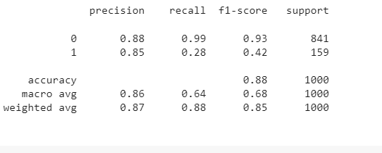
KNN
Train/Test Data | Accuracy | Precision Score | Recall Score | F1 Score
Training Data | 88 | 88 | 99 | 93
Test Data | 86 | 85 | 28 | 42

Slide 15
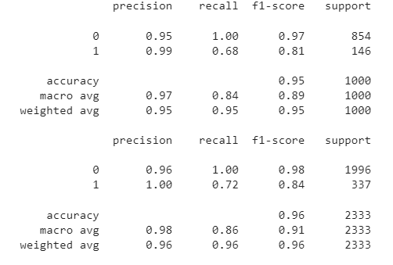
Decision Tree Classifier
Train/Test | Accuracy | Specificity Score | Sensitivity/Recall | Precision Score | F1 Score
Training Data | 96 | 95.5 | 72.4 | 100 | 84
Test Data | 95.3 | 94.9 | 68.5 | 99 | 81

Slide 16
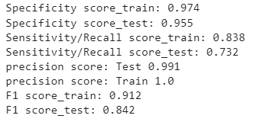
Decision Tree Classifier (Entropy)
Train/Test | Accuracy | Specificity Score | Sensitivity/Recall | Precision Score | F1 Score
Training Data | 97.7 | 97.4 | 83.8 | 100 | 91.2
Test Data | 95.9 | 95.5 | 73.2 | 99.1 | 84.2

Slide 17
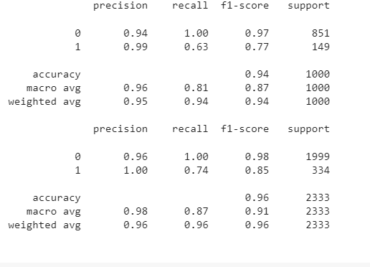
Random Forest Classifier
Train/Test | Accuracy | Specificity Score | Sensitivity/Recall | Precision Score | F1 Score
Training Data | 93.5 | 93 | 55.2 | 100 | 71.1
Test Data | 93.4 | 92.8 | 54.8 | 100 | 70.8

Slide 18
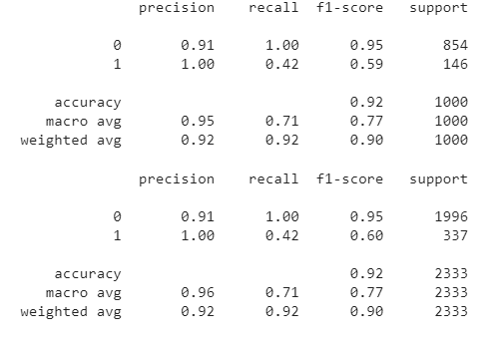
Random Forest Classifier (Gini)
Train/Test | Accuracy | Specificity Score | Sensitivity/Recall | Precision Score | F1 Score
Training Data | 91.7 | 91.1 | 42.4 | 100 | 59.6
Test Data | 91.5 | 90.9 | 41.8 | 100 | 58.9

Slide 19
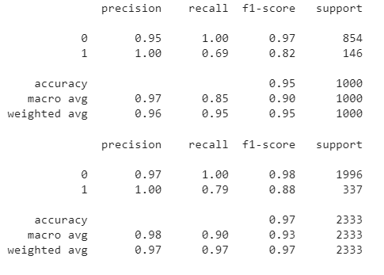
Random Forest Classifier (Entropy)
Train/Test | Accuracy | Specificity Score | Sensitivity/Recall | Precision Score | F1 Score
Training Data | 97 | 96.6 | 79.2 | 100 | 88.4
Test Data | 95.5 | 95 | 69.2 | 100 | 81.8

Slide 20
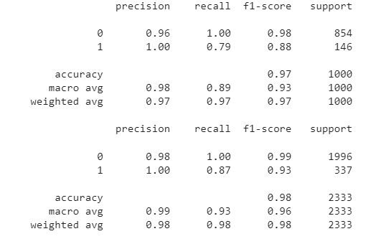
Gradient Boosting Classifier
Train/Test | Accuracy | Specificity Score | Sensitivity/Recall | Precision Score | F1 Score
Training Data | 98.1 | 97.8 | 86.9 | 100 | 93
Test Data | 96.9 | 96.5 | 78.8 | 100 | 88.1

Slide 21
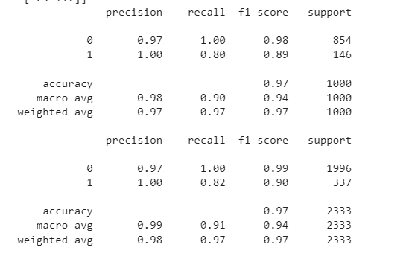
ADA Boost Classifier
Train/Test | Accuracy | Specificity Score | Sensitivity/Recall | Precision Score | F1 Score
Training Data | 97.4 | 97.1 | 82.2 | 100 | 90.2
Test Data | 97.1 | 96.7 | 80.1 | 100 | 89

Slide 22
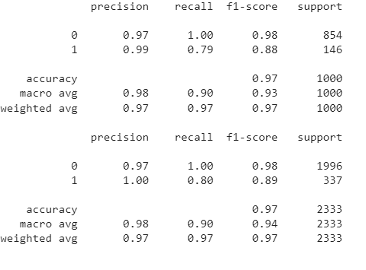
XGBoost Classifier
Train/Test | Accuracy | Specificity Score | Sensitivity/Recall | Precision Score | F1 Score
Training Data | 97.1 | 96.8 | 80.1 | 100 | 89
Test Data | 96.9 | 96.6 | 79.5 | 99.1 | 88.2

Slide 23
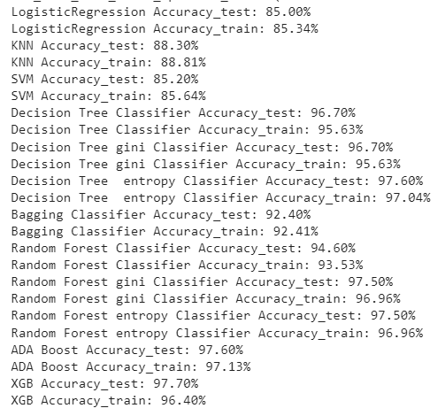
Selecting the best model
In this classification model we have created different models using ML Algorithms to measure the performance of the model that gives us best accuracy rate to predict the data. As we have the performance results with us for the models, we will select the best one out of them which suits for our business models and predicts correctly.
Decision Tree, Random Forest, ADA Boost and XGB Boost suits best for our model and gives the perfect prediction.

Slide 24
Model Deployment using Random Forest
Now that we have calculated accuracy score for all the models, we will select the best model i.e. random forest using Gini Index to deploy our model locally and globally.

Slide 25
Model Deployment – Locally – Part 1
Before we deploy our model, we need to load our model in our pickle format from where streamlit will run our main python file.
We use the below code to prepare the .pkl file and save it in our path(# Saving the model to disk - dump(rfc, open('rfcintel1.pkl', 'wb’)))
Preparing the python file with our parameters(with all our prediction variables)
Saving the .py and .pkl file in our path so that we can run them locally.
We can deploy the model using anaconda prompt > create a virtual environment > create a folder to store our data files> run that folder using streamlit command.

Slide 26
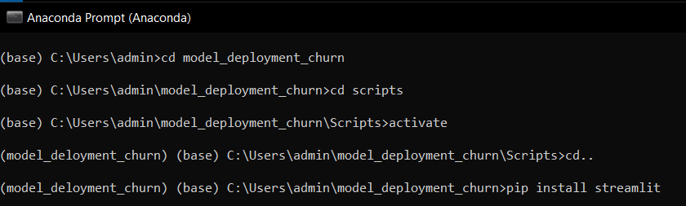
Model Deployment – Locally – Part 2
Create a virtual environment and data folder in your local disk.
Run the model using streamlit (i.e. streamlit run random_for.py). Which will create a local page (http://localhost:8501)

Slide 27
Model Deployment – Globally – Part 1
Here we will deploy our model globally, using GitHub and streamlit.
Below are the steps to follow :
Create a GitHub Account
Upload your data files in GitHub by creating a repository
Upload an additional file named requirements.txt, here you will need to add our libraries that will be required to run your file.
Open streamlit web page > share.streamlit.io
Open/Link your Github account with Streamlit account
Run streamlit/Deploy options to run the data file

Slide 28
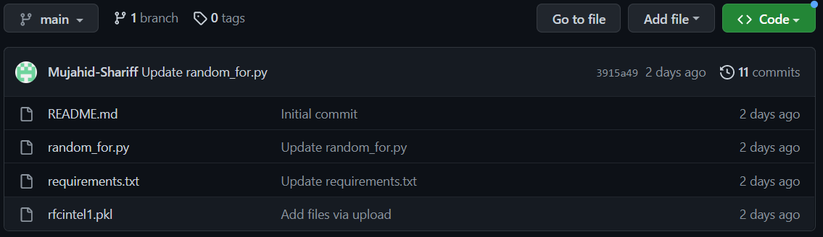
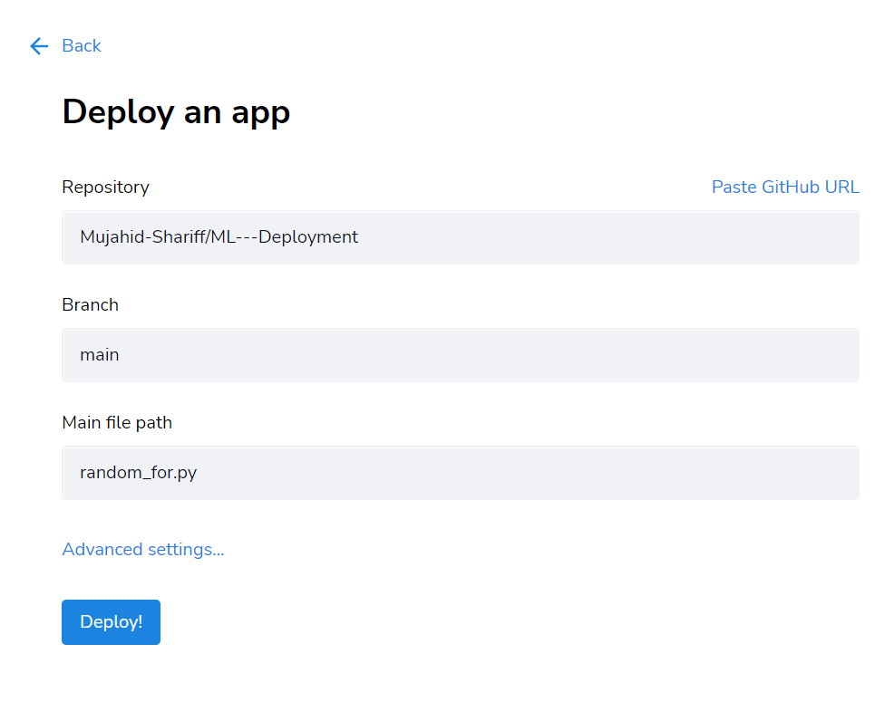
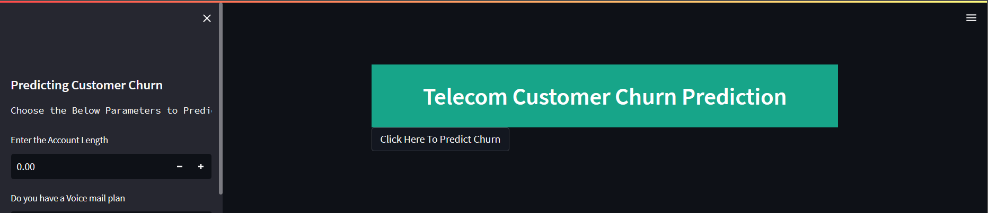
Once you successfully select the repository>give the branch> .py file for model deployment.
Click Deploy > Your model is successfully deployed.
Model Deployment Link –> Access Churn Prediction

Slide 29
Thank You

