Slide 1
CNN Architecture
CNN Architecture
Input
Conv2D
Conv2D
Conv2D
C-32,K-3*3,A-Relu,P-Same,R-L2
C-64,K-3*3,A-Relu,P-Same,R-L2
C-128,K-3*3,A-Relu,P-Same,R-L2
Conv2D
BN
Conv2D
BN
Conv2D
BN
C-32,K-3*3,A-Relu,P-Same,R-L2
C-64,K-3*3,A-Relu,P-Same,R-L2
C-128,K-3*3,A-Relu,P-Same,R-L2
BN
BN
BN
MP(2,2)
MP(2,2)
MP(2,2)
DP(0.2)
DP(0.3)
DP(0.4)
C- Channel
K- Kernel
P- Padding
R- Regularizer
A- Activation
BN- Batch Normalization
MP- Max Pooling
DP – Drop out
Flatten
Dense ,A- ‘softmax’

Slide 2
Homework 6 – CIFAR10
Problem | 1
Training Set | 20000
Testing Set | 10000
Mini Batch Size | 128
Total Number of Parameters | 309290
Optimizer | Adam
Initializer | Glorat
Learning Rate | 0.001
Epochs | 100
Regularizer | L2
Training Accuracy | 0.96
Testing Accuracy | 0.78
r | 0.22
Hidden Layer Activation | Relu
Output Layer | Softmax

Slide 3
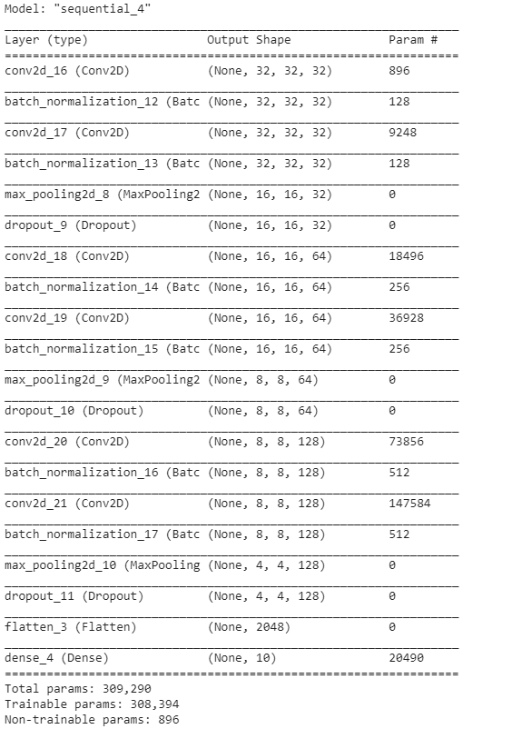
Model Summary

Slide 4
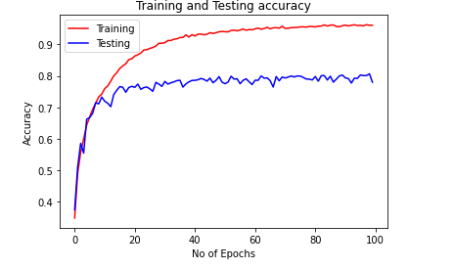
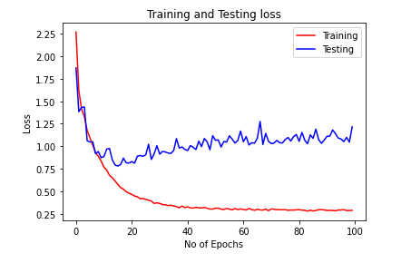

Slide 5
Problem 2 with Augmentation
Problem | 1
Training Set | 20000
Testing Set | 10000
Mini Batch Size | 128
Total Number of Parameters | 309290
Optimizer | Adam
Initializer | Glorat
Learning Rate | 0.001
Epochs | 100
Regularizer | L2
Training Accuracy | 0.93
Testing Accuracy | 0.82
r | 0.23
Hidden Layer Activation | Relu
Output Layer | Softmax
I tried different augmentation techniques but with only horizontal flip I got better accuracy

Slide 6
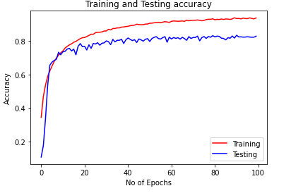
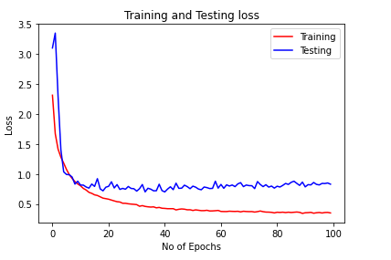

Slide 7
Code Collab Links
Problem 1: https://colab.research.google.com/drive/1AqNi7unvRk-NkKId3wHfRtu5WUVmiloC
Problem 2: https://colab.research.google.com/drive/1medLw3hqpZ5NJ3M6PaLIJZrurKGjZo98

