Slide 1
LSTM Architecture
Input
Embedding Layer (Vocab-8000,Dimension-128,maxLength-250)
Bidirectional LSTM(32)
GlobalMaxPool1D()
Dense(20,Act-Relu)
Dropout(0.05)
Dense(1,Act-Sigmoid)
Output

Slide 2
Homework 6 – IMDB
Problem | 1
Training Set | 25000
Testing Set | 25000
Mini Batch Size | 128
Total Number of Parameters | 42537
Optimizer | Adam
Initializer | Glorat
Learning Rate | 0.001
Epochs | 10
Training Accuracy | 0.9945
Testing Accuracy | 0.8798
r | 0.299
Hidden Layer Activation | Relu
Output Layer | Sigmoid

Slide 3
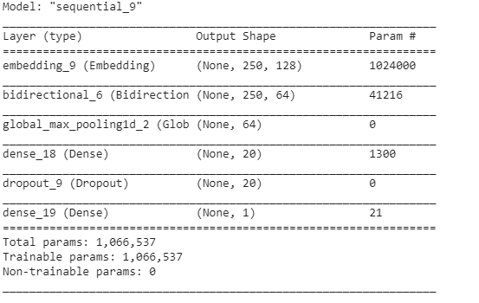
Model Summary

Slide 4
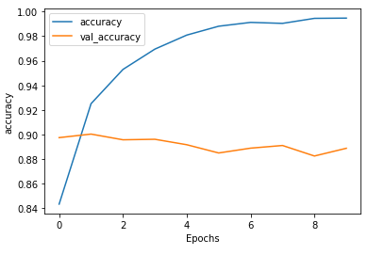
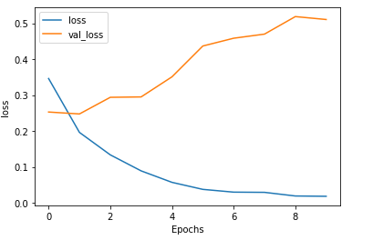

Slide 5
GRU Architecture
Input
Embedding Layer (Vocab-8000,Dimension-128,maxLength-250)
Bidirectional GRU (32)
Dense(6,Act-Relu)
Dense(1,Act-Sigmoid)
Output

Slide 6
Problem | 2
Training Set | 25000
Testing Set | 25000
Mini Batch Size | 128
Total Number of Parameters | 42537
Optimizer | Adam
Initializer | Glorat
Learning Rate | 0.001
Epochs | 10
Training Accuracy | 0.9827
Testing Accuracy | 0.89
r | 0.315
Hidden Layer Activation | Relu
Output Layer | Sigmoid

Slide 7
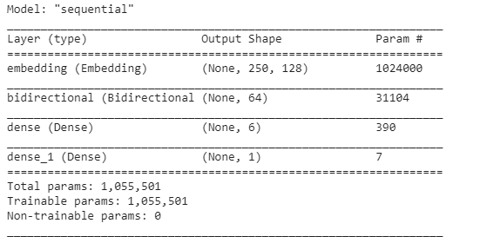
Model Summary

Slide 8
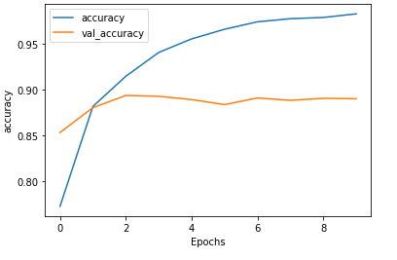
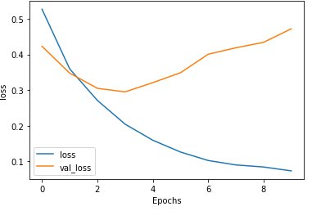

Slide 9
Conv1D Architecture
Input
Embedding Layer (Vocab-8000,Dimension-128,maxLength-250)
Conv1D(Channels-128,kernel-5)
GlobalMaxPool1D()
Dense(64,Act-Relu)
Dropout(0.05)
Dense(1,Act-Sigmoid)
Output

Slide 10
Problem 2 with Augmentation
Problem | 3
Training Set | 25000
Testing Set | 25000
Mini Batch Size | 128
Total Number of Parameters | 90369
Optimizer | Adam
Initializer | Glorat
Learning Rate | 0.001
Epochs | 10
Training Accuracy | 0.9944
Testing Accuracy | 0.8725
r | 0.277
Hidden Layer Activation | Relu
Output Layer | Sigmoid

Slide 11
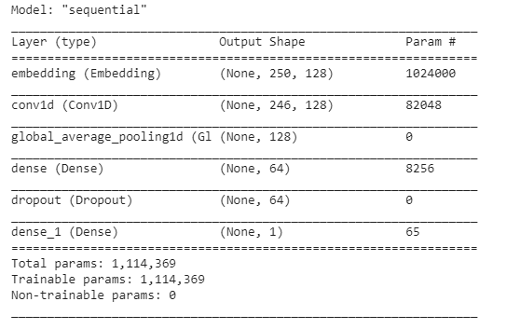

Slide 12
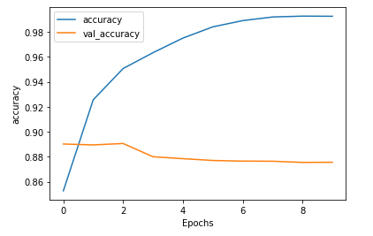
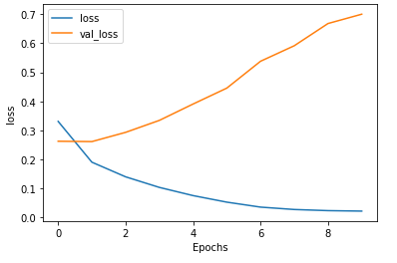
Model Summary

Slide 13
Code Collab Links
LSTM:https://colab.research.google.com/drive/1RhrzqsiNiK5gUsBFbAvZFGSRHHCJJXps
GRU:https://colab.research.google.com/drive/1aLMuAGwst_UgjyqLkNYMMH6H0Gc7YEsr
Conv1D:https://colab.research.google.com/drive/1YHxwuQ0ruVt2VnCYk2ktdt4cLVNqNzOK

