Slide 1
INF551 – Foundations of data management project proposal (PPT)

Slide 2
Databases:
Apart from the “world” database provided as the required database by the faculty team and post researching around 50+ databases from several online repositories like Kaggle, Google Datasearch, MySQL databases and sample databases from Microsoft.
We selected 2 databases relating to:
SF Bay Area Bike Share and
Questions from Cross Validated Stack Exchange.
These databases were selected because of several reasons despite satisficing project requirements of having 3 related tables with over 100+ records in each table.
Links for these databases are:
SF Bay Area Bike Share:
https://www.kaggle.com/benhamner/sf-bay-area-bike-share
Questions from Cross Validated Stack Exchange:
https://www.kaggle.com/stackoverflow/statsquestions

Slide 3
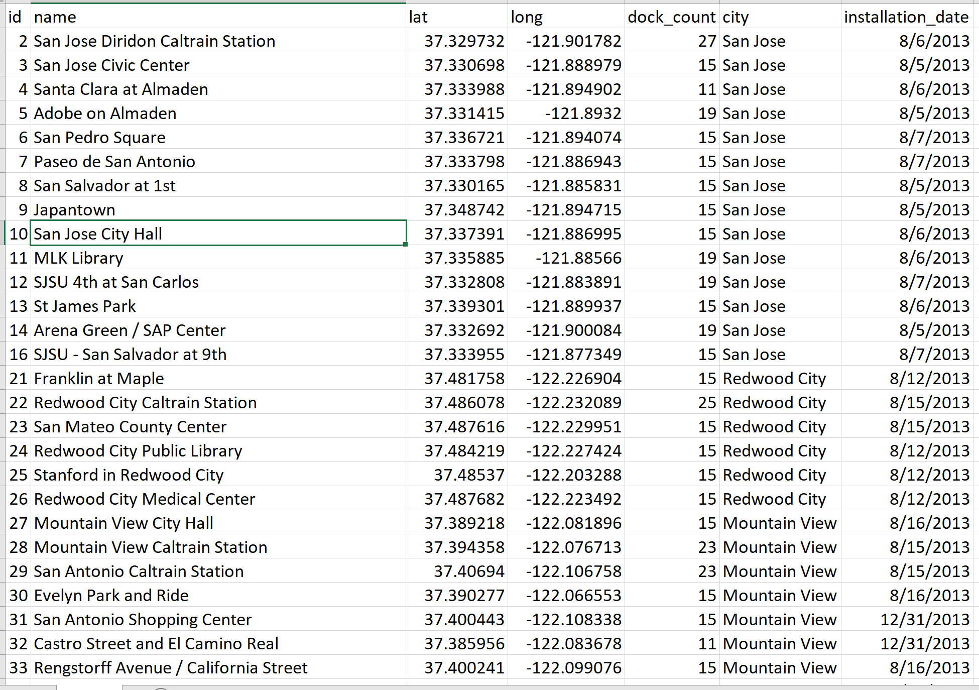
Example Data – SF Bay Area Bike Share Database:
Table Station:

Slide 4
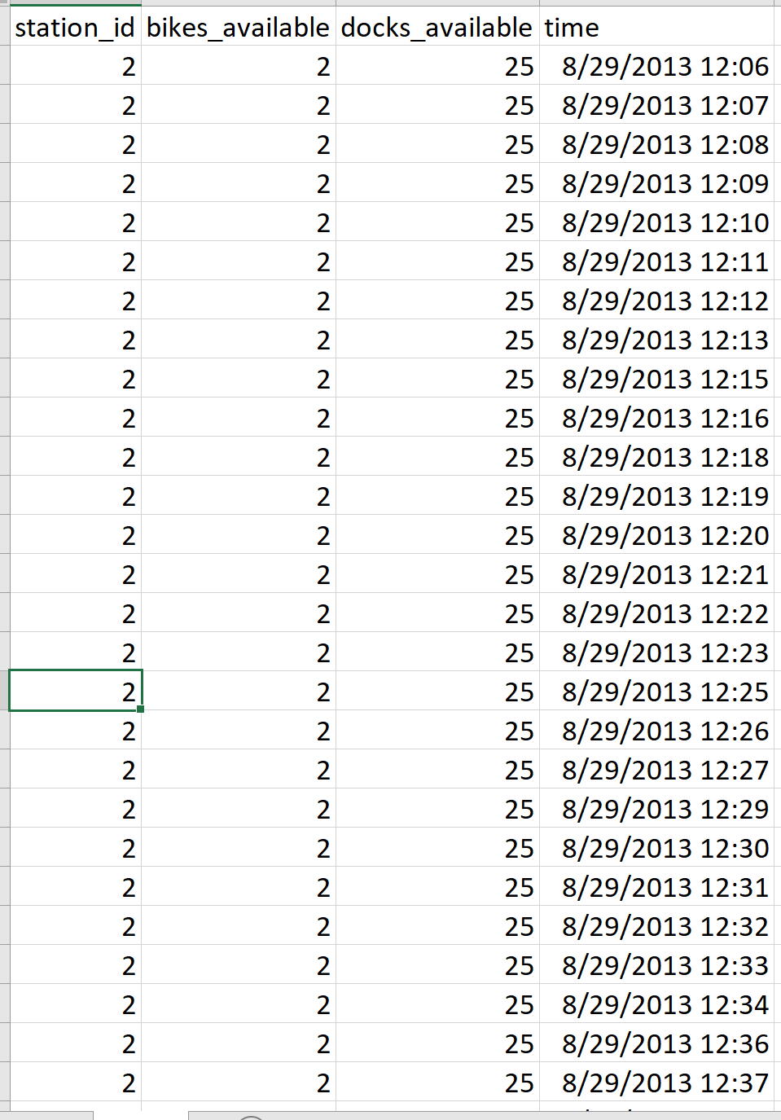
Table Status:

Slide 5
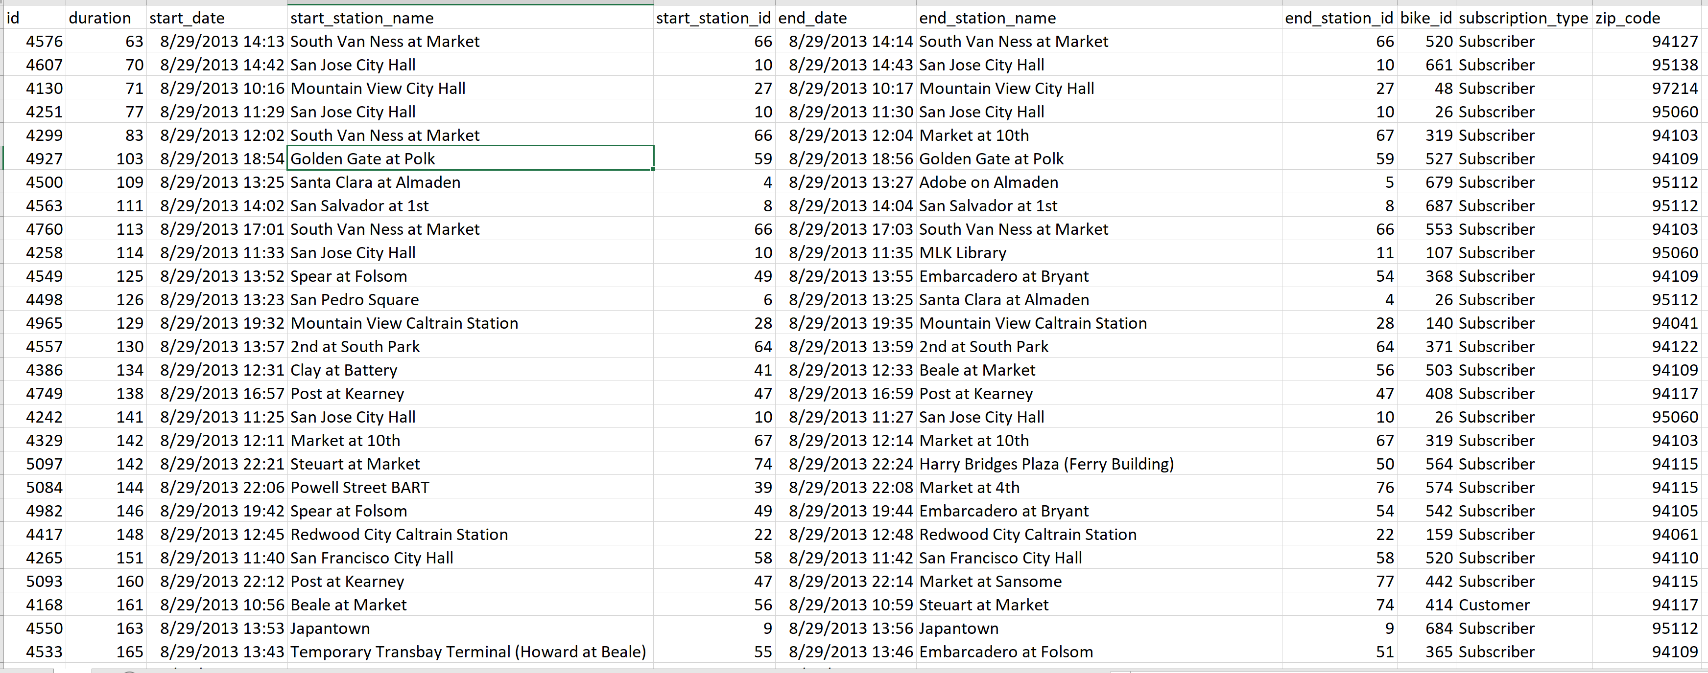
Table Trip:

Slide 6
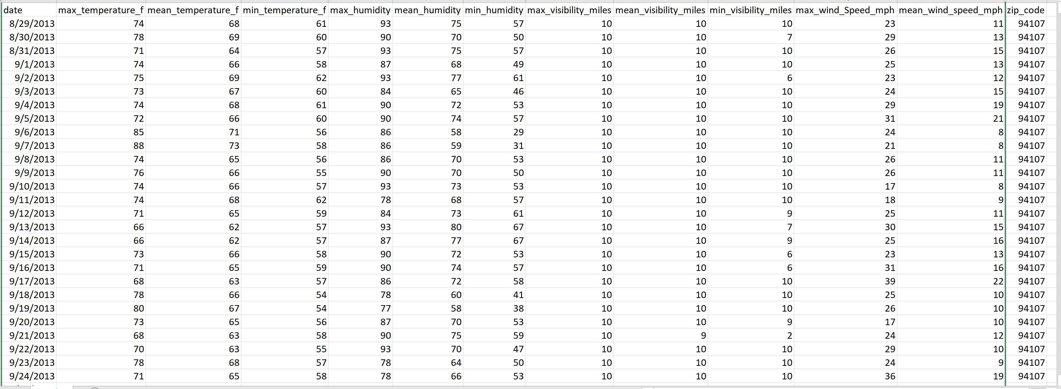
Table Weather:

Slide 7
Questions from Cross Validated Stack Exchange Database:
Stack Exchange is a network of question-and-answer (Q&A) websites on topics in diverse fields, each site covering a specific topic. As of August 2019, the 3 most actively-viewed sites in the network are Stack Overflow, Super User and Ask Ubuntu.
This database is a sample database of the network and contains 3 related tables:
Table Questions contains the Id, title, body, creation date, score, and owner ID for each question.
Table Answers contains the Id, body, creation date, score, and owner ID for each of the answers to these questions. The ParentId column links back to the Questions table.
Table Tags contains the tags on each question.

Slide 8
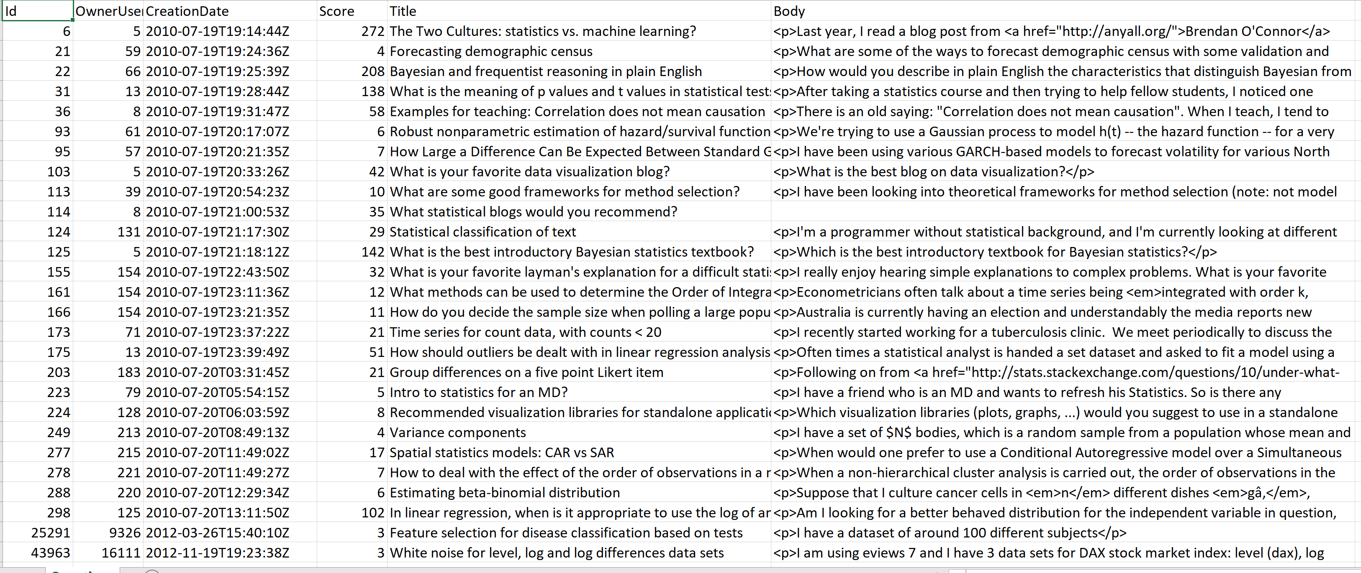
Example Data - : Table Questions

Slide 9
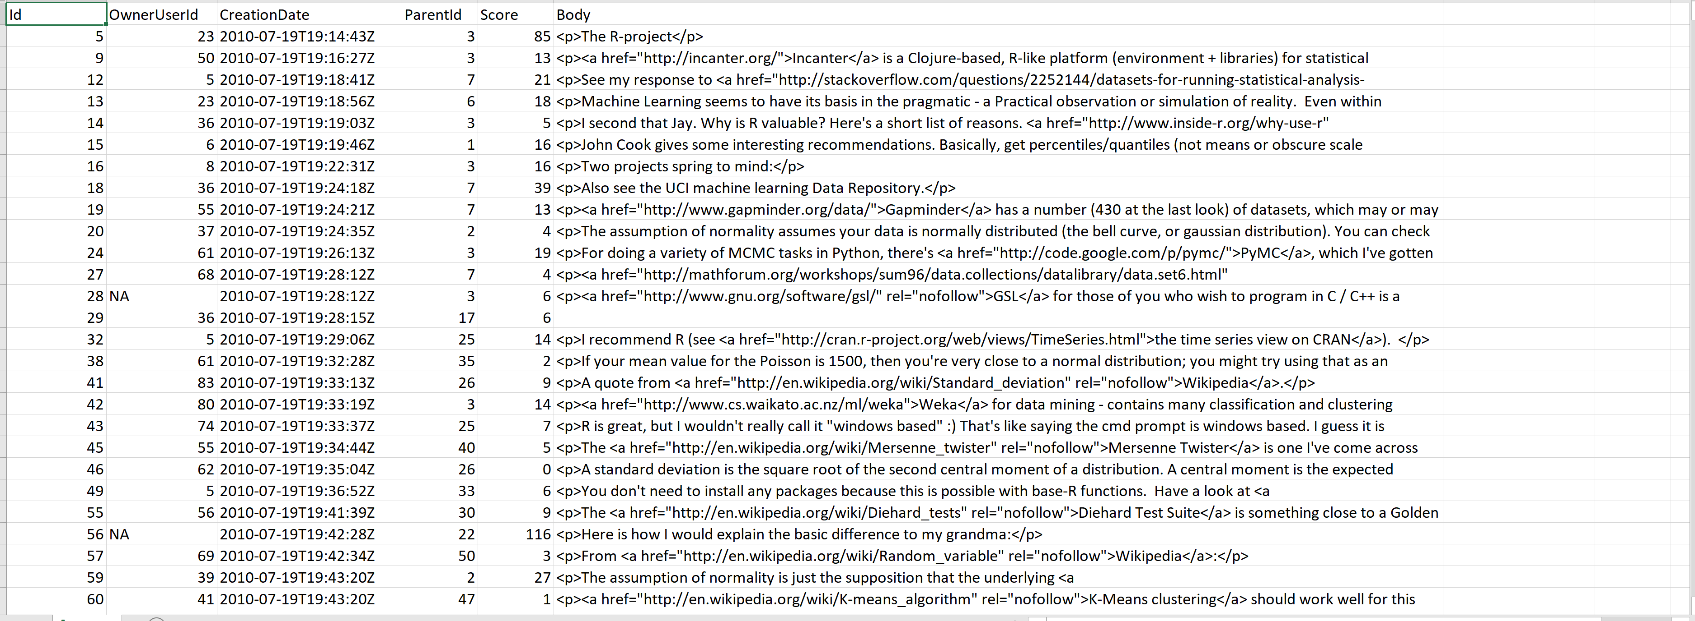
Table Answers:

Slide 10
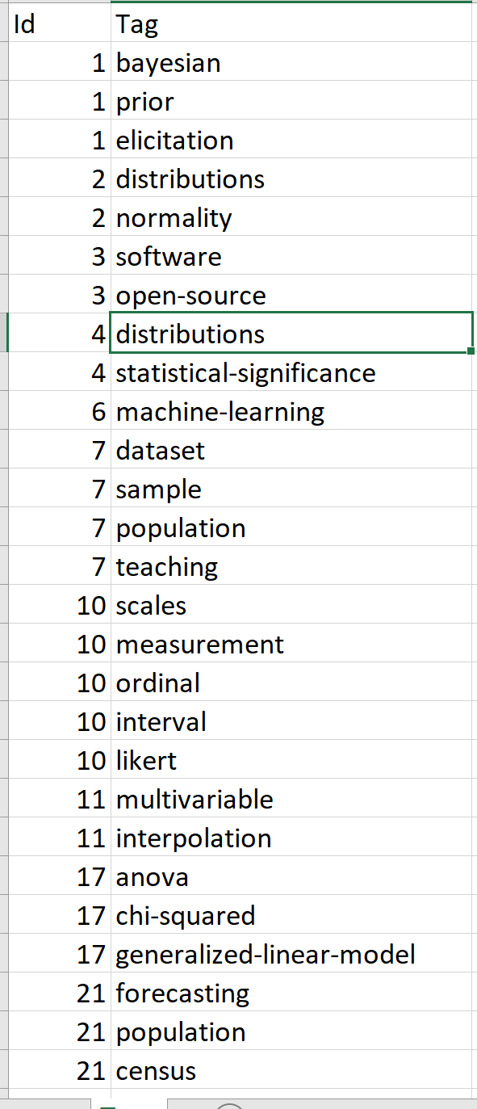
Table Tags:

Slide 11
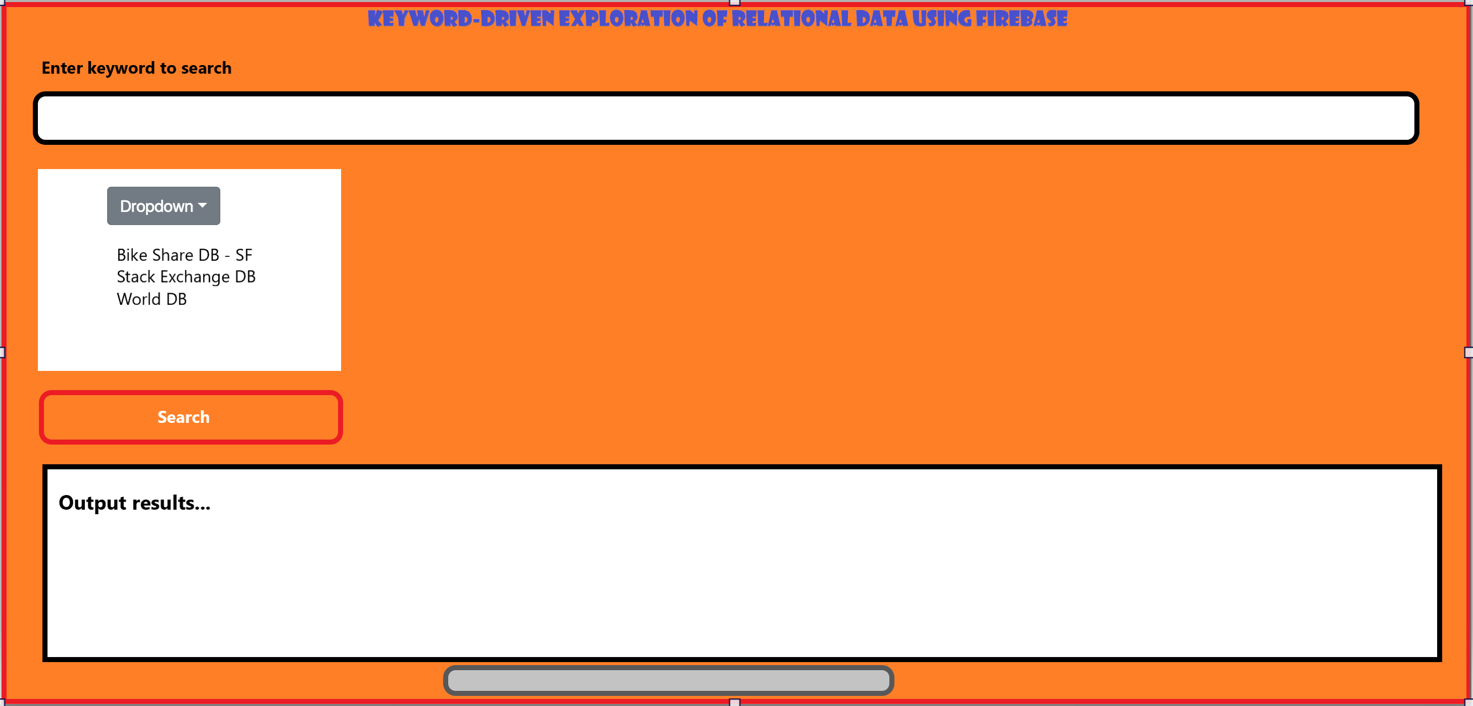
UI Interface: An example…
2 records retrieved…

Slide 12
Note: Detailed description of the database tables, technologies used for the project and UI development, steps followed to implement the project, group information along with group member capabilities and project milestone tracker are included in PDF document of the project report.
THANK YOU…

