Slide 1





VEHICLE PARKING MANAGEMENT SYSTEM
Team Members:
Guide:
Chilipi Venkata Subbulu
Sairam Matampalli
Umamaheswari R

Slide 2
VEHICLE PARKING MANAGEMENT SYSTEM
OUTLINE
Abstract
Problem Statement
Aims, Objective & Proposed System/Solution
System Design/Architecture
System Development Approach (Technology Used)
Algorithm & Deployment
Conclusion
Future Scope
References
Output
Notes:
These are the list of chapters that we are going to cover in these foundation codes. Those are chapter one what are AI and ML? chapter 2 applied Python programming in AI, and chapter 3 is exploratory data analysis for ML.

Slide 3
Abstract
VEHICLE PARKING MANAGEMENT SYSTEM
The Vehicle Parking Management System is a comprehensive solution designed to streamline and enhance the parking operations for owners and administrators. This project empowers owners with exclusive functionalities, granting them the ability to efficiently manage parking facilities. Key features include real-time monitoring of available parking slots, generating parking bills, and accessing revenue reports.
Owners can seamlessly navigate through the system, gaining insights into the current status of parking slots, allowing for optimal space utilization. The system enables owners to generate accurate and timely parking bills, providing a transparent and automated billing process. Additionally, owners have the capability to track and analyze revenue, ensuring a clear understanding of the financial performance of the parking facility.

Slide 4
Problem Statement
VEHICLE PARKING MANAGEMENT SYSTEM
Traditional vehicle parking management systems often lack a centralized and user-friendly approach, leading to inefficiencies and challenges in the overall management of parking facilities. Current systems may not provide exclusive functionalities for owners, resulting in a lack of control and real-time insights into parking operations. The absence of a streamlined process for generating parking bills and tracking revenue further compounds the difficulties faced by owners in managing parking spaces effectively.

Slide 5
Aim and Objective
VEHICLE PARKING MANAGEMENT SYSTEM
Aim: The primary aim of the Vehicle Parking Management System is to provide an efficient and user-friendly solution that empowers owners to take full control of their parking facilities. By addressing the shortcomings of traditional systems, the aim is to streamline parking operations, enhance space utilization, and facilitate seamless financial management.
Objective:
Real-time Monitoring: Develop a system that enables owners to monitor parking slots in real-time, allowing for immediate insights into the availability and occupancy of parking spaces.
Automated Billing: Implement a user-friendly interface for owners to generate accurate and automated parking bills, reducing manual efforts and ensuring a transparent billing process.
Revenue Tracking: Create a robust tracking mechanism to allow owners to monitor and analyze revenue generated from the parking facility, providing a comprehensive overview of financial performance.
User-Friendly Interface: Design an intuitive and easy-to-navigate interface for owners to access and utilize the system effortlessly, promoting user adoption and satisfaction.

Slide 6
Proposed System/Solution
VEHICLE PARKING MANAGEMENT SYSTEM
The proposed Vehicle Parking Management System is a cutting-edge solution designed to empower parking facility owners with exclusive functionalities, revolutionizing their control and management capabilities. Featuring a centralized owner dashboard, the system provides real-time insights into parking slot occupancy and availability, facilitating informed decision-making. The automated billing module ensures a user-friendly experience for owners to effortlessly generate parking bills, with customizable parameters for pricing structures and promotions. Robust revenue tracking and analytics tools offer owners a comprehensive overview of financial performance, aiding strategic planning. The system's flexibility is further enhanced through customization options, allowing owners to tailor settings to their unique requirements. With an intuitive interface, interactive data visualizations, and stringent security measures, this proposed system aims to enhance efficiency, transparency, and overall control in parking operations, catering specifically to the needs of parking facility owners.

Slide 7
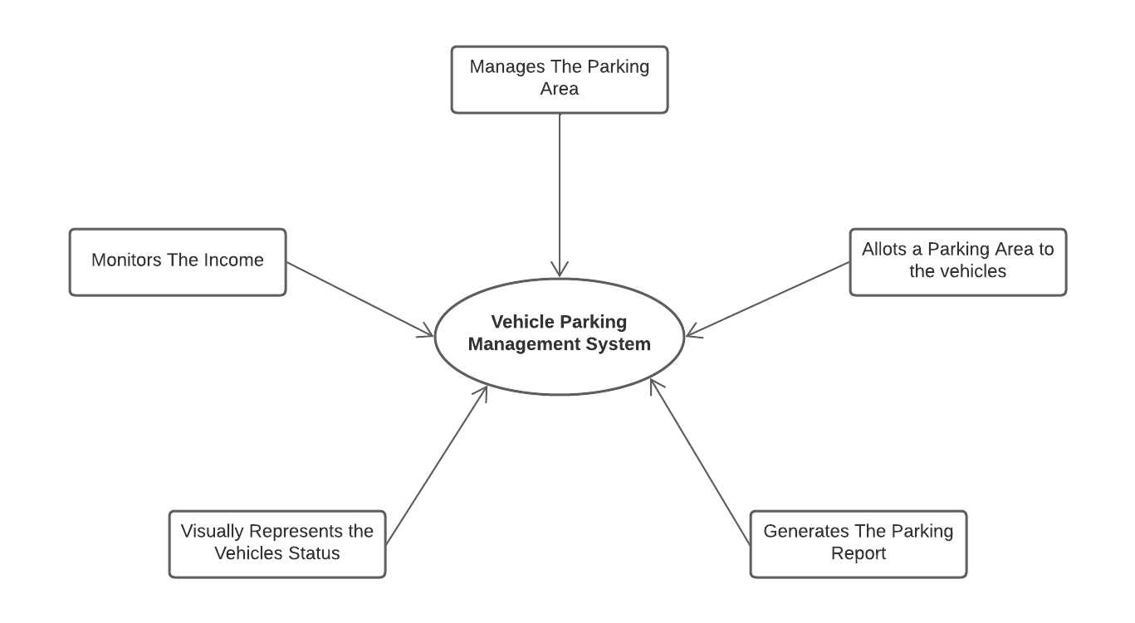
System Architecture
VEHICLE PARKING MANAGEMENT SYSTEM

Slide 8
System Deployment Approach
VEHICLE PARKING MANAGEMENT SYSTEM
Frontend Technologies:
HTML (Hyper Text Markup Language):
Utilized for structuring the website and creating the basic layout.
Responsible for defining the elements and content of web pages.
CSS (Cascading Style Sheets):
Employed for styling and formatting the HTML elements.
Ensures a visually appealing and consistent design across the website.
JavaScript:
Implemented for dynamic and interactive features on the client side.
Enhances user experience through functionalities such as form validation and asynchronous communication with the server.

Slide 9
System Deployment Approach
VEHICLE PARKING MANAGEMENT SYSTEM
Backend Technologies:
PHP (Hypertext Preprocessor):
Used as the server-side scripting language to handle dynamic content.
Responsible for processing user input, managing database interactions, and executing server-side logic.
XAMPP Server:
XAMPP is a cross-platform web server solution that includes Apache, MySQL, PHP, and Perl.
Apache is the web server responsible for serving web pages.
MySQL is the relational database management system (RDBMS) used for storing and retrieving data.
PHP interacts with the Apache server to dynamically generate content and communicate with the MySQL database.
phpMyAdmin:
A web-based tool for managing MySQL databases.
Used for database administration, including creating, modifying, and querying the database.

Slide 10
Algorithm & Deployment
VEHICLE PARKING MANAGEMENT SYSTEM
Revenue tracking Algorithm
The revenue tracking algorithm for the Vehicle Parking Management System begins by initializing the system, loading configuration settings, and establishing a connection to the database. It then retrieves transaction data related to parking billing from the database, incorporating details such as transaction date, parking duration, and associated charges. Subsequently, the algorithm iterates through the transaction data, calculating revenue for each transaction based on a predefined pricing structure and summing up individual revenues to obtain the total revenue. The algorithm updates the revenue tracking database with the calculated total revenue, including a timestamp for reference. Optionally, it may generate a detailed revenue report with visualizations. The algorithm is scheduled to run periodically to ensure up-to-date information, integrating seamlessly with the billing module and implementing security measures for data protection.

Slide 11
Deployment
VEHICLE PARKING MANAGEMENT SYSTEM
Deployment in the context of software development refers to the process of making a developed application or system available and accessible for use. It involves the transition from a development environment to a production environment, where the software can be utilized by end-users. It involves the following :
Web Server Hosting
Database Setup
Server Configuration
Security Measures
Testing
Monitoring
Maintenance
User Access

Slide 12
Conclusion
VEHICLE PARKING MANAGEMENT SYSTEM
In conclusion, the proposed Vehicle Parking Management System offers a robust and user-centric solution for owners to efficiently manage parking facilities. The system's architecture, deployment approach, and algorithms collectively aim to streamline parking operations, enhance user experience, and provide owners with valuable insights into their facilities. By focusing on real-time monitoring, automated reports, and revenue tracking, the system contributes to improved efficiency, transparency, and financial management. The deployment approach ensures a smooth transition, and the algorithms lay the foundation for accurate revenue tracking. Overall, the Vehicle Parking Management System presents a comprehensive and adaptable solution to meet the evolving needs of parking facility owners, promising enhanced control and operational effectiveness in the realm of parking management.

Slide 13
Future Scope
VEHICLE PARKING MANAGEMENT SYSTEM
The future scope of the Vehicle Parking Management System holds significant potential for further advancements and innovations. Embracing emerging technologies and market trends, the system could integrate features such as:
Smart Parking Integration
Mobile Application
Feedback Mechanisms and User Engagement
Autonomous Vehicle Parking
By embracing these future possibilities, the Vehicle Parking Management System can evolve into an even more sophisticated and adaptive solution, staying at the forefront of technological advancements and contributing to the transformation of modern parking management practices.

Slide 14
VEHICLE PARKING MANAGEMENT SYSTEM
Reference
Notes:
Reference
These are the references for this session.
14

Slide 15
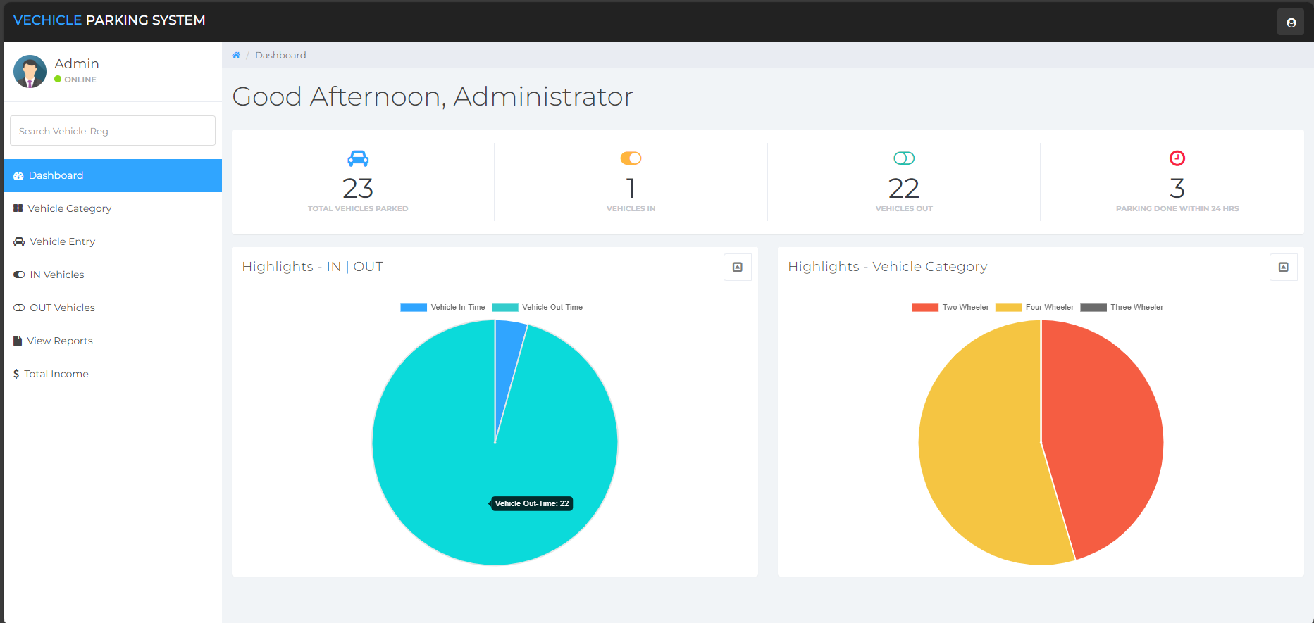
Output
VEHICLE PARKING MANAGEMENT SYSTEM
Dashboard:

Slide 16
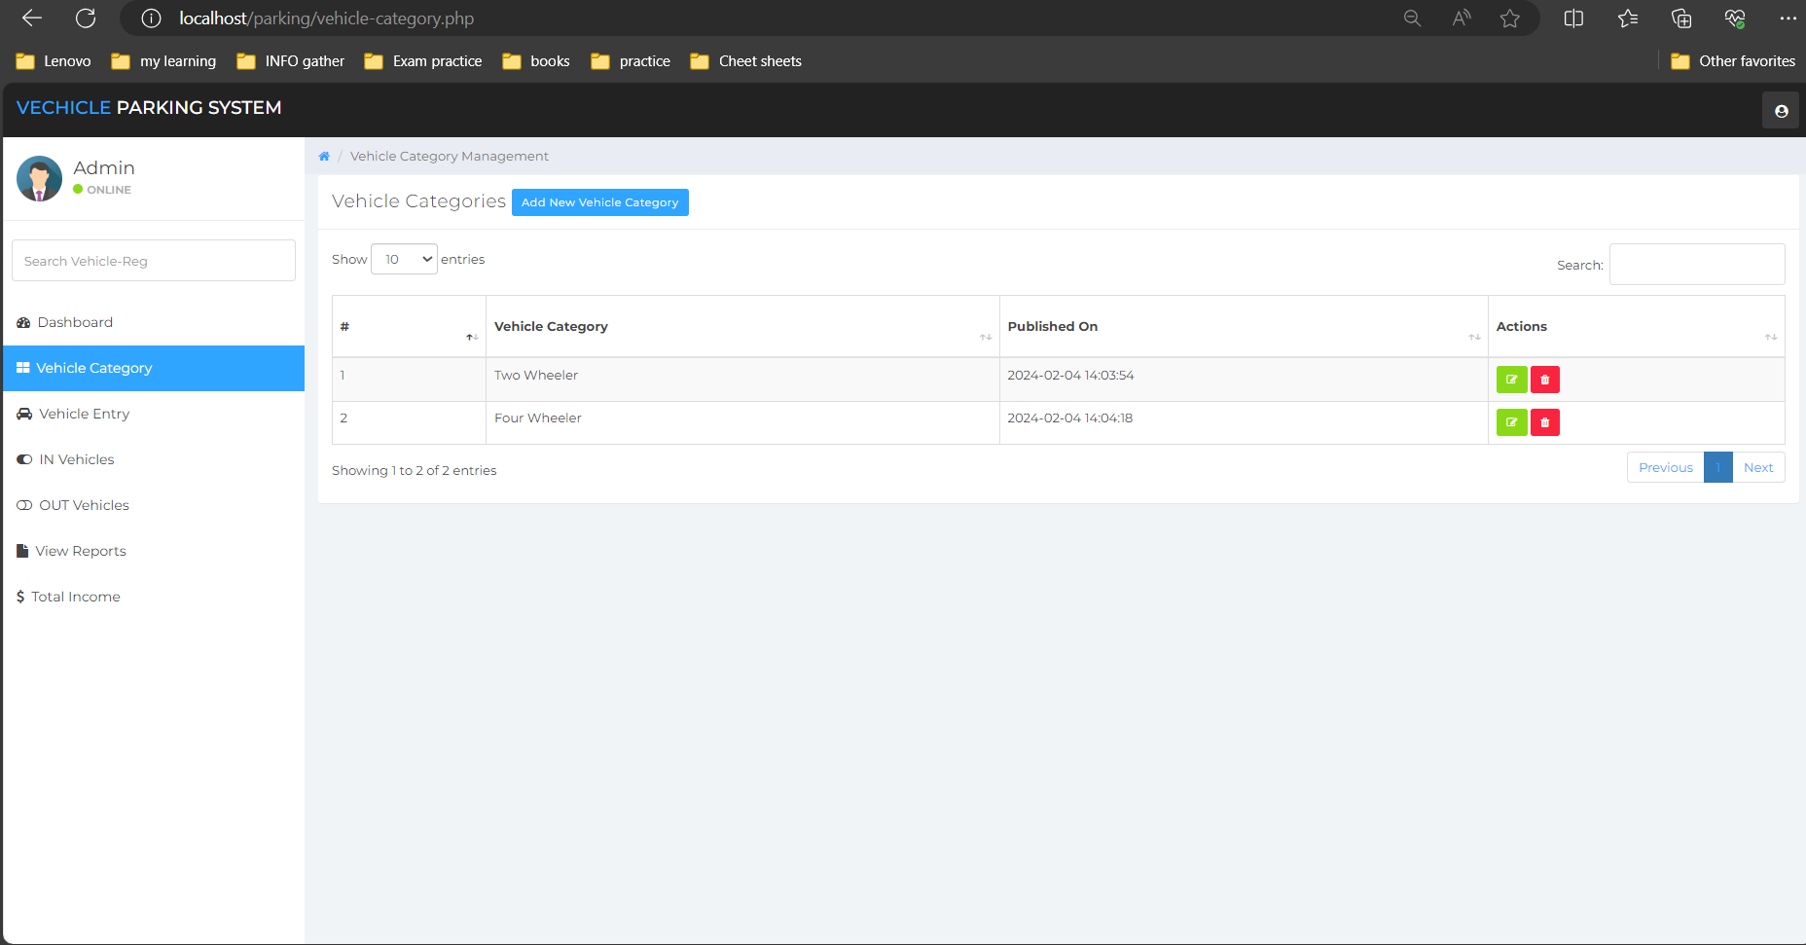
VEHICLE PARKING MANAGEMENT SYSTEM
Vehicle Category

Slide 17
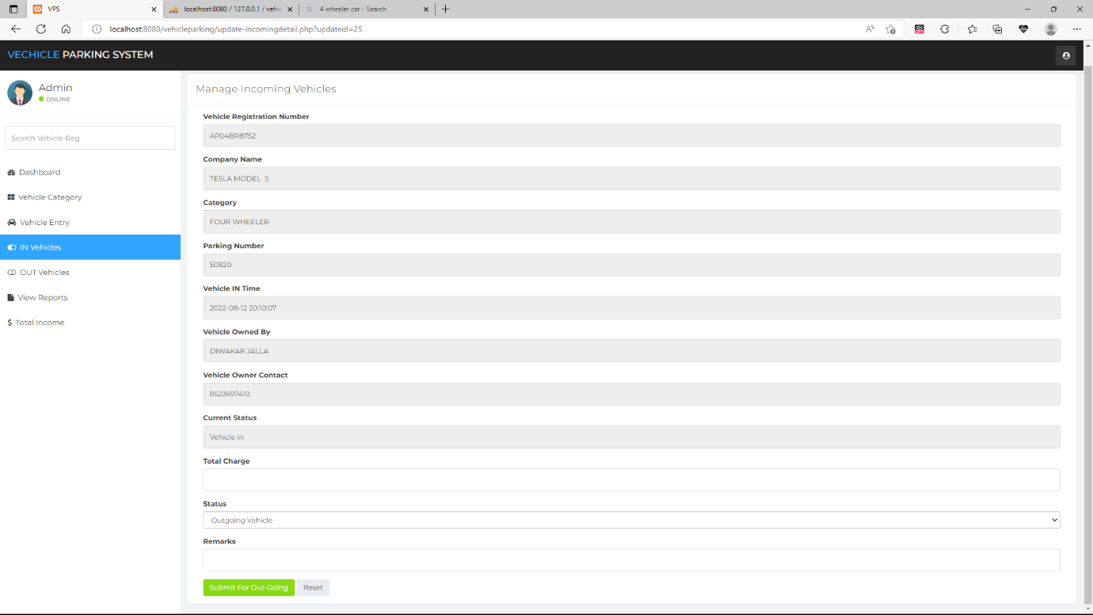
VEHICLE PARKING MANAGEMENT SYSTEM
Vehicle Entry

Slide 18
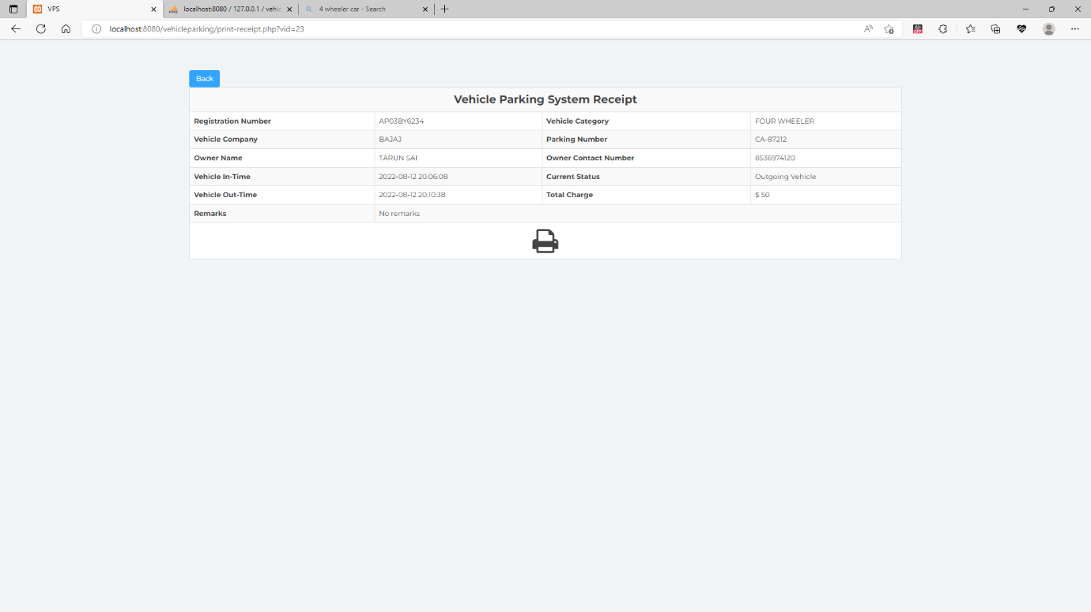
VEHICLE PARKING MANAGEMENT SYSTEM
Receipt Generation

Slide 19
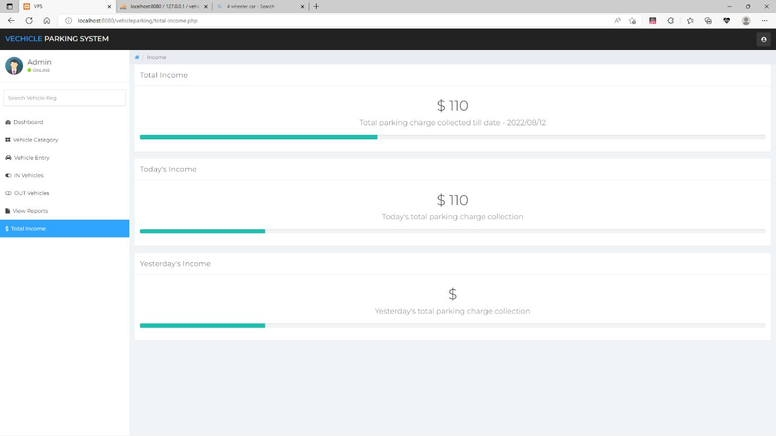
VEHICLE PARKING MANAGEMENT SYSTEM
Revenue Monitoring

Slide 20
VEHICLE PARKING MANAGEMENT SYSTEM
Thank you!
Notes:
thank you very much for joining this PPT, keep learning.
20

