Slide 1
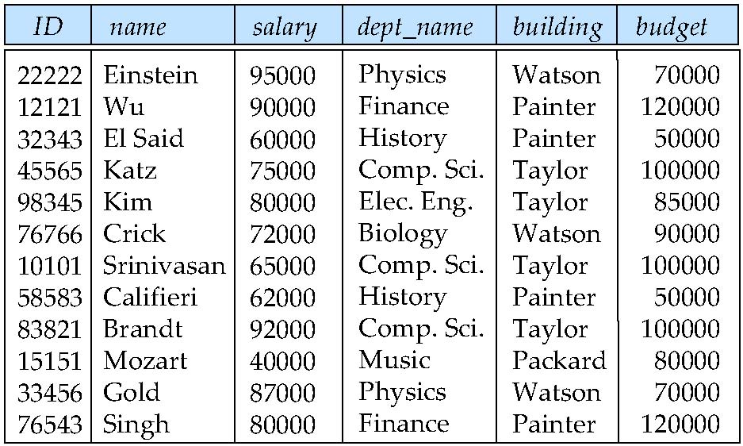
Features of Good Relational Design:
Normalization PPT Starts…
Suppose we combine instructor and department into in_dep, which represents the natural join on the relations instructor and department
There is repetition of information
Need to use null values (if we add a new department with no instructors)
Combined Schema without repetition:
Not all combined schemas result in repetition of information
Consider combining relations
sec_class (sec_id, building, room_number) and
section(course_id, sec_id, semester, year)
into one relation
section(course_id, sec_id, semester, year, building, room_number)
No repetition in this case

Slide 2
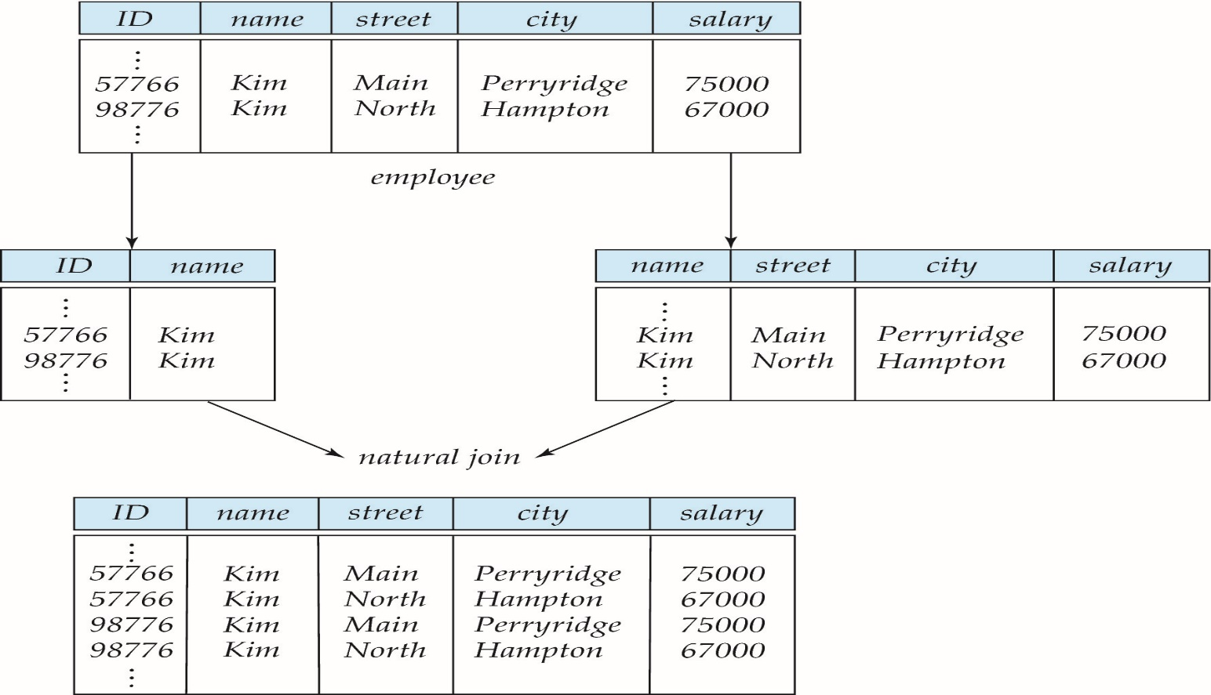
Decomposition
The only way to avoid the repetition-of-information problem in the in_dep schema is to decompose it into two schemas – instructor and department schemas.
Not all decompositions are good. Suppose we decompose
employee(ID, name, street, city, salary)
into
employee1 (ID, name)
employee2 (name, street, city, salary)
The problem arises when we have two employees with the same name
The next slide shows how we lose information -- we cannot reconstruct the original employee relation -- and so, this is a lossy decomposition
A Lossy Decomposition

Slide 3
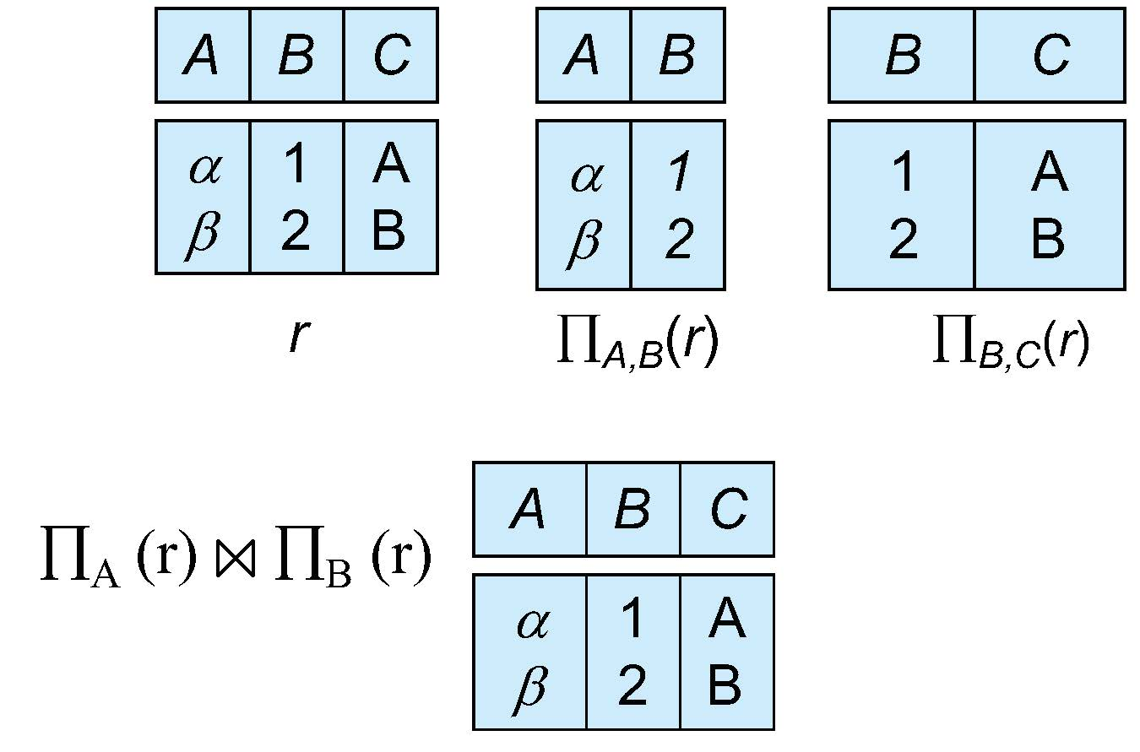
Lossless Decomposition
Let R be a relation schema and let R₁ and R₂ form a decomposition of R . That is R = R₁ U R₂
We say that the decomposition is a lossless decomposition if there is no loss of information by replacing R with the two relation schemas R₁ U R₂
Formally,
∏ _{R1} (r) ∏ _{R2} (r) = r
And, conversely a decomposition is lossy if
r ⊂ ∏ _{R1} (r) ∏ _{R2} (r) = r
Example:

Slide 4
Normalization theory
Decide whether a particular relation R is in “good” form.
In the case that a relation R is not in “good” form, decompose it into set of relations {R₁, R₂, ..., R_{n}} such that
Each relation is in good form
The decomposition is a lossless decomposition
Our theory is based on:
Functional dependencies
Multivalued dependencies
------------------------------------------------------
Normalization is the process of organizing the data in the database.
Normalization is used to minimize the redundancy from a relation or set of relations. It is also used to eliminate the undesirable characteristics like Insertion, Update and Deletion Anomalies.
Normalization divides the larger table into the smaller table and links them using relationship.
The normal form is used to reduce redundancy from the database table.

Slide 5
Functional Dependencies
There are usually a variety of constraints (rules) on the data in the real world.
For example, some of the constraints that are expected to hold in a university database are:
Students and instructors are uniquely identified by their ID.
Each student and instructor has only one name.
Each instructor and student is (primarily) associated with only one department.
Each department has only one value for its budget, and only one associated building.
An instance of a relation that satisfies all such real-world constraints is called a legal instance of the relation;
A legal instance of a database is one where all the relation instances are legal instances
Constraints on the set of legal relations.
Require that the value for a certain set of attributes determines uniquely the value for another set of attributes.
A functional dependency is a generalization of the notion of a key

Slide 6
Functional Dependencies Definition
Let R be a relation schema
α ⊆ R and β ⊆ R
The functional dependency
α → β
holds on R if and only if for any legal relations r(R), whenever any two tuples t₁ and t₂ of r agree on the attributes α, they also agree on the attributes β. That is,
t₁[α] = t₂ [α] ⇒ t₁[β ] = t₂ [β ]
Example: Consider r(A,B ) with the following instance of r.
On this instance, B → A hold; A → B does NOT hold,
4
1 5
3 7

Slide 7
Closure Set of Functional Dependencies
Given a set F set of functional dependencies, there are certain other functional dependencies that are logically implied by F.
If A → B and B → C, then we can infer that A → C
etc.
The set of all functional dependencies logically implied by F is the closure of F.
We denote the closure of F by F⁺.

Slide 8
Keys and Functional Dependencies
K is a superkey for relation schema R if and only if K → R
K is a candidate key for R if and only if
K → R, and
for no α ⊂ K, α → R
Functional dependencies allow us to express constraints that cannot be expressed using superkeys. Consider the schema:
in_dep (ID, name, salary, dept_name, building, budget ).
We expect these functional dependencies to hold:
dept_name→ building
ID → building
but would not expect the following to hold:
dept_name → salary

Slide 9
Use of Functional Dependencies
We use functional dependencies to:
To test relations to see if they are legal under a given set of functional dependencies.
If a relation r is legal under a set F of functional dependencies, we say that r satisfies F.
To specify constraints on the set of legal relations
We say that F holds on R if all legal relations on R satisfy the set of functional dependencies F.
Note: A specific instance of a relation schema may satisfy a functional dependency even if the functional dependency does not hold on all legal instances.
For example, a specific instance of instructor may, by chance, satisfy name → ID.

Slide 10
Trivial Functional Dependencies
A functional dependency is trivial if it is satisfied by all instances of a relation
Example:
ID, name → ID
name → name
In general, α → β is trivial if β ⊆ α

Slide 11
Lossless Decomposition
We can use functional dependencies to show when certain decomposition are lossless.
For the case of R = (R₁, R₂), we require that for all possible relations r on schema R
r = ∏_{R1} (r ) ∏_{R2} (r )
A decomposition of R into R₁ and R₂ is lossless decomposition if at least one of the following dependencies is in F⁺:
R₁ ∩ R₂ → R₁
R₁ ∩ R₂ → R₂
The above functional dependencies are a sufficient condition for lossless join decomposition; the dependencies are a necessary condition only if all constraints are functional dependencies
Example:
R = (A, B, C) F = {A → B, B → C)
R₁ = (A, B), R₂ = (B, C)
Lossless decomposition:
R₁ ∩ R₂ = {B} and B → BC
R₁ = (A, B), R₂ = (A, C)
Lossless decomposition:
R₁ ∩ R₂ = {A} and A → AB
Note:
B → BC
is a shorthand notation for
B → {B, C}

Slide 12
Dependency Preservation
Testing functional dependency constraints each time the database is updated can be costly
It is useful to design the database in a way that constraints can be tested efficiently.
If testing a functional dependency can be done by considering just one relation, then the cost of testing this constraint is low
When decomposing a relation it is possible that it is no longer possible to do the testing without having to perform a Cartesian Produced.
A decomposition that makes it computationally hard to enforce functional dependency is said to be NOT dependency preserving.

Slide 13
Dependency Preservation Example
Consider a schema:
dept_advisor(s_ID, i_ID, department_name)
With function dependencies:
i_ID → dept_name
s_ID, dept_name → i_ID
In the above design we are forced to repeat the department name once for each time an instructor participates in a dept_advisor relationship.
To fix this, we need to decompose dept_advisor
Any decomposition will not include all the attributes in
s_ID, dept_name → i_ID
Thus, the composition NOT be dependency preserving

Slide 14
Functional Dependency Theory Road Map
We now consider the formal theory that tells us which functional dependencies are implied logically by a given set of functional dependencies.
We then develop algorithms to generate lossless decompositions into BCNF and 3NF
We then develop algorithms to test if a decomposition is dependency-preserving
Closure Set of Functional Dependencies
Given a set F set of functional dependencies, there are certain other functional dependencies that are logically implied by F.
If A → B and B → C, then we can infer that A → C
etc.
The set of all functional dependencies logically implied by F is the closure of F.
We denote the closure of F by F⁺.

Slide 15
We can compute F⁺, the closure of F, by repeatedly applying Armstrong’s Axioms:
Reflexive rule: if β ⊆ α, then α → β
Augmentation rule: if α → β, then γ α → γ β
Transitivity rule: if α → β, and β → γ, then α → γ
These rules are
Sound -- generate only functional dependencies that actually hold, and
Complete -- generate all functional dependencies that hold
Example:
R = (A, B, C, G, H, I) F = { A → B A → C CG → H CG → I B → H}
Some members of F⁺
A → H
by transitivity from A → B and B → H
AG → I
by augmenting A → C with G, to get AG → CG and then transitivity with CG → I
CG → HI
by augmenting CG → I to infer CG → CGI,
and augmenting of CG → H to infer CGI → HI,
and then transitivity

Slide 16
Closure of Functional Dependencies
Additional rules:
Union rule: If α → β holds and α → γ holds, then α → β γ holds.
Decomposition rule: If α → β γ holds, then α → β holds and α → γ holds.
Pseudotransitivity rule:If α → β holds and γ β → δ holds, then α γ → δ holds.
The above rules can be inferred from Armstrong’s axioms.

Slide 17
Procedure for Computing F⁺
To compute the closure of a set of functional dependencies F:
F ⁺ = F repeat for each functional dependency f in F⁺ apply reflexivity and augmentation rules on f add the resulting functional dependencies to F ⁺ for each pair of functional dependencies f₁and f₂ in F ⁺ if f₁ and f₂ can be combined using transitivity then add the resulting functional dependency to F ⁺ until F ⁺ does not change any further
NOTE: We shall see an alternative procedure for this task later

Slide 18
Closure of Attribute Sets
Given a set of attributes α, define the closure of α under F (denoted by α⁺) as the set of attributes that are functionally determined by α under F
Algorithm to compute α⁺, the closure of α under F
result := α; while (changes to result) do for each β → γ in F do begin if β ⊆ result then result := result ∪ γ end

Slide 19
Example of Attribute Set Closure
R = (A, B, C, G, H, I)
F = {A → B A → C CG → H CG → I B → H}
(AG)⁺
1. result = AG
2. result = ABCG (A → C and A → B)
3. result = ABCGH (CG → H and CG ⊆ AGBC)
4. result = ABCGHI (CG → I and CG ⊆ AGBCH)
Is AG a candidate key?
Is AG a super key?
Does AG → R? == Is R ⊇ (AG)⁺
Is any subset of AG a superkey?
Does A → R? == Is R ⊇ (A)⁺
Does G → R? == Is R ⊇ (G)⁺
In general: check for each subset of size n-1

Slide 20
Use of Attribute Closure
There are several uses of the attribute closure algorithm:
Testing for superkey:
To test if α is a superkey, we compute α^{+,} and check if α⁺ contains all attributes of R.
Testing functional dependencies
To check if a functional dependency α → β holds (or, in other words, is in F⁺), just check if β ⊆ α⁺.
That is, we compute α⁺ by using attribute closure, and then check if it contains β.
Is a simple and cheap test, and very useful
Computing closure of F
For each γ ⊆ R, we find the closure γ⁺, and for each S ⊆ γ⁺, we output a functional dependency γ → S.

Slide 21
Canonical Cover
Suppose that we have a set of functional dependencies F on a relation schema. Whenever a user performs an update on the relation, the database system must ensure that the update does not violate any functional dependencies; that is, all the functional dependencies in F are satisfied in the new database state.
If an update violates any functional dependencies in the set F, the system must roll back the update.
We can reduce the effort spent in checking for violations by testing a simplified set of functional dependencies that has the same closure as the given set.
This simplified set is termed the canonical cover
To define canonical cover we must first define extraneous attributes.
An attribute of a functional dependency in F is extraneous if we can remove it without changing F ⁺

Slide 22
Extraneous Attributes
Removing an attribute from the left side of a functional dependency could make it a stronger constraint.
For example, if we have AB → C and remove B, we get the possibly stronger result A → C. It may be stronger because A → C logically implies AB → C, but AB → C does not, on its own, logically imply A → C
But, depending on what our set F of functional dependencies happens to be, we may be able to remove B from AB → C safely.
For example, suppose that
F = {AB → C, A → D, D → C}
Then we can show that F logically implies A → C, making extraneous in AB → C.

Slide 23
Removing an attribute from the right side of a functional dependency could make it a weaker constraint.
For example, if we have AB → CD and remove C, we get the possibly weaker result AB → D. It may be weaker because using just AB → D, we can no longer infer AB → C.
But, depending on what our set F of functional dependencies happens to be, we may be able to remove C from AB → CD safely.
For example, suppose that
F = { AB → CD, A → C.
Then we can show that even after replacing AB → CD by AB → D, we can still infer $AB → C and thus AB → CD

Slide 24
An attribute of a functional dependency in F is extraneous if we can remove it without changing F ⁺
Consider a set F of functional dependencies and the functional dependency α → β in F.
Remove from the left side: Attribute A is extraneous in α if
A ∈ α and
F logically implies (F – {α → β}) ∪ {(α – A) → β}.
Remove from the right side: Attribute A is extraneous in β if
A ∈ β and
The set of functional dependencies
(F – {α → β}) ∪ {α →(β – A)} logically implies F.
Note: implication in the opposite direction is trivial in each of the cases above, since a “stronger” functional dependency always implies a weaker one

Slide 25
Testing if Attribute is Extraneous
Let R be a relation schema and let F be a set of functional dependencies that hold on R . Consider an attribute in the functional dependency α → β.
To test if attribute A ∈ β is extraneous in β
Consider the set: F' = (F – {α → β}) ∪ {α →(β – A)},
check that α⁺ contains A; if it does, A is extraneous in β
To test if attribute A ∈ α is extraneous in α
Let γ = α – {A}. Check if γ → β can be inferred from F.
Compute γ⁺ using the dependencies in F
If γ⁺ includes all attributes in β then , A is extraneous in α
Example:
Let F = {AB → CD, A → E, E → C }
To check if C is extraneous in AB → CD, we:
Compute the attribute closure of AB under F' = {AB → D, A → E, E → C}
The closure is ABCDE, which includes CD
This implies that C is extraneous

Slide 26
Canonical Cover
To compute a canonical cover for F:
repeat
Use the union rule to replace any dependencies in F of the form
α₁ → β₁ and α₁ → β₂ with α₁ → β₁ β₂
Find a functional dependency α → β in F_{c} with an extraneous
attribute either in α or in β
/* Note: test for extraneous attributes done using F_{c,} not F*/
If an extraneous attribute is found, delete it from α → β
until (F_{c} not change
Note: Union rule may become applicable after some extraneous attributes have been deleted, so it has to be re-applied
Example:
R = (A, B, C) F = {A → BC B → C A → B AB → C}
Combine A → BC and A → B into A → BC
Set is now {A → BC, B → C, AB → C}
A is extraneous in AB → C
Check if the result of deleting A from AB → C is implied by the other dependencies
Yes: in fact, B → C is already present!
Set is now {A → BC, B → C}
C is extraneous in A → BC
Check if A → C is logically implied by A → B and the other dependencies
Yes: using transitivity on A → B and B → C.
Can use attribute closure of A in more complex cases
The canonical cover is: A → B B → C

Slide 27
Dependency Preservation
Let F_{i} be the set of dependencies F ⁺ that include only attributes in R_{i}.
A decomposition is dependency preserving, if
(F₁ ∪ F₂ ∪ … ∪ F_{n} )⁺ = F ⁺
Using the above definition, testing for dependency preservation take exponential time.
Not that if a decomposition is NOT dependency preserving then checking updates for violation of functional dependencies may require computing joins, which is expensive
Let F be the set of dependencies on schema R and let R₁, R₂ , .., R_{n} be a decomposition of R.
The restriction of F to R_{i} is the set F_{i} of all functional dependencies in F ⁺ that include only attributes of R_{i} .
Since all functional dependencies in a restriction involve attributes of only one relation schema, it is possible to test such a dependency for satisfaction by checking only one relation.
Note that the definition of restriction uses all dependencies in in F ⁺, not just those in F.
The set of restrictions F₁, F₂ , .. , F_{n} is the set of functional dependencies that can be checked efficiently.

Slide 28
Testing for Dependency Preservation
To check if a dependency α → β is preserved in a decomposition of R into R₁, R₂, …, R_{n} , we apply the following test (with attribute closure done with respect to F)
result = α repeat for each R_{i} in the decomposition t = (result ∩ R_{i})⁺ ∩ R_{i} result = result ∪ t
until (result does not change)
If result contains all attributes in β, then the functional dependency α → β is preserved.
We apply the test on all dependencies in F to check if a decomposition is dependency preserving
This procedure takes polynomial time, instead of the exponential time required to compute F⁺ and (F₁ ∪ F₂ ∪ … ∪ F_{n})⁺

Slide 29
Normalization
The process of normalization is a formal method that identifies relational schemas based upon their primary or candidate keys and the functional dependencies that exists amongst their attributes.
Normalization is primarily a tool to validate and improve a logical design so that it satisfies certain constraints that avoid unnecessary duplication of data.
Normalization is the process of decomposing relation with anomalies to produce smaller, well-structured relations.
Normalisation should remove redundancy, but not at the expense of data integrity.
Normalization is necessary if you do not do it then the overall integrity of the data stored in the database will eventually degrade. Specifically, this is due to data anomalies. These anomalies naturally occur and result in data that does not match the real-world the database purports to represent.

Slide 30
Transforming data from a problem into relations while ensuring data integrity and eliminating data redundancy.
Data integrity : consistent and satisfies data constraint rules
Data redundancy: if data can be found in two places in a single database (direct redundancy) or calculated using data from different parts of the database (indirect redundancy) then redundancy exists.
Normalisation should remove redundancy, but not at the expense of data integrity.
------------------------------------------------------------------------------------------------------------------------------------------------------------------------------
Anomalies are caused when there is too much redundancy in the database's information. Anomalies can often be caused when the tables that make up the database suffer from poor construction. So, what does "poor construction" mean? Poor table design will become evident if, when the designer creates the database, he doesn't identify the entities that depend on each other for existence, like the rooms of a hotel and the hotel, and then minimize the chance that one would ever exist independent of the other. The normalization process was created largely in order to reduce the negative effects of creating tables that will introduce anomalies into the database.
Update Anomalies happen when the person charged with the task of keeping all the records current and accurate, is asked, for example, to change an employee’s title due to a promotion. If the data is stored redundantly in the same table, and the person misses any of them, then there will be multiple titles associated with the employee. The end user has no way of knowing which is the correct title.
Insertion Anomalies happen when inserting vital data into the database is not possible because other data is not already there. For example, if a system is designed to require that a customer be on file before a sale can be made to that customer, but you cannot add a customer until they have bought something, then you have an insert anomaly. It is the classic "catch-22" situation.
Deletion Anomalies happen when the deletion of unwanted information causes desired information to be deleted as well. For example, if a single database record contains information about a particular product along with information about a salesperson for the company and the salesperson quits, then information about the product is deleted along with salesperson information.

Slide 31
First Normal form
Domain is atomic if its elements are considered to be indivisible units
Examples of non-atomic domains:
Set of names, composite attributes
Identification numbers like CS101 that can be broken up into parts
A relational schema R is in first normal form if the domains of all attributes of R are atomic
Non-atomic values complicate storage and encourage redundant (repeated) storage of data
Example: Set of accounts stored with each customer, and set of owners stored with each account
First normal form (1NF) deals with the `shape' of the record.
A relation is in 1NF if, and only if, it contains no repeating attributes or groups of attributes.
Example:
The Student table with the repeating group is not in 1NF
It has repeating groups, it is an `unnormalised table'.
To remove the repeating group, either:
flatten the table and extend the key, or
decompose the relation- leading to First Normal Form

Slide 32
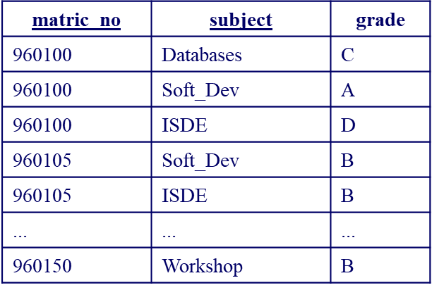
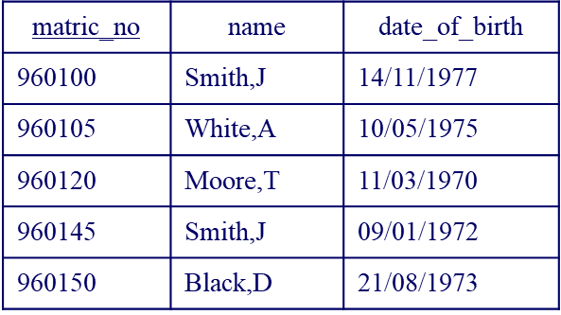
Flatten Table and Extend Primary Key
The Student table with the repeating group can be written as:
Student(matric_no, name, date_of_birth, ( subject, grade ) )
If the repeating group was flattened, it would look something like:
Student(matric_no, name, date_of_birth, subject, grade )
This does not have repeating groups, but has redundancy. For every matric_no/subject combination, the student name and date of birth is replicated. This can lead to errors.
Redundant data is the main cause of insertion, deletion, and updating anomalies.
Insertion anomaly – Subject is now in the primary key, we cannot add a student until they have at least one subject. Remember, no part of a primary key can be NULL.
Update anomaly – changing the name of a student means finding all rows of the database where that student exists and changing each one separately.
Deletion anomaly- for example deleting all database subject information also deletes student 960145.
Decomposing Relation
The alternative approach is to split the table into two parts, one for the repeating groups and one of the non-repeating groups.
The primary key for the original relation is included in both of the new relations
Record: Student

Slide 33
Second Normal Form
We now have two relations, Student and Record.
Student contains the original non-repeating groups
Record has the original repeating groups and the matric_no Student(matric_no, name, date_of_birth ) Record(matric_no, subject, grade )
This version of the relations does not have insertion, deletion, or update anomalies.
Without repeating groups, we say the relations are in First Normal Form (1NF).
A relation is in 2NF if, and only if, it is in 1NF and every non-key attribute is fully functionally dependent on the whole key.
Thus the relation is in 1NF with no repeating groups, and all non-key attributes must depend on the whole key, not just some part of it. Another way of saying this is that there must be no partial key dependencies (PKDs).
The problems arise when there is a compound key, e.g. the key to the Record relation - matric_no, subject. In this case it is possible for non-key attributes to depend on only part of the key - i.e. on only one of the two key attributes. This is what 2NF tries to prevent.
Consider again the Student relation from the flattened table: Student(matric_no, name, date_of_birth, subject, grade )
There are no repeating groups, so the relation is in 1NF
However, we have a compound primary key - so we must check all of the non-key attributes against each part of the key to ensure they are functionally dependent on it.
matric_no determines name and date_of_birth, but not grade.
subject together with matric_no determines grade, but not name or date_of_birth.
So there is a problem with potential redundancies

Slide 34
Dependency Diagram
A dependency diagram is used to show how non-key attributes relate to each part or combination of parts in the primary key.
Student
matric_no
name
date_of_bith
subject
grade
PKD
Fully Dependent

Slide 35
This relation is not in 2NF
It appears to be two tables squashed into one.
the solutions is to split the relation into component parts.
separate out all the attributes that are solely dependent on matric_no - put them in a new Student_details relation, with matric_no as the primary key
separate out all the attributes that are solely dependent on subject - in this case no attributes are solely dependent on subject.
separate out all the attributes that are solely dependent on matric_no + subject - put them into a separate Student relation, keyed on matric_no + subject
Student Details
matrix_no
name
date_of_birth
All attributes in each relation are fully functionally dependent upon its primary key These relations are now in 2NF
Student
matrix_no
subject
grade

Slide 36
Third Normal Form
3NF is an even stricter normal form and removes virtually all the redundant data :
A relation is in 3NF if, and only if, it is in 2NF and there are no transitive functional dependencies
Transitive functional dependencies arise:
when one non-key attribute is functionally dependent on another non-key attribute:
FD: non-key attribute -> non-key attribute
and when there is redundancy in the database
By definition transitive functional dependency can only occur if there is more than one non-key field, so we can say that a relation in 2NF with zero or one non-key field must automatically be in 3NF
project_no | manager | address |  | Project has more than one non-key field so we must check for transitive dependency:
p1 | Black,B | 32 High Street
p2 | Smith,J | 11 New Street
p3 | Black,B | 32 High Street
p4 | Black,B | 32 High Street

Slide 37
Address depends on the value of manager.
From the table we can propose:
Project(project_no, manager, address) manager -> address
In this case address is transitively dependent on manager. The primary key is project_no, but the LHS and RHS have no reference to this key, yet both sides are present in the relation.
Data redundancy arises from this
we duplicate address if a manager is in charge of more than one project
causes problems if we had to change the address- have to change several entries, and this could lead to errors.
Eliminate transitive functional dependency by splitting the table
create two relations - one with the transitive dependency in it, and another for all of the remaining attributes.
split Project into Project and Manager.
the determinant attribute becomes the primary key in the new relation - manager becomes the primary key to the Manager relation
the original key is the primary key to the remaining non-transitive attributes - in this case, project_no remains the key to the new Projects table.

Slide 38
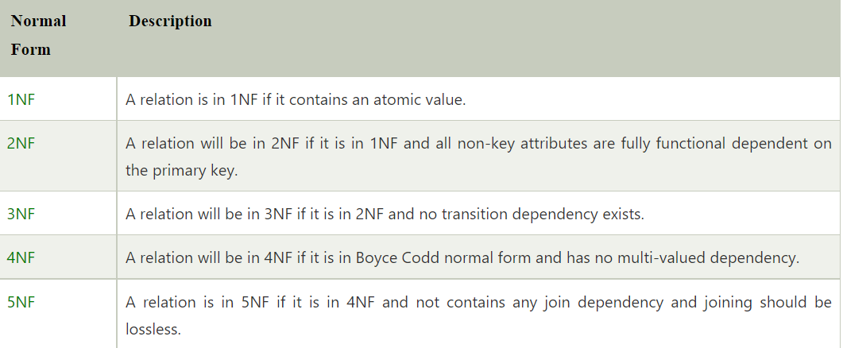
Now we need to store the address only once
If we need to know a manager's address we can look it up in the Manager relation
The manager attribute is the link between the two tables, and in the Projects table it is now a foreign key.
These relations are now in third normal form.
Project | project_no | manager
 | p1 | Black,B
 | p2 | Smith,J
 | p3 | Black,B
 | p4 | Black,B
Manager | manager | address
 | Black,B | 32 High Street
 | Smith,J | 11 New Street

Slide 39
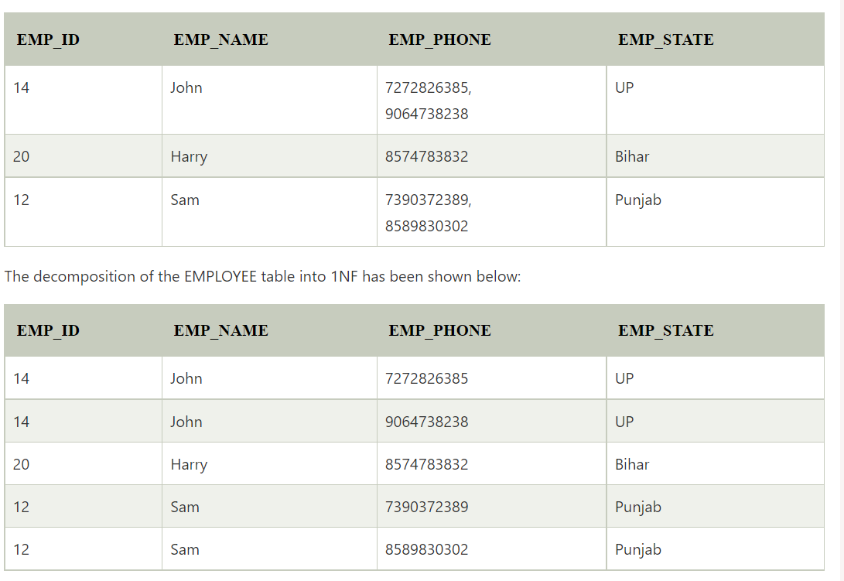
First Normal Form (1NF)
A relation will be 1NF if it contains an atomic value.
It states that an attribute of a table cannot hold multiple values. It must hold only single-valued attribute.
First normal form disallows the multi-valued attribute, composite attribute, and their combinations.
Example: Relation EMPLOYEE is not in 1NF because of multi-valued attribute EMP_PHONE.

Slide 40

Second Normal Form (2NF)
In the 2NF, relational must be in 1NF.
In the second normal form, all non-key attributes are fully functional dependent on the primary key
Example: Let's assume, a school can store the data of teachers and the subjects they teach. In a school, a teacher can teach more than one subject.

Slide 41
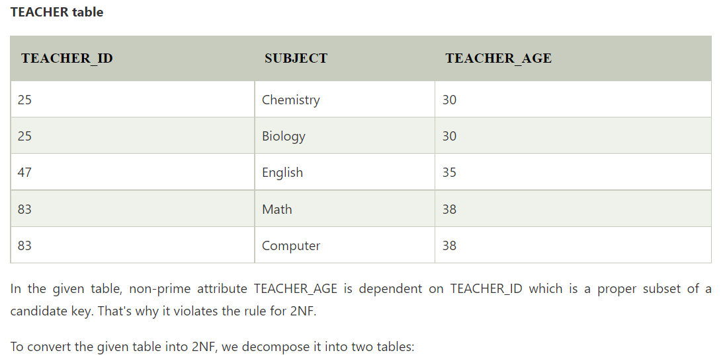
Prime attribute is an attribute that is part of any candidate key.
Non prime attribute is an attribute that is not part of any candidate key.

Slide 42
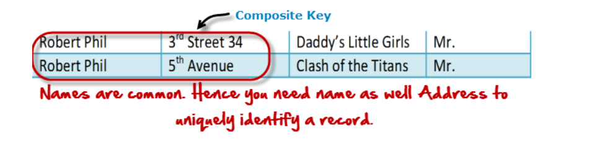
Prime attribute is an attribute that is part of any candidate key.
Non prime attribute is an attribute that is not part of any candidate key.
A KEY in SQL is a value used to identify records in a table uniquely. An SQL KEY is a single column or combination of multiple columns used to uniquely identify rows or tuples in the table
SQL Key is used to identify duplicate information, and it also helps establish a relationship between multiple tables in the database.
A primary key is a single column value used to identify a database record uniquely.
It has following attributes
A primary key cannot be NULL
A primary key value must be unique
The primary key values should rarely be changed
The primary key must be given a value when a new record is inserted.
A composite key is a primary key composed of multiple columns used to identify a record uniquely
In our database, we have two people with the same name Robert Phil, but they live in different places.
Hence, we require both Full Name and Address to identify a record uniquely. That is a composite key.
Let’s move into second normal form 2NF

Slide 43
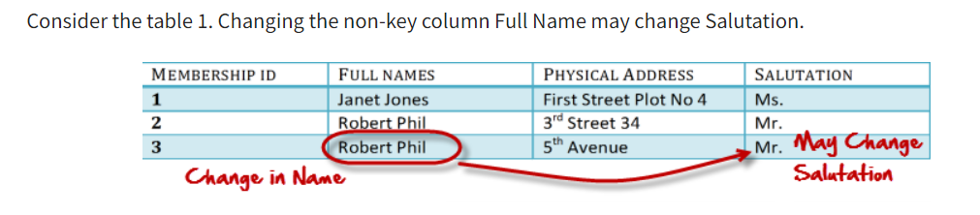
Candidate keys are defined as the minimal set of fields which can uniquely identify each record in a table.
It is an attribute or a set of attributes that can act as a Primary Key for a table to uniquely identify each record in that table. There can be more than one candidate key.
Prime attribute is an attribute that is part of any candidate key.
Non prime attribute is an attribute that is not part of any candidate key.
A transitive functional dependency is when changing a non-key column, might cause any of the other non-key columns to change

Slide 44
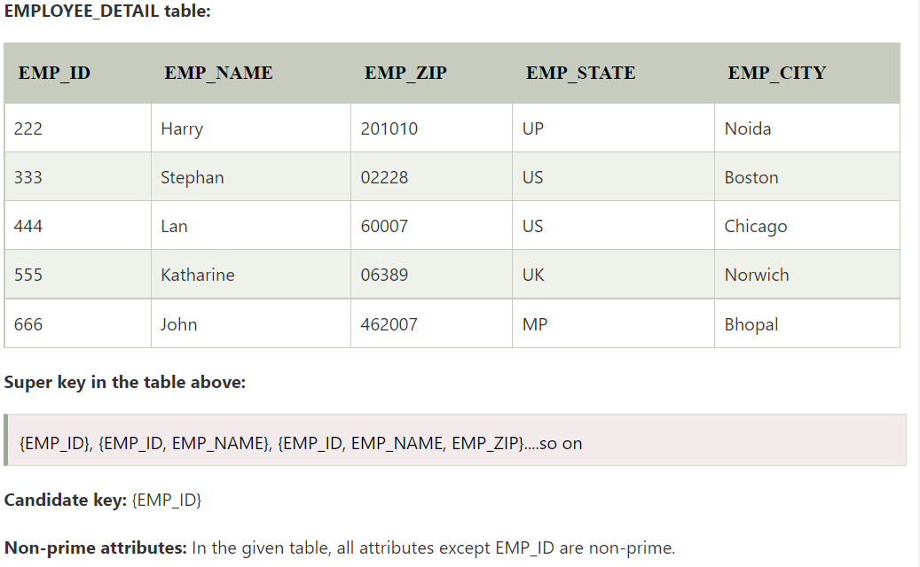
Third Normal Form (3NF)
A relation will be in 3NF if it is in 2NF and not contain any transitive partial dependency.
3NF is used to reduce the data duplication. It is also used to achieve the data integrity.
If there is no transitive dependency for non-prime attributes, then the relation must be in third normal form.
A relation is in third normal form if it holds at least one of the following conditions for every non-trivial function dependency X → Y.
X is a super key.
Y is a prime attribute, i.e., each element of Y is part of some candidate key.

Slide 45

Here, EMP_STATE & EMP_CITY dependent on EMP_ZIP and EMP_ZIP dependent on EMP_ID.
The non-prime attributes (EMP_STATE, EMP_CITY) transitively dependent on super key(EMP_ID). It violates the rule of third normal form.
That's why we need to move the EMP_CITY and EMP_STATE to the new <EMPLOYEE_ZIP> table, with EMP_ZIP as a Primary key.
As the data req inc, db complexity inc, and the need for normalisation inc too.

Slide 46
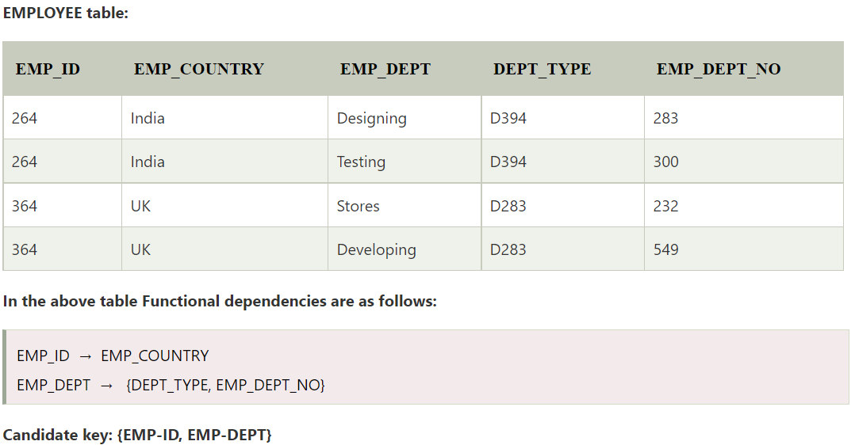
BCNF is the advance version of 3NF. It is stricter than 3NF.
A table is in BCNF if every functional dependency X → Y, X is the super key of the table.
For BCNF, the table should be in 3NF, and for every FD, LHS is super key.
Example: Let's assume there is a company where employees work in more than one department.

Slide 47
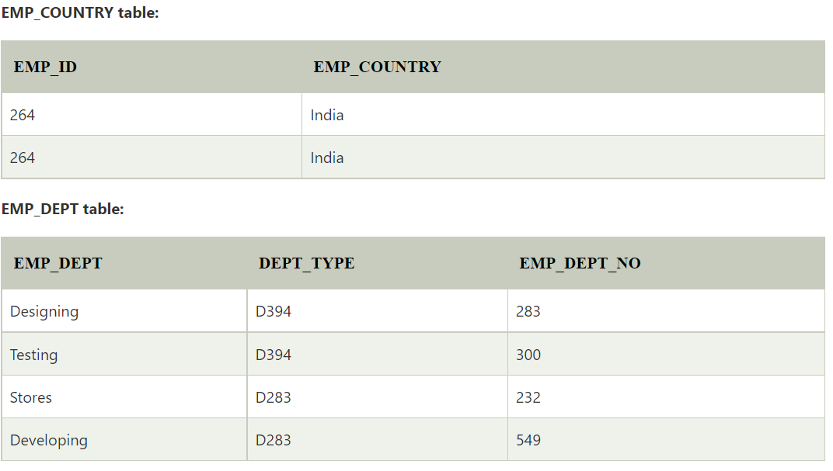
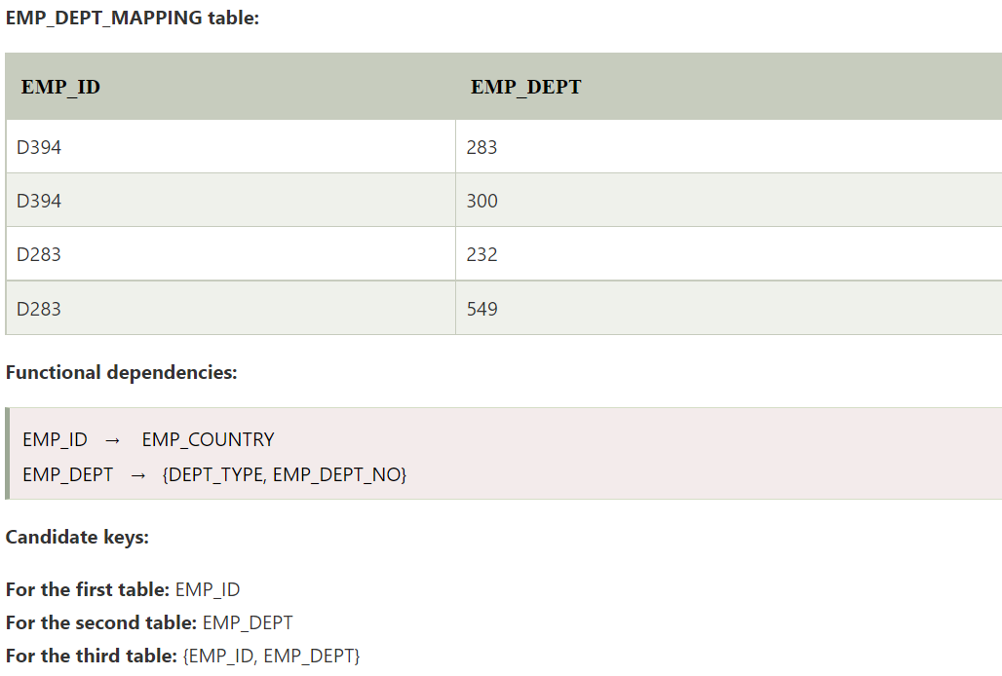
The table is not in BCNF because neither EMP_DEPT nor EMP_ID alone are keys.
To convert the given table into BCNF, we decompose it into three tables:

Slide 48



Fourth normal form (4NF)
A relation will be in 4NF if it is in Boyce Codd normal form and has no multi-valued dependency.
For a dependency A → B, if for a single value of A, multiple values of B exists, then the relation will be a multi-valued dependency.
The given STUDENT table is in 3NF, but the COURSE and HOBBY are two independent entity. Hence, there is no relationship between COURSE and HOBBY.
In the STUDENT relation, a student with STU_ID, 21 contains two courses, Computer and Math and two hobbies, Dancing and Singing. So there is a Multi-valued dependency on STU_ID, which leads to unnecessary repetition of data.
So to make the above table into 4NF, we can decompose it into two tables:

Slide 49

Fifth normal form (5NF)
A relation is in 5NF if it is in 4NF and not contains any join dependency and joining should be lossless.
A table is in 5th Normal Form only if it is in 4NF and it cannot be decomposed into any number of smaller tables without loss of data.
5NF is satisfied when all the tables are broken into as many tables as possible in order to avoid redundancy.
5NF is also known as Project-join normal form (PJ/NF).

Slide 50

In the above table, John takes both Computer and Math class for Semester 1
but he doesn't take Math class for Semester 2. In this case, combination of all these fields required to identify a valid data.
Suppose we add a new Semester as Semester 3 but do not know about the subject and who will be taking that subject so we leave Lecturer and Subject as NULL.
But all three columns together acts as a primary key, so we can't leave other two columns blank.
So to make the above table into 5NF, we can decompose it into three relations P1, P2 & P3:

