Slide 1
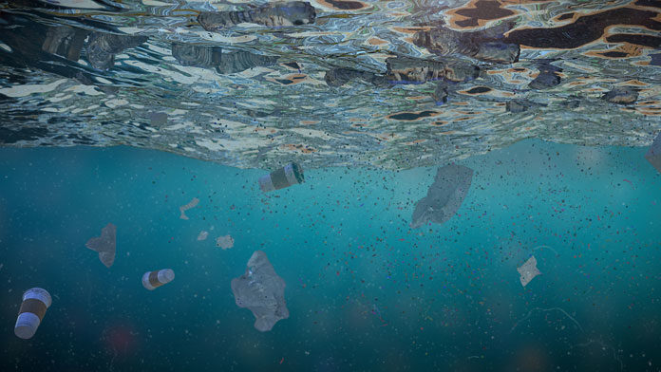

MICROPLASTICS DETECTION
Detection of micro-plastics in water using Deep Learning

Slide 2
Problem Statement
Microplastics are one of the major pollutant issues in the aquatic zone, are required to be identified in the water and needed to take preventive measures in order to eliminate them.
The issue of microplastics has become a pressing matter in environmental circles as these tiny plastic particles, usually measuring between 1 and 5 millimeters, pose a threat to aquatic ecosystems.
Elimination of microplastics in water should be done in order to avoid major problems like ecosystem disruption, water pollution, respiratory and endocrine system diseases

Slide 3
Statistics
“Studies have found microplastic concentrations varying depending on location and water type. One study reported an average of 64-1770 microplastic particles per liter in surface waters [ResearchGate].”
“Estimates suggest there could be 50-75 trillion microplastic pieces floating in our oceans [UNESCO ocean literacy portal].”
Souíce link: Plastic pollution in the ocean: data, facts, consequences (unesco.org)
Souíce link: (PDF) Microplastic Pollution: Sources, Fate, Impacts and Research Gaps (researchgate.net)

Slide 4
Stakeholders
Environmental Researchers
Government Agencies
Water Utilities and NGOs
Chemical and Material Sciences companies

Slide 5
Present Scenario
Microplastics are practically everywhere in aquatic environments. Estimates suggest a staggering range of 50-75 trillion microplastic particles floating just in our oceans.
The main culprits are plastic breakdown from various sources. Additionally, synthetic clothing fibers shed microplastics during washing, further polluting waterways.
The full extent of the consequences is still being researched, but there are concerns about microplastics entering the food chain.
Traditional methods for microplastic detection can be expensive, time-consuming, and require specialized expertise.

Slide 6
Proposed Solution
Objective: Develop an efficient CNN model for automated microplastic detection in water.
Key Steps:
Diverse dataset collection.
CNN architecture with transfer learning.
Training, fine-tuning, and evaluation.
Optimization for real-time processing.
Validation with real-world samples.
Major Outcome:
Accurate detection with key metrics.

Slide 7
Features
Image Recognition Capability: CNNs automatically extract crucial features like shape, color, texture, and patterns, enabling robust microplastic identification.
Convolutional Layers: CNNs recognize patterns at different scales, crucial for varied microplastic particle sizes, shapes, and arrangements.
Adaptability to Different Environments: CNNs adapt well to diverse environments by leveraging pre-trained models, facilitating efficient training on smaller datasets.
Handling Nonlinear Relationships: CNNs capture complex relationships, vital for detecting microplastics with diverse shapes and characteristics.
Real-time or Near-real-time Analysis: Trained CNN models provide quick, real-time analysis, suitable for time-sensitive applications like continuous environmental monitoring.

Slide 8

Thank You!
☺

