Slide 1
Support Vector Machine I
Syed Sajid Hussain
UPES Dehradun
School of Computer Science
Spring 2025

Slide 2
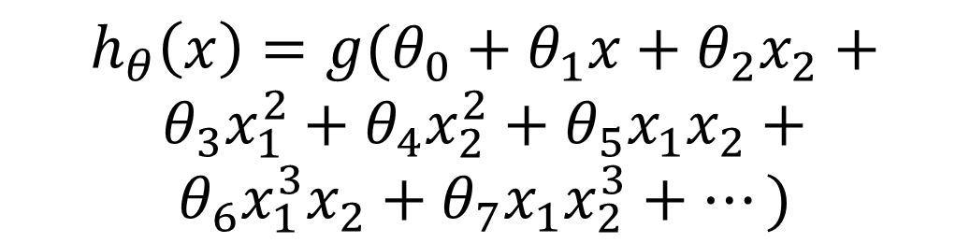

Regularized logistic regression
Cost function:
$$J\left(θ\right)=\frac{1}{m}\left[\sum_{i=1}^{m}{y^{\left(i\right)}\log{h_{θ}\left(x^{\left(i\right)}\right)}+(1−y^{\left(i\right)})\log\left(1−h_{θ}\left(x^{\left(i\right)}\right)\right)}+\frac{λ}{2}\sum_{j=1}^{n}{θ_{j}^{2}}\right]$$
$$h_{θ}\left(x\right)={g(θ}_{0}+θ_{1}x+θ_{2}x_{2}+$$
$$θ_{3}x_{1}^{2}+θ_{4}x_{2}^{2}+θ_{5}x_{1}x_{2}+$$
$$θ_{6}x_{1}^{3}x_{2}+θ_{7}x_{1}x_{2}^{3}+⋯)$$
Age
Tumor Size

Slide 3
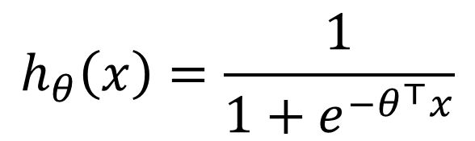
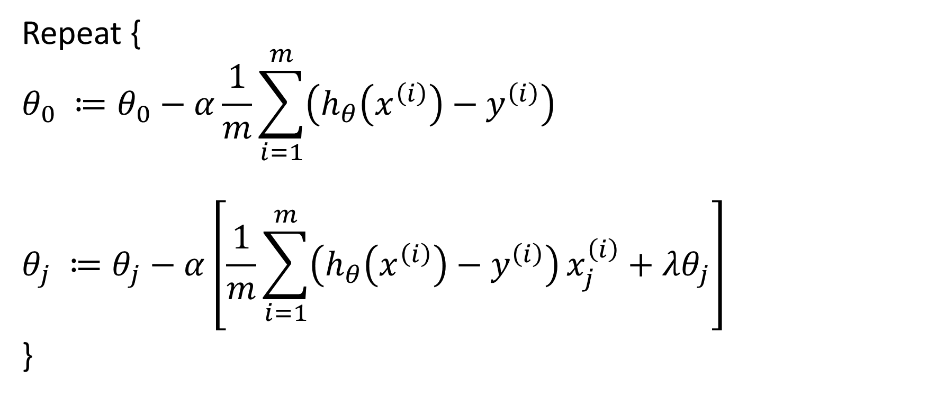

Gradient descent (Regularized)
Repeat {
$$θ_{0} ≔θ_{0}−α\frac{1}{m}\sum_{i=1}^{m}{\left(h_{θ}\left(x^{\left(i\right)}\right)−y^{\left(i\right)}\right)}$$
$$θ_{j} ≔θ_{j}−α\left[\frac{1}{m}\sum_{i=1}^{m}{\left(h_{θ}\left(x^{\left(i\right)}\right)−y^{\left(i\right)}\right)}x_{j}^{\left(i\right)}+λθ_{j}\right]$$
}
$$h_{θ}\left(x\right)=\frac{1}{1+e^{−θ^{⊤}x}}$$
$$\frac{∂}{∂θ_{j}}J(θ)$$

Slide 4
Support Vector Machine
Cost function
Large margin classification
Kernels
Using an SVM

Slide 5
Support Vector Machine
Cost function
Large margin classification
Kernels
Using an SVM

Slide 6
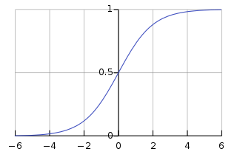
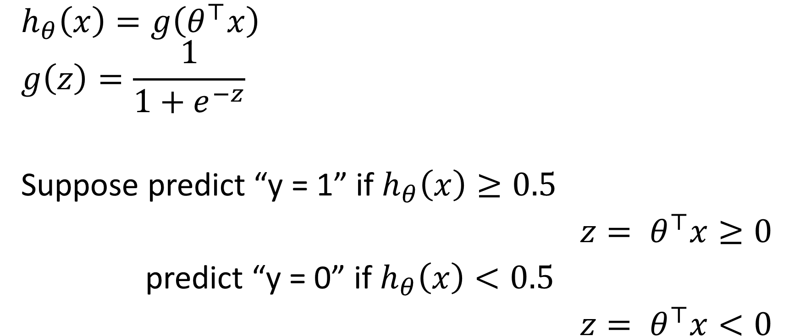


Logistic regression
$$g(z)$$
$$h_{θ}\left(x\right)=g\left(θ^{⊤}x\right)$$
$$g\left(z\right)=\frac{1}{1+e^{−z}}$$
Suppose predict “y = 1” if $h_{θ}\left(x\right)≥0.5$
${z= θ}^{⊤}x≥0$
predict “y = 0” if $h_{θ}\left(x\right)<0.5$
${z= θ}^{⊤}x<0$
$$z=θ^{⊤}x$$

Slide 7
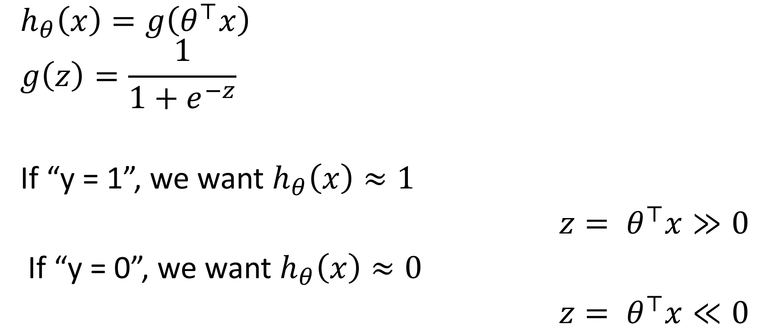
Alternative view
$$g(z)$$
$$h_{θ}\left(x\right)=g\left(θ^{⊤}x\right)$$
$$g\left(z\right)=\frac{1}{1+e^{−z}}$$
If “y = 1”, we want $h_{θ}\left(x\right)≈1$
${z= θ}^{⊤}x≫0$
If “y = 0”, we want $h_{θ}\left(x\right)≈0$
${z= θ}^{⊤}x≪0$
$$z=θ^{⊤}x$$

Slide 8



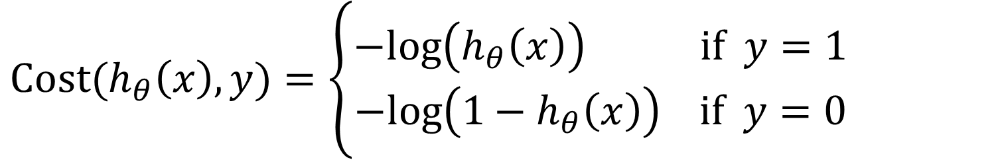





Cost function for Logistic Regression
$$Cost(h_{θ}\left(x\right),y)=\left\{\begin{aligned}−log\left(h_{θ}\left(x\right)\right) if y=1 \\ −log\left({1−h}_{θ}\left(x\right)\right) if y=0\end{aligned}\right.$$
$$if y=1$$
$$if y=0$$
$$0$$
$$h_{θ}\left(x\right)$$
$$1$$
$$0$$
$$h_{θ}\left(x\right)$$
$$1$$

Slide 9






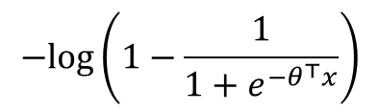










Alternative view of logistic regression
$Cost\left(h_{θ}\left(x\right),y\right)=− y log\left(h_{θ}\left(x\right)\right)−(1−y)$ $log\left({1−h}_{θ}\left(x\right)\right)$ $= y \left(−log\left(\frac{1}{1+e^{−θ^{⊤}x}}\right)\right)+\left(1−y\right) \left(−log\left(1−\frac{1}{1+e^{−θ^{⊤}x}}\right)\right)$
0
$$−log\left(\frac{1}{1+e^{−θ^{⊤}x}}\right)$$
$$−log\left(1−\frac{1}{1+e^{−θ^{⊤}x}}\right)$$
$$if y=1$$
$$if y=0$$
$$−2$$
$$−1$$
$$0$$
$$1$$
$$2$$
$$θ^{⊤}x$$
$$−2$$
$$−1$$
$$0$$
$$1$$
$$2$$
$$θ^{⊤}x$$

Slide 10

Logistic regression (logistic loss)
$$\min_{θ} \frac{1}{m}\left[\sum_{i=1}^{m}{y^{(i)}\left(−log\left(h_{θ}\left(x^{(i)}\right)\right)\right)+(1−y^{\left(i\right)}\text{)}\left(−log\left({1−h}_{θ}\left(x^{(i)}\right)\right)\right) }\right]+\frac{λ}{2m }\sum_{j=1}^{n}{θ_{j}^{2}}$$
Support vector machine (hinge loss)
$$\min_{θ} \frac{1}{m}\left[\sum_{i=1}^{m}{y^{(i)} cost_{1}\left(θ^{⊤}x^{\left(i\right)}\right)+(1−y^{\left(i\right)}\text{)} cost_{0}\left(θ^{⊤}x^{\left(i\right)}\right)}\right]+\frac{λ}{2m }\sum_{j=1}^{n}{θ_{j}^{2}}$$
0
$$−log\left(\frac{1}{1+e^{−θ^{⊤}x}}\right)$$
$$−log\left(1−\frac{1}{1+e^{−θ^{⊤}x}}\right)$$
$$if y=1$$
$$if y=0$$
$$−2$$
$$−1$$
$$0$$
$$1$$
$$2$$
$$θ^{⊤}x$$
$$−2$$
$$−1$$
$$0$$
$$1$$
$$2$$
$$θ^{⊤}x$$

Slide 11
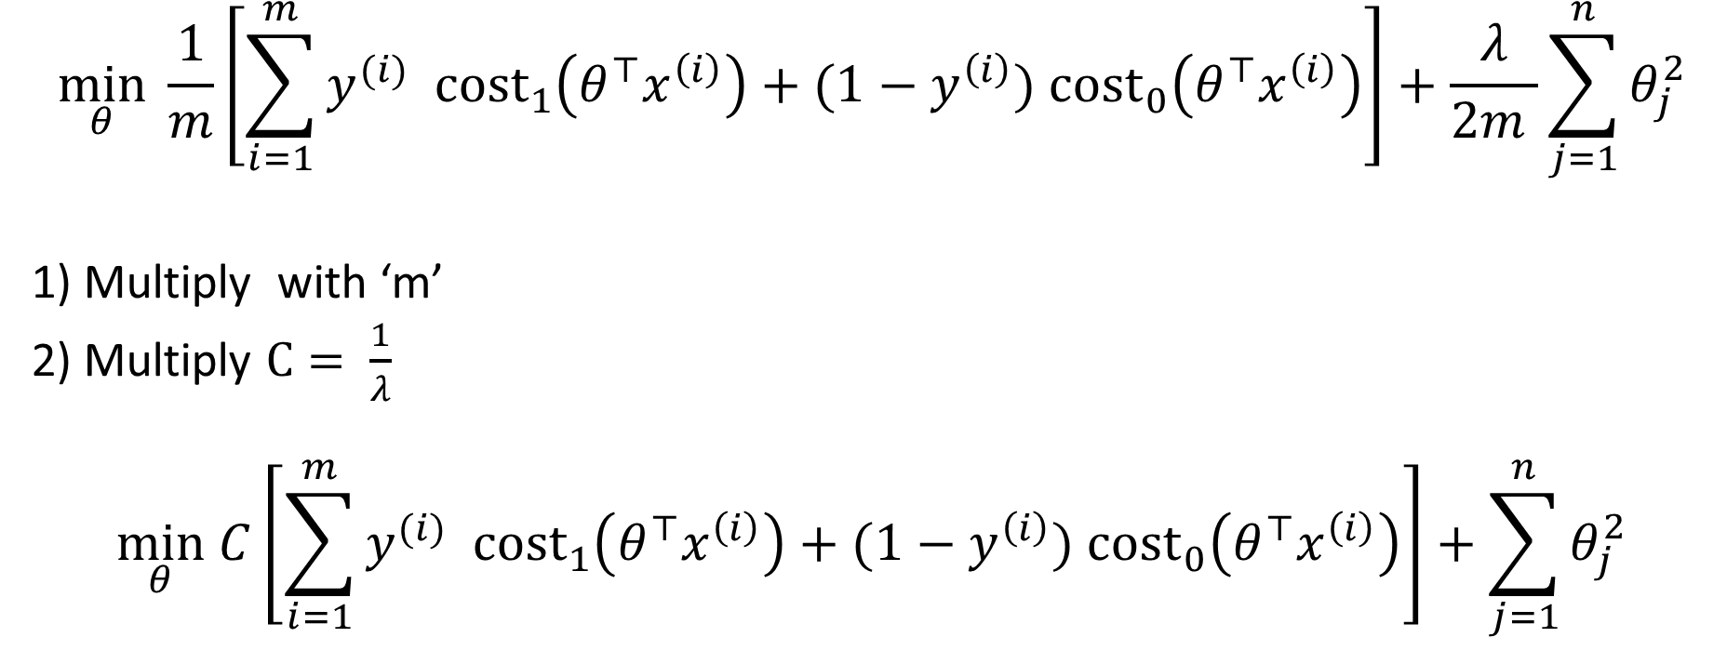
Optimization objective for SVM
$$\min_{θ} \frac{1}{m}\left[\sum_{i=1}^{m}{y^{(i)} cost_{1}\left(θ^{⊤}x^{\left(i\right)}\right)+(1−y^{\left(i\right)}\text{)} cost_{0}\left(θ^{⊤}x^{\left(i\right)}\right)}\right]+\frac{λ}{2m }\sum_{j=1}^{n}{θ_{j}^{2}}$$
1) Multiply with ‘m’
2) Multiply $C= \frac{1}{λ}$
$$\min_{θ} C\left[\sum_{i=1}^{m}{y^{(i)} cost_{1}\left(θ^{⊤}x^{\left(i\right)}\right)+(1−y^{\left(i\right)}\text{)} cost_{0}\left(θ^{⊤}x^{\left(i\right)}\right)}\right]+\sum_{j=1}^{n}{θ_{j}^{2}}$$

Slide 12
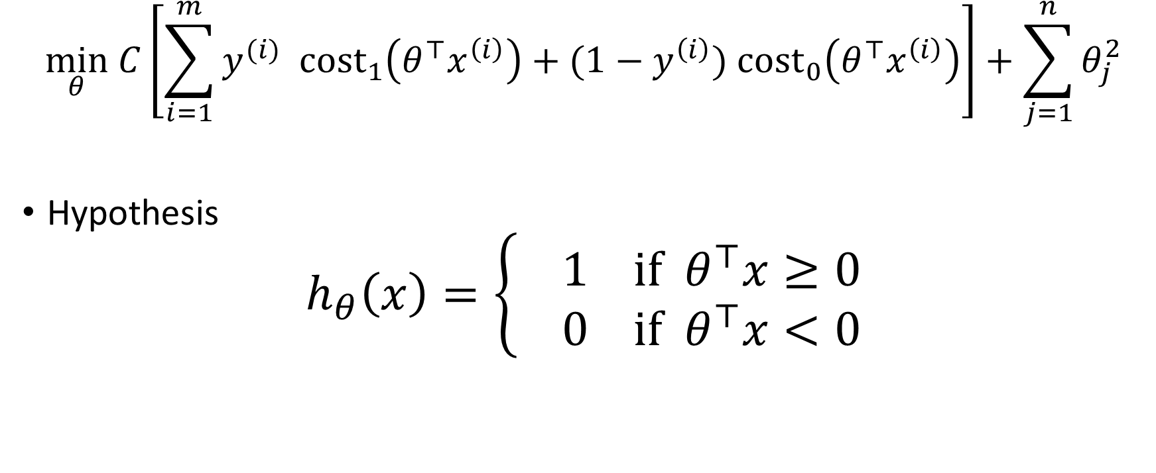
Hypothesis of SVM
$$\min_{θ} C\left[\sum_{i=1}^{m}{y^{(i)} cost_{1}\left(θ^{⊤}x^{\left(i\right)}\right)+(1−y^{\left(i\right)}\text{)} cost_{0}\left(θ^{⊤}x^{\left(i\right)}\right)}\right]+\sum_{j=1}^{n}{θ_{j}^{2}}$$
Hypothesis
$$h_{θ}\left(x\right)=\left\{ \begin{aligned}1 if θ^{⊤}x≥0 \\ 0 if{ θ}^{⊤}x<0\end{aligned}\right.$$

Slide 13
Support Vector Machine
Cost function
Large margin classification
Kernels
Using an SVM

Slide 14

















Support vector machine
$$\min_{θ} C\left[\sum_{i=1}^{m}{y^{(i)} cost_{1}\left(θ^{⊤}x^{\left(i\right)}\right)+(1−y^{\left(i\right)}\text{)} cost_{0}\left(θ^{⊤}x^{\left(i\right)}\right)}\right]+\sum_{j=1}^{n}{θ_{j}^{2}}$$
If “y = 1”, we want $θ^{⊤}x≥ 1$ ($not just ≥0)$
If “y = 0”, we want${ θ}^{⊤}x≤−1$ ($not just <0)$
$$cost_{1}\left(θ^{⊤}x\right)$$
$$cost_{0}\left(θ^{⊤}x\right)$$
$$if y=1$$
$$if y=0$$
$$−2$$
$$−1$$
$$0$$
$$1$$
$$2$$
$$θ^{⊤}x$$
$$−2$$
$$−1$$
$$0$$
$$1$$
$$2$$
$$θ^{⊤}x$$

Slide 15
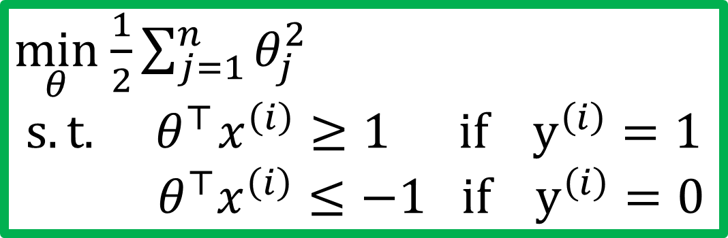
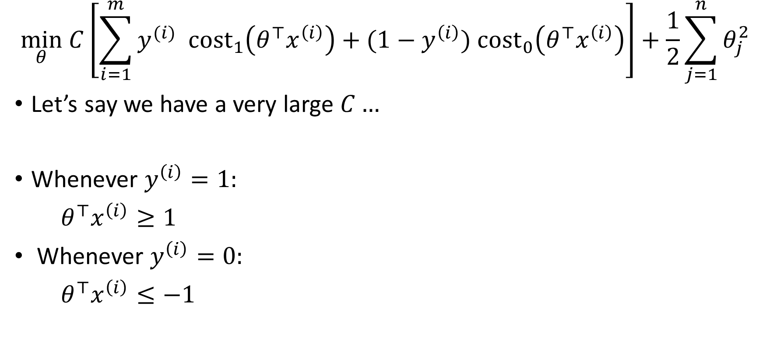
SVM decision boundary
$$\min_{θ} C\left[\sum_{i=1}^{m}{y^{(i)} cost_{1}\left(θ^{⊤}x^{\left(i\right)}\right)+(1−y^{\left(i\right)}\text{)} cost_{0}\left(θ^{⊤}x^{\left(i\right)}\right)}\right]+\frac{1}{2}\sum_{j=1}^{n}{θ_{j}^{2}}$$
Let’s say we have a very large $C…$
Whenever $y^{\left(i\right)}=1:$
$θ^{⊤}x^{\left(i\right)}≥1$
Whenever $y^{\left(i\right)}=0:$
$θ^{⊤}x^{\left(i\right)}≤−1$
$\min_{θ}$ $\frac{1}{2}\sum_{j=1}^{n}{θ_{j}^{2}}$ $$s.t.{ θ}^{⊤}x^{\left(i\right)}≥1 if y^{\left(i\right)}=1$$
$${ θ}^{⊤}x^{\left(i\right)}≤−1 if y^{\left(i\right)}=0$$

Slide 16

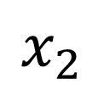
SVM decision boundary: Linearly separable case
$$x_{2}$$
$$x_{1}$$

Slide 17
SVM decision boundary: Linearly separable case
$$x_{2}$$
margin
$$x_{1}$$

Slide 18
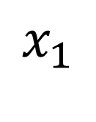
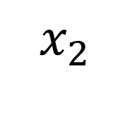


Large margin classifier in the presence of outlier
$C$ very large
$$x_{2}$$
$C$ not too large
$$x_{1}$$

Slide 19



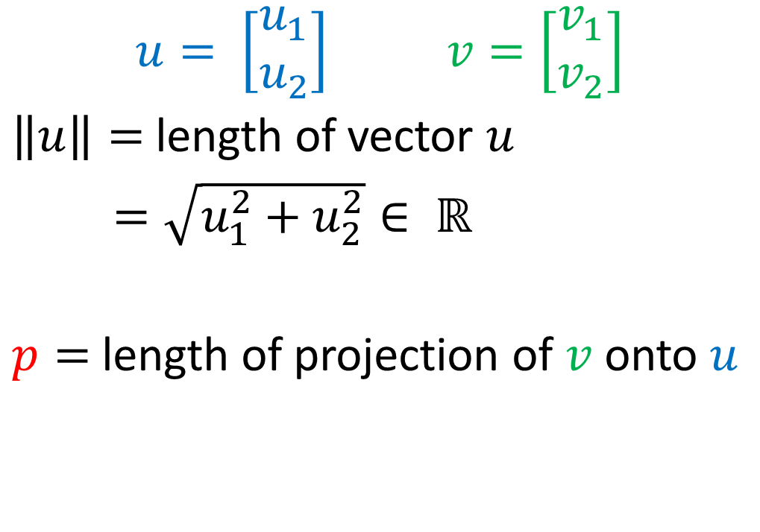



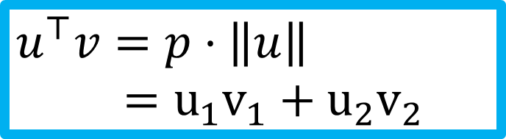
Vector inner product
$$u= \left[\begin{aligned}u_{1} \\ u_{2}\end{aligned}\right] v=\left[\begin{aligned}v_{1} \\ v_{2}\end{aligned}\right]$$
$\left\|u\right\|=$length of vector $u$
$=\sqrt{u_{1}^{2}+u_{2}^{2}}∈ ℝ$
$p=$length of projection of $v$ onto $u$
$$v$$
$v_{2}$
$$u$$
$$u_{2}$$
$v_{1}$
$$u_{1}$$
$$u^{⊤}v=p⋅\left\|u\right\|$$ $=u_{1}v_{1}+u_{2}v_{2}$

Slide 20

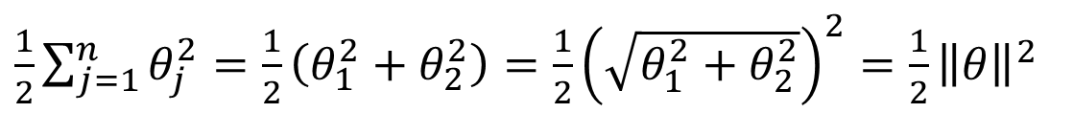







SVM decision boundary
$\frac{1}{2}\sum_{j=1}^{n}{θ_{j}^{2}}=\frac{1}{2}\left(θ_{1}^{2}+θ_{2}^{2}\right)=\frac{1}{2}{\left(\sqrt{θ_{1}^{2}+θ_{2}^{2}}\right)}^{2}=\frac{1}{2}{\left\|θ\right\|}^{2}$
$\min_{θ}$ $\frac{1}{2}\sum_{j=1}^{n}{θ_{j}^{2}}$ $$s.t.{ θ}^{⊤}x^{\left(i\right)}≥1 if y^{\left(i\right)}=1$$ $θ^{⊤}x^{\left(i\right)}≤−1 if y^{\left(i\right)}=0$
Simplication: $θ_{0}=0, n=2$
What’s $θ^{⊤}x^{\left(i\right)}$?
$$θ^{⊤}x^{\left(i\right)}=p^{(i)}{\left\|θ\right\|}^{2}$$
$$x^{(i)}$$
$x_{2}^{\left(i\right)}$
$$θ$$
$${\text{θ}}_{2}$$
$$p^{(i)}$$
$x_{1}^{\left(i\right)}$
$$θ_{1}$$

Slide 21










SVM decision boundary
$$\min_{θ}\frac{1}{2}{\left\|θ\right\|}^{2} \\ s.t.{ p}^{(i)}{\left\|θ\right\|}^{2}≥1 if y^{\left(i\right)}=1 \\ { p}^{(i)}{\left\|θ\right\|}^{2}≤−1 if y^{\left(i\right)}=0$$
Simplication: $θ_{0}=0, n=2$
$p^{\left(1\right)},p^{(2)}$ small $→$ ${\left\|θ\right\|}^{2}$ large
$p^{\left(1\right)},p^{(2)}$ large $→$ ${\left\|θ\right\|}^{2}$ can be small
$$θ$$
$$x^{\left(2\right)}$$
$$x^{\left(2\right)}$$
$$θ$$
$$x^{\left(1\right)}$$
$$x^{\left(1\right)}$$

Slide 22
Support Vector Machine
Cost function
Large margin classification
Kernels
Using an SVM

Slide 23



Non-linear decision boundary
$$x_{2}$$
Predict $y=1 if$
$θ_{0}+θ_{1}x_{1}+θ_{2}x_{2}+θ_{3}x_{1}x_{2}$
$+ θ_{4}x_{1}^{2}+θ_{5}x_{2}^{2}+⋯≥0$
$$θ_{0}+θ_{1}f_{1}+θ_{2}f_{2}+θ_{3}f_{3}+⋯$$
$$f_{1}=x_{1}, f_{2}=x_{2}, f_{3}=x_{1}x_{2}, ⋯$$
Is there a different/better choice of the features $f_{1},f_{2},f_{3}, ⋯$?
$$x_{1}$$

Slide 24
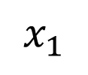

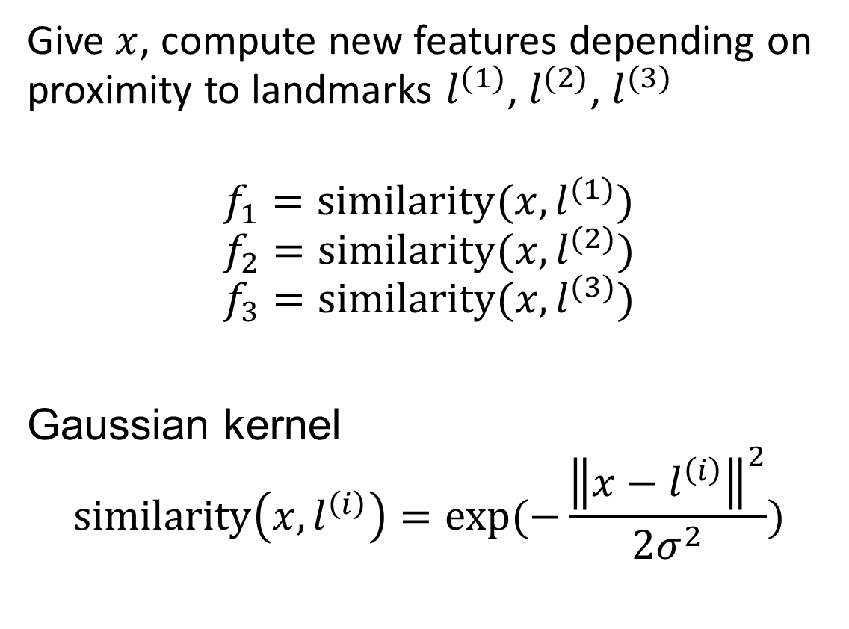


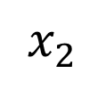
Kernel
$$x_{2}$$
Give $x$, compute new features depending on proximity to landmarks $l^{(1)}$, $l^{(2)}$, $l^{(3)}$
$$f_{1}=similarity(x, l^{(1)})$$
$$f_{2}=similarity(x, l^{(2)})$$
$$f_{3}=similarity(x, l^{(3)})$$
Gaussian kernel
$$similarity\left(x, l^{\left(i\right)}\right)=exp⁡(−\frac{{\left\|x−l^{\left(i\right)}\right\|}^{2}}{2σ^{2}})$$
$$l^{(1)}$$
$$l^{(2)}$$
$$l^{(3)}$$
$$x_{1}$$

Slide 25
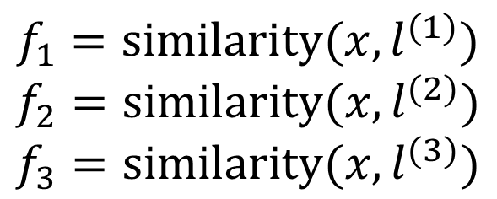
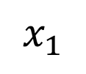




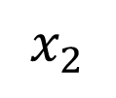
$$x_{2}$$
$$l^{(1)}$$
$$l^{(2)}$$
Predict $y=1 if$
$$θ_{0}+θ_{1}f_{1}+θ_{2}f_{2}+θ_{3}f_{3}≥0$$
Ex: $θ_{0}=−0.5, θ_{1}=1, θ_{2}=1, θ_{3}=0$
$$l^{(3)}$$
$$x_{1}$$
$$f_{1}=similarity(x, l^{(1)})$$
$$f_{2}=similarity(x, l^{(2)})$$
$$f_{3}=similarity(x, l^{(3)})$$

Slide 26




Choosing the landmarks
Given $x$
$$f_{i}=similarity\left(x,l^{\left(i\right)}\right)=exp⁡(−\frac{{\left\|x−l^{\left(i\right)}\right\|}^{2}}{2σ^{2}})$$
Predict $y=1 if θ_{0}+θ_{1}f_{1}+θ_{2}f_{2}+θ_{3}f_{3}≥0$
Where to get $l^{(1)},l^{(2)},l^{\left(3\right)}, ⋯?$
$$l^{\left(1\right)}$$
$$l^{\left(2\right)}$$
$$l^{\left(3\right)}$$
$$⋮$$
$$l^{\left(m\right)}$$
$$x_{2}$$
$$x_{1}$$

Slide 27

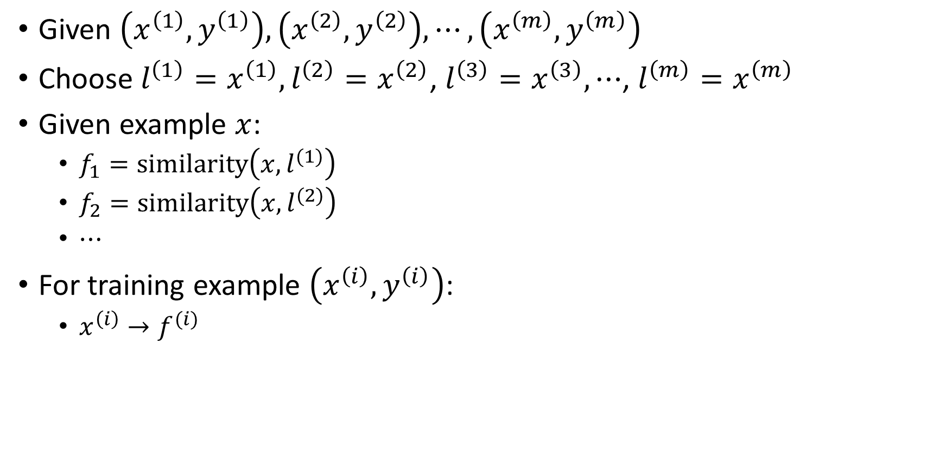
SVM with kernels
Given $\left(x^{\left(1\right)},y^{\left(1\right)}\right), \left(x^{\left(2\right)},y^{\left(2\right)}\right), ⋯,\left(x^{\left(m\right)},y^{\left(m\right)}\right)$
Choose ${l^{\left(1\right)}=x}^{\left(1\right)},{l^{\left(2\right)}=x}^{\left(2\right)}$, ${l^{\left(3\right)}=x}^{\left(3\right)}, ⋯$, ${l^{\left(m\right)}=x}^{\left(m\right)}$
Given example $x$:
$f_{1}=similarity\left(x, l^{(1)}\right)$
$f_{2}=similarity\left(x, l^{(2)}\right)$
$⋯$
For training example $\left(x^{\left(i\right)},y^{\left(i\right)}\right)$:
$x^{\left(i\right)}→f^{(i)}$
$$f=\left[\begin{aligned}f_{0} \\ f_{1} \\ f_{2} \\ ⋮ \\ f_{m}\end{aligned}\right]$$

Slide 28
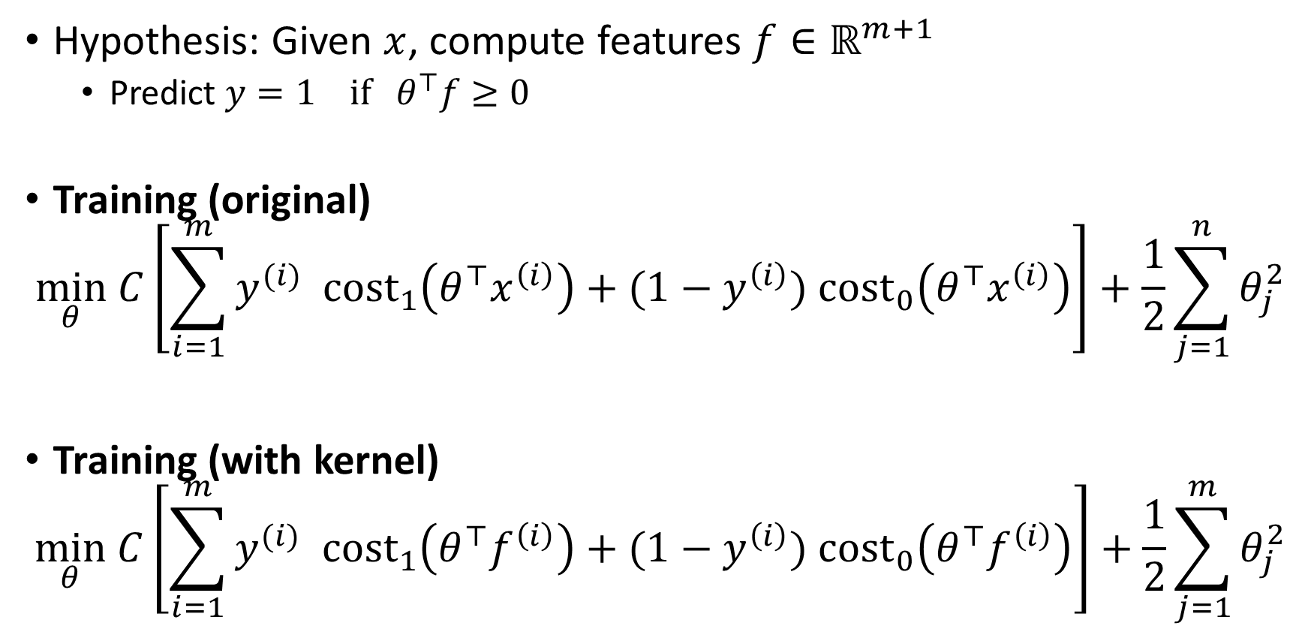
SVM with kernels
Hypothesis: Given $x$, compute features $f∈ℝ^{m+1}$
Predict $y=1 if θ^{⊤}f≥0$
Training (original)
$$\min_{θ} C\left[\sum_{i=1}^{m}{y^{(i)} cost_{1}\left(θ^{⊤}x^{\left(i\right)}\right)+(1−y^{\left(i\right)}\text{)} cost_{0}\left(θ^{⊤}x^{\left(i\right)}\right)}\right]+\frac{1}{2}\sum_{j=1}^{n}{θ_{j}^{2}}$$
Training (with kernel)
$$\min_{θ} C\left[\sum_{i=1}^{m}{y^{(i)} cost_{1}\left(θ^{⊤}f^{\left(i\right)}\right)+(1−y^{\left(i\right)}\text{)} cost_{0}\left(θ^{⊤}f^{\left(i\right)}\right)}\right]+\frac{1}{2}\sum_{j=1}^{m}{θ_{j}^{2}}$$

Slide 29
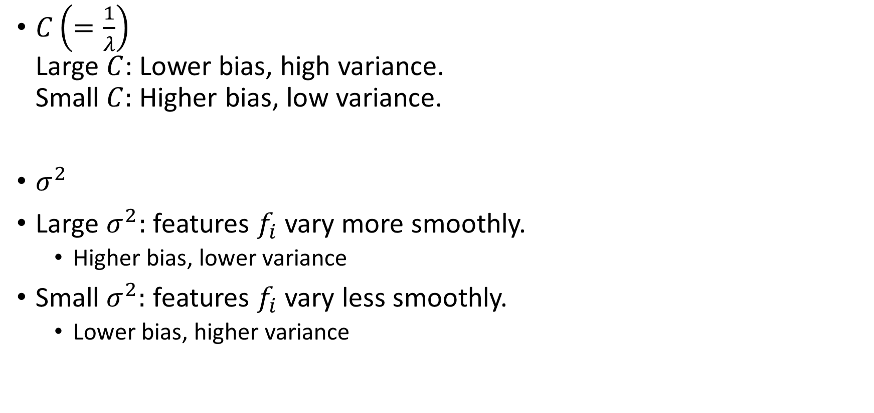
SVM parameters
$C\left(=\frac{1}{λ}\right)$ Large $C$: Lower bias, high variance. Small $C:$ Higher bias, low variance.
$σ^{2}$
Large $σ^{2}:$ features $f_{i}$ vary more smoothly.
Higher bias, lower variance
Small $σ^{2}:$ features $f_{i}$ vary less smoothly.
Lower bias, higher variance

Slide 30
SVM song
https://www.youtube.com/watch?v=g15bqtyidZs

Slide 31
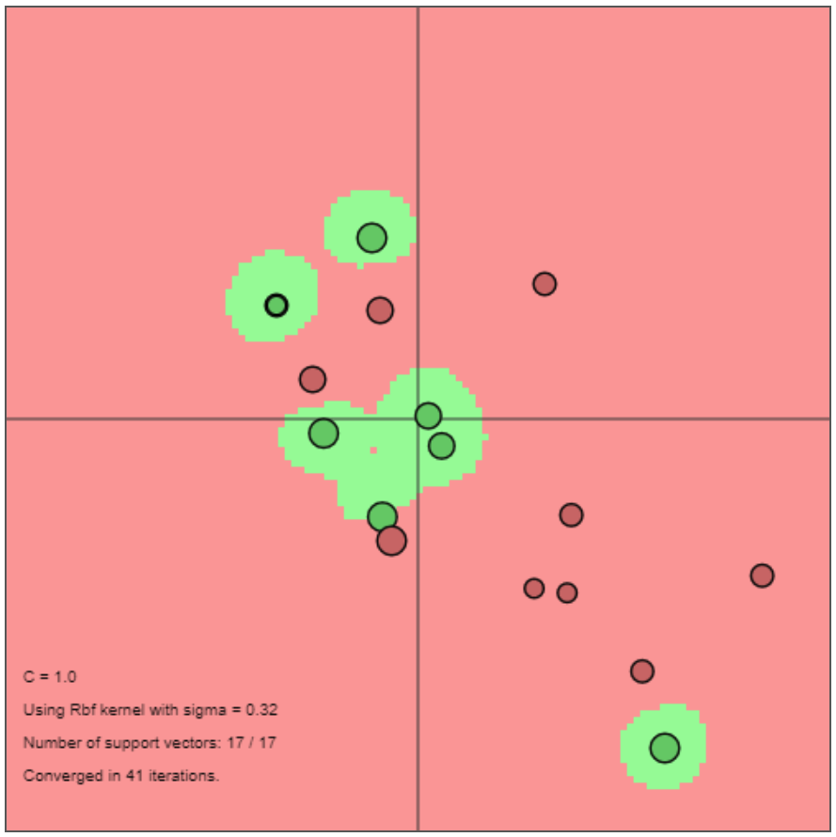
SVM Demo
https://cs.stanford.edu/people/karpathy/svmjs/demo/

Slide 32
Support Vector Machine
Cost function
Large margin classification
Kernels
Using an SVM

Slide 33
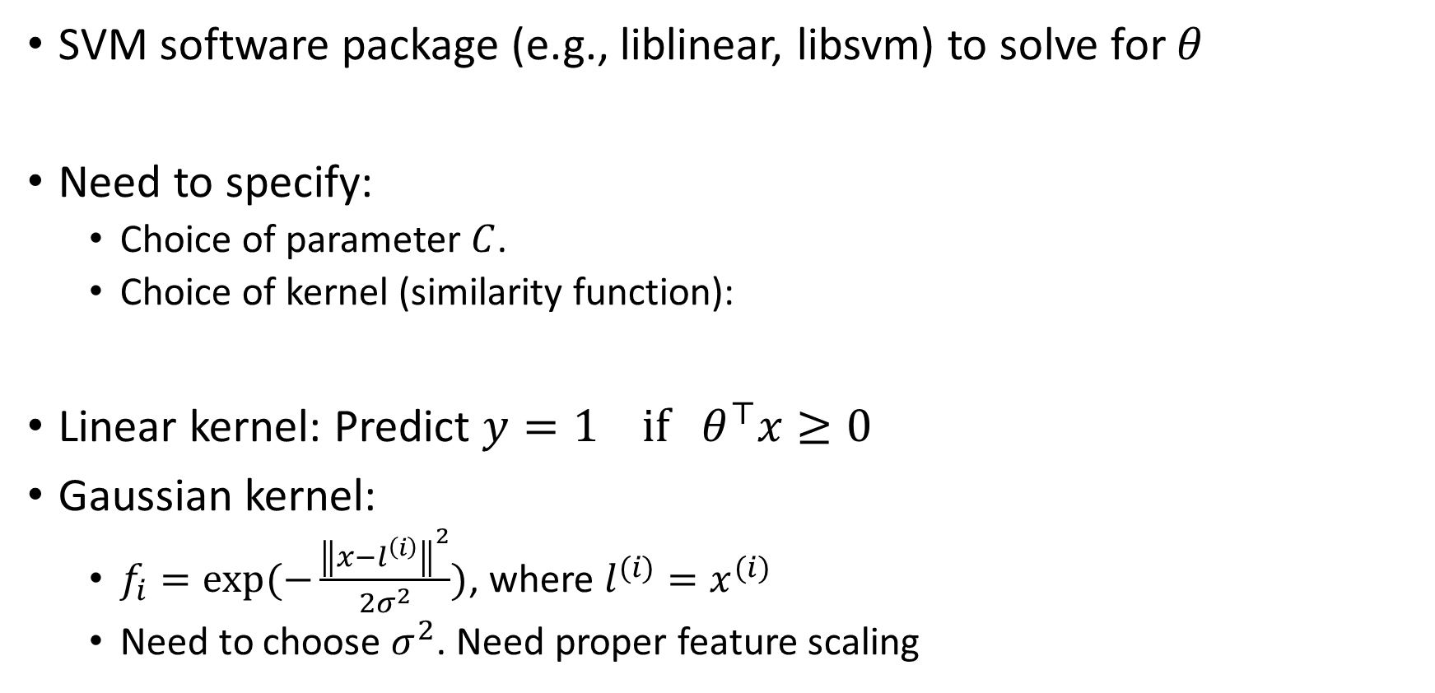
Using SVM
SVM software package (e.g., liblinear, libsvm) to solve for $θ$
Need to specify:
Choice of parameter $C$.
Choice of kernel (similarity function):
Linear kernel: Predict $y=1 if θ^{⊤}x≥0$
Gaussian kernel:
$f_{i}=exp⁡(−\frac{{\left\|x−l^{\left(i\right)}\right\|}^{2}}{2σ^{2}})$, where $l^{(i)}=x^{(i)}$
Need to choose $σ^{2}$. Need proper feature scaling

Slide 34
Kernel (similarity) functions
Note: not all similarity functions make valid kernels.
Many off-the-shelf kernsl available:
Polynomial kernel
String kernel
Chi-square kernel
Histogram intersection kernel

Slide 35
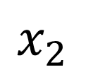
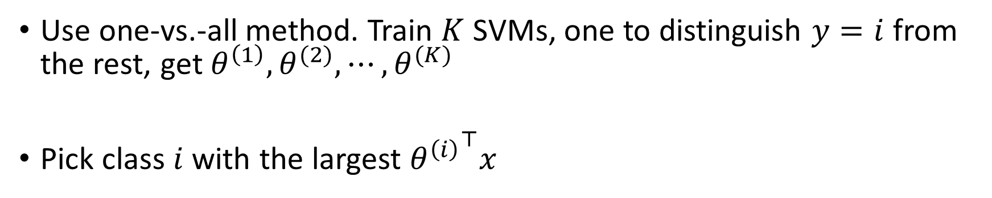

Multi-class classification
$$x_{2}$$
$$x_{1}$$
Use one-vs.-all method. Train $K$ SVMs, one to distinguish $y=i$ from the rest, get $θ^{\left(1\right)}, θ^{(2)}, ⋯,θ^{(K)}$
Pick class$i$ with the largest ${θ^{\left(i\right)}}^{⊤}x$

Slide 36

Logistic regression vs. SVMs
$n=$number of features ($x∈ℝ^{n+1})$, $m=$ number of training examples
If $n$ is large (relative to $m$): $(n=10,000, m=10−1000)$ $→$Use logistic regression or SVM without a kernel (“linear kernel”)
If $n$ is small, $m$ is intermediate: $(n=1−1000, m=10−10,000)$ $→$ Use SVM with Gaussian kernel
If $n$ is small, $m$ is large: $(n=1−1000, m=50,000+)$ $→$ Create/add more features, then use logistic regression of linear SVM
Neural network likely to work well for most of these case, but slower to train

Slide 37

Things to remember
Cost function
$$\min_{θ} C\left[\sum_{i=1}^{m}{y^{(i)} cost_{1}\left(θ^{⊤}f^{\left(i\right)}\right)+(1−y^{\left(i\right)}\text{)} cost_{0}\left(θ^{⊤}f^{\left(i\right)}\right)}\right]+\frac{1}{2}\sum_{j=1}^{m}{θ_{j}^{2}}$$
Large margin classification
Kernels
Using an SVM
$$x_{2}$$
margin
$$x_{1}$$

