Slide 1
Support Vector Machine II
Syed Sajid Hussain
UPES Dehradun
School of Computer Science
Spring 2025

Slide 2
Support Vector Machine
Cost function
Large margin classification
Kernels
Using an SVM

Slide 3

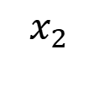
SVM decision boundary: Linearly separable case
$$x_{2}$$
$$x_{1}$$

Slide 4
SVM decision boundary: Linearly separable case
$$x_{2}$$
margin
$$x_{1}$$

Slide 5



Why large margin classifiers?
$\min_{θ}$ $\frac{1}{2}\sum_{j=1}^{n}{θ_{j}^{2}}$
$$s.t.{ θ}^{⊤}x^{\left(i\right)}≥1 if y^{\left(i\right)}=1$$
$${ θ}^{⊤}x^{\left(i\right)}≤−1 if y^{\left(i\right)}=0$$
$$x_{2}$$
margin
$$x_{1}$$

Slide 6
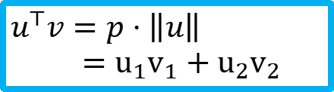






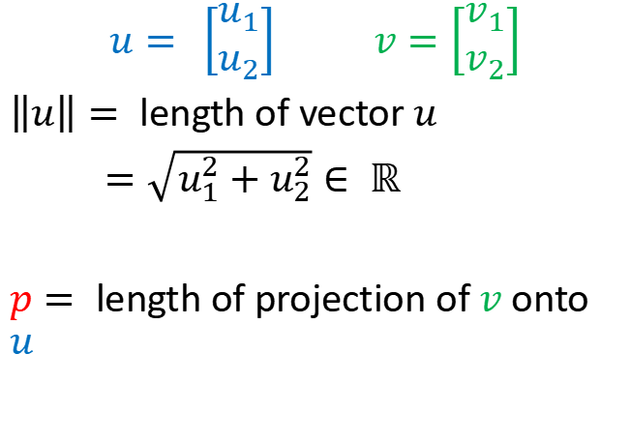
Vector inner product
$$u= \left[\begin{aligned}u_{1} \\ u_{2}\end{aligned}\right] v=\left[\begin{aligned}v_{1} \\ v_{2}\end{aligned}\right]$$
$\left\|u\right\|=$length of vector $u$
$=\sqrt{u_{1}^{2}+u_{2}^{2}}∈ ℝ$
$p=$length of projection of $v$ onto $u$
$$v$$
$v_{2}$
$$u$$
$$u_{2}$$
$v_{1}$
$$u_{1}$$
$$u^{⊤}v=p⋅\left\|u\right\|$$ $=u_{1}v_{1}+u_{2}v_{2}$

Slide 7









SVM decision boundary
$\frac{1}{2}\sum_{j=1}^{n}{θ_{j}^{2}}=\frac{1}{2}\left(θ_{1}^{2}+θ_{2}^{2}\right)=\frac{1}{2}{\left(\sqrt{θ_{1}^{2}+θ_{2}^{2}}\right)}^{2}=\frac{1}{2}{\left\|θ\right\|}^{2}$
$\min_{θ}$ $\frac{1}{2}\sum_{j=1}^{n}{θ_{j}^{2}}$ $$s.t.{ θ}^{⊤}x^{\left(i\right)}≥1 if y^{\left(i\right)}=1$$ $θ^{⊤}x^{\left(i\right)}≤−1 if y^{\left(i\right)}=0$
Simplication: $θ_{0}=0, n=2$
What’s $θ^{⊤}x^{\left(i\right)}$?
$$θ^{⊤}x^{\left(i\right)}=p^{(i)}{\left\|θ\right\|}^{2}$$
$$x^{(i)}$$
$x_{2}^{\left(i\right)}$
$$θ$$
$${\text{θ}}_{2}$$
$$p^{(i)}$$
$x_{1}^{\left(i\right)}$
$$θ_{1}$$

Slide 8







SVM decision boundary
$$\min_{θ}\frac{1}{2}{\left\|θ\right\|}^{2} \\ s.t.{ p}^{(i)}{\left\|θ\right\|}^{2}≥1 if y^{\left(i\right)}=1 \\ { p}^{(i)}{\left\|θ\right\|}^{2}≤−1 if y^{\left(i\right)}=0$$
Simplication: $θ_{0}=0, n=2$
$p^{\left(1\right)},p^{(2)}$ small $→$ ${\left\|θ\right\|}^{2}$ large
$p^{\left(1\right)},p^{(2)}$ large $→$ ${\left\|θ\right\|}^{2}$ can be small
$$θ$$
$$x^{\left(2\right)}$$
$$x^{\left(2\right)}$$
$$θ$$
$$x^{\left(1\right)}$$
$$x^{\left(1\right)}$$

Slide 9


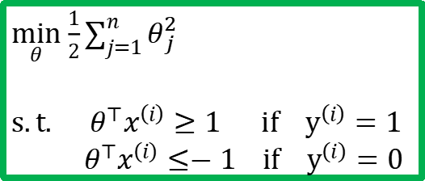
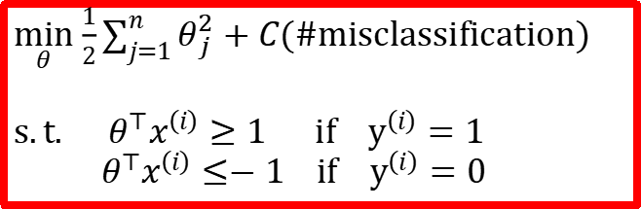
Data not linearly separable?
$\min_{θ}$ $\frac{1}{2}\sum_{j=1}^{n}{θ_{j}^{2}}$
$$s.t.{ θ}^{⊤}x^{\left(i\right)}≥1 if y^{\left(i\right)}=1$$
$${ θ}^{⊤}x^{\left(i\right)}≤−1 if y^{\left(i\right)}=0$$
$$x_{2}$$
$\min_{θ}$ $\frac{1}{2}\sum_{j=1}^{n}{θ_{j}^{2}}+C(\#misclassification)$
$$s.t.{ θ}^{⊤}x^{\left(i\right)}≥1 if y^{\left(i\right)}=1$$
$${ θ}^{⊤}x^{\left(i\right)}≤−1 if y^{\left(i\right)}=0$$
$$x_{1}$$
NP-hard ☹

Slide 10
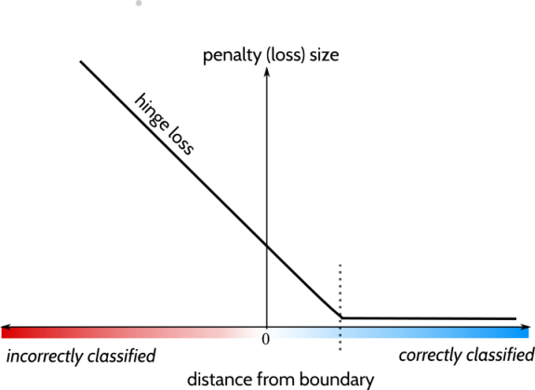
Hinge loss

Slide 11
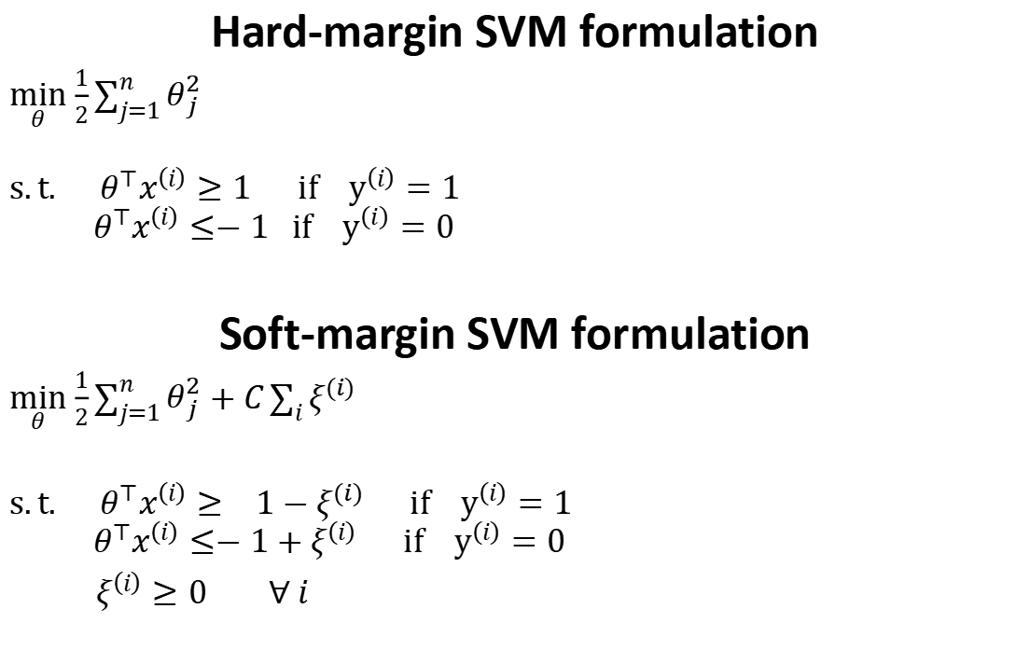
Hard-margin SVM formulation
$\min_{θ}$ $\frac{1}{2}\sum_{j=1}^{n}{θ_{j}^{2}}$
$$s.t.{ θ}^{⊤}x^{\left(i\right)}≥1 if y^{\left(i\right)}=1$$
$${ θ}^{⊤}x^{\left(i\right)}≤−1 if y^{\left(i\right)}=0$$
Soft-margin SVM formulation
$\min_{θ}$ $\frac{1}{2}\sum_{j=1}^{n}{θ_{j}^{2}}+C\sum_{i}{ξ^{(i)}}$
$$s.t.{ θ}^{⊤}x^{\left(i\right)}≥ 1−ξ^{(i)} if y^{\left(i\right)}=1$$
$${ θ}^{⊤}x^{\left(i\right)}≤−1+ξ^{\left(i\right)} if y^{\left(i\right)}=0$$
$ξ^{\left(i\right)}≥0 ∀ i$

Slide 12
Support Vector Machine
Cost function
Large margin classification
Kernels
Using an SVM

Slide 13


Non-linear classification
How do we separate the two classes using a hyperplane?
$$h_{θ}\left(x\right)=\left\{ \begin{aligned}1 if θ^{⊤}x≥0 \\ 0 if{ θ}^{⊤}x<0\end{aligned}\right.$$
$$x$$

Slide 14

Non-linear classification
$$x^{2}$$
$$x$$

Slide 15
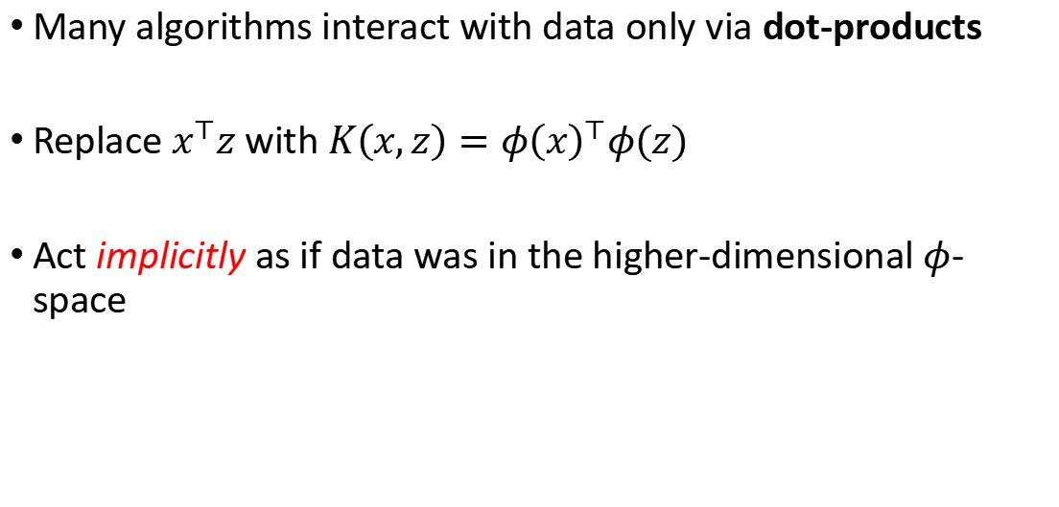
Why Kernels matter?
Many algorithms interact with data only via dot-products
Replace $x^{⊤}z$ with $K\left(x,z\right)=φ{\left(x\right)}^{⊤}φ(z)$
Act implicitly as if data was in the higher-dimensional $φ$-space

Slide 16
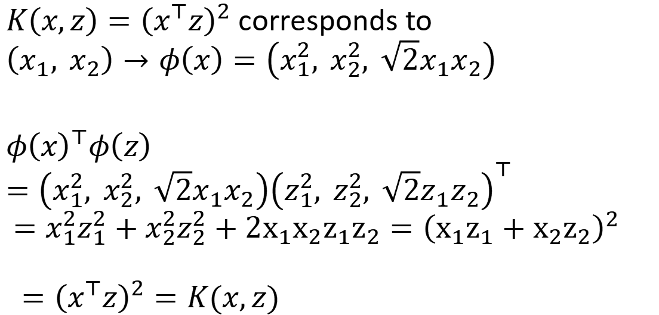
Example
$K\left(x,z\right)={\left(x^{⊤}z\right)}^{2}$ corresponds to
$$\left(x_{1}, x_{2}\right)→φ\left(x\right)=\left(x_{1}^{2}, x_{2}^{2}, \sqrt{2}x_{1}x_{2}\right)$$
$$φ{\left(x\right)}^{⊤}φ\left(z\right)=\left(x_{1}^{2}, x_{2}^{2}, \sqrt{2}x_{1}x_{2}\right){\left(z_{1}^{2}, z_{2}^{2}, \sqrt{2}z_{1}z_{2}\right)}^{⊤}$$ $=x_{1}^{2}z_{1}^{2}+x_{2}^{2}z_{2}^{2}+2x_{1}x_{2}z_{1}z_{2}={\left(x_{1}z_{1}+x_{2}z_{2}\right)}^{2}$
$$={\left(x^{⊤}z\right)}^{2}=K(x,z)$$

Slide 17
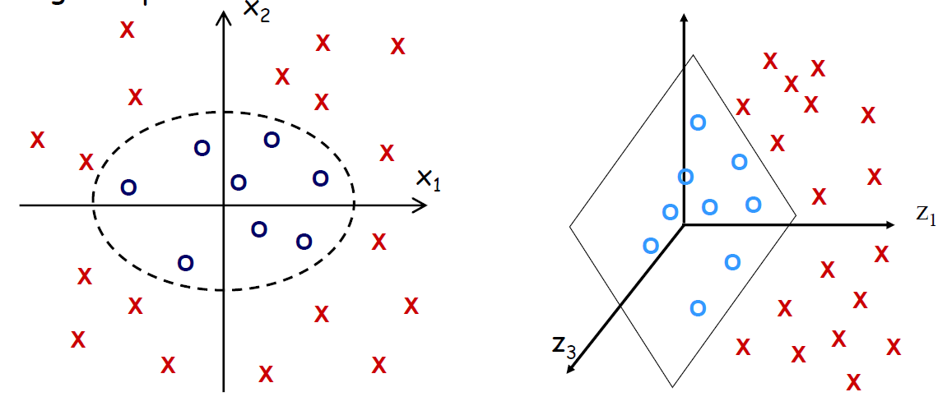

Example
$K\left(x,z\right)={\left(x^{⊤}z\right)}^{2}$ corresponds to
$$\left(x_{1}, x_{2}\right)→φ\left(x\right)=\left(x_{1}^{2}, x_{2}^{2}, \sqrt{2}x_{1}x_{2}\right)$$

Slide 18
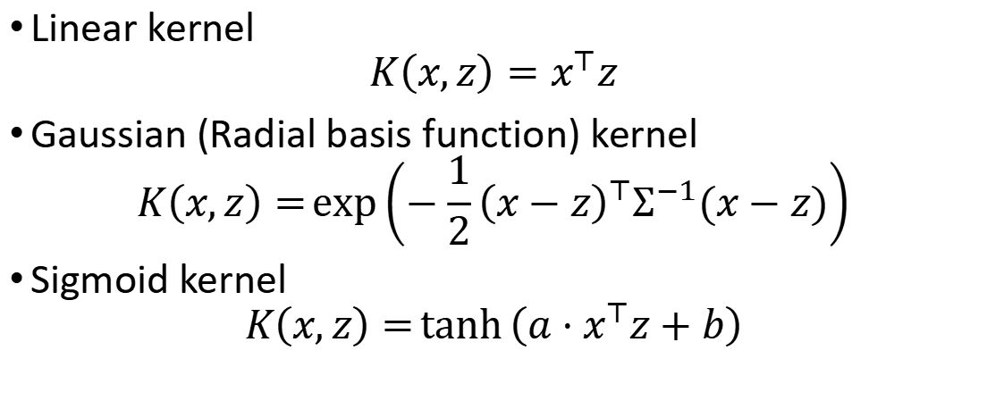
Example kernels
Linear kernel
$$K\left(x,z\right)=x^{⊤}z$$
Gaussian (Radial basis function) kernel
$$K\left(x,z\right)=\exp\left(−\frac{1}{2}{\left(x−z\right)}^{⊤}Σ^{−1}(x−z)\right)$$
Sigmoid kernel
$$K\left(x,z\right)=\tanh\left(a⋅x^{⊤}z+b\right)$$

Slide 19


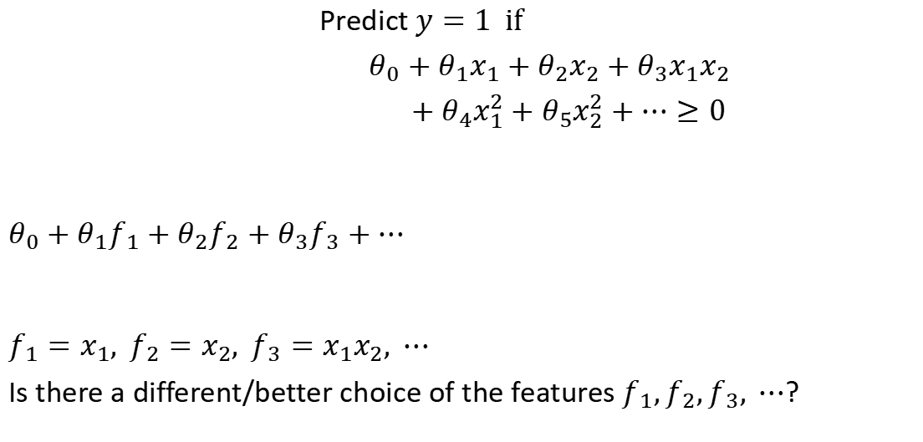
Non-linear decision boundary
$$x_{2}$$
Predict $y=1 if$
$θ_{0}+θ_{1}x_{1}+θ_{2}x_{2}+θ_{3}x_{1}x_{2}$
$+ θ_{4}x_{1}^{2}+θ_{5}x_{2}^{2}+⋯≥0$
$$θ_{0}+θ_{1}f_{1}+θ_{2}f_{2}+θ_{3}f_{3}+⋯$$
$$f_{1}=x_{1}, f_{2}=x_{2}, f_{3}=x_{1}x_{2}, ⋯$$
Is there a different/better choice of the features $f_{1},f_{2},f_{3}, ⋯$?
$$x_{1}$$

Slide 20





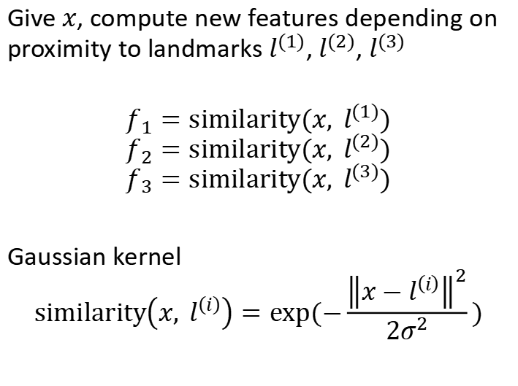
Kernel
$$x_{2}$$
Give $x$, compute new features depending on proximity to landmarks $l^{(1)}$, $l^{(2)}$, $l^{(3)}$
$$f_{1}=similarity(x, l^{(1)})$$
$$f_{2}=similarity(x, l^{(2)})$$
$$f_{3}=similarity(x, l^{(3)})$$
Gaussian kernel
$$similarity\left(x, l^{\left(i\right)}\right)=exp⁡(−\frac{{\left\|x−l^{\left(i\right)}\right\|}^{2}}{2σ^{2}})$$
$$l^{(1)}$$
$$l^{(2)}$$
$$l^{(3)}$$
$$x_{1}$$

Slide 21
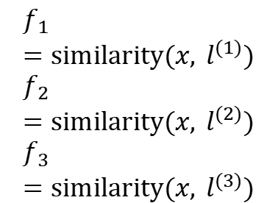

$$x_{2}$$
$$l^{(1)}$$
$$l^{(2)}$$
Predict $y=1 if$
$$θ_{0}+θ_{1}f_{1}+θ_{2}f_{2}+θ_{3}f_{3}≥0$$
Ex: $θ_{0}=−0.5, θ_{1}=1, θ_{2}=1, θ_{3}=0$
$$l^{(3)}$$
$$x_{1}$$
$$f_{1}=similarity(x, l^{(1)})$$
$$f_{2}=similarity(x, l^{(2)})$$
$$f_{3}=similarity(x, l^{(3)})$$

Slide 22

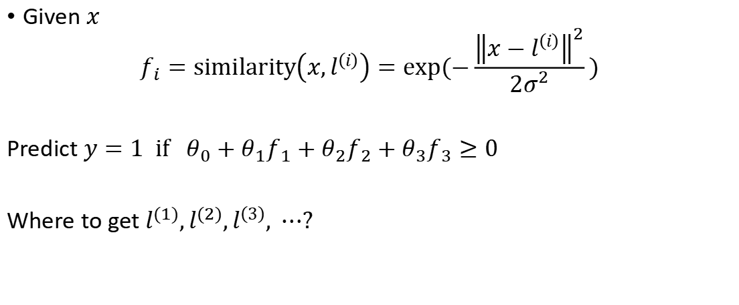
Choosing the landmarks
Given $x$
$$f_{i}=similarity\left(x,l^{\left(i\right)}\right)=exp⁡(−\frac{{\left\|x−l^{\left(i\right)}\right\|}^{2}}{2σ^{2}})$$
Predict $y=1 if θ_{0}+θ_{1}f_{1}+θ_{2}f_{2}+θ_{3}f_{3}≥0$
Where to get $l^{(1)},l^{(2)},l^{\left(3\right)}, ⋯?$
$$l^{\left(1\right)}$$
$$l^{\left(2\right)}$$
$$l^{\left(3\right)}$$
$$⋮$$
$$l^{\left(m\right)}$$
$$x_{2}$$
$$x_{1}$$

Slide 23

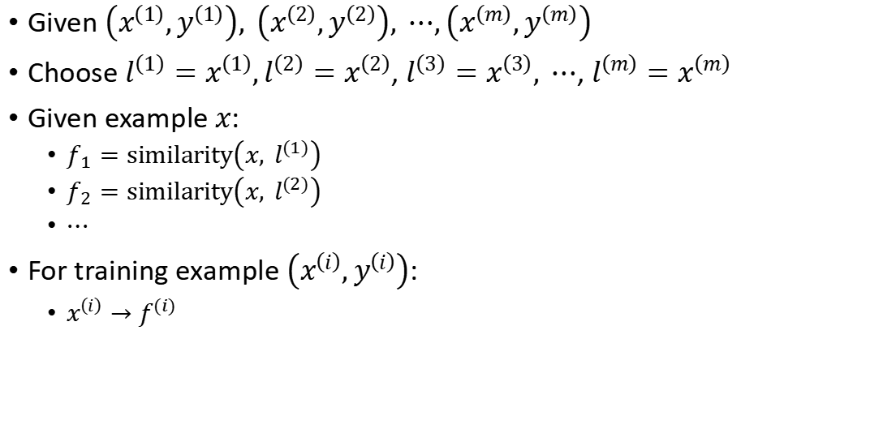
SVM with kernels
Given $\left(x^{\left(1\right)},y^{\left(1\right)}\right), \left(x^{\left(2\right)},y^{\left(2\right)}\right), ⋯,\left(x^{\left(m\right)},y^{\left(m\right)}\right)$
Choose ${l^{\left(1\right)}=x}^{\left(1\right)},{l^{\left(2\right)}=x}^{\left(2\right)}$, ${l^{\left(3\right)}=x}^{\left(3\right)}, ⋯$, ${l^{\left(m\right)}=x}^{\left(m\right)}$
Given example $x$:
$f_{1}=similarity\left(x, l^{(1)}\right)$
$f_{2}=similarity\left(x, l^{(2)}\right)$
$⋯$
For training example $\left(x^{\left(i\right)},y^{\left(i\right)}\right)$:
$x^{\left(i\right)}→f^{(i)}$
$$f=\left[\begin{aligned}f_{0} \\ f_{1} \\ f_{2} \\ ⋮ \\ f_{m}\end{aligned}\right]$$

Slide 24
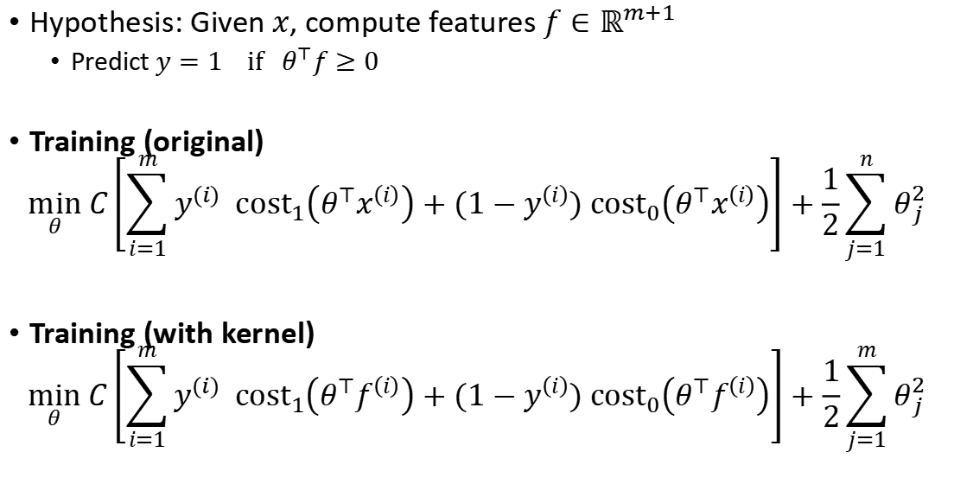
SVM with kernels
Hypothesis: Given $x$, compute features $f∈ℝ^{m+1}$
Predict $y=1 if θ^{⊤}f≥0$
Training (original)
$$\min_{θ} C\left[\sum_{i=1}^{m}{y^{(i)} cost_{1}\left(θ^{⊤}x^{\left(i\right)}\right)+(1−y^{\left(i\right)}\text{)} cost_{0}\left(θ^{⊤}x^{\left(i\right)}\right)}\right]+\frac{1}{2}\sum_{j=1}^{n}{θ_{j}^{2}}$$
Training (with kernel)
$$\min_{θ} C\left[\sum_{i=1}^{m}{y^{(i)} cost_{1}\left(θ^{⊤}f^{\left(i\right)}\right)+(1−y^{\left(i\right)}\text{)} cost_{0}\left(θ^{⊤}f^{\left(i\right)}\right)}\right]+\frac{1}{2}\sum_{j=1}^{m}{θ_{j}^{2}}$$

Slide 25
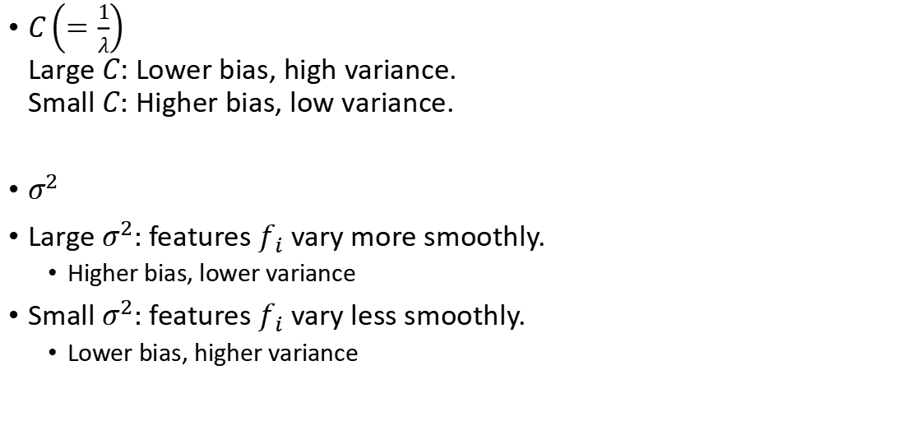
SVM parameters
$C\left(=\frac{1}{λ}\right)$ Large $C$: Lower bias, high variance. Small $C:$ Higher bias, low variance.
$σ^{2}$
Large $σ^{2}:$ features $f_{i}$ vary more smoothly.
Higher bias, lower variance
Small $σ^{2}:$ features $f_{i}$ vary less smoothly.
Lower bias, higher variance

Slide 26
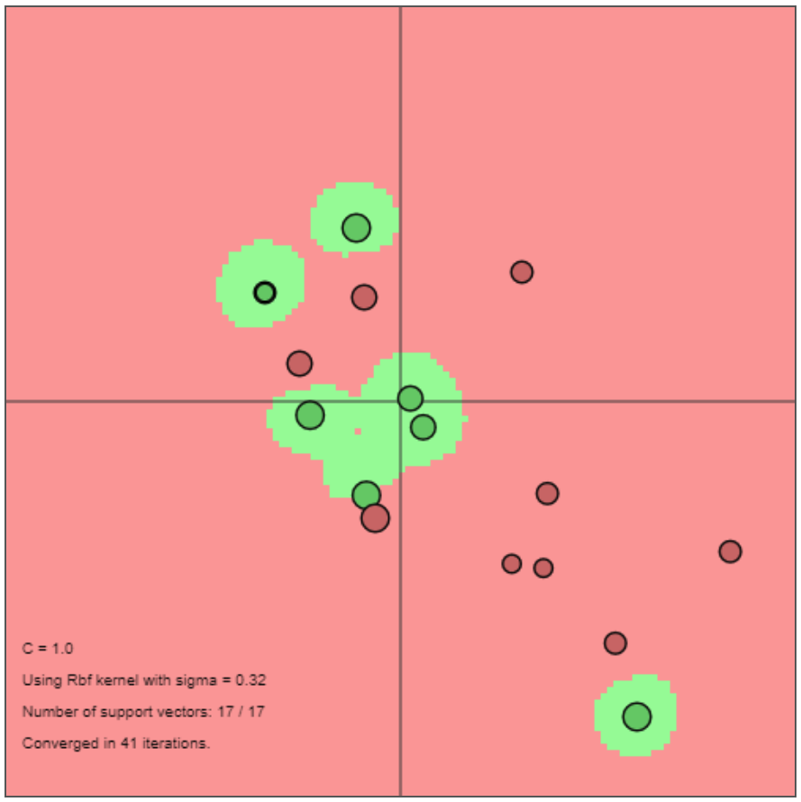
SVM Demo
https://cs.stanford.edu/people/karpathy/svmjs/demo/

Slide 27
SVM song
https://www.youtube.com/watch?v=g15bqtyidZs

Slide 28
Support Vector Machine
Cost function
Large margin classification
Kernels
Using an SVM

Slide 29
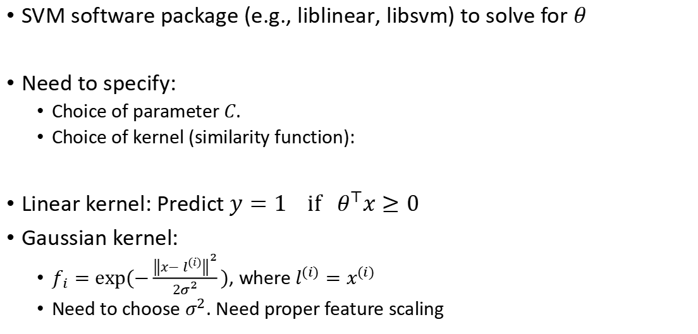
Using SVM
SVM software package (e.g., liblinear, libsvm) to solve for $θ$
Need to specify:
Choice of parameter $C$.
Choice of kernel (similarity function):
Linear kernel: Predict $y=1 if θ^{⊤}x≥0$
Gaussian kernel:
$f_{i}=exp⁡(−\frac{{\left\|x−l^{\left(i\right)}\right\|}^{2}}{2σ^{2}})$, where $l^{(i)}=x^{(i)}$
Need to choose $σ^{2}$. Need proper feature scaling

Slide 30
Kernel (similarity) functions
Note: not all similarity functions make valid kernels.
Many off-the-shelf kernels available:
Polynomial kernel
String kernel
Chi-square kernel
Histogram intersection kernel

Slide 31


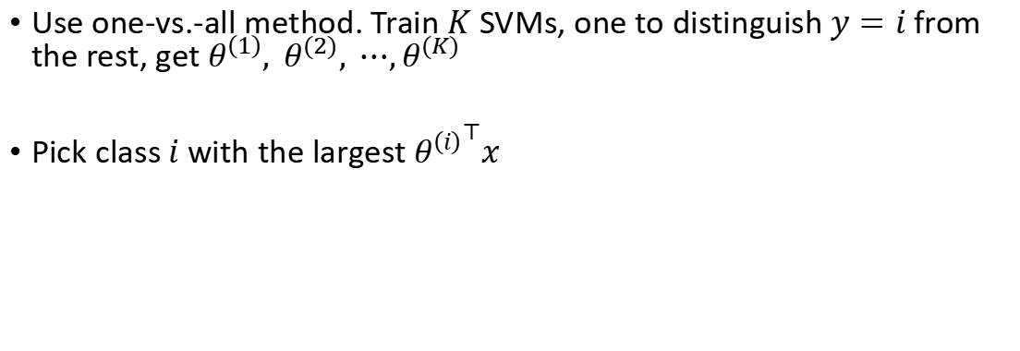
Multi-class classification
$$x_{2}$$
$$x_{1}$$
Use one-vs.-all method. Train $K$ SVMs, one to distinguish $y=i$ from the rest, get $θ^{\left(1\right)}, θ^{(2)}, ⋯,θ^{(K)}$
Pick class$i$ with the largest ${θ^{\left(i\right)}}^{⊤}x$

Slide 32
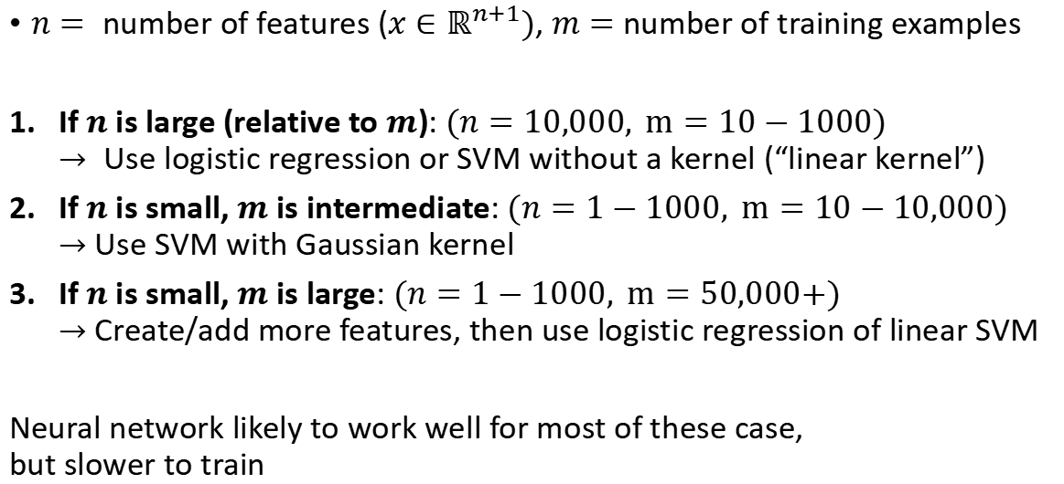
Logistic regression vs. SVMs
$n=$number of features ($x∈ℝ^{n+1})$, $m=$ number of training examples
If $n$ is large (relative to $m$): $(n=10,000, m=10−1000)$ $→$Use logistic regression or SVM without a kernel (“linear kernel”)
If $n$ is small, $m$ is intermediate: $(n=1−1000, m=10−10,000)$ $→$ Use SVM with Gaussian kernel
If $n$ is small, $m$ is large: $(n=1−1000, m=50,000+)$ $→$ Create/add more features, then use logistic regression of linear SVM
Neural network likely to work well for most of these case, but slower to train

Slide 33



Things to remember
Cost function
$$\min_{θ} C\left[\sum_{i=1}^{m}{y^{(i)} cost_{1}\left(θ^{⊤}f^{\left(i\right)}\right)+(1−y^{\left(i\right)}\text{)} cost_{0}\left(θ^{⊤}f^{\left(i\right)}\right)}\right]+\frac{1}{2}\sum_{j=1}^{m}{θ_{j}^{2}}$$
Large margin classification
Kernels
Using an SVM
$$x_{2}$$
margin
$$x_{1}$$

