Slide 1
Introduction to Virtualization
Unit-1

Slide 2
What is IT infrastructure?
Information technology infrastructure, or IT infrastructure, refers to the combined components needed for the operation and management of enterprise IT services and IT environments.

Slide 3
Why is IT infrastructure important?
With an IT infrastructure, a company can:
Provide a positive customer experience by providing uninterrupted access to its website and online store.
Develop and start solutions to market with speed.
Collect data in real time to make quick decisions.
Improve employee productivity.

Slide 4
How do the components of IT infrastructure work?
Two core groups of components are:
hardware and software.
Hardware uses software—like an operating system—to work. Likewise, an operating system manages system resources and hardware.
Operating systems also connect software applications and physical resources using networking components.

Slide 5
Hardware
Hardware components can include:
Desktop computers
Servers
Data centers
Hubs
Routers
Switches
Facilities

Slide 6
Facilities
Facilities or physical plants provide space for networking hardware, servers and data centers. It also includes the network cabling in office buildings to connect components of an IT infrastructure together.
Network
Networks are composed of switches, routers, hubs and servers. Switches connect network devices like routers, servers and others on local area networks (LAN). Routers allow devices on different LANs to communicate and move packets between networks. Hubs connect multiple networking devices to act as a single component.
Server
A core hardware component needed for an enterprise IT infrastructure is a server. Servers are essentially computers that allow multiple users to access and share resources.
Server room/data center
Organizations house multiple servers in rooms called server rooms or data centers. Data centers are the core of most networks.

Slide 7
Software
Software components can include:
Content management systems (CMS)
Customer relationship management (CRM)
Enterprise resource planning (ERP)
Operating systems
Web servers

Slide 8
Types of infrastructure
The two primary types of IT infrastructure are :
Traditional IT infrastructure, and
Cloud infrastructure.

Slide 9
Traditional IT Infrastructure
A traditional IT infrastructure is made up of the usual hardware and software components: facilities, data centers, servers, networking hardware desktop computers and enterprise application software solutions.
Typically, this infrastructure setup requires more power, physical space and money than other infrastructure types. A traditional infrastructure is typically installed on-premises for company-only or private use.

Slide 10
Cloud infrastructure
A cloud computing IT infrastructure is similar to traditional infrastructure.
However, end users can access the infrastructure via the internet, with the ability to use computing resources without installing on-premises through virtualization.
Virtualization connects physical servers maintained by a service provider at any or many geographical locations.
Then, it divides and abstracts resources, like storage, to make them accessible to users almost anywhere an internet connection can be made.

Slide 11
An optimal IT infrastructure
IT infrastructure setups vary by business needs and goals, but some goals are universal for every enterprise.
The optimal infrastructure provides a business high-performance storage, a low-latency network, security, an optimized wide area network (WAN), virtualization and zero downtime.

Slide 12
An optimal IT infrastructure
High-performance storage systems store and back up data and include a data recovery system in case of disasters.
Low-latency networks use enterprise-level infrastructure components to reduce the delay of data flow.
Secure infrastructures include systems that control information access and data availability. It can also safeguard a business against breaches and cyberattacks wherever the data resides, maintaining the customers’ trust.
WANs manage the network by prioritizing traffic and giving certain applications more or less bandwidth as needed.
Virtualization provides faster server provisioning, increases uptime, improves disaster recovery and saves energy.
Zero downtime aims to reduce disruptions to business operations and eliminates system downtime to keep costs down and profits up.

Slide 13
Virtualization
Virtualization technology is one of the fundamental components of cloud computing, especially in regard to infrastructure-based services.
Virtualization allows the creation of a secure, customizable, and isolated execution environment for running applications.
The basis of this technology is the ability of a computer program—or a combination of software and hardware—to emulate an executing environment separate from the one that hosts such programs.
For example, we can run Windows OS on top of a virtual machine, which itself is running on Linux OS.

Slide 14
Virtualization
The term virtualization is often synonymous with hardware virtualization, which plays a fundamental role in efficiently delivering Infrastructure-as-a-Service (IaaS) solutions for cloud computing.
Virtualization technologies provide a virtual environment for not only executing applications but also for storage, memory, and networking.

Slide 15
Virtualization technologies have gained renewed interested recently due to the confluence of several phenomena:
Increased performance and computing capacity.
Underutilized hardware and software resources.
Lack of space.
Greening initiatives.
Rise of administrative costs.

Slide 16
Characteristics of virtualized environments
Three major components of a virtualized environment:
guest,
host, and
Virtualization layer (virtual machine manager)

Slide 17
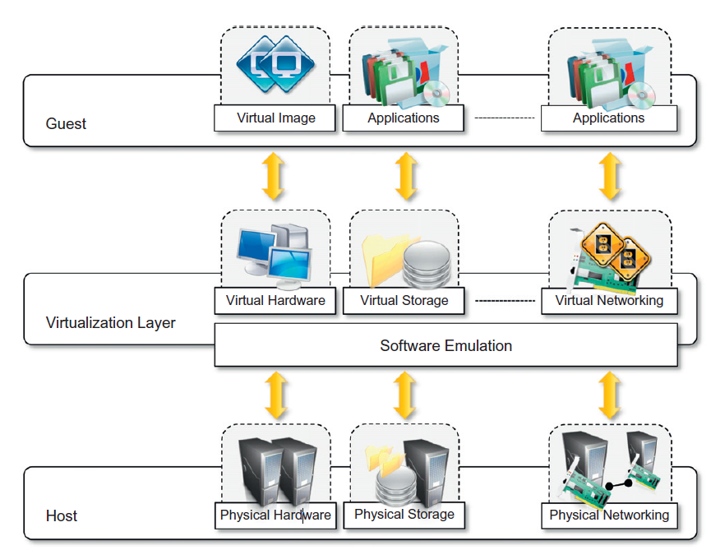
The virtualization reference model

Slide 18
Characteristics of virtualized environments
Increased security (controls and filters, sandboxed environment)
Managed execution (sharing, aggregation, emulation, and isolation )
Performance tuning
Virtual machine migration
Portability

Slide 19
Advantages of Virtualization in Cloud Computing
1. Cost Savings
2. Resource Utilization
3. Scalability
4. Isolation
5. Improved Management
6. Flexibility
7. Disaster Recovery

Slide 20
Challenges of Virtualization in Cloud Computing
Performance Overhead
Security Concerns
Complexity
Resource Contention

Slide 21
How Does Virtualization Work?
The core of virtualization is using hypervisors or virtual machine monitors (VMMs).
These vital software components serve as bridges between actual hardware and virtual computers.
Hypervisors give room to the construction, administration, and execution of virtual machines (VMs), assuring their isolation and effective use of computer resources.

Slide 22
Types of Hypervisors
Type 1 Hypervisor (Bare-Metal)
This hypervisor operates directly on physical hardware without needing an underlying operating system. VMware ESXi and Microsoft Hyper-V are two examples.
Type 2 Hypervisor (Hosted)
These hypervisors run on top of a host operating system and use its resources. VMware Workstation and Oracle VirtualBox are two well-known examples.

Slide 23
Taxonomy of virtualization techniques
Virtualization is mainly used to emulate execution environments, storage, and networks.
Execution virtualization constitutes the oldest, most popular, and most developed area.
Execution virtualization techniques can be divided into two major categories by considering the type of host they require:
Process-level, and
System-level

Slide 24
Taxonomy of virtualization techniques
Process-level techniques are implemented on top of an existing operating system, which has full control of the hardware.
System-level techniques are implemented directly on hardware and do not require or require a minimum of support from an existing operating system.

Slide 25
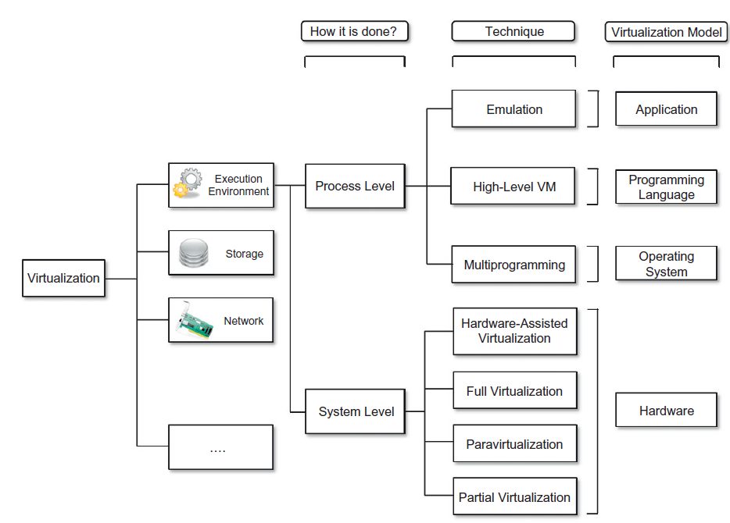
Taxonomy of virtualization techniques

Slide 26
Execution virtualization
Execution virtualization includes all techniques that aim to emulate an execution environment that is separate from the one hosting the virtualization layer.
Virtualizing an execution environment at different levels of the computing stack requires a reference model that defines the interfaces between the levels of abstractions, which hide implementation details.
From this perspective, virtualization techniques actually replace one of the layers and intercept the calls that are directed toward it.

Slide 27
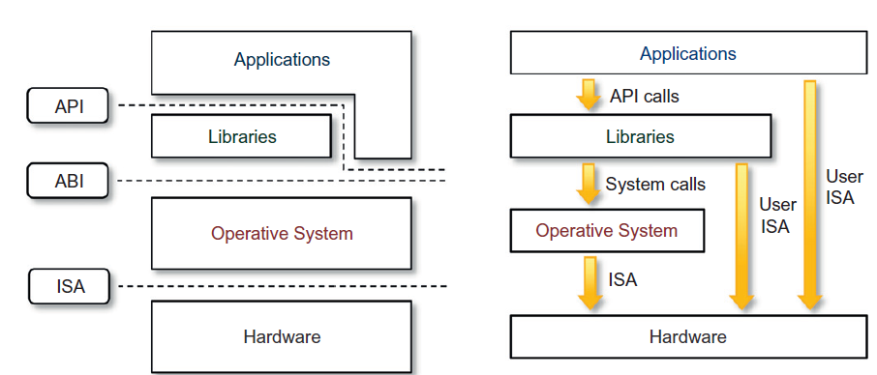
Machine reference model

Slide 28
Machine reference model
Bottom layer: Instruction Set Architecture- defines the instruction set for the processor, registers, memory, and interrupt management.
ISA: interface between H/w and S/w. Important for OS developers and developers of applications that directly manage the underlying hardware.
Application binary interface (ABI): separates the operating system layer from the applications and libraries, which are managed by the OS.
System calls are defined at this level.
This interface allows portability of applications and libraries across operating systems that implement the same ABI.

Slide 29
Machine reference model
Application programming interface(API): it represents the highest level of abstraction which interfaces applications to libraries and/or the underlying operating system.
For any operation to be performed in the application level API, ABI and ISA are responsible for making it happen.
The high-level abstraction is converted into machine-level instructions to perform the actual operations supported by the processor.
The machine-level resources, such as processor registers and main memory, are used to perform the operation at the hardware level of the central processing unit (CPU)

Slide 30
Priviliged/Non-privileged Instructions
The instruction set exposed by the hardware has been divided into different security classes that define who can operate with them.
The first distinction can be made between privileged and non-privileged instructions.
Non-privileged instructions are those instructions that can be used without interfering with other tasks because they do not access shared resources.
This category contains, for example, all the floating, fixed-point, and arithmetic instructions.

Slide 31
Priviliged/Non-privileged Instructions
Privileged instructions are those that are executed under specific restrictions and are mostly used for sensitive operations, which expose (behavior-sensitive) or modify(control-sensitive) the privileged state.
For instance, behavior-sensitive instructions are those that operate on the I/O, whereas control-sensitive instructions alter the state of the CPU registers.

Slide 32
Priviliged/Non-privileged Instructions
Some types of architecture feature more than one class of privileged instructions and implement a finer control of how these instructions can be accessed.
For instance, a possible implementation features a hierarchy of privileges in the form of ring-based security: Ring 0, Ring 1, Ring 2, and Ring 3; Ring 0 is in the most privileged level and Ring 3 in the least privileged level.
Ring 0 is used by the kernel of the OS, rings 1 and 2 are used by the OS-level services, and Ring 3 is used by the user.
Recent systems support only two levels, with Ring 0 for supervisor mode and Ring 3 for user mode.

Slide 33
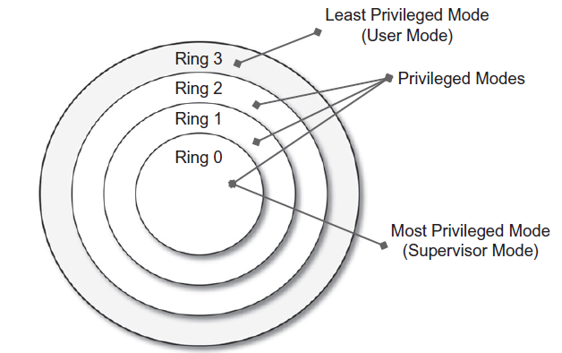
Priviliged/Non-privileged Instructions

Slide 34
Supervisor Mode and User Mode
All the current systems support at least two different execution modes: supervisor mode and user mode.
The first mode denotes an execution mode in which all the instructions (privileged and non-privileged) can be executed without any restriction.
This mode, also called master mode or kernel mode, is generally used by the operating system (or the hypervisor) to perform sensitive operations on hardware- level resources.

Slide 35
Supervisor Mode and User Mode
In user mode, there are restrictions to control the machine-level resources.
If code running in user mode invokes the privileged instructions, hardware interrupts occur and trap the potentially harmful execution of the instruction.
The distinction between user and supervisor mode allows us to understand the role of the hypervisor and why it is called that.
Conceptually, the hypervisor runs above the supervisor mode, and from here the prefix hyper is used.
In reality, hypervisors are run in supervisor mode, and the division between privileged and non-privileged instructions has posed challenges in designing virtual machine managers.
It is expected that all the sensitive instructions will be executed in privileged mode, which requires supervisor mode in order to avoid traps

Slide 36
Hardware-level virtualization
Provides an abstract execution environment in terms of computer hardware on top of which a guest operating system can be run.
In this model, the guest is represented by the operating system, the host by the physical computer hardware, the virtual machine by its emulation, and the virtual machine manager by the hypervisor.
Hardware-level virtualization is also called system virtualization, since it provides ISA to virtual machines, which is the representation of the hardware interface of a system.
This is to differentiate it from process virtual machines, which expose ABI to virtual machines

Slide 37
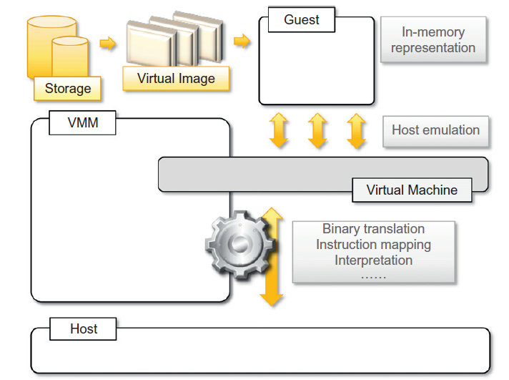
A hardware virtualization reference model

Slide 38
Hypervisors
A fundamental element of hardware virtualization is the hypervisor, or virtual machine manager (VMM).
It recreates a hardware environment in which guest operating systems are installed.
There are two major types of hypervisor: Type I and Type II.
Type I hypervisors run directly on top of the hardware. Therefore, they take the place of the operating systems and interact directly with the ISA interface exposed by the underlying hardware, and they emulate this interface in order to allow the management of guest operating systems.

Slide 39
Hypervisors
Type II hypervisors require the support of an operating system to provide virtualization services.
This means that they are programs managed by the operating system, which interact with it through the ABI and emulate the ISA of virtual hardware for guest operating systems.

Slide 40
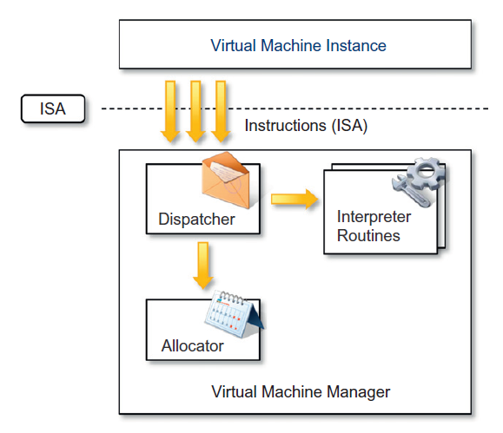
Hypervisors
Conceptually, a virtual machine manager is internally organized as described.
Three main modules, dispatcher, allocator, and interpreter, coordinate their activity in order to emulate the underlying hardware.

Slide 41
Types of Virtualization
Hardware Virtualization
The term refers to a scenario in which the hardware provides architectural support for building a virtual machine manager able to run a guest operating system in complete isolation.
Types:
Full virtualization: VMM is installed directly on hardware (bare-metal/type-1)
Para-virtualization: VMM installed on top of a host OS (type-2)
Partial virtualization: Entire hardware is not virtualized, only a part of H/W can be virtualized.
Eg. Address space virtualization (most common). This allows multiple applications and users to run concurrently in a separate memory space, but they still share the same hardware resources.

Slide 42
Operating system virtualization
It offers the opportunity to create different and separated execution environments for applications that are managed concurrently.
There is no virtual machine manager or hypervisor, and the virtualization is done within a single operating system.
The OS kernel allows for multiple isolated user space instances.
The kernel is also responsible for sharing the system resources among instances and for limiting the impact of instances on each other.
Operating system-level virtualization aims to provide separated and multiple execution containers for running applications.
Operating system-level virtualization does not expose the same flexibility of hardware virtualization, since all the user space instances must share the same oper- ating system .

Slide 43
Other types of virtualization
Storage virtualization:
It is a system administration practice that allows decoupling the physical organization of the hardware from its logical representation.
Using this technique, users do not have to be worried about the specific location of their data, which can be identified using a logical path.
Storage virtualization allows us to harness a wide range of storage facilities and represent them under a single logical file system.
There are different techniques for storage virtualization, one of the most popular being network-based virtualization by means of storage area networks (SANs).

Slide 44
Other types of virtualization
Network virtualization
It combines hardware appliances and specific software for the creation and management of a virtual network.
Network virtualization can aggregate different physical networks into a single logical network (external network virtualization) or provide network-like functionality to an operating system partition (internal network virtualization).
The result of external network virtualization is generally a virtual LAN (VLAN).

Slide 45
Other types of virtualization
Desktop virtualization
Desktop virtualization abstracts the desktop environment available on a personal computer in order to provide access to it using a client/server approach.
Desktop virtualization provides the same out- come of hardware virtualization but serves a different purpose.

Slide 46
Other types of virtualization
Application server virtualization
Application server virtualization abstracts a collection of application servers that provide the same services as a single virtual application server by using load-balancing strategies and providing a high-availability infrastructure for the services hosted in the application server.

Slide 47
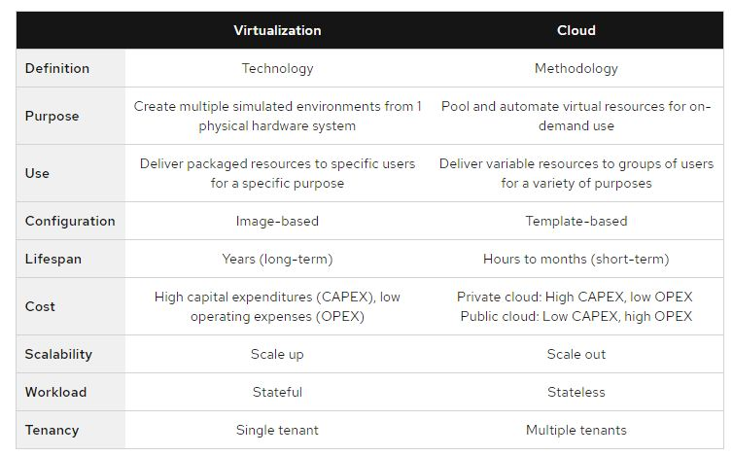
Virtualization vs cloud computing

