Slide 1
India Cost of Living
Analysis & Prediction
From Data Collection to Predictive Modelling
Data Collection
Data Cleaning
EDA & Viz
Model Training
Clustering
Data Source: Numbeo Cost of Living Website | 150 Indian Cities

Slide 2
Project Agenda
Project Agenda
01
02
03
04
05
🌐
🧹
📊
🤖
🗺️
Data Collection
Data Cleaning
EDA & Visualisation
Model Training
K-Means Clustering
Scraped Numbeo — 150 Indian cities, 50+ cost features
Column renaming, feature engineering, imputation
Distributions, correlations, scatter plots, rankings
Linear Regression vs. Random Forest — salary prediction
City segmentation into 3 affordability tiers

Slide 3
01 Data Collection
Scraping Numbeo for 150 Indian cities

Slide 4
Data Collection — Numbeo Web Scrape
150
56
12
0
Indian Cities
Raw Features
Final Features
Missing After Imputation
🍽️
Food & Dining
🏠
Housing & Rent
Inexpensive meal, Fast food, Cappuccino, Groceries
1-BHK city centre & outside, 3-BHK, Price/m²
⚡
Utilities
🚌
Transport
Electricity, Water, Internet, Mobile Plan
Local ticket, Monthly pass, Taxi, Fuel
👶
Childcare & Education
💰
Income & Finance
Preschool, International school fees
Net salary, Mortgage interest rate

Slide 5
02 Data Cleaning
Feature engineering & missing value treatment

Slide 6
Data Cleaning & Feature Engineering
Cleaning Pipeline
Composite Feature Indices
1️⃣
Column Standardisation
Market Basket Index
Lowercase, strip spaces, replace special chars → snake_case
Milk + Bread + Rice + Eggs + Chicken + 6 Fruits/Veg
2️⃣
Feature Selection
50+ raw cols → 12 meaningful features kept
Transportation Index
Bus ticket + Monthly pass + Taxi (start + per km)
3️⃣
Composite Indices
Market Basket, Transport, Sports/Leisure, Childcare indices
Sports & Leisure Index
4️⃣
Missing Value Imputation
Gym + Tennis court + Cinema ticket
Median imputer for numeric, Most-frequent for categorical
Childcare Cost Index
5️⃣
Affordability Ratios
Preschool (monthly) + Int'l school (annual/12)
SalaryToRent & SalaryToMarket derived columns added

Slide 7
03 EDA & Visualisation
Distributions, correlations & city rankings

Slide 8
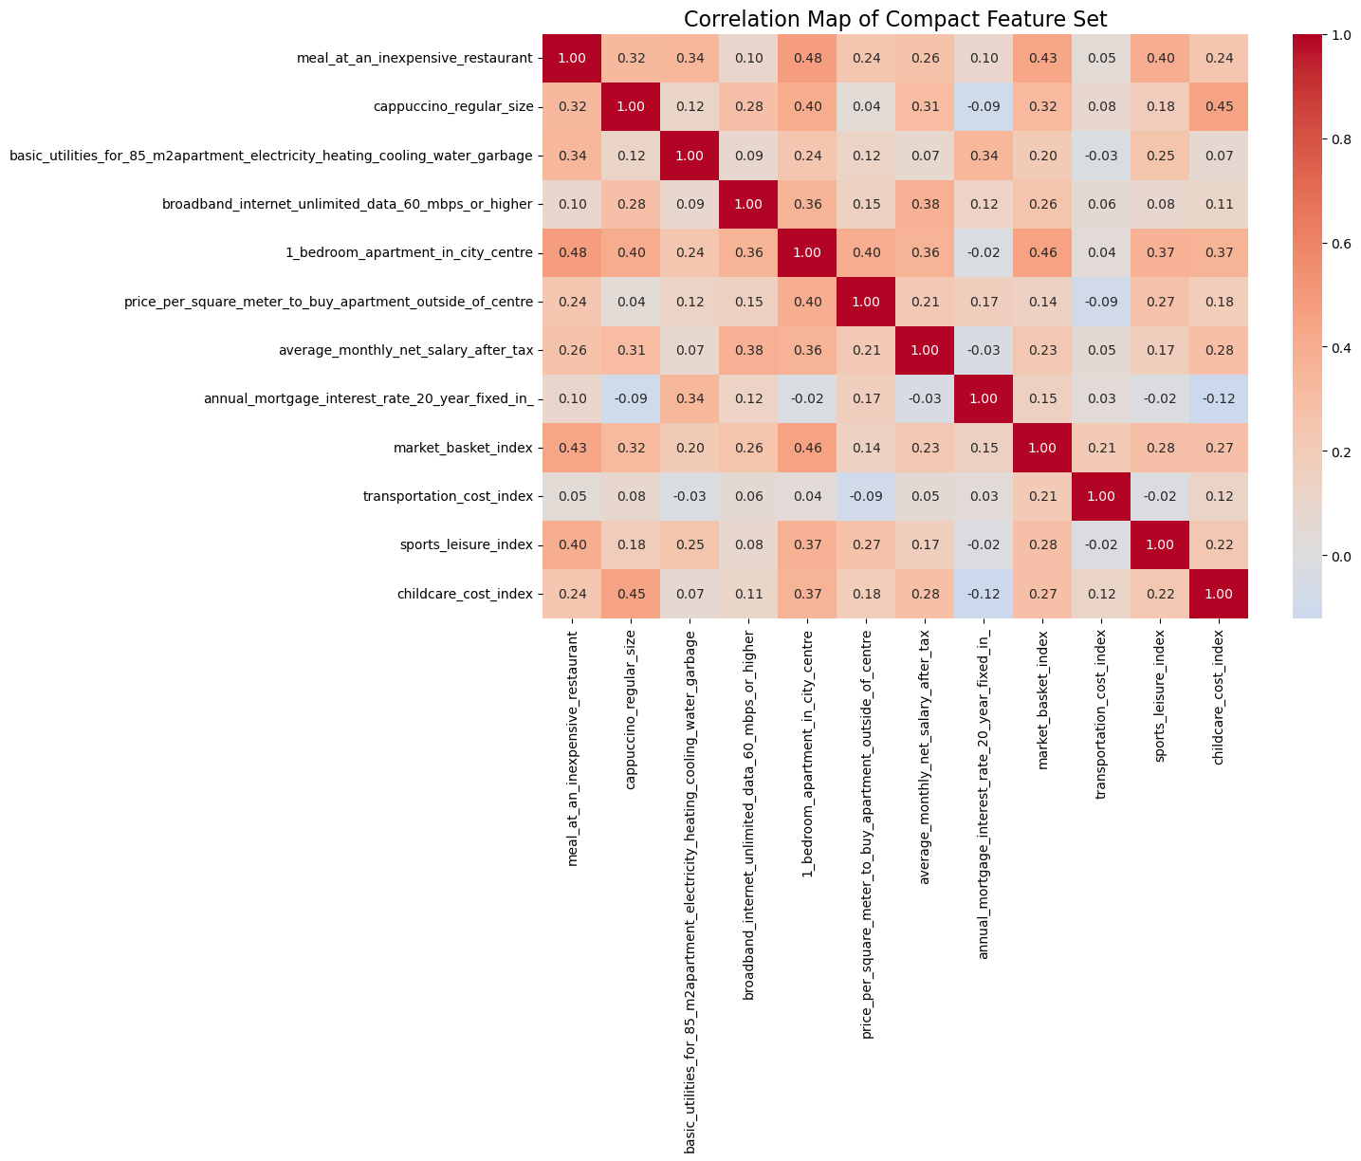
EDA — Correlation Heatmap of Selected Features
Key Insights
🔴
Meal ↔ 1-BHK Rent (0.48) — Cities with expensive dining also have higher rents; both reflect overall urban cost level
🟠
Cappuccino ↔ Childcare (0.45) — Premium lifestyle costs (coffee culture) co-exist with expensive childcare in the same cities.
🟡
1-BHK Rent ↔ Market Basket (0.46) — Cities with high rent also have costlier groceries — affordability pressure hits on multiple fronts.
🟢
Broadband ↔ Salary (0.38) — Better internet infrastructure is associated with higher-paying cities.
🔵
Salary (0.26–0.38 range) has only moderate correlation with most features — meaning salary alone doesn't explain cost of living, which is why Linear Regression failed (R² = -0.377).

Slide 9
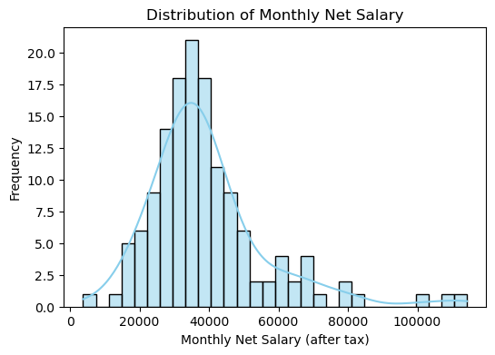
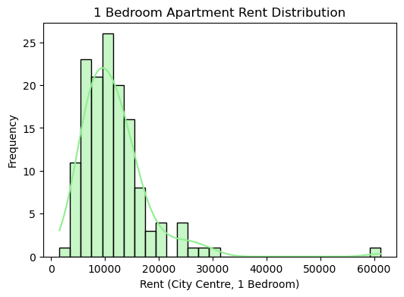
EDA — Salary & Rent Distributions
Salary: Right-skewed — most cities cluster in ₹30K–₹50K band. A few metros like Hyderabad (₹1.14L) and Pune (₹1.1L) are outliers. Rent: Concentrated between ₹5K–₹15K; Tier-2/3 cities offer rentals as low as ₹1.5K–₹5K.

Slide 10
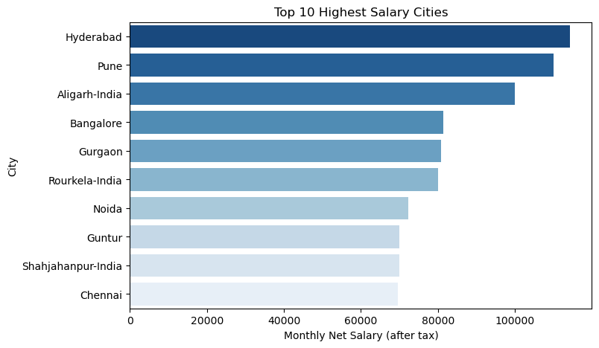
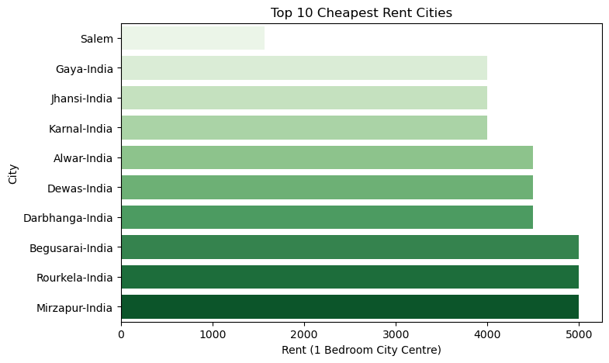
EDA — City Rankings: Salary & Rent

Slide 11
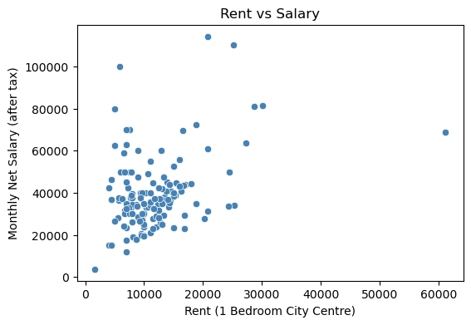
EDA — Rent vs Salary Relationship
Scatter Insights
Most Cities Cluster at Low Rent & Moderate Salary The dense cluster between ₹0–₹15,000 rent and ₹20,000–₹50,000 salary shows that the majority of Indian Tier-2/3 cities share a very similar cost-salary profile with little variation.
Weak Positive Relationship There is a loose upward trend — higher rent cities tend to offer slightly higher salaries — but the relationship is too scattered and non-linear to be reliably predicted, which is confirmed by the low correlation of 0.36 in the heatmap
Best Affordability Cities (Top-Left Outliers) A few cities like Hyderabad and Pune show very high salaries (₹80K–₹1.1L) at relatively low-to-moderate rent (₹5K–₹25K), making them the most financially rewarding cities to live in.
Worst Affordability City (Bottom-Right Outlier) The city at ₹60,000+ rent with only ~₹68,000 salary (likely Mumbai) represents the worst salary-to-rent ratio — residents pay extremely high rent without a proportional salary compensation.
Wide Salary Variance at Similar Rent Levels Multiple cities share the same rent range (₹20K–₹27K) yet have salaries ranging from ₹35,000 to ₹1,10,000 — proving that rent alone cannot determine salary, which is exactly why Random Forest (R² = 0.799) outperformed Linear Regression (R² = -0.377).

Slide 12
04 Model Training
Linear Regression vs Random Forest Regressor

Slide 13
Model Training — Problem Setup & Features
🎯 Target Variable: Average Monthly Net Salary (After Tax) — Regression Task
Input Features (10 predictors):
🍽️ Meal (inexpensive restaurant)
🏗️ Price/m² (outside centre)
80/20
Train/
Test
Split
☕ Cappuccino price
🛒 Market basket index
⚡ Basic utilities (85m²)
🚌 Transportation index
🌐 Broadband internet
🏋️ Sports & leisure index
🏠 1-BHK rent (city centre)
👶 Childcare cost index

Slide 14
Model Results — Linear Regression vs Random Forest
Linear Regression
Random Forest
Baseline Model
Tuned with GridSearchCV
R² Score
R² Score
-0.377
0.799
RMSE
RMSE
₹12,044
₹7,503
Verdict
Best CV R²
Poor Fit
0.027 → 0.799
Why it failed: Salary does not have a linear relationship with cost-of-living features. Negative R² means the model performs worse than simply predicting the mean.
Why it worked: Random Forest captures non-linear interactions between features. Hyperparameter tuning (n_estimators, max_depth) improved generalisation from CV R²=0.027 to final R²=0.799.

Slide 15
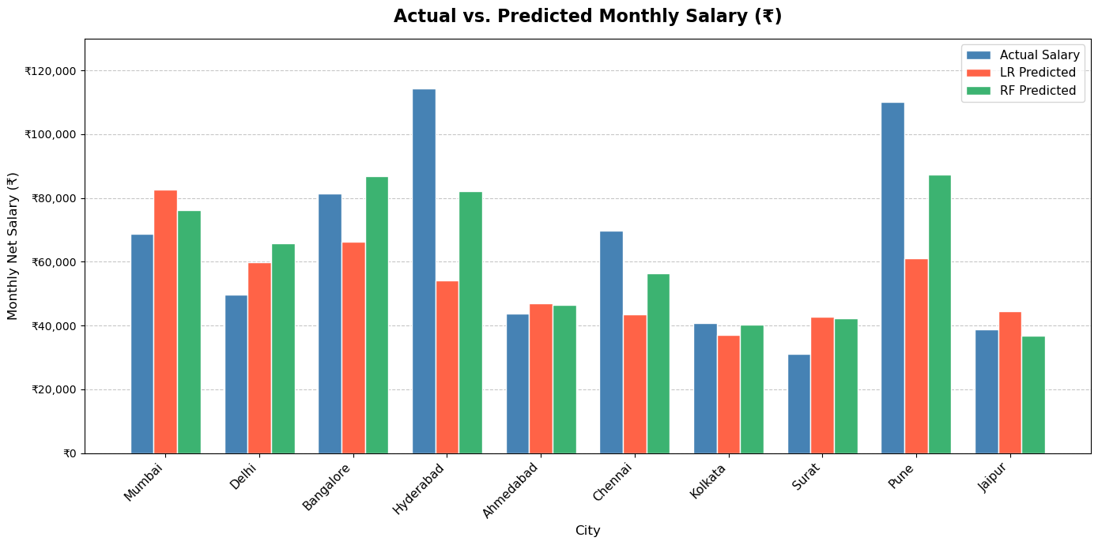
Model Comparison — Actual vs Predicted Salary
Performance Summary
Linear Reg.
R²: -0.377
RMSE: ₹12,044
RF (tuned)
R²: 0.799
RMSE: ₹7,503
✅ Random Forest (tuned) explains ~80% variance in salary — a strong predictive model for cost-of-living driven salary estimation.

Slide 16
05 K-Means Clustering
Segmenting 150 cities into affordability tiers

Slide 17
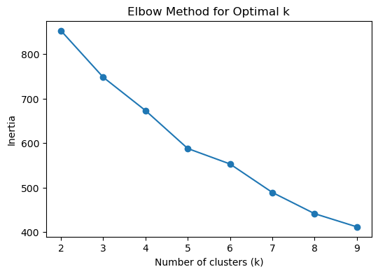
Clustering — Elbow Method & Optimal K
Elbow Interpretation
k = 2
Clearest separation — 2 distinct city tiers
k = 3
Elbow point — optimal balance of compactness & granularity
k > 3
Diminishing returns — clusters overlap without adding clarity
✅ Final model uses k=3 for meaningful city segmentation.

Slide 18
Clustering — City Tier Profiles (k = 3)
🏙️ Cluster 0
🏬 Cluster 1
🏘️ Cluster 2
Tier 1 — Premium Metros
Tier 2 — Major Cities
Tier 3 — Smaller Cities
6 Cities
64 Cities
80 Cities
Mumbai, Bangalore, Hyderabad, Pune, Navi Mumbai, Gurgaon
Delhi, Ahmedabad, Chennai, Kolkata, Surat, Jaipur, Noida…
Lucknow, Meerut, Varanasi, Dhanbad, Jabalpur, Salem…
Avg Salary
₹86,498
Avg Salary
₹37,143
Avg Salary
₹37,142
Avg Rent
₹32,175
Avg Rent
₹12,931
Avg Rent
₹9,121
Market Basket
₹1,144
Market Basket
₹1,001
Market Basket
₹865
Transport
₹1,298
Transport
₹1,338
Transport
₹1,120
Top-tier metros with highest incomes — but also the most expensive to live in. Suited for high earners.
Large secondary cities with moderate costs. Strong infrastructure but income is nearly 2.3× lower than Tier 1.
Affordable Tier-3 cities — similar salaries to Tier 2 but significantly lower rent and market costs. Highest affordability ratio.

Slide 19
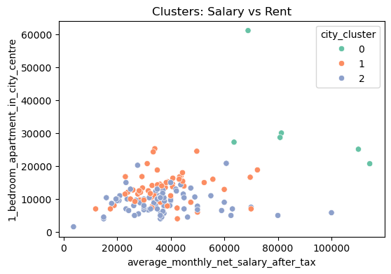
Clustering — Salary vs rent
Cluster Takeaways
Cluster 0 (Premium Metros)
Highest salaries (₹60K–₹1.14L) and rents (₹21K–₹61K).
Clearly separated, forming a distinct high‑cost, high‑income tier.
Cluster 1 (Major Tier‑2 Cities)
Salary range ₹20K–₹70K, rent ₹5K–₹25K.
More spread and variation, showing diverse cost‑income combinations.
.
Cluster 2 (Smaller Tier‑3 Cities)
Low salaries (₹10K–₹45K) and very low rents (₹1K–₹15K).
Densely packed, highly homogeneous low‑cost, low‑income profile.
Rent vs Salary Dynamics
In metros, rent rises faster than salary (rent ≈ 100% of income in extreme cases).
Smaller cities enjoy better salary‑to‑rent ratios (₹30K–₹40K salary vs ₹5K–₹10K rent).
Validation of k=3
Clear separation of clusters with minimal overlap.
Cluster 0 distinct; Clusters 1 & 2 overlap slightly in lower salary range.
Average salaries nearly identical (~₹37K), but rents differ significantly (~₹13K vs ~₹9K).

Slide 20
Key Takeaways & Conclusions
🗃️
Dataset
📊
EDA Insight
150 Indian cities × 50+ Numbeo features. Engineered 4 composite indices to reduce noise.
Salary right-skewed (₹30–50K cluster). Rent ↔ Salary strongly correlated (0.71). Tier-1 cities expensive but high-paying.
📉
Linear Regression
🌲
Random Forest
R² = -0.377. Failed due to non-linear salary patterns. Cannot use linear assumptions for cost-driven salary prediction.
Tuned RF achieves R² = 0.799, RMSE ₹7,503. Non-linear feature interactions captured through ensemble learning.
🗺️
K-Means Clustering
💡
Business Insight
k=3 optimal (elbow). Tier-1 (6 metro cities), Tier-2 (64 major cities), Tier-3 (80 smaller cities).
Tier-3 cities offer best affordability (lowest rent, similar salary to Tier-2). Best for remote/cost-sensitive workers.

