Slide 1


COLOR SUBSTANTIATION OF PASSWORD
Team Members
Guide
M.Saish Datta (12241A1287)
N.Sai Kaushik (12241A1288)
P.Madhu Vaibhav (12241A1293)
Dr.Padmalaya Nayak
(Professor)

Slide 2
INTRODUCTION
Even though random and lengthy passwords make system secure, the vulnerabilities of textual password methods are well known.
So some of the alternative techniques that we can apply are graphical passwords and biometrics.This project explains one of the methods that comes under graphical password techniques.

Slide 3
PROPOSED SYSTEMS
Recognition based systems
Recall based systems
Pair based authentication scheme
Hybrid authentication scheme

Slide 4
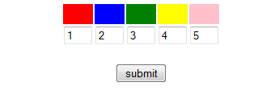
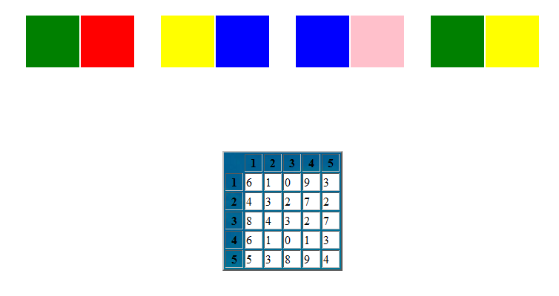

Slide 5

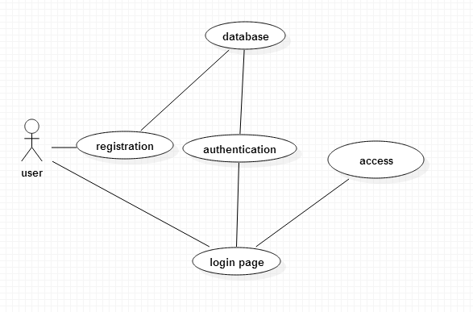
Use-case diagram

Slide 6
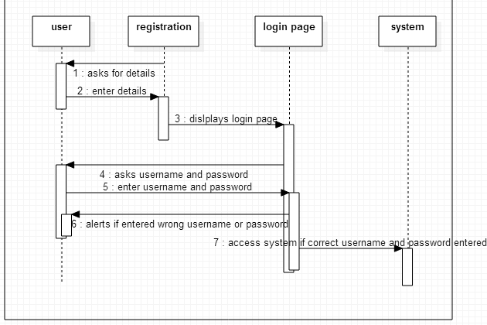
Sequence diagram

Slide 7
SYSTEM REQUIREMENTS
Hardware Requirements
Software Requirements
Intel Processor
256 MB RAM
Hard disk of minimum 8 GB
Any version of windows
MS SQL server

Slide 8
SUMMARY
The techniques proposed by our project will be resistant to dictionary attack. However these schemes are new to the users and the proposed authentication techniques are to be verified extensively for usability and effectiveness.

Slide 9
REFERENCES
G. Blonder, 1996. “Graphical passwords”
http://www.oracle.com/us/corporate/Acquisitions/passlogix

Slide 10
THANK YOU

