Slide 1
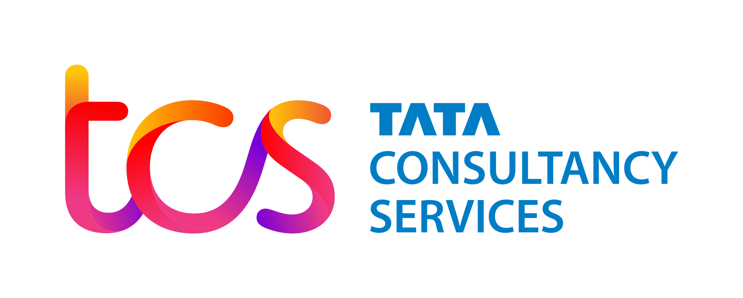

Slide 2
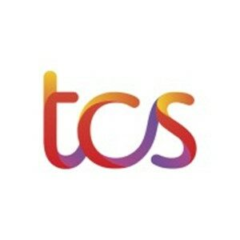
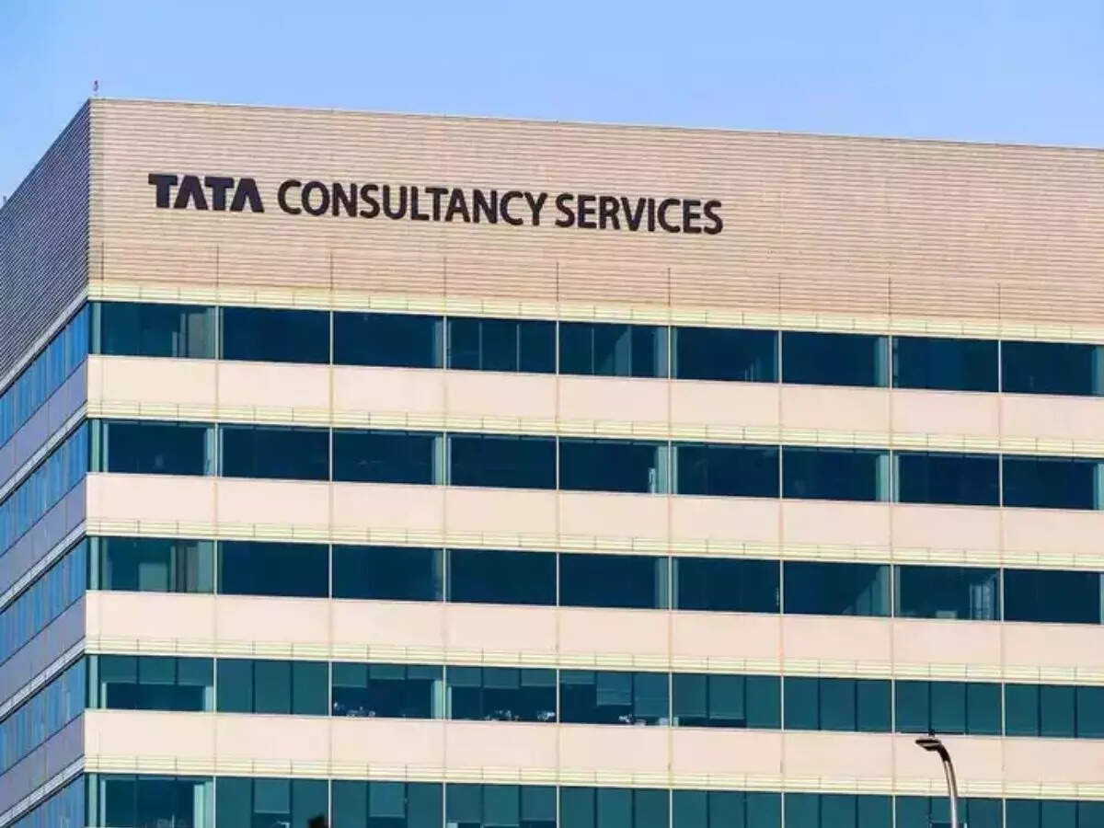
Company Overview
About TCS
Founded in 1968, headquartered in Mumbai, India.
Operates in 50+ countries with 700,000+ employees globally.
Core Services
Offers IT services, digital transformation, consulting, AI, automation, and cybersecurity.
Serves industries like BFSI, retail, telecom, manufacturing, and healthcare.
Financial Snapshot (FY 2024-25)
FY 2024-25 revenue: approx. ₹2.5 lakh crore; net profit: approx. ₹48,800 crore.
Strong operating margin (~24.5%) and one of the largest IT firms in market capitalization globally.

Slide 3
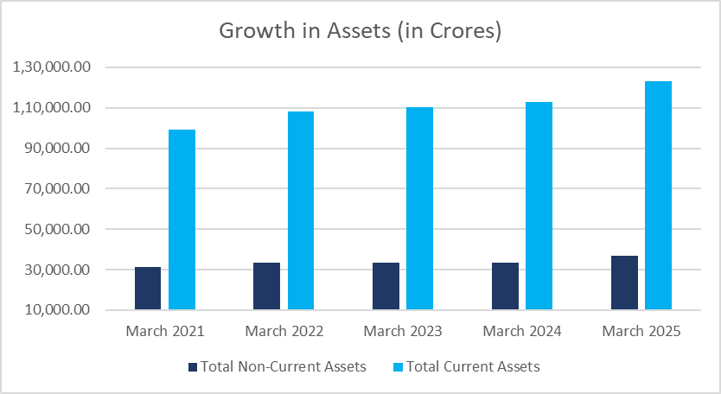




Balance Sheet- Assets Side
Trade Receivables increased by ₹28,967 Cr
Due to rising business volumes, extended payment terms, and currency effects.
Cash & Cash Equivalents increased by ₹6,134 Cr
Driven by strong cash flow and prudent liquidity management amid global uncertainties.
Short Term Loans and Advances decreased by ₹11,447 Cr
Reflects tighter credit and collections policies, plus repayments.
Fixed Assets increased by ₹2,590 Cr
Due to investments in tech infrastructure and new delivery centers.

Slide 4
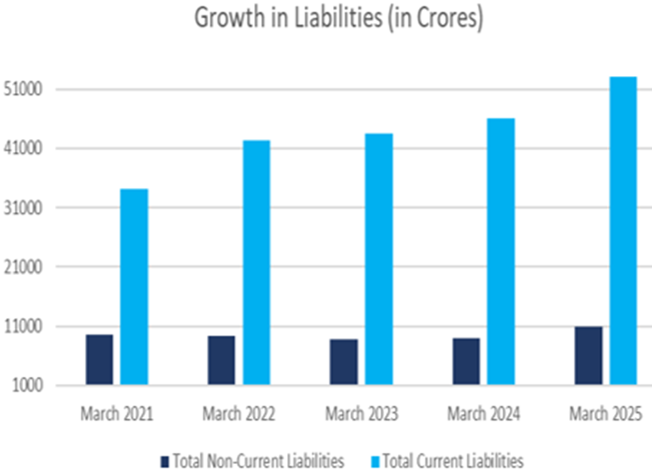

Balance Sheet- Liabilities
Other Current Liabilities increased by ₹14,011 Cr
Reflects higher accruals, contract advances from clients, and increased statutory/vendor dues as business scaled.
Trade Payables increased by ₹6,049 Cr
Due to higher vendor/supplier payments linked with expansion in project volumes and outsourcing.
Reserves and Surplus increased by ₹8,331 Cr
Growth from consistent profitability and retained earnings, strengthening shareholder funds.
Short Term Provisions decreased by ₹1,214 Cr
Indicative of improved risk management and settlement of earlier provisions.

Slide 5
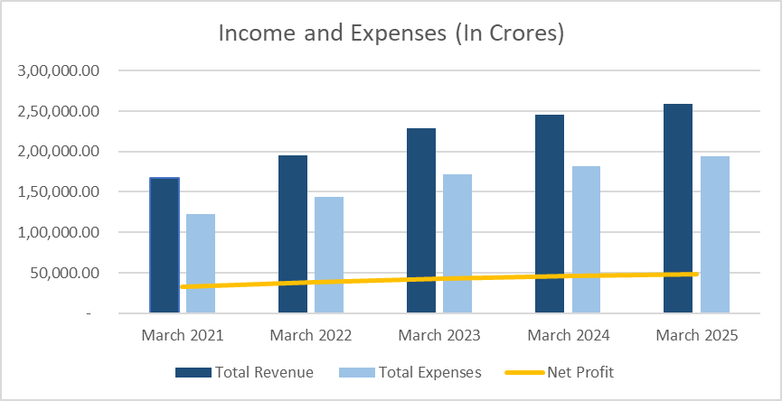
Profit and Loss
Operating and Direct Expenses surged from ₹1,462 Cr to ₹11,648 Cr, particularly increasing in FY25
Depreciation and Amortization Expenses increased from ₹4,065 Cr to ₹5,242 Cr
Indicates bulk outsourcing, increased subcontractor costs, or large IT hardware/software purchases.
Due to capital asset growth and technology investments.

Slide 6
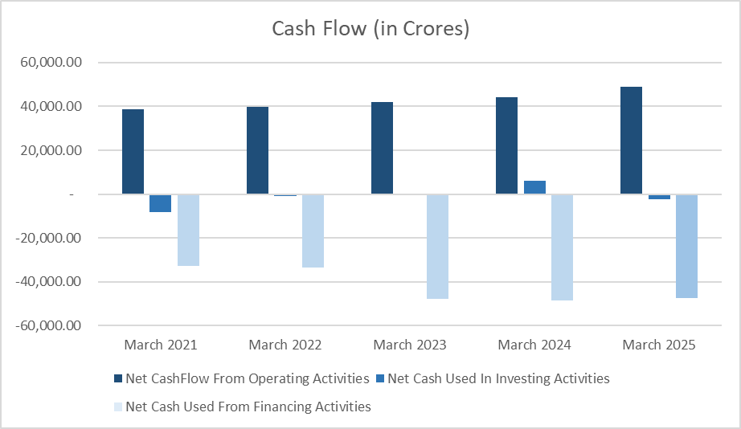


Cash Flow
Operating Activities:
Investing Activities:
Financing Activities:
Shows steady growth indicates strong client demand for digital services and robust collection processes.
Fluctuations represent continued strategic investments in technology infrastructure, acquisitions, and capacity expansion.
Consistently large outflows tied to dividend payouts and share buybacks, highlighting shareholder-friendly capital allocation.

Slide 7
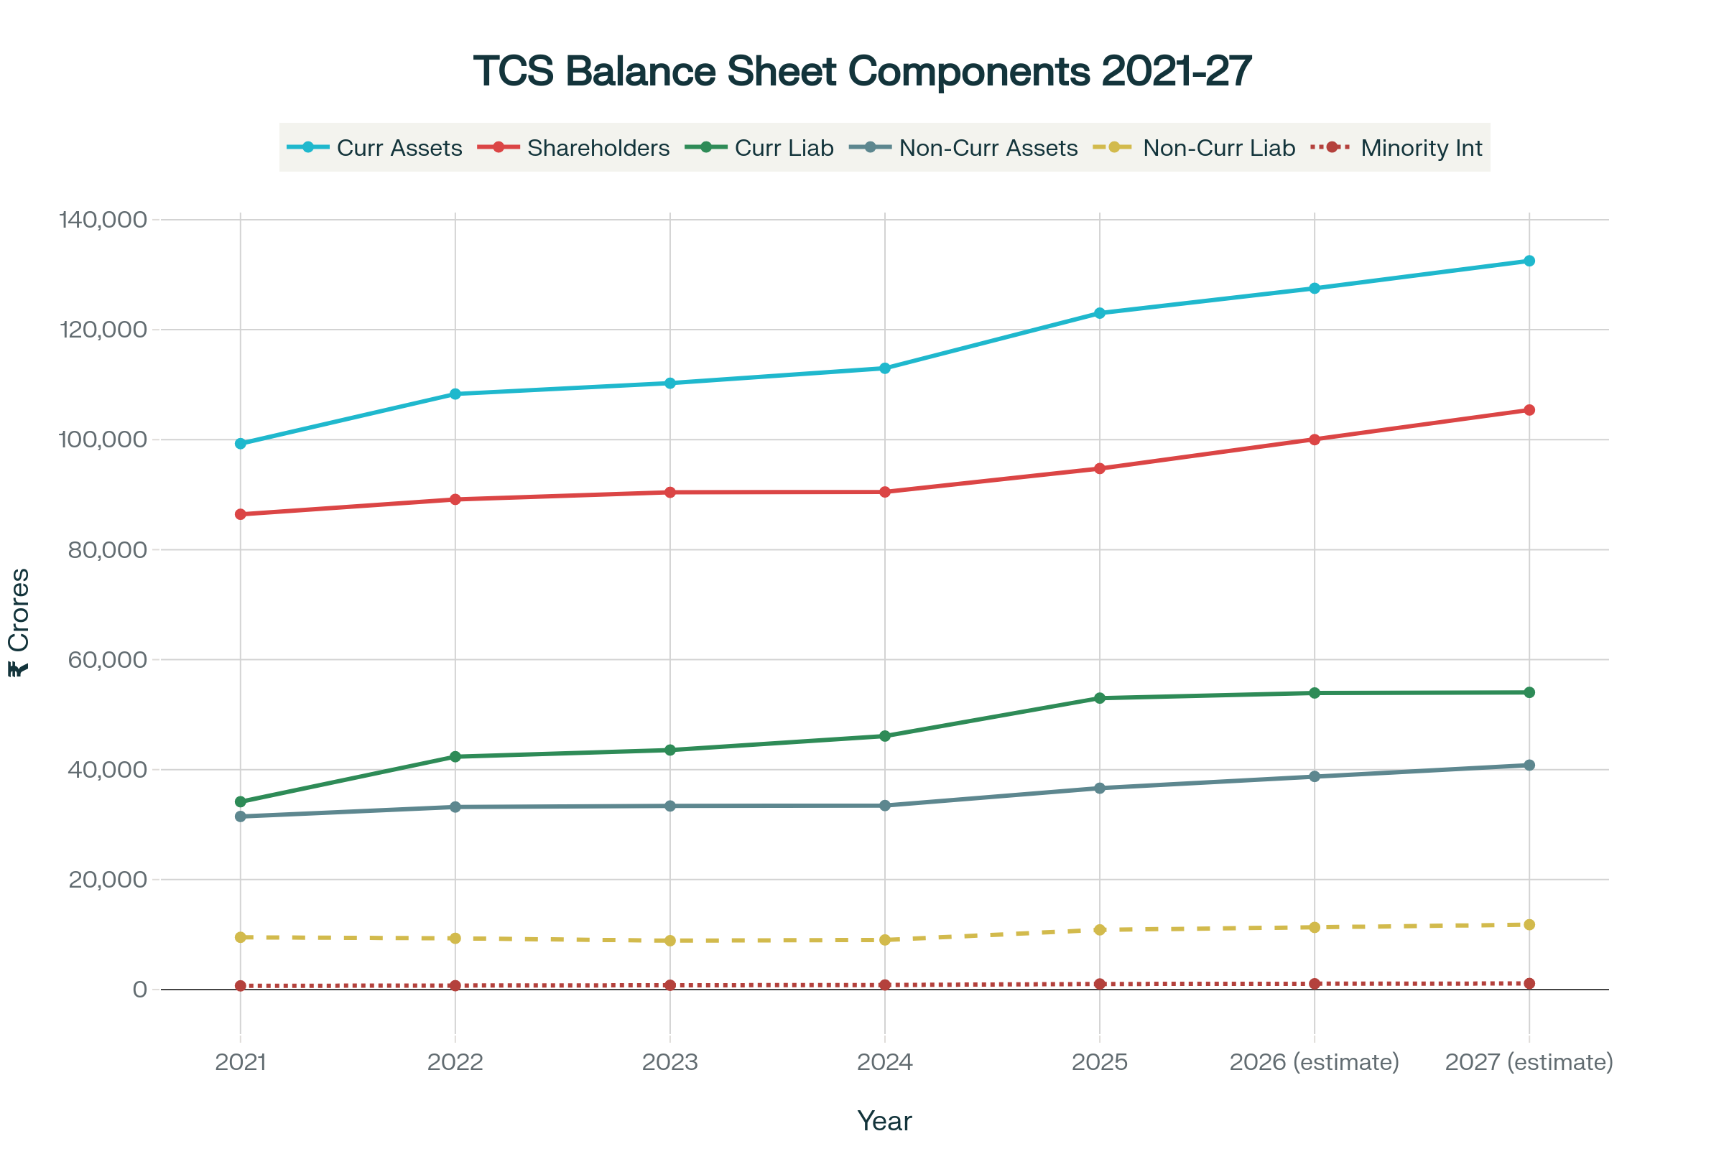




Balance Sheet - Forecast
Ongoing investments in technology (like GenAI and ML) and infrastructure drive steady growth in non-current assets.
Expansion of business scale leads to higher current assets like receivables and cash balances.
Consistent profit retention supports gradual increase in shareholders’ funds and equity base.
Minority interest grows with wider global operations and consolidation of subsidiaries.
Moderate rise in non-current and current liabilities reflects scale of business and vendor payables, without new debt reliance.
Projections align with historical growth patterns and expected market/industry conditions.

Slide 8
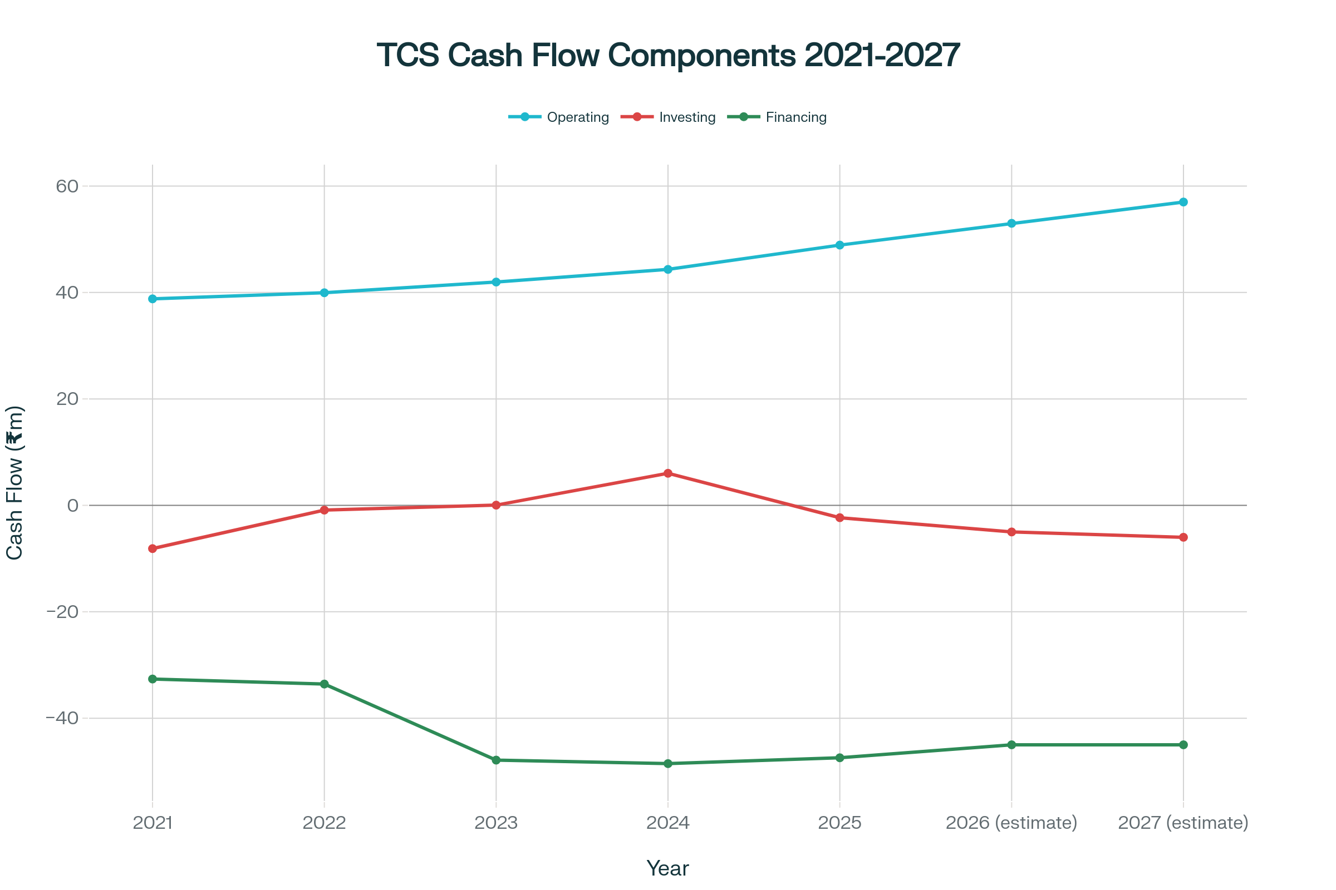

Profit and Loss - Forecast
Operating Cash Flow Growth: Increasing due to strong profitability and efficient working capital management.
Investing Cash Flow: Fluctuates reflecting ongoing technology and infrastructure investments, partly offset by asset sales or reduced capex in some years.
Financing Cash Flow: Consistent cash outflows driven by dividends and share repurchases, maintaining shareholder returns.

Slide 9

TCS Stock Snapshot & Market Sentiment
TCS stock traded between ₹2,992 and ₹4,494 from 2021 to 2025, ending near ₹3,035 amid market volatility.
Strong fundamentals, consistent profits (~₹32,500 Cr to ₹48,800 Cr), and ~4.15% dividend yield supported investor confidence.
Recent IT Sector News & Impact
GST Reforms 2025: Simplified tax slabs and rate cuts expected to ease compliance, benefiting MSMEs and improving working capital for companies like TCS.
Geopolitical Tensions: Regulatory uncertainties and cyber threats due to regional issues create risks but also drive growth in cybersecurity and consulting services.
Visa & Tariff Challenges: US visa restrictions and tariffs put pressure on revenues, but TCS’s global diversification limits concentrated risk.
Financial Impact Outlook (Next 2 Years)
Revenue growth expected from AI, cloud, and digital services globally.
Margins face slight pressure from wage inflation, offset by productivity gains and cost control.
Moderate capex increase for tech investment.
Dividends likely maintained to support investor confidence.

