Slide 1

MATURI VENKATA SUBBA RAO (M.V.S.R) ENGINEERING COLLEGE
(An Autonomous Institution)
Department of Information technology
Demonstration of Keylogging
Team no:03
Team Details
S.Sai Vishwas
2451-21-737-146
K.Sai Shankar
2451-21-737-162
B.Neeraj Kumar
2451-21-737-145
N.Ravi Teja
2451-21-737-147
DETAILS OF INTERNSHIP
Name: AICTE - EduSkills,Cyber_Ekta
Domain: Cybersecurity
Duration: 8 Weeks

Slide 2
ABSTRACT
Keyloggers have been a subject of interest in cybersecurity due to their potential for misuse. In this case study, development and functionality of a Python based keylogging software are explored, which serves as a tool for demonstrating keylogging capabilities. Three primary aspects of this software are capturing keystrokes, extracting system information, and transmitting collected data via email. Software’s ability to silently record keystrokes made by users on a targeted system is showcased. The keylogger not only captures keystrokes but also extracts valuable system information such as system specifications, user profiles, and network related details. Another functionality of the keylogger is its ability to transmit the collected data via email to a predetermined recipient. By investigating these aspects of the keylogging software, this case study aims to raise awareness about the capabilities about potential threats posed by such tools .It emphasizes the significance of cybersecurity practices, including proactive measures to safeguard systems and data against keyloggers and other malicious software. In conclusion, this case study underscores the importance of responsible utilization and ethical considerations when using tools designed for such surveillance.

Slide 3
INTRODUCTION
This case study explores a Python-based keylogging software, serving as a demonstrative tool to showcase three main aspects: capturing keystrokes, extracting system information, and transmitting collected data via email. The objectives involve silently recording keystrokes to highlight potential risks, extracting detailed system information for a comprehensive overview, and transmitting data via email to underscore the threat of unauthorized exfiltration. The study aims to illuminate keyloggers' capabilities and potential threats, emphasizing the significance of cybersecurity awareness and responsible tool usage in the digital landscape.

Slide 4
PROBLEM STATEMENT
This cybersecurity project focuses on developing a stealthy keylogger for security monitoring. The goal is to discreetly capture user interactions, including keystrokes, system information, clipboard activity, and screenshots. The challenge lies in creating a comprehensive tool that operates covertly, offering detailed insights into user activities without detection.
EXISTING SYSTEM
In the cybersecurity landscape, current tools often lack a comprehensive solution for discreet keystroke logging, system information extraction, and secure data transmission. Our project introduces a Python-based keylogger that excels in these aspects, providing a more sophisticated and versatile solution compared to traditional systems, addressing the evolving needs of cybersecurity.

Slide 5
PROPOSED SYSTEM
Our sophisticated Python-based keylogger offers a comprehensive approach, discreetly capturing keystrokes and extracting detailed system information for a thorough understanding of user interactions. Unlike conventional tools, it excels by securely transmitting data via email, ensuring confidentiality. Overcoming existing limitations, this versatile system emerges as an all-encompassing cybersecurity tool, addressing diverse monitoring needs.
SCOPE
The Keylogger project serves as an educational tool, allowing users to explore keylogger mechanics, including keystroke logging and screenshot capture in a controlled environment. It emphasizes ethical and legal considerations, promoting responsible exploration to raise security awareness and highlight potential risks associated with deploying such tools.

Slide 6
SYSTEM REQUIREMENTS
Operating System: Windows
Python 3.8 Version Python is a programming language used to perform different tasks; it is a high-level interpreted language. It’s unique for its unambiguous syntax and actions for each module, classes. 1. Pip 19.3 - The de facto standard package management system for installing and managing Python software packages. 2. Setup tools 41.4 - Python packages may be easily downloaded, built, installed, upgraded, and uninstalled.
Libraries Requried :
Pynput.keyboard
smtplib
socket
Win32clipboard
time
Requests

Slide 7
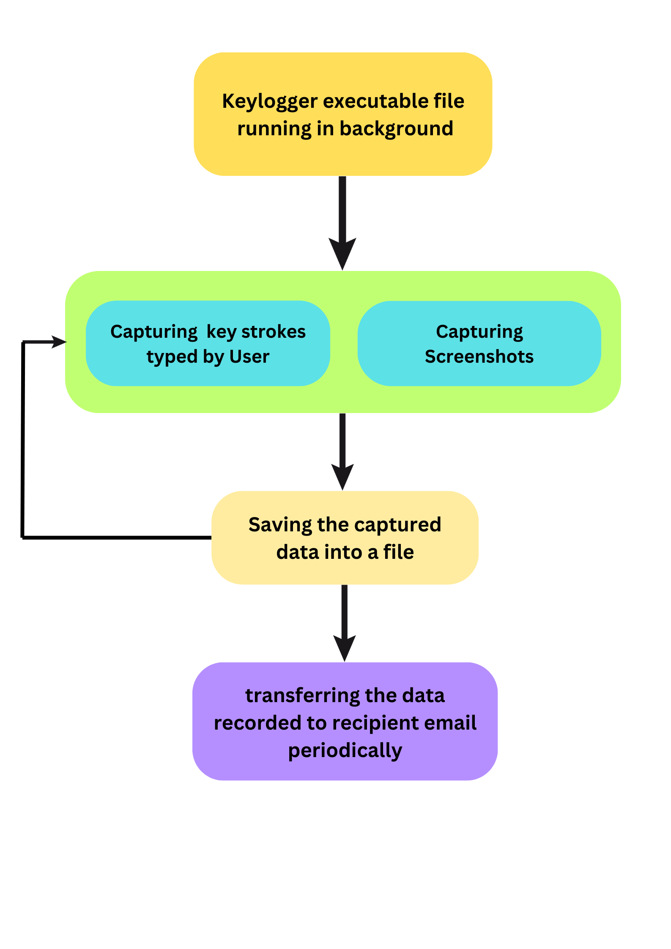
SYSTEM ARCHITECTURE

Slide 8
DESIGN AND IMPLEMENTATION
Features:
Keylogging: The project involves capturing keystrokes made by a user, allowing for the recording of text input.
Clipboard Monitoring: It includes functionality to grab text and images from the clipboard. This can be useful for capturing copied information.
Screenshot Capture: The project allows for taking screenshots of the user's screen. This feature enables the monitoring of the visual content displayed on the screen.
Email Notification: The project has the capability to send email notifications or reports containing the captured information. This could include logs of keystrokes, text from the clipboard, and attached screenshots.

Slide 9
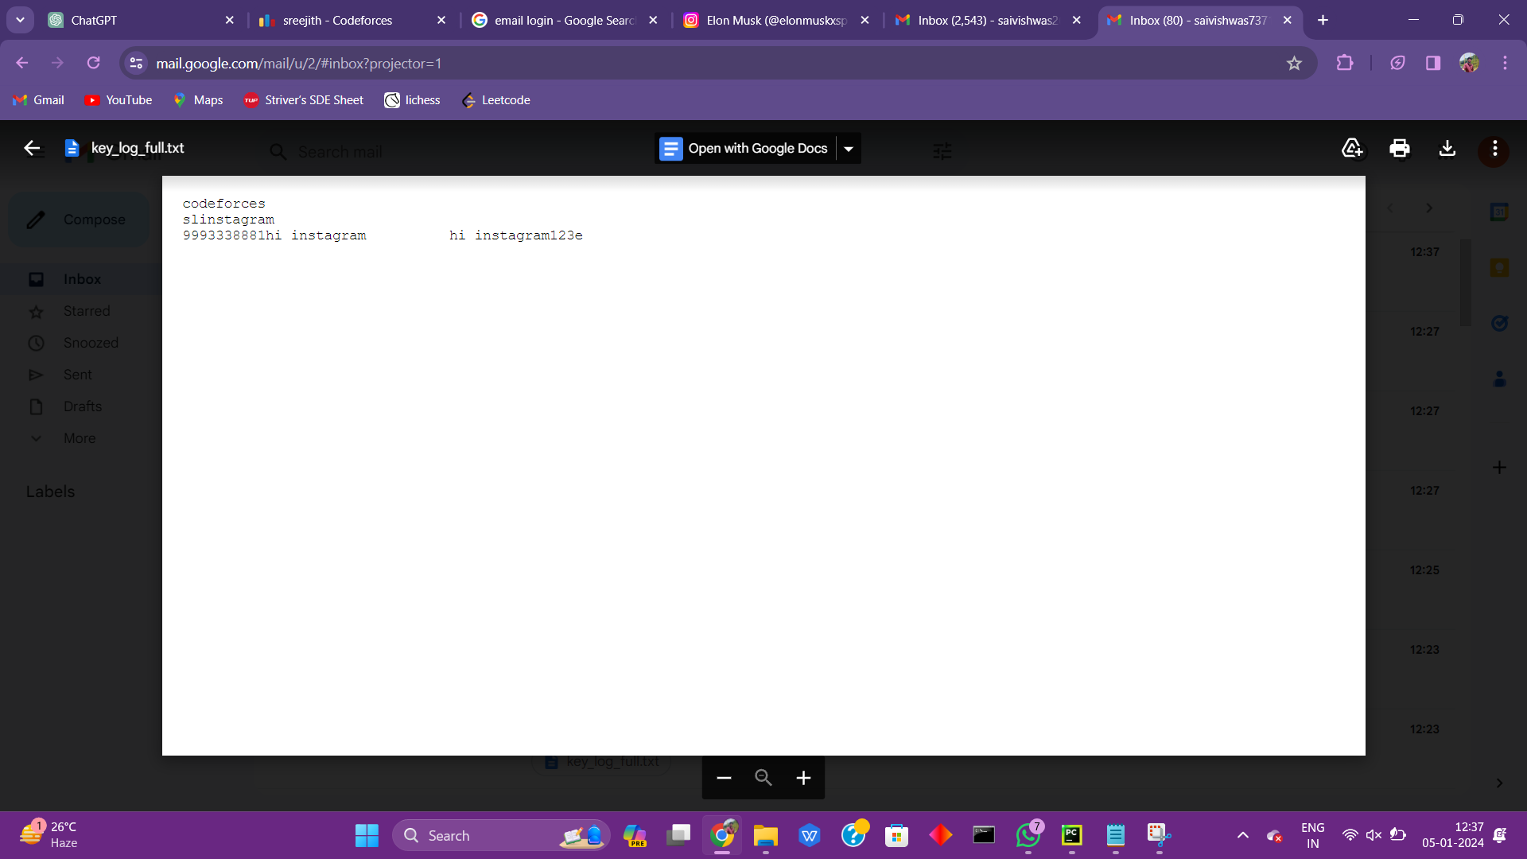
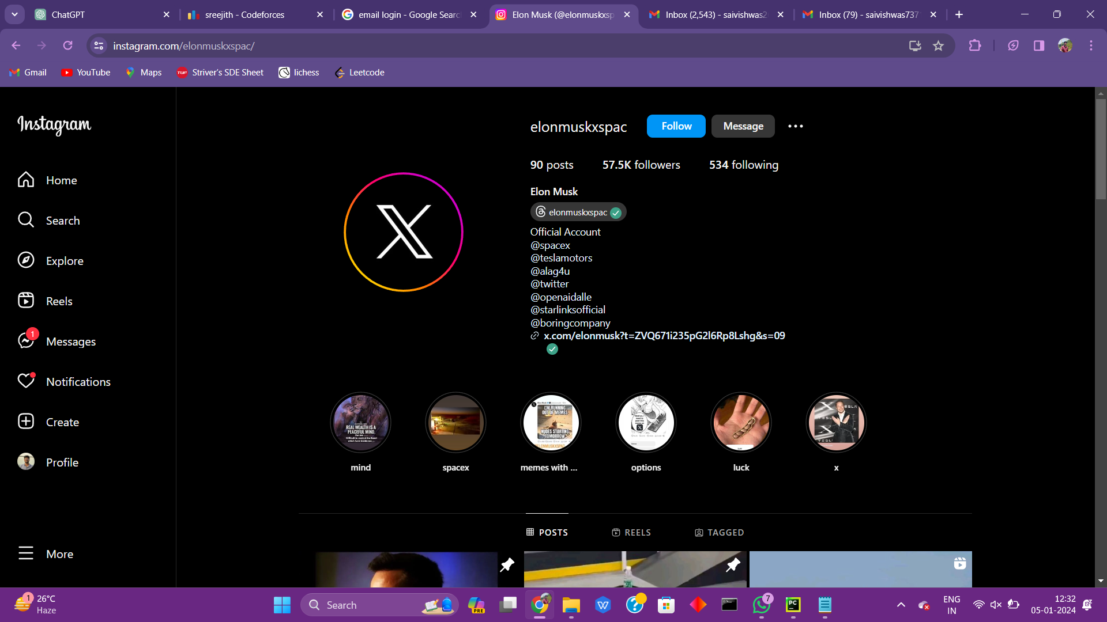
Sample Captured Data

Slide 10
CONCLUSION
Keyloggers are sophisticated tools that can access not only the platform, but also the user’s private information like their name, password, pin, card and bank statement. While some keyloggers are utilized in a legal manner, the creators of many keyloggers do so unlawfully. The most frequent keylogger types and strategies used to hide themselves while subverting a user's PC were examined in this study. In addition, we looked at the present situation of keyloggers and the methods through which they spread Finally, we looked into existing detection methods and made some recommendations for prevention.

