Slide 1

DISEASE PREDICTION SYSTEM
Final Project Review | Department of CSE | KL Deemed to be University
TEAM MEMBERS
2420030339 – P. Venkata Sai Charan
2420030210 – M. Sai Shashank
2420030088 – P. Pardhasaradhi
Guide: Dr. N. Sunanda, Associate Professor | Academic Year: 2026–27
Notes:
Title slide. Replace all bracketed text. Use the full project title, list every team member with registration number, and name your guide. Insert the institution logo in the dashed box.

Slide 2
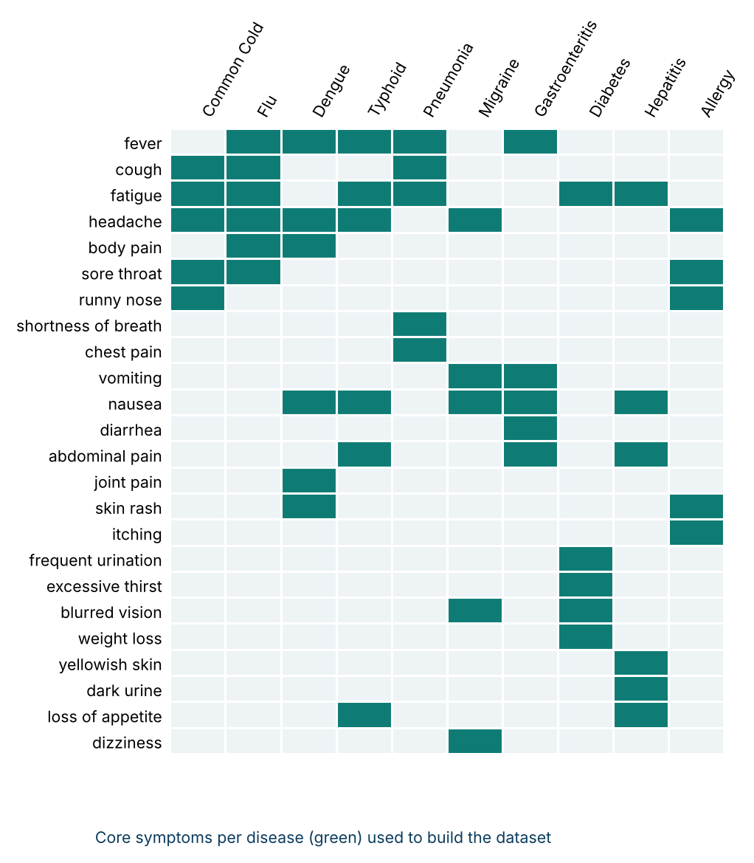



Introduction & Problem Statement
Background
Many diseases share overlapping symptoms, which makes early identification difficult and often delays people from seeking care.
Problem Statement
Build a data-driven system that analyses user-selected symptoms and gives a preliminary indication of the most likely disease.
Motivation / Need
Users without immediate access to healthcare guidance get a quick specialist and care suggestion. It supports, not replaces, diagnosis.
Notes:
State the domain, the exact problem and why it matters. Keep it to about 2 minutes. Add one real-world statistic if you can, with a citation.

Slide 3


Objectives & Scope
Objectives
In Scope
1
Develop an ML system that predicts the most likely disease from user-selected symptoms.
Symptom-based prediction of 10 common diseases (24 symptoms)
Comparison of 4 ML models
Specialist recommendation, care guidance and emergency warning
Streamlit web interface
2
Collect, preprocess and explore disease–symptom data (EDA) to identify symptom patterns.
3
Train and compare Decision Tree, Random Forest, KNN and Naive Bayes using Accuracy, Precision, Recall and F1-score.
Out of Scope
Clinical diagnosis or treatment
Lab reports, imaging, age or medical history
Medicine prescription
4
Recommend a specialist, care guidance and emergency warnings through a Streamlit web interface.
Notes:
Objectives should be measurable and start with action verbs. The scope slide tells the panel what you did and did not attempt.

Slide 4

Literature Survey
S.No | Author(s) & Year | Method / Technique | Key Findings | Limitation / Gap
1 | Sogandi et al. [1] | Supervised and unsupervised ML; Apriori association rules | Finds symptom–disease relationships and rules | Needs validation on broader datasets
2 | Keniya et al. [2] | Weighted KNN on symptoms, age and gender | 230+ diseases; 93.5% accuracy | Needs larger, more diverse clinical data
3 | Joshi, Kant, Shakya [3] | Symptom-based ML classification on medical datasets | ML can predict disease from symptoms | Accuracy needs further improvement
4 | Ashok et al. [4] | Decision Tree, KNN, Naive Bayes, Random Forest | Compares algorithms for quick preliminary prediction | Depends on dataset quality
5 | Hedaoo et al. [5] | Supervised ML, symptom-based prediction | Supports early disease prediction | Needs richer datasets; relies on input quality
6 | Sood, Sharma [6] | Decision Tree, KNN, Naive Bayes, Random Forest | Estimates disease likelihood from symptoms | Needs real patient data; low explainability
Research Gap
Existing work stops at basic symptom-to-disease prediction: few diseases, little model comparison, no specialist advice and no interactive interface. Our system combines prediction, 4-model comparison, doctor recommendation and care guidance in one app (Objectives 2–4).
Notes:
Summarise four to six relevant papers or existing systems. End with the research gap, because that gap justifies your project.

Slide 5





Proposed System & Methodology
STEP 1
STEP 2
STEP 3
STEP 4
STEP 5
Define Problem
Collect Data
Design
Implement
Test & Evaluate
Need for symptom-based preliminary screening; decision support only.
24 symptoms, 10 diseases, 1,500 records generated in Python.
Imputer → scaler (KNN) → Decision Tree, Random Forest, KNN, Naive Bayes.
Python modules plus a 4-page Streamlit app.
Accuracy, Precision, Recall, F1 on 300 held-out records.
Key Novelty / Contribution
Prediction, 4-model comparison, specialist recommendation, care guidance and emergency warnings combined in one interactive application.
Notes:
Walk through the five steps left to right. Rename the steps to match your project (for example, Requirement Analysis, Design, Coding, Testing, Deployment). End with your novelty.

Slide 6
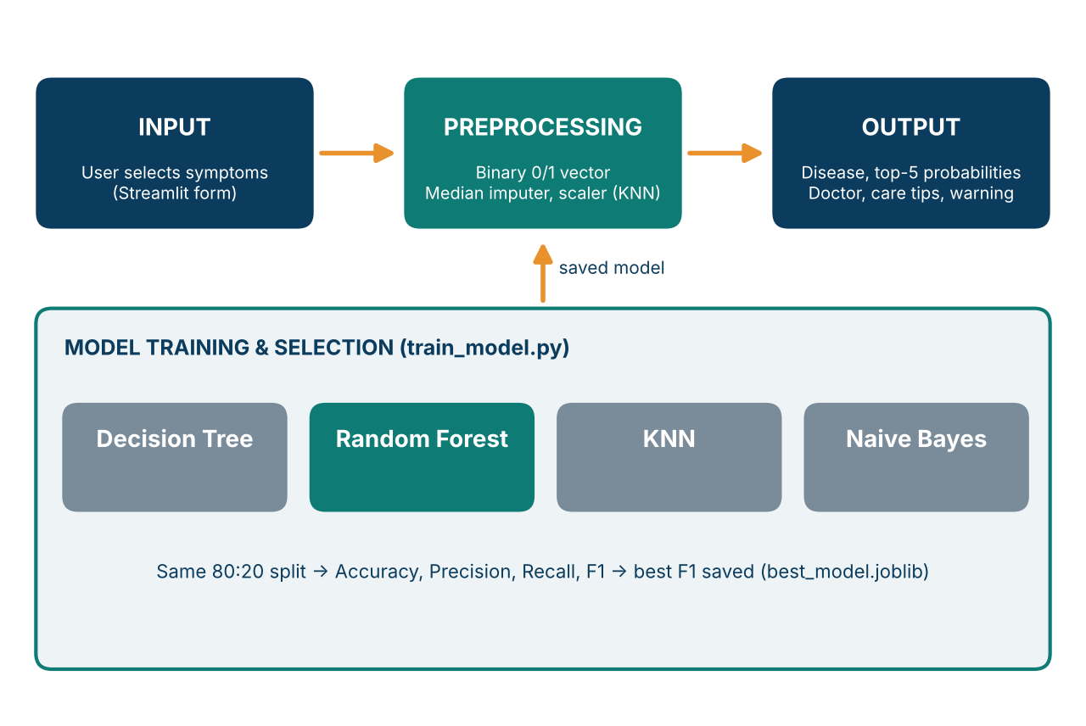
System Architecture
Components
1
Data Module
data_generator.py builds the 1,500-record symptom dataset.
2
Model Module
train_model.py preprocesses, trains and compares 4 models; saves the best.
3
Knowledge Base
disease_info.py holds specialist, description, care and medicine caution.
4
Streamlit App
app.py: Home, Dataset & EDA, Model Comparison and Prediction pages.
Notes:
Insert a clear block diagram: input, processing, storage, output. Number each block and explain them on the right. Redraw the figure yourself rather than copying it.

Slide 7


Hardware & Software Requirements
Hardware
Software & Tools
Libraries / Frameworks
Standard laptop / desktop PC
No GPU required
Storage: about 25 MB (code, data, saved model)
Network: only to install packages
Windows / Linux / macOS
Python 3.10
Any Python IDE (e.g. VS Code)
Git / GitHub for version control
pandas, NumPy
scikit-learn, joblib
Matplotlib, Seaborn
Streamlit (no database: CSV + joblib model)
Deployment / Platform: Runs locally as a Streamlit web app (streamlit run app.py)
Notes:
List only what you actually used, with versions. For a pure software project, shorten the hardware list and add cloud or deployment resources.

Slide 8
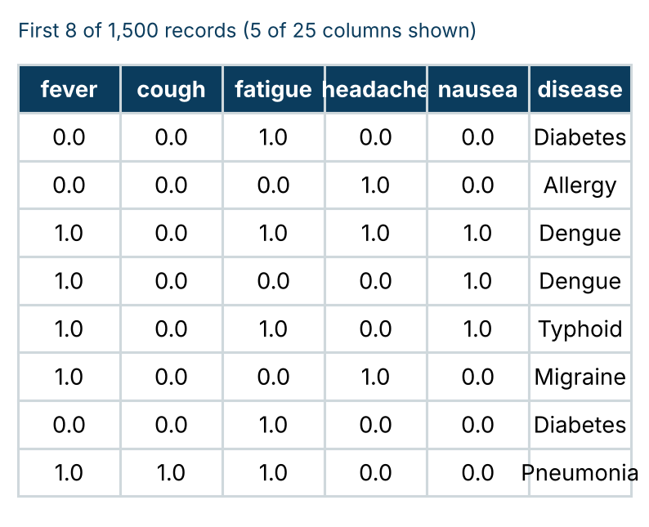
Dataset / Data Understanding
1,500
24
Records (rows)
Features (columns)
120
10
Missing values
Target classes
Source: generated in Python (data_generator.py); 150 records per disease, seed 42
Features: 24 binary symptoms (1 = present); target = disease
Quality: 120 missing values (5 per symptom); classes fully balanced
Notes:
Explain where the data came from and what it contains. Show a screenshot of the first rows or the info summary. For non-data projects, replace this slide with “Requirement Analysis” or “Input Specification”.

Slide 9
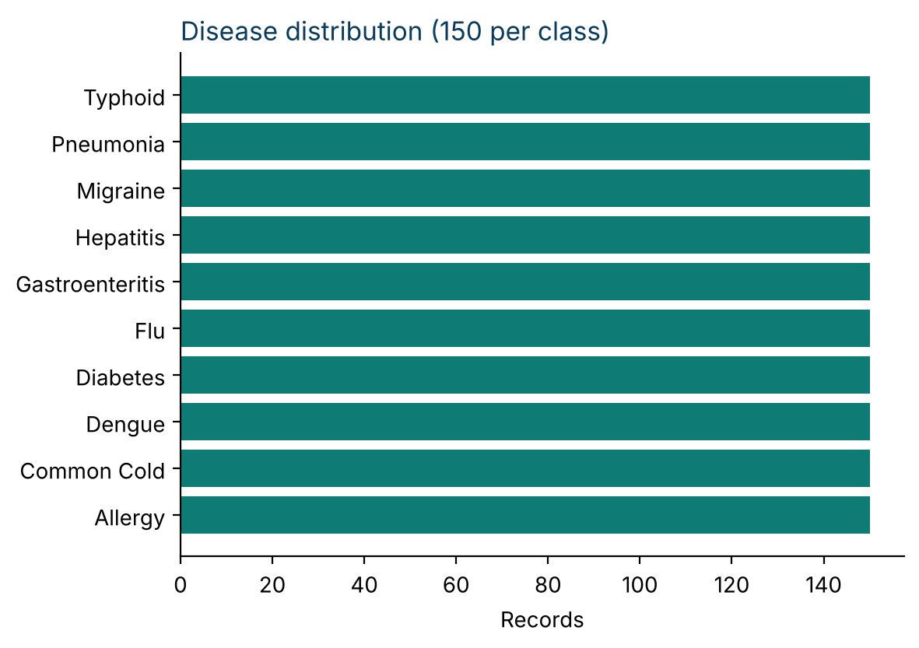
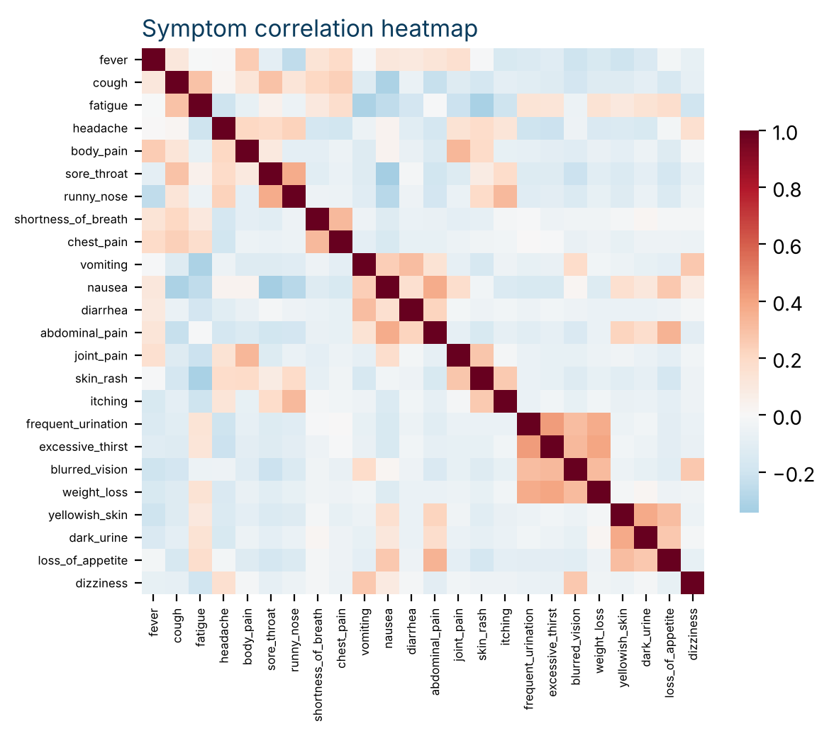



Data Preprocessing & Exploratory Analysis
Cleaning
Transformation
Feature Selection
120 missing values filled by median imputation inside the pipeline.
Symptoms coded 1/0; StandardScaler applied for KNN.
All 24 symptom columns used as inputs; none dropped.
Notes:
Show two or three plots that tell a story: distributions, correlations, outliers. Explain what each plot told you and what you did about it.

Slide 10
Module-wise Description
1
Home
2
Dataset & EDA
Purpose: Show dataset size, symptom and disease counts, best model and workflow
Input → Output: Saved model and data → overview metrics
Developed by: Team
Purpose: Explore the data: preview, missing values, distribution, correlations
Input → Output: Dataset → tables and charts
Developed by: Team
3
Model Comparison
4
Disease Prediction
Purpose: Compare the 4 models on the test set
Input → Output: Test split → metrics table, confusion matrix, report
Developed by: Team
Purpose: Predict the disease and give guidance
Input → Output: Selected symptoms → disease, top-5, doctor, care tips, warning
Developed by: Team
Notes:
Divide the project into three to five modules. For each, state its purpose, inputs, outputs and who built it. Duplicate a card if you have more modules.

Slide 11

Algorithms & Technologies Used
Random Forest
K-Nearest Neighbors
Naive Bayes
Why chosen
Many trees vote, which reduces overfitting and handles overlapping symptoms.
Key parameters
n_estimators = 250, random_state = 42
Why chosen
Matches a new case to the most similar past records.
Key parameters
n_neighbors = 7, StandardScaler
Why chosen
Fast probabilistic model based on Bayes’ theorem.
Key parameters
GaussianNB, median imputer
Selection criteria: highest weighted F1-score on the same 300-record test set. Random Forest won (92.36%); Decision Tree (max_depth = 10) scored lowest (76.23%).
Notes:
Name each model, algorithm or technology, say why you chose it, and list the key settings. Then explain how you picked the final one.

Slide 12
Implementation / Model Building
Feature Selection
Code snippet / pseudocode
All 24 binary symptom columns; target is the disease label.
# Core of train_model.py
X_train, X_test, y_train, y_test = \
train_test_split(X, y, test_size=0.20,
random_state=42, stratify=y)
model = Pipeline([
("imputer", SimpleImputer("median")),
("model", RandomForestClassifier(
n_estimators=250))
])
model.fit(X_train, y_train) # x4 models
Preprocessing Pipeline
Numeric conversion → median imputation → StandardScaler (KNN only).
Data Splitting
80:20 stratified split: 1,200 train / 300 test records.
Configuration
RF: 250 trees; DT: depth 10; KNN: k = 7; NB: Gaussian. Classes balanced (150 each).
Notes:
Describe the build in the order you did it. Paste only the most important code or pseudocode, not entire files. For hardware projects, show the circuit or wiring summary instead.

Slide 13
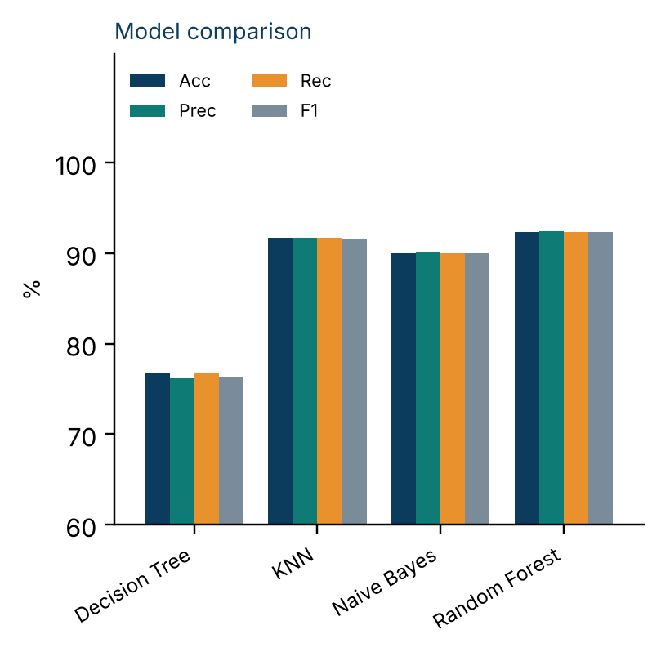
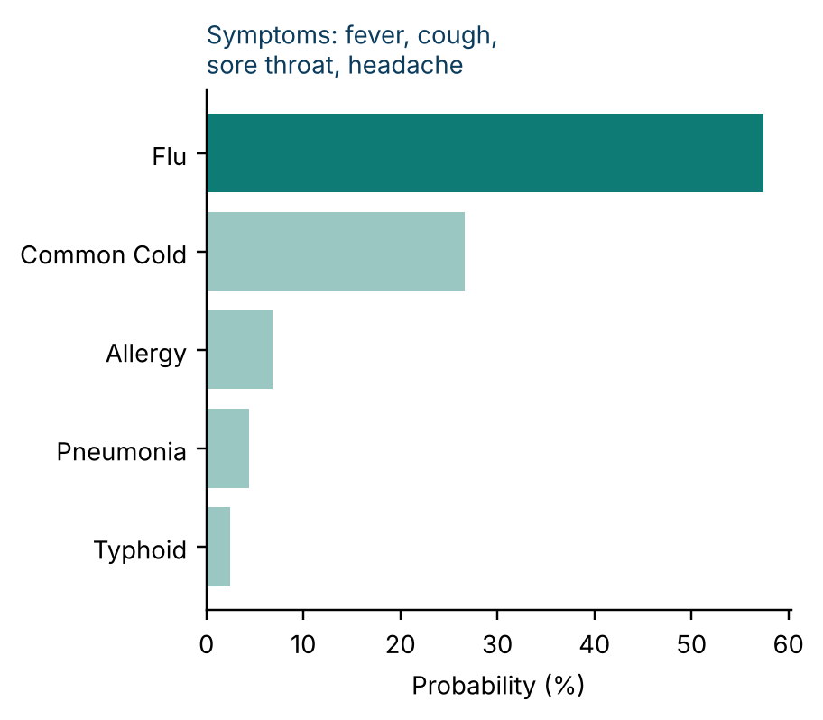
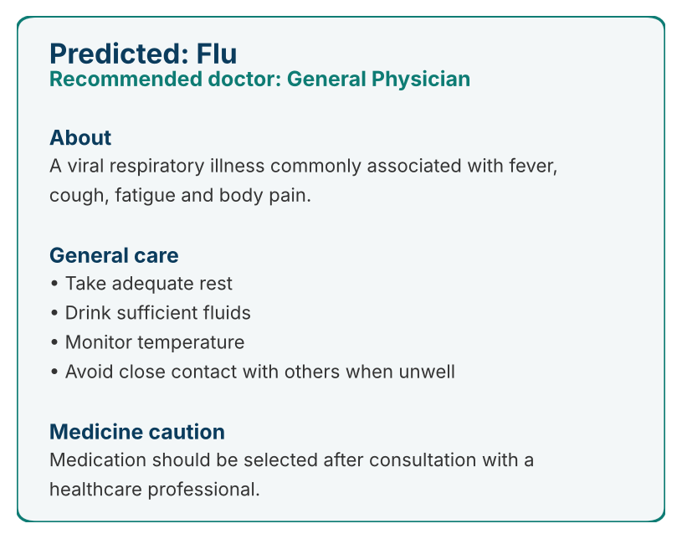
Working Prototype / Output Screens
Disease Prediction
Top-5 probabilities for the selected symptoms
Model Comparison
Accuracy, Precision, Recall and F1 of all 4 models
Doctor & Care Guidance
Specialist, description, care steps, medicine caution
Notes:
Show real screenshots, photos of the hardware or a short demo video link. Caption each one with what the viewer should notice.

Slide 14
Results & Performance Comparison
Metric (%) | Decision Tree | Random Forest | KNN | Naive Bayes
Accuracy | 76.67 | 92.33 | 91.67 | 90.00
Precision | 76.14 | 92.41 | 91.74 | 90.21
Recall | 76.67 | 92.33 | 91.67 | 90.00
F1-score | 76.23 | 92.36 | 91.61 | 89.95
Best: Random Forest – F1 = 92.36%
Weighted averages over 10 classes on the 300-record test set. The dataset is generated from symptom patterns, so real clinical data may give different results.
Notes:
Right-click the chart and choose Edit Data to enter your real numbers. Replace the metrics with the ones that fit your project (accuracy, latency, power, throughput, user rating). State clearly which option performed best.

Slide 15
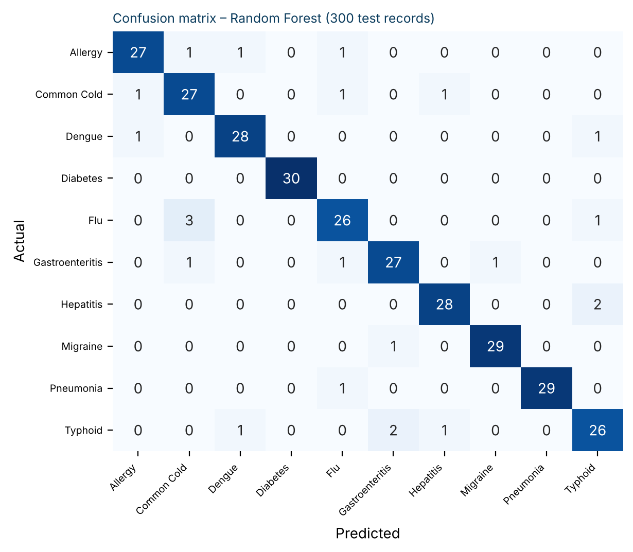
Analysis & Key Findings
92.36%
Best F1-score achieved by Random Forest
Interpretation: 277 of 300 test records classified correctly (92.33% accuracy).
Error analysis: Main confusions are Flu → Common Cold and Hepatitis / Typhoid, which share symptoms.
Key drivers: fever, headache, fatigue, body pain and nausea (top feature importances).
Notes:
Explain what the numbers mean. Use a confusion matrix, ROC curve, feature-importance chart or output comparison. Be honest about weak results; panels value that.

Slide 16

Testing & Validation
Test ID | Test Description | Expected Result | Actual Result | Status
TC-01 | Pneumonia symptoms: fever, cough, breathlessness, chest pain, fatigue | Pneumonia | Pneumonia (100%) | Pass
TC-02 | Diabetes symptoms: frequent urination, thirst, blurred vision, weight loss, fatigue | Diabetes | Diabetes (100%) | Pass
TC-03 | Hepatitis symptoms: yellow skin, dark urine, appetite loss, nausea, fatigue | Hepatitis | Hepatitis (100%) | Pass
TC-04 | Overlapping symptoms: fever, cough, sore throat, headache | Flu or Common Cold on top | Flu 57.4%, Common Cold 26.6% | Pass
Functional Testing
Validation Method
Performance Testing
Predictions checked on 4 symptom sets; app asks for at least one symptom before predicting.
Stratified 80:20 hold-out; all 4 models scored on the same 300 unseen records.
Each prediction takes well under 0.1 s; best accuracy 92.33% on the test set.
Notes:
List representative test cases with expected and actual outcomes. Name the validation methods you used. Delete rows you do not need.

Slide 17


Challenges & Limitations
Challenges Faced
Limitations
Missing values (120) → median imputation in the pipeline
Overlapping symptoms → top-5 probabilities, not one label
Weak Decision Tree (F1 76.23%) → compared 4 models, chose Random Forest
Synthetic dataset – real clinical data may give different results
Only 24 symptoms and 10 diseases; no age, history or lab results
Decision support only; not clinically validated
Notes:
Be candid. Pair every challenge with how you solved it, and list limitations that the panel would otherwise spot themselves.

Slide 18

Conclusion
Built a Streamlit disease prediction system with scikit-learn on a 1,500-record, 24-symptom, 10-disease dataset.
1
Final Outcome
Random Forest was best: 92.33% accuracy and 92.36% F1, ahead of KNN (91.61%), Naive Bayes (89.95%) and Decision Tree (76.23%).
92.3%
2
Best accuracy – Random Forest
Objectives achieved: 4 of 4
The system predicts the disease, recommends a specialist and gives care guidance as a decision-support tool.
3
Notes:
Revisit each objective and say whether you met it. Quote your headline result with numbers. Do not introduce new material here.

Slide 19



Future Scope & Applications
Improve Performance
Tune models and try advanced ML algorithms
Applications
Preliminary symptom screening for patients
Decision support in primary care and telehealth
Health-awareness and education tool
Adopters: clinics, students, health apps
Expand Data / Features
Real clinical datasets, patient history, lab results
Deploy & Build an Interface
Web or mobile app with explainability
Scale & Secure
Cloud deployment, patient-data privacy, clinical validation
Notes:
Give concrete next steps, ideally tied to the limitations. Then name two or three real-world uses.

Slide 20
Team Contribution
Reg. No. | Name | Contribution / Modules Handled
2420030339 | P. Venkata Sai Charan | Joint work: dataset, model training, Streamlit app, testing and report
2420030210 | M. Sai Shashank | Joint work: dataset, model training, Streamlit app, testing and report
2420030088 | P. Pardhasaradhi | Joint work: dataset, model training, Streamlit app, testing and report
Notes:
Show that work was planned and shared. Every member should be able to explain their own module.

Slide 21

References
[1] F. Sogandi et al., “Identifying diseases symptoms and general rules using supervised and unsupervised machine learning.”
[2] R. Keniya et al., “Disease Prediction From Various Symptoms Using Machine Learning.”
[3] D. Joshi, R. Kant, S. Shakya, “Disease Prediction System Using Machine Learning.”
[4] N. Ashok et al., “Symptoms Based Disease Prediction System Using Machine Learning.”
[5] R. Hedaoo et al., “Disease Symptoms Prediction Application.”
[6] R. Sood, V. Sharma, “Symptom Based Disease Prediction Using Machine Learning.”
[7] F. Pedregosa et al., “Scikit-learn: Machine learning in Python,” J. Mach. Learn. Res., vol. 12, pp. 2825–2830, 2011.
Project Links
Code: Disease_Prediction_System/ (app.py, train_model.py)
Dataset: data/disease_symptoms.csv
Run: streamlit run app.py
Notes:
Use IEEE style, numbered in order of first citation in the deck. Include datasets, documentation and code repositories.

Slide 22
THANK YOU
Questions & Discussion
2420030210@klh.edu.in | 2420030339@klh.edu.in | 2420030088@klh.edu.in
Guide: Dr. N. Sunanda, Department of Computer Science and Engineering
Notes:
Leave this slide up during questions. Make sure every team member can answer questions about their own module.

