Slide 1


LEAVE MASTER
Presented by
Saishashank Petkar
Ritesh Pampanaboyina
Naman Kudesia
Kajal Shukla
Anitha Gayatri
Pretheeba Udhayakumar

Slide 2


Overview of the .NET Framework
Object-Oriented Programming
Common Language Runtime (CLR)
The .NET Framework supports object-oriented programming principles, enabling developers to create modular and reusable code.
The CLR provides a runtime environment for .NET applications, managing memory, security, and other critical aspects.
Class Library
The .NET Framework includes a rich class library that provides pre-built components for various tasks, such as data access, networking, and UI development.

Slide 3
Abstract
User Interface for managing employee leaves and attendance.
Employee can mark attendance and request leaves.
Managers can approve/reject leaves and view attendance data.
Leave credits are assigned based on employee grade on a monthly basis.

Slide 4
Implementing Web API for RESTful Services
RESTful Architecture
CRUD Operations
JSON Serialization
RESTful APIs adhere to principles of statelessness and resource-based interactions, making them ideal for web-based applications.
Web API allows developers to define controllers and actions that map to common CRUD operations (Create, Read, Update, Delete) on data resources.
Web API supports JSON serialization, making it easy to exchange data between the client and server.

Slide 5


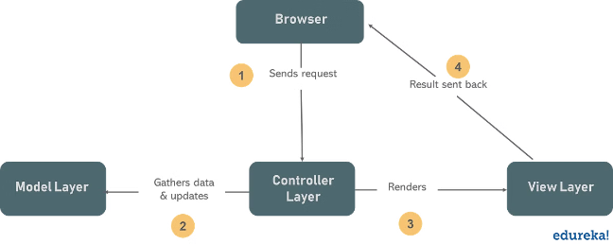


Building the MVC Web Application
Model
Represents data entities and business logic.
View
Presents data to the user through UI elements.
Controller
Handles user input, interacts with the model, and selects the appropriate view.

Slide 6


User Authentication and Authorization
1
User Accounts
2
Role-Based Access Control
The system will create user accounts for each employee with unique usernames and passwords.
Different roles (e.g., employees, managers, administrators) will have varying levels of access to system functionalities.
3
Secure Communication
The system will utilize HTTPS to encrypt sensitive data transmitted between the client and server.

Slide 7
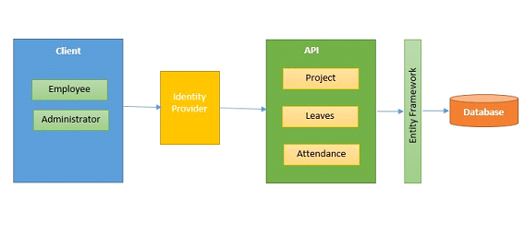
Leave Request Submission and Approval Workflow
1
Request Submission
Employees can submit leave requests through the web application, specifying the leave type, duration, and dates.
2
Manager Approval
Requests are routed to the employee's manager for review and approval or rejection.
3
Notification and Confirmation
The system sends notifications to both the employee and manager about the request status and confirmation.

Slide 8

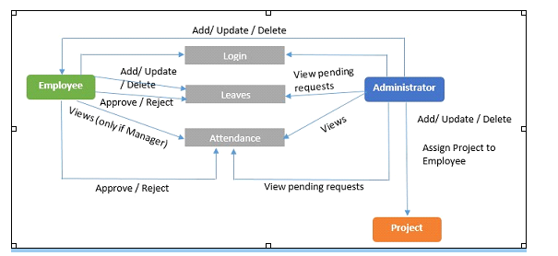
Leave Table
Leave Type
Leave Status
Approval status
Vacation
Active
Approved
Sick Leave
Inactive
Pending

Slide 9
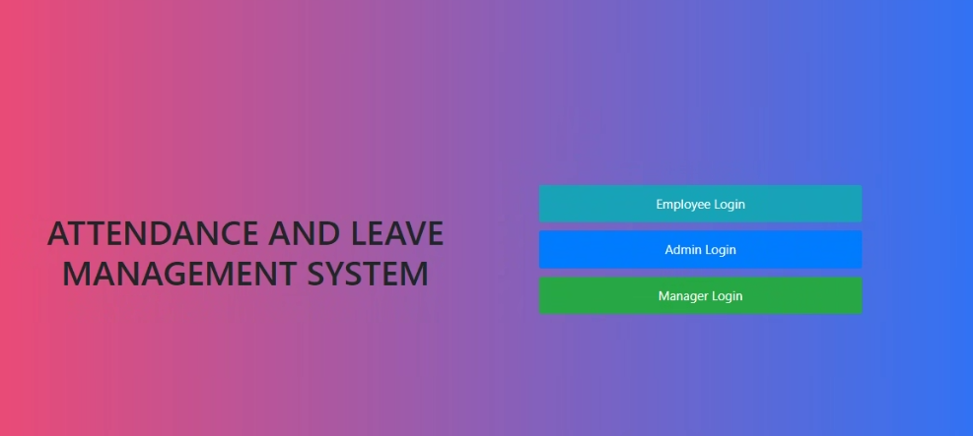
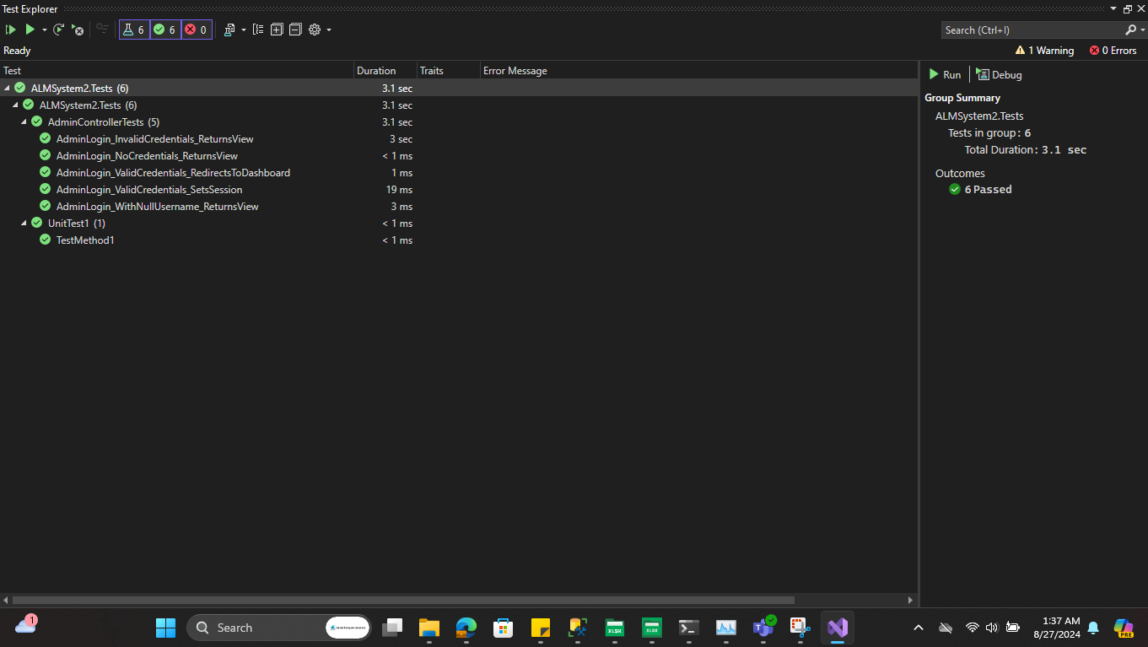
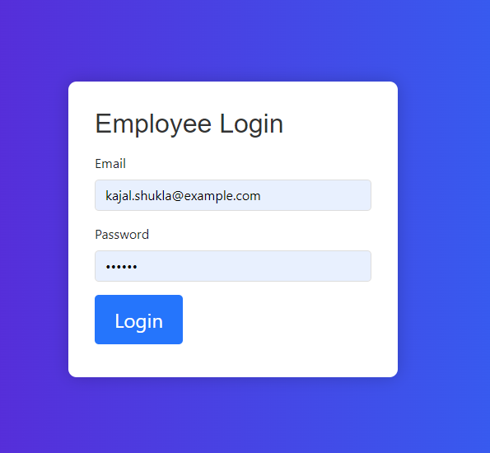
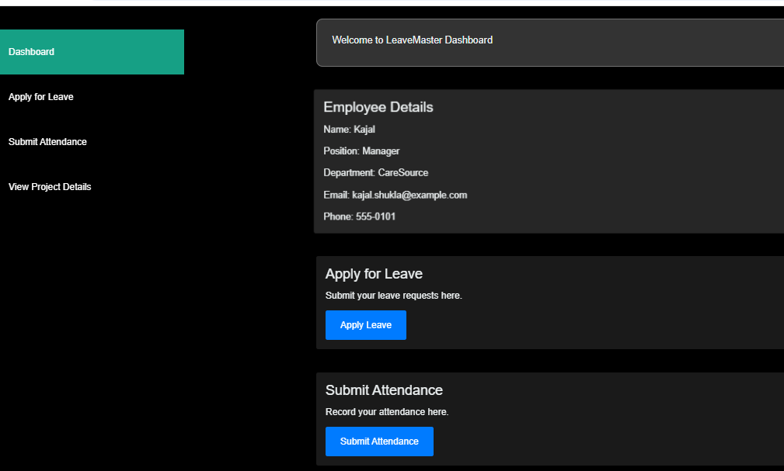

Few Snapshots
.

Slide 10

Conclusion and Future Enhancements
This system provides a comprehensive solution for managing employee leave requests, ensuring compliance with company policies and facilitating efficient leave administration. Future enhancements could include integration with mobile devices, automated leave reminders, and advanced analytics features.

Slide 11
THANK YOU

