Slide 1
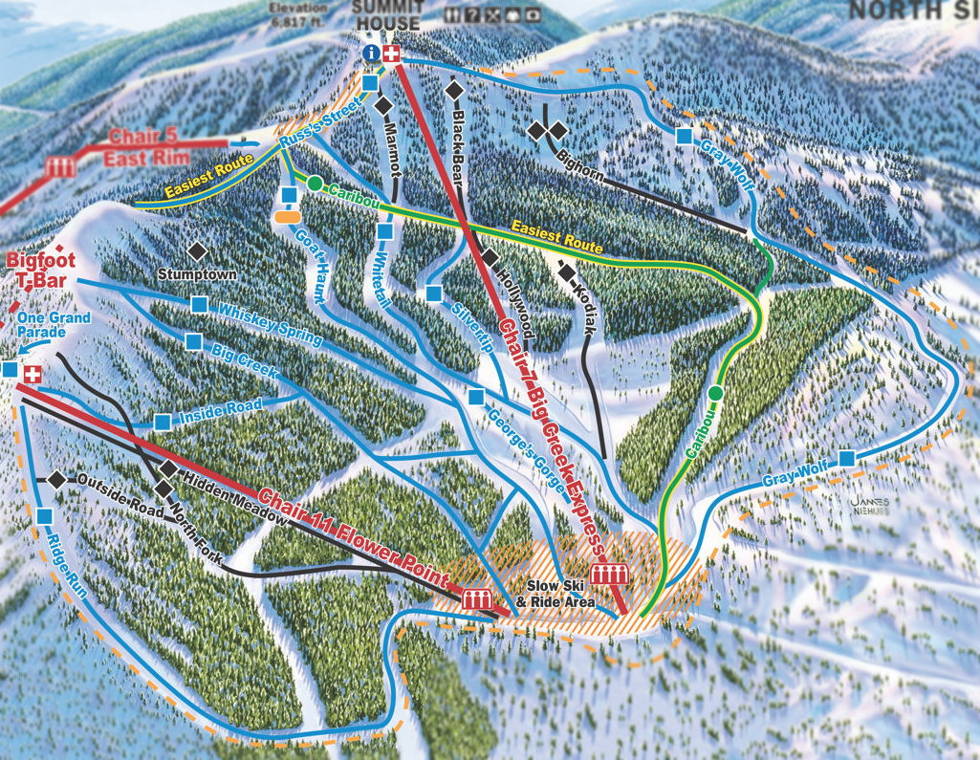
Big Mountain Ski Resort
Ticket Pricing Model

Slide 2
Problem Identification
Create a pricing model for ski resort tickets pricing.
Select a better value for their ticket price to incur the operating costs for additional chairs installed.
Provide insight to what facilities can be expanded for visitors.
utilize all the facilities available, up to their maximum effort, to accommodate all people.

Slide 3
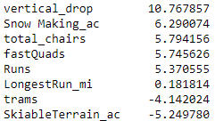
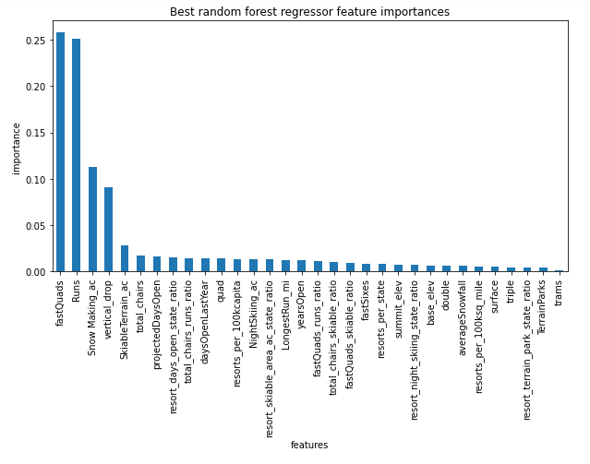
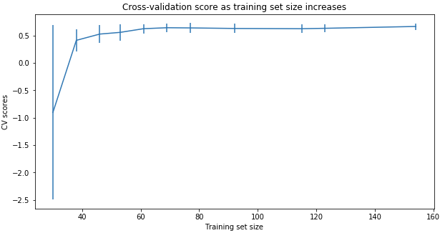
Modeling Results and Comparison
Linear Regression Model
Random Forest Regression Model
Cross-Validation Score
Notes:
The random forest model has a lower cross-validation mean absolute error (MAE errors between paired observations expressing the same phenomenon) by almost $1. It also exhibits less variability. Verifying performance on the test set produces performance consistent with the cross-validation results. (10.499032338015294, 1.6220608976799664) vs. (9.649477185159107, 1.505326312688125)
This shows that you seem to have plenty of data. There's an initial rapid improvement in model scores as one would expect, but it's essentially levelled off by around a sample size of 40-50

Slide 4
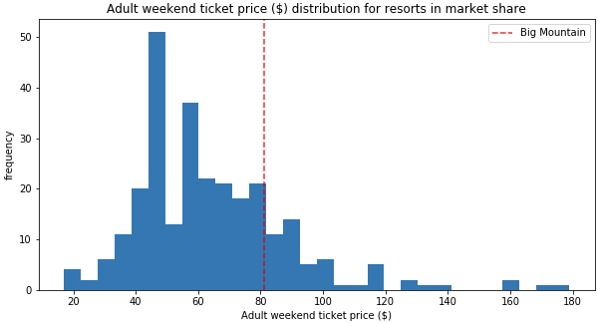
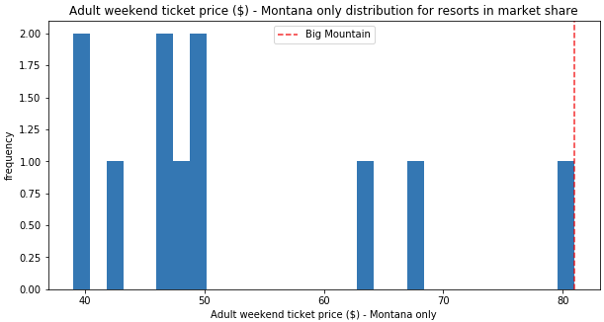
Big Mountain Resort modeled price is $95.87 and its actual price is $81.00.
MAE = $10.36 suggests there is room for an increase
Ticket Prices

Slide 5
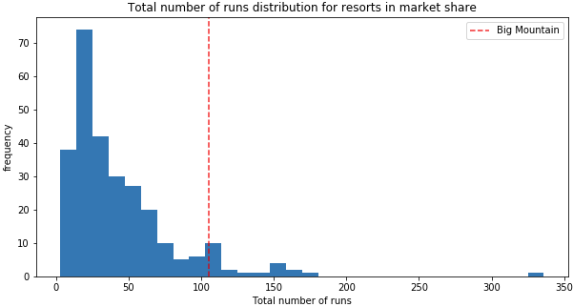
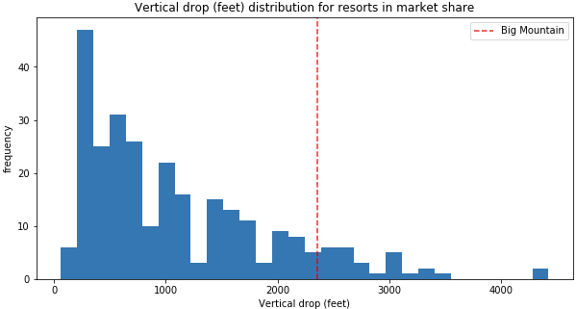
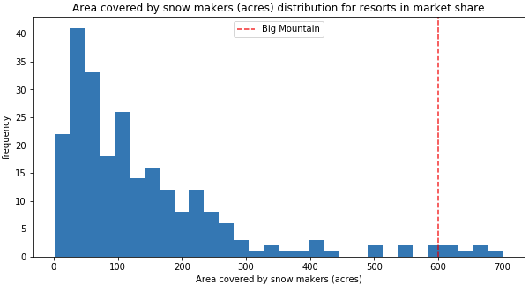
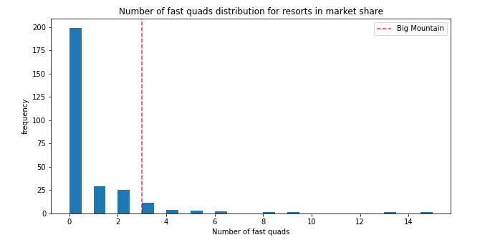
Feature Comparisons
Big Mountain is one among the top resorts in the following facilities-
Number of Runs
Snow making capacity
Vertical drop
Number of Fast Quads

Slide 6
Key Findings
Scenario 1- closing of up to 10 of the least used runs
can close upto 5 runs results in drop in ticket prices and revenue
Scenario 2- increase vertical drop by 150ft and addition of a chair lift
increases the ticket price of $8.61 and additional revenue of $3 million
Scenario 3- including scenario 2, and adding 2 acres of snow making
increases the ticket price of $9.9 and additional revenue of $3.45 million.
Scenario 4- increase the longest run by 0.2 miles and additional snow making of 4 acres
no change in ticket price
Recommendation
Recommend scenario 2, to increase vertical drop by 150ft with the addition of a chair lift.
increases the ticket price of $8.61 and additional revenue of $3 million

Slide 7
Summary
Proposed Scenarios
closure of 5 least used runs
increase vertical drop by 150ft and addition of a chair lift
increase vertical drop and addition of chair lift with snow making.
By implementing scenario 2, will provide an additional revenue of $3 million, with increase of ticket price of $8.61
Conclusion

