Slide 1
Inter-Integrated Circuit(I2C)
Presented by,
Saishitha

Slide 2
Table of contents: •Design(Architecture) •Basics of I2C •I2C Data Frame •Start & Stop Bytes •Repeated Start •Address Byte Format •Data Byte Format •Clock Stretching •Arbitaration

Slide 3
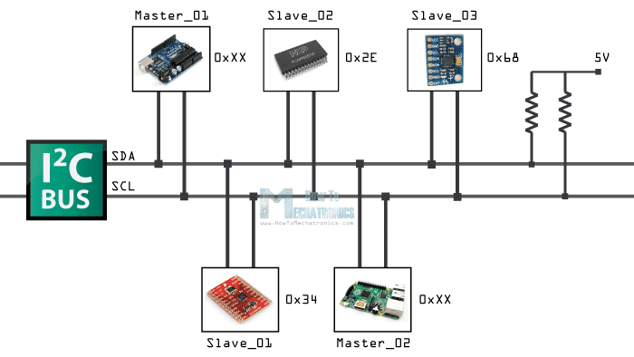

Slide 4
Basics of I2C Protocol / TWI(Two Wire Interface)
• I2C is Inter Integrated Circuit bus protocol.
• Only two lines are required for the communication.
• I2C lines :
1) Serial Data SDA
2) Serial Clock SCL
•Both of this lines are pulled up at 5v,explains that no communication is happening.
• It is simple,low bandwidth protocol used for short range communication.
• Master is initiating data transfer and controls the clock normally and the device being addressed is slave.

Slide 5
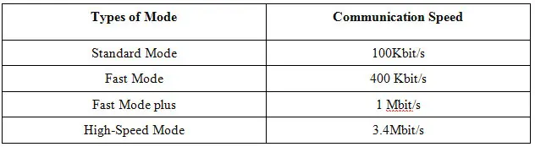
•In I2C, both master and slave can receive or transmit data. So there are 4 modes of operation for each node.
• Addressing is done by 7 bits to communication with 128 devices max.
• Number of devices is also limited by the total bus capacitance of 400 pF.
• Most I2C devices operates up to speed of 400Kbps.
• Main advantage of I2C protocol is interfacing simply and with the use of two wires we can interface 128 devices.

Slide 6
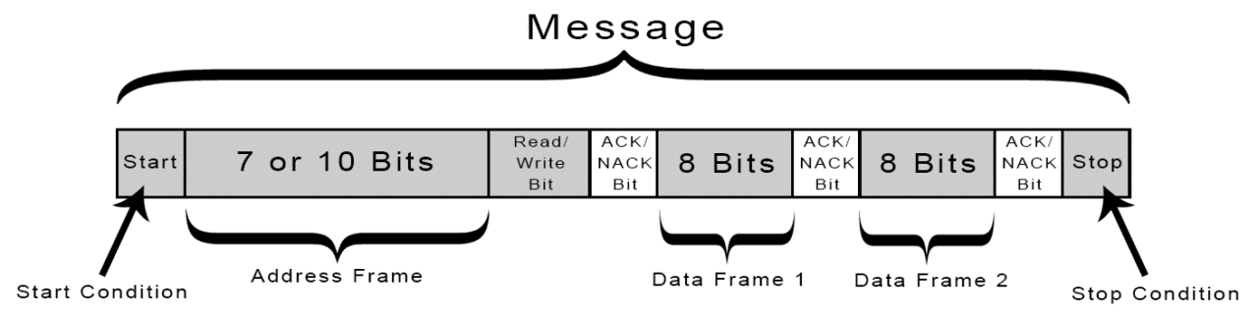
I2C Data Frame

Slide 7
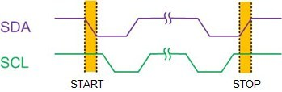
Start & Stop Bits
• In I2C,each transmission is initiated by a START condition and is terminated by STOP condition.
•Between the START and STOP, a connection is established between the master and the slave
•These START and STOP conditions are generated by the master.

Slide 8
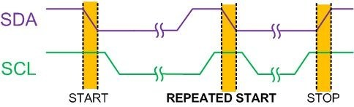
Repeated Start
• When master wants to initiate a new transfer and does not want to release the bus before starting the new transfer, it issues a new START condition between a pair of START and STOP condition. It is called REPEATED START condition or simply RESTART condition.

Slide 9
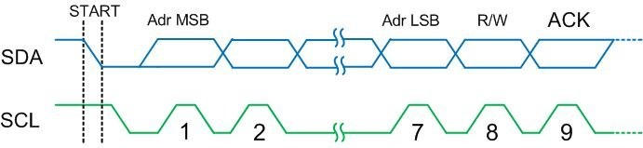
Address Byte Format
• In I2C bus,address bits are nine bits long. It consists of seven address bits, one READ/WRITE control bit, and an acknowledge bit.
• In I2C bus the MSB of the address is transmitted first.

Slide 10
• The 8th bit in the address byte is READ/WRITE control bit.In read/write flag,0 indicates a write operation and 1 indicates a read operation.
• 9th bit is ACK/NACK.The slave should acknowledge by pulling SDA to low.Else master will take it as NACK by leaveing the SDA line high.
• In case of NACK,the master can transmit a STOP condition to terminate the transmission, or a REPEATED START condition to initiate a new transmission.

Slide 11
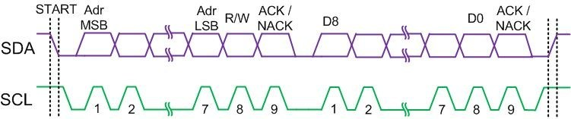
Data Byte Format
• The data bytes are 9 bits long.
• First 8 bits are a byte of data to be transmitted and the 9th bit, is for ACK.
• Each data bit transferred on the SDA line is synchronized by a high to low pulse of the clock on SCL line.

Slide 12
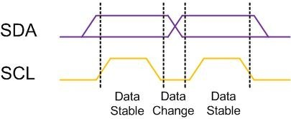
• If the receiver has received the last byte of data and does not wish to receive more data, it may signal a NACK by leaving the SDA line high.
• The master should terminate the transmission with a STOP after a NACK appears.
• In data bytes, like address bytes, MSB is transmitted first.

Slide 13
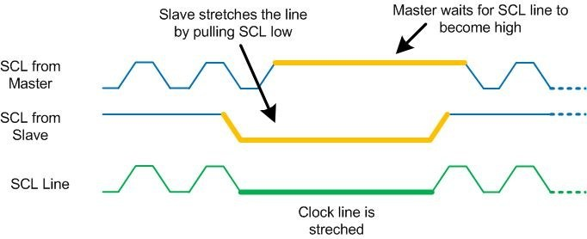
Clock stretching
• Clock stretching is happen when master is transpering data to slave.
• Slave will make clock signal (SCL) to active low,as if slave make this active low and will wait until the slave releases the SCL line to show it is ready for the next bit that is reffered as clock stretching.

Slide 14
Arbitration
• Each master has to check the level of the bus and compare it with the levels it is driving.
• If it doesn't match, that master has lost the arbitration and will switch to slave mode.
• In the case of arbitration, the winning master will continue the transmission. Notice that neither the bus is corrupted nor the data is lost.

