Slide 1

Exploaratoty Data Analysis.
Group2
Leng Xiaofeng
Saisindhu Jammula
ManiChandana Kilaru

Slide 2



Agenda
Exploratory Data Analysis Of Cars info Dataset Using Python Functions and machine learning techniques.

Slide 3




Introduction
As mentioned in the agenda our data set consists of different used cars information including price, mileage , no of kilometers driven etc. We are going to perform EDA on this data set using python functions and machine learning techniques.

Slide 4
Data Set:
Our data set consists of information of different brand cars and models. Data set has information of car’s age, it’s selling price , seller type and transmission.
It also had the information of car’s engine power, mileage , number of kilometers driven and its fuel type.
This data set can be used for a lot of purposes such as price prediction to exemplify the use of linear regression in machine learning.
This Data set Analysis helps the common man to understand different cars features and estimate the cars value after it has been used for some time.
And EDA of this dataset also helps to choose the best car in the current market after understating different model cars features and its value.

Slide 5
Data Set:

Slide 6
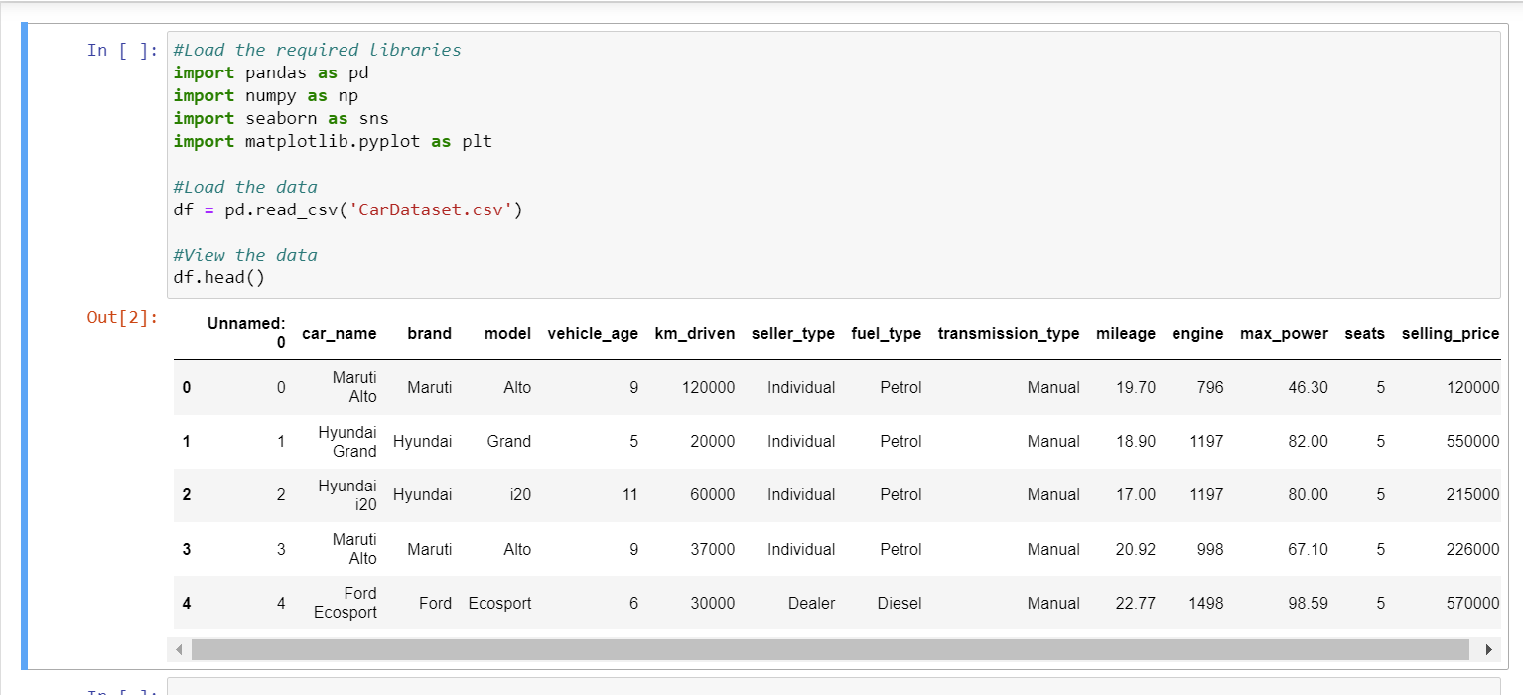
Load and view the data of the data set.

Slide 7
EDA METHODOLOGY

Slide 8
Import data

Slide 9
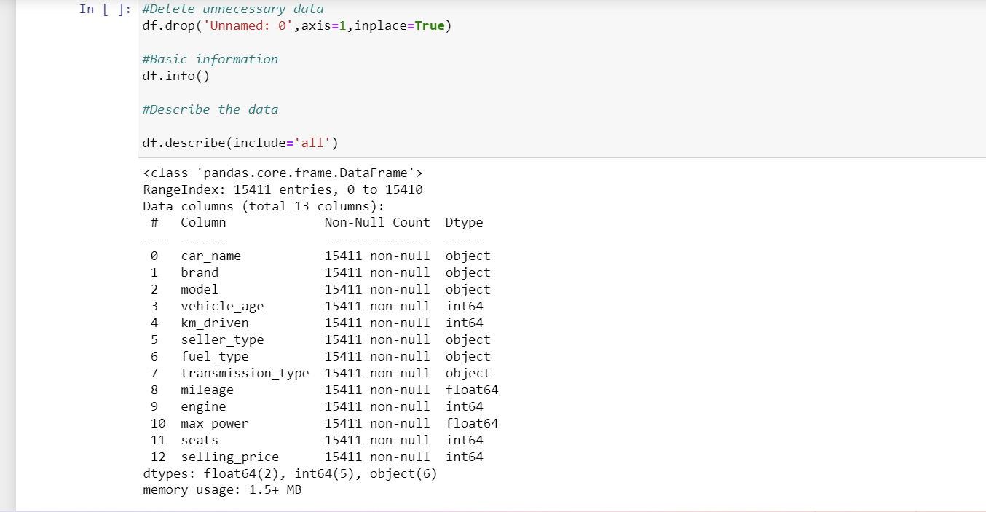
Basic information of the data

Slide 10
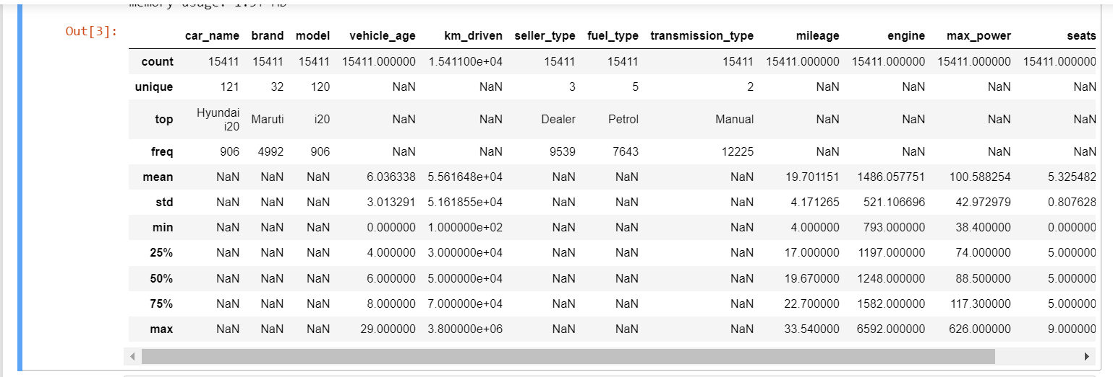
Describe the data

Slide 11
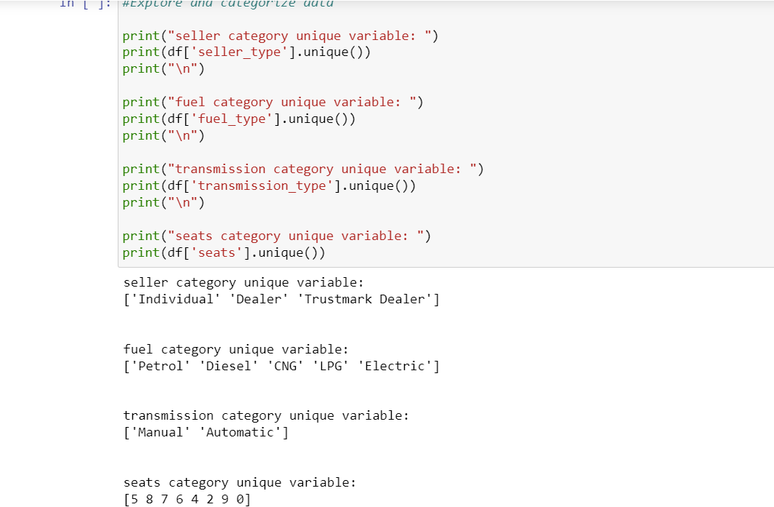
Explore and Categorize data

Slide 12
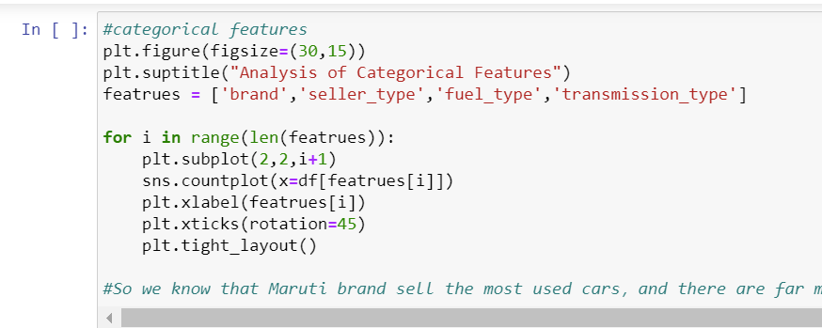
Categorical Features

Slide 13
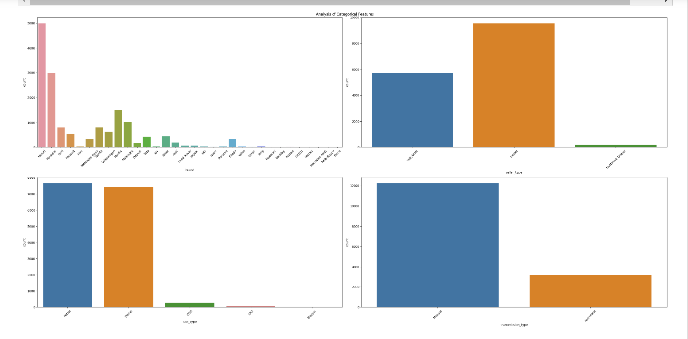
Categorical Features.

Slide 14
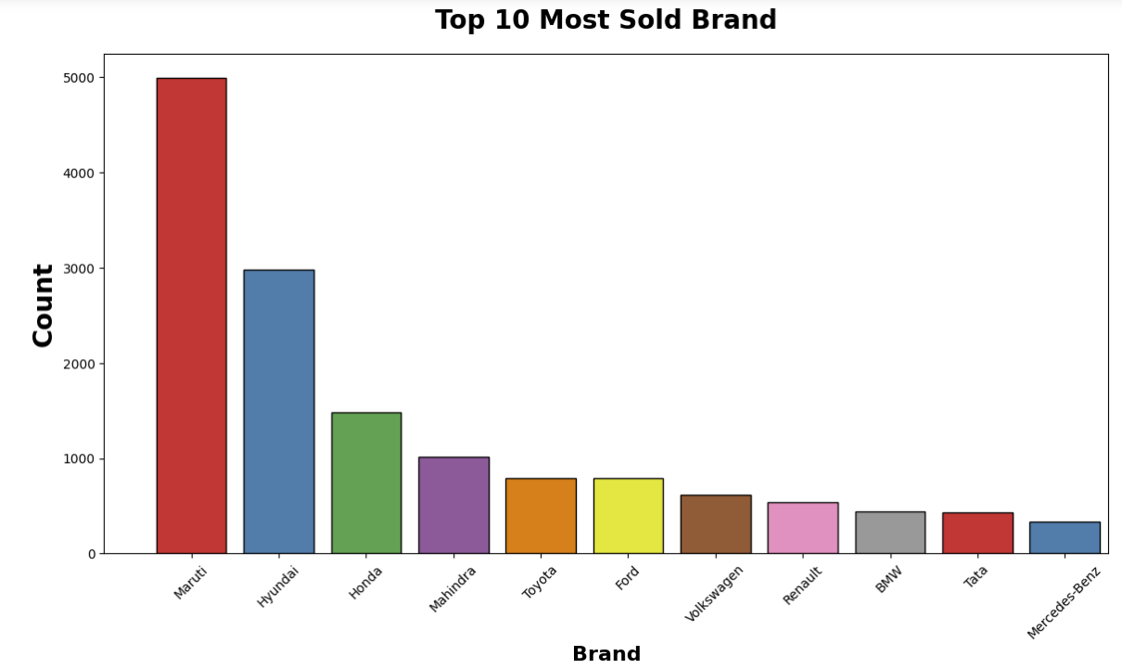
Top 10 Most Sold Brand.

Slide 15
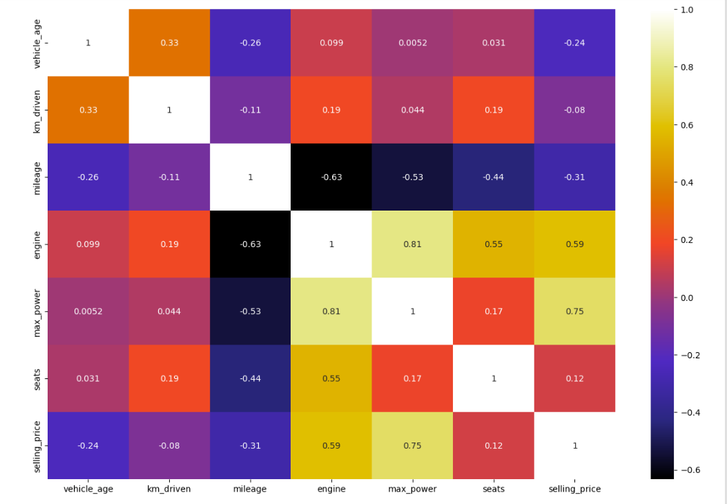
Heat Map

Slide 16
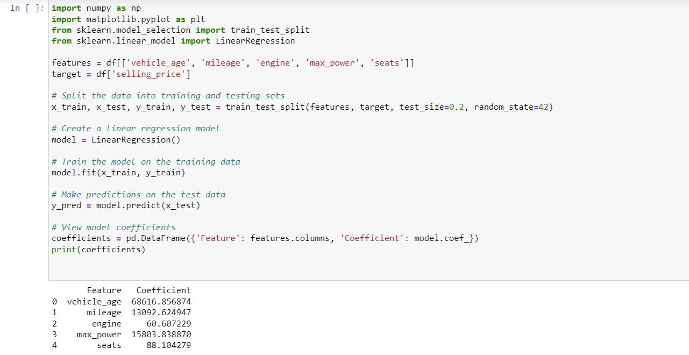
Linear Regression Model.

Slide 17
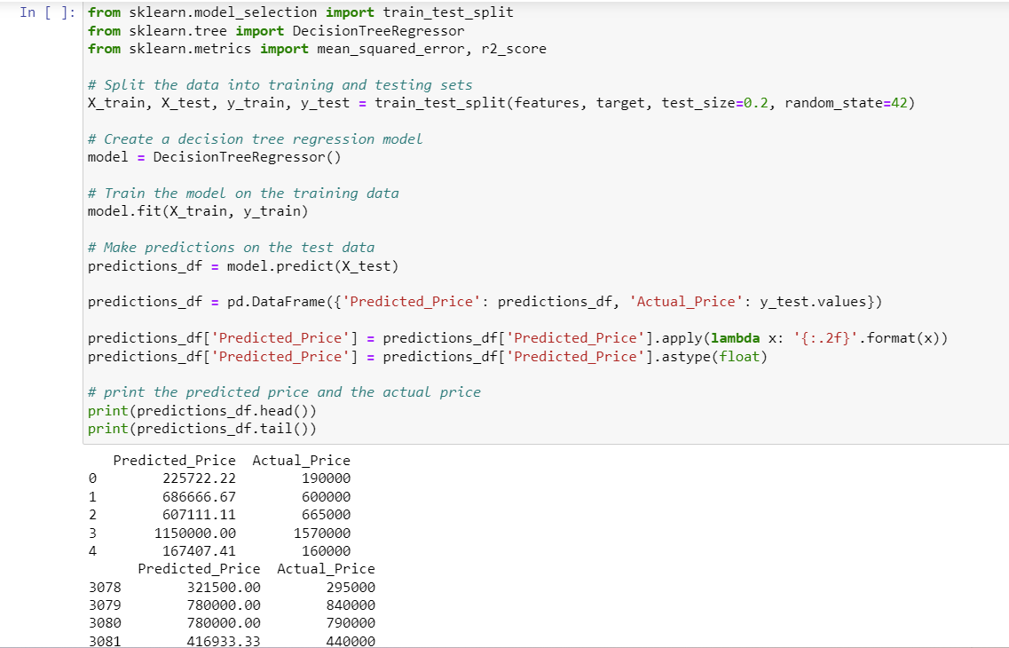
Decision Tree Model

Slide 18
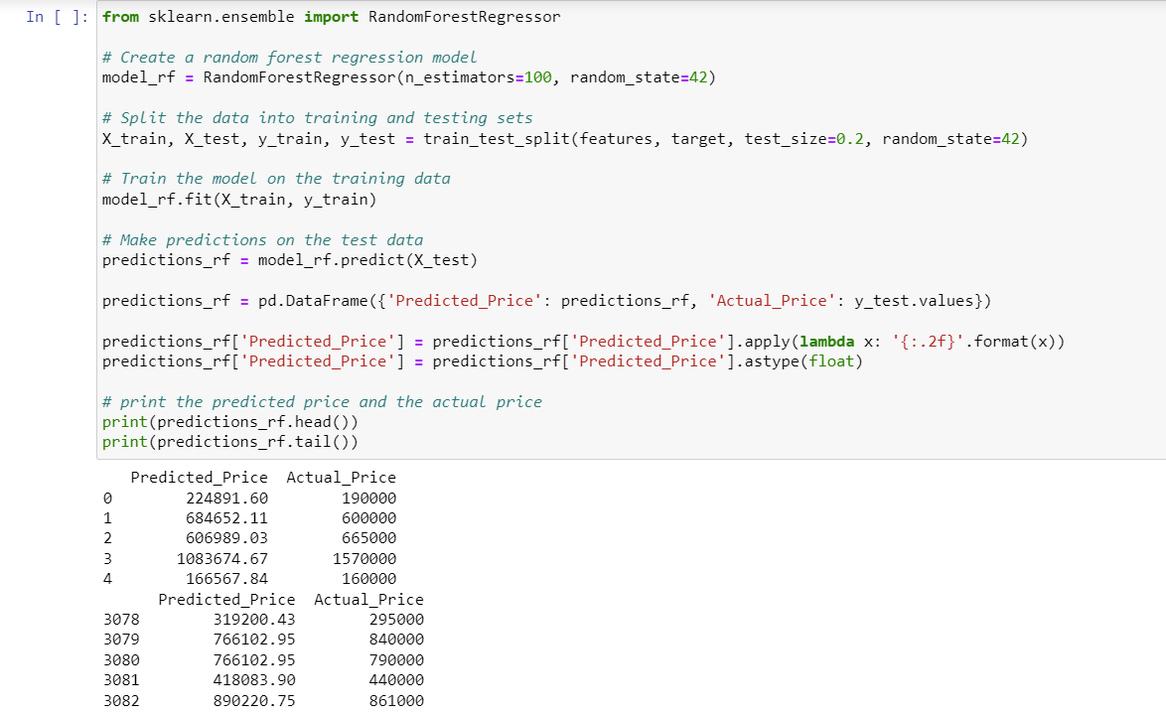
Random Forest Model

Slide 19
Key insights observed
The EDA Methodology used in the code covered data loading, Preliminary examination , data integrity and data checks and data visualization. It provided a comprehensive and visually appealing exploration of the car information dataset. It is facilitating data-driven decision making and a better understanding market dynamics.
From the Analysis we have observed that Maruti brand sells the most used cars compared to others, after that Hyundai sells most used cars and most of the cars has manual transmission rather than automatic.
Most of the cars are sold by dealers in the market and they use both petrol and diesel. Top5 most sold brands are Maruti, Hyundai, Honda, Mahindra and Toyota

Slide 20
Key insights observed
From the Heat Map we can observe that
Older Vehicles may have lower sales prices, and lower mileage.
Bigger engine capacity will cause lower mileage.
Vehicles with larger engine displacements generally have higher maximum power.
Bigger engine capacity or bigger Maxpower cause higher price.

Slide 21


Thank You
Leng Xiaofeng
Saisindhu Jammula
Mani Chandana Kilaru

