Slide 1

A Machine Learning–Based Disaster Prediction and
Impact Analysis Using a Neural – XGBoost Model
Guided by
Dr.RamKumar K
Associate Dean-Academic, SOC
Presented by
127156003-Abarna V(AIDS)
127003222-Saismiruthi M(CSE)
127003226-Sanjana A(CSE)
1
School of Computing

Slide 2
Base Paper Details
Base Paper Title : Machine Learning-Based Disaster Prediction and Impact Analysis Using Neural-XGBoost Model
Journal Name : IEEE Explore
Year of Publication : 2025
Electronic ISSN : 2169-3536
Base Paper Link : https://ieeexplore.ieee.org/document/11002470

Slide 3
Abstract
Natural disasters cause severe global damage.
Prediction is challenging due to complex and imbalanced data.
Proposed Neural-XGBoost (N-XGB) hybrid model.
Uses EM-DAT dataset with SMOTE for balancing.
Predicts floods, wildfires, and earthquakes.
Achieves 94.8% accuracy and 0.95 F1-score.
Supports disaster preparedness and decision-making.

Slide 4
Introduction
Natural disasters cause major damage to life, infrastructure, and the economy.
Climate change has increased the frequency of disasters worldwide.
Developing countries are more vulnerable due to limited resources.
Accurate prediction models are needed to reduce disaster impact.
Machine learning provides better solutions compared to traditional methods.
Hybrid machine learning models can improve prediction accuracy by capturing complex patterns in disaster data.
Early disaster prediction helps authorities in better preparedness, resource allocation, and risk management.
.

Slide 5
Literature Review
Sl.No | Paper Title | Technique Used | Merits | Limitations
1 | Flood Prediction Using Machine Learning Models: Literature Review Publisher: MDPI | Random Forest for prediction Support Vector Machine (SVM) for classification Decision Tree–based models | Good performance on structured datasets Easy to implement and interpret Suitable as baseline models | Poor performance with imbalanced data Limited ability to capture nonlinear patterns Accuracy depends heavily on dataset quality
2 | Machine Learning Techniques for Wildfire Prediction Publisher: Elsevier | Logistic Regression for prediction Random Forest for classification Gradient Boosting models | Suitable for environmental datasets Faster training and implementation Provides good baseline accuracy | Limited performance for multi-class problems Requires manual feature engineering Cannot handle missing data effectively

Slide 6
Literature Review
Sl.No | Paper Title | Technique Used | Merits | Limitations
3 | Hybrid CNN-XGBoost Model for Disaster Classification Publisher: IEEE | CNN for feature extraction XGBoost for classification Hybrid deep learning framework | Combines deep learning and ensemble learning Improved classification accuracy Better feature representation | Requires large labeled dataset Complex training process Not suitable for tabular disaster data
4 | A Hybrid Prediction Model Integrating Artificial Intelligence and Geospatial Analysis for Disaster Management Publisher: IEEE | Machine learning with geospatial analysis AI-based prediction framework Data preprocessing and feature engineering | Integrates spatial data with prediction models Improves disaster prediction accuracy Supports decision-making and planning | Requires high-quality geospatial data Computational complexity is high Performance depends on data

Slide 7
Problem Statement
Disaster datasets are imbalanced (some disasters over-represented).
Important information is often missing in datasets like EM-DAT.
Traditional models cannot capture complex nonlinear relationships.
Deep learning models require high computation and large data.
Existing hybrid models are not suitable for tabular disaster data.

Slide 8
Dataset
Dataset Name: EM-DAT (Emergency Events Database)
Provided By: Center for Research on the Epidemiology of Disasters (CRED)
Source: https://public.emdat.be/data
Type: Global disaster dataset (tabular data)
Features: Around 40–45 attributes

Slide 9
Objective
To develop a hybrid Neural-XGBoost (N-XGB) model for disaster prediction.
To handle class imbalance using SMOTE and manage missing data through preprocessing.
To improve prediction accuracy by capturing complex disaster patterns.
To compare performance with traditional machine learning models.
To support disaster preparedness, risk management, and decision-making.
To introduce Disaster Risk Score Index (DRSI) using SHAP-based explainability for risk assessment.

Slide 10
Methodology
Collect disaster data from the EM-DAT dataset.
Preprocess the data by handling missing values, encoding features, and normalizing values.
Apply SMOTE to balance the dataset.
Extract features using a Neural Network and classify using XGBoost.
Train and test the model using a 70:30 data split.
Evaluate performance using accuracy, F1-score, and other metrics.
Apply SHAP for model explainability and compute DRSI for risk scoring.

Slide 11
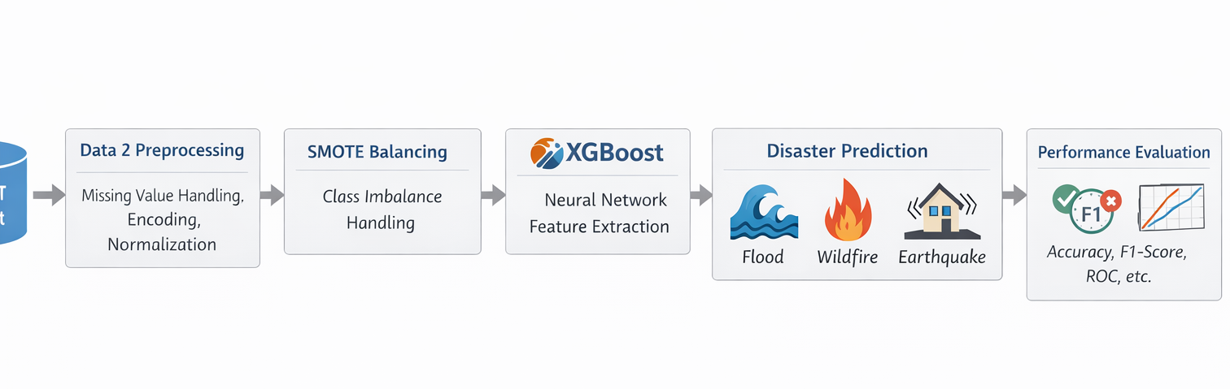
Flow diagram / System Architecture

Slide 12
List of Modules
Module 1: Literature Review & Problem Analysis – 20%
Module 2: Dataset Generation & Preprocessing – 20%
Module 3: Feature Engineering & Model Development – 25%
Module 4: Prediction & Analysis – 10%
Module 5: Performance Evaluation & Analysis – 10%
Module 6: Explainability & Risk Scoring (SHAP + DRSI) – 15%

Slide 13
Hardware and Software Requirements
HARDWARE REQUIREMENTS
Processor: Intel i5 / Ryzen 5 or above
RAM: Minimum 8 GB (16 GB recommended)
Storage: 256 GB SSD
GPU: Optional
SOFTWARE REQUIREMENTS
Python 3.8+
Jupyter Notebook / VS Code
Libraries:
NumPy
Pandas
Scikit-learn
XGBoost
TensorFlow / PyTorch
Matplotlib / Seaborn

Slide 14
Module 1
Dataset Collection & Preprocessing
The EM-DAT dataset is collected and loaded using Python Pandas library.
Example Code
df = pd.read_excel("Disaster_Datatset.xlsx")
print("Dataset Shape:", df.shape)
print("\nColumn Names:")
print(df.columns)
print("\nFirst Five Row ")
df.head()
The dataset contains information about various disasters including location, year, disaster type, and impact.

Slide 15
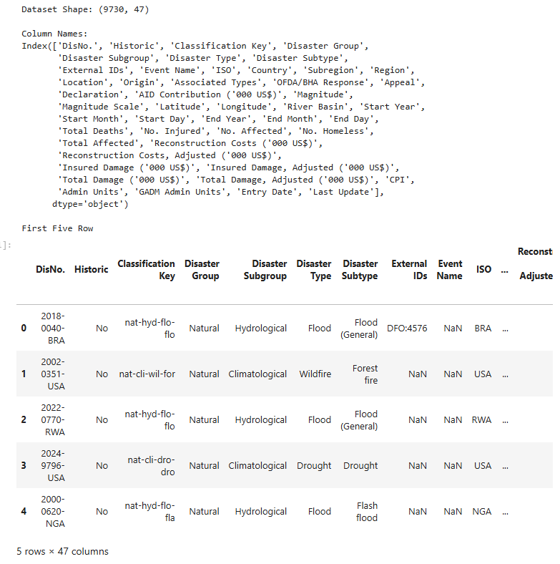
.
.

Slide 16
Module 2
Handling Missing Values
Disaster datasets contain missing values which can reduce model performance.
Steps used
Identify missing values
Remove columns with more than 80% missing data
Use median imputation to fill missing values
Example Code
# Calculate missing percentage
missing_percent = df_filtered.isnull().mean() * 100
# Identify columns with >80% missing values
cols_to_drop = missing_percent[missing_percent > 80].index
print("Columns to drop:")

Slide 17
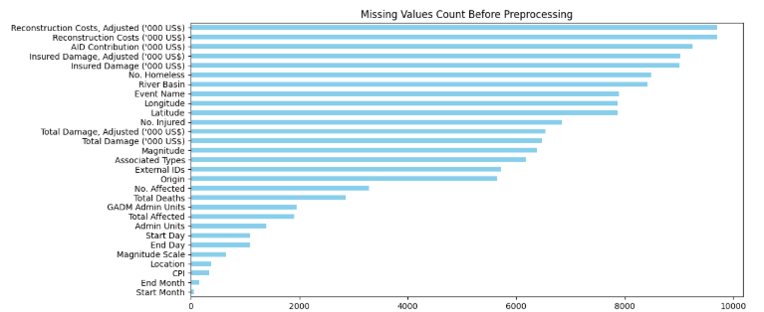
.
print(cols_to_drop)
# Drop them
df_clean=df_filtered.drop(columns=cols_to_drop)
print("\nShape after dropping columns:", df_clean.shape)

Slide 18
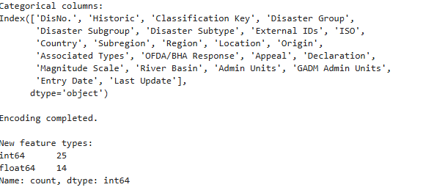
Module 3
Feature Encoding
from sklearn.preprocessing import LabelEncoder
# Encode each categorical column
encoders = {}
for col in categorical_cols:
le = LabelEncoder()
X_encoded[col] = le.fit_transform(X_encoded[col].astype(str))
encoders[col] = le

Slide 19
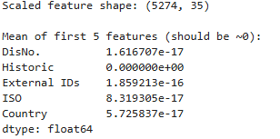
Module 3
Standardize feature
scaler = StandardScaler()
X_scaled = scaler.fit_transform(X_clean)

Slide 20
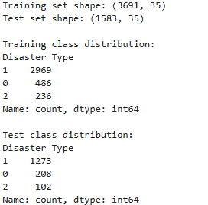
Split Test and Train
X_train, X_test, y_train, y_test = train_test_split(
X_scaled,
y,
test_size=0.30,
random_state=42,
stratify=y
)

Slide 21
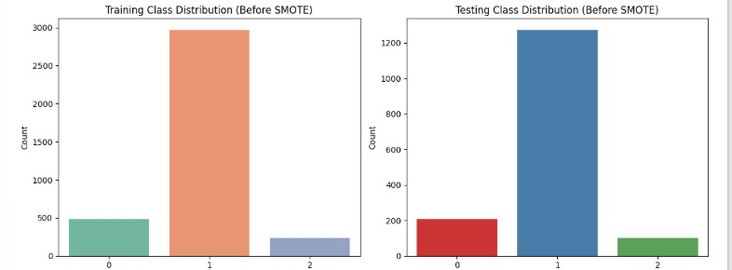
SMOTE BALANCING
BEFORE APPLYING

Slide 22
SMOTE BALANCING
AFTER APPLYING
Disaster datasets are often imbalanced where some disaster types appear more frequently.
SMOTE (Synthetic Minority Oversampling Technique) is used to balance the dataset.
Algorithm
1 Generate synthetic samples for minority class
2 Balance class distribution
3 Improve classification performance

Slide 23
Example Code
smote = SMOTE(random_state=42)
X_train_balanced, y_train_balanced =
smote.fit_resample(X_train, y_train)
print("After SMOTE - Training shape:", X_train_balanced.shape)
print("\nBalanced class distribution:")
print(pd.Series(y_train_balanced).value_counts())
plt.figure(figsize=(7,5))
sns.countplot(x=y_train_balanced, hue=y_train_balanced, palette="Set3", legend=False)
plt.title("Class Distribution After SMOTE")
plt.show()

Slide 24
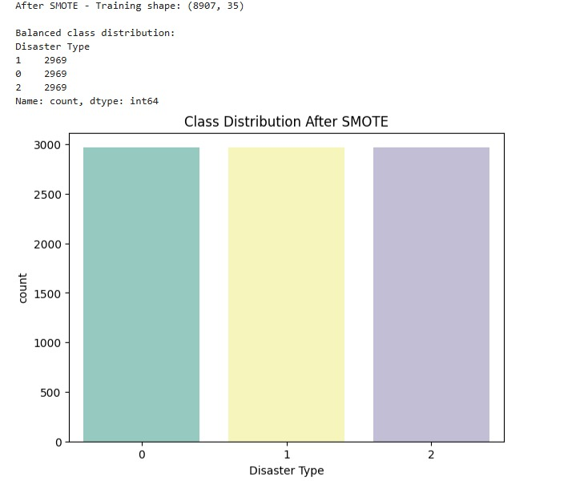
.

Slide 25
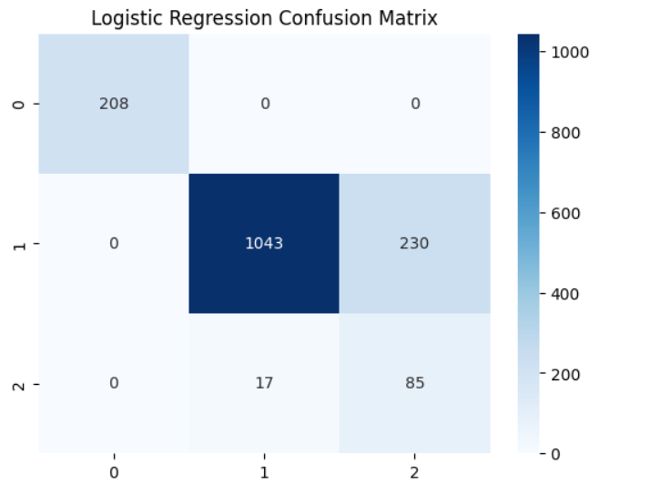
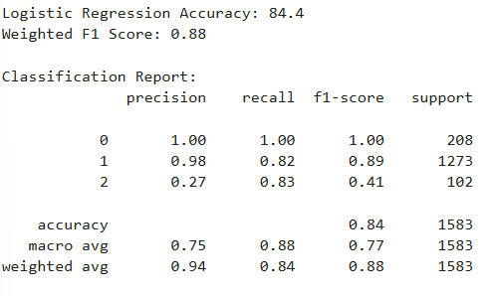
BASELINE MODEL
. Logistic Regression
from sklearn.linear_model import LogisticRegression
# Train modellog_model =LogisticRegression(max_iter=2000)
log_model.fit(X_train_balanced, y_train_balanced)

Slide 26
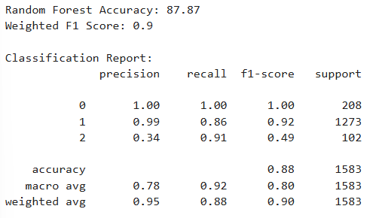
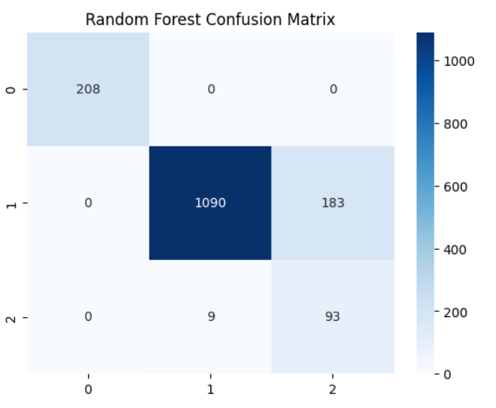
BASELINE MODEL
Random Forest
from sklearn.ensemble import RandomForestClassifier
rf_model = RandomForestClassifier(
n_estimators=60,
max_depth=5,
min_samples_split=10,
min_samples_leaf=8,
max_features=0.6,
random_state=42,
n_jobs=-1
)
# Train model
rf_model.fit(X_train_balanced, y_train_balanced)

Slide 27
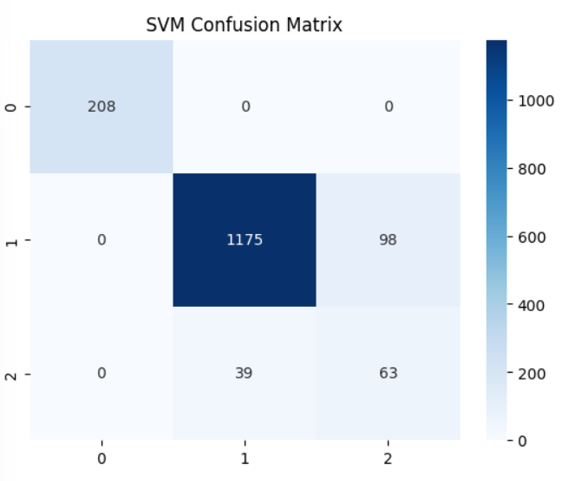
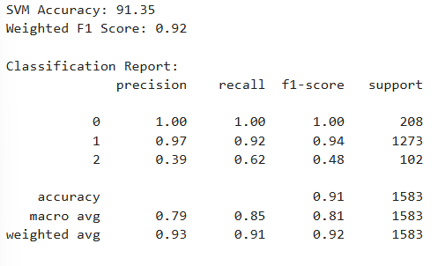
BASELINE MODEL
SVM
from sklearn.svm import SVC
svm_model = SVC(
kernel='rbf’,
C=1,
gamma='scale’
)
# Trainsvm_model.fit(X_train_balanced, y_train_balanced)

Slide 28
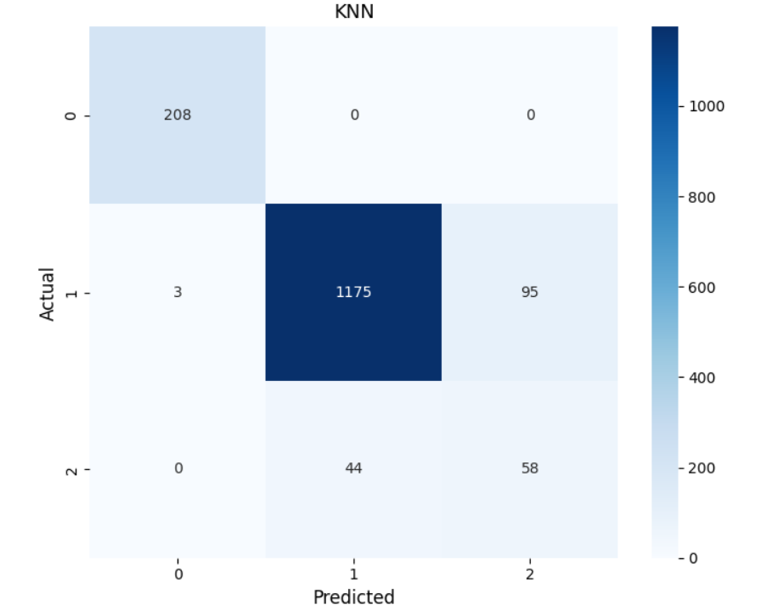
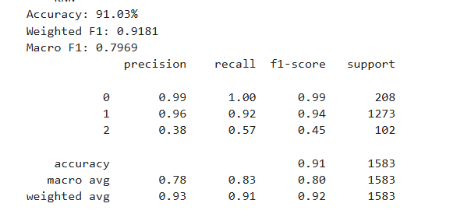
BASELINE MODEL
KNN
from sklearn.neighbors import KNeighborsClassifier
knn_model = KNeighborsClassifier(
n_neighbors=best_k,
weights='distance’)
knn_model.fit(X_train_balanced, y_train_balanced)

Slide 29
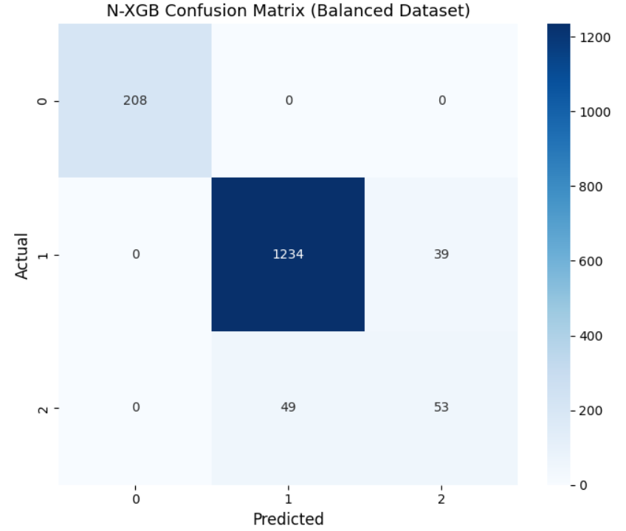
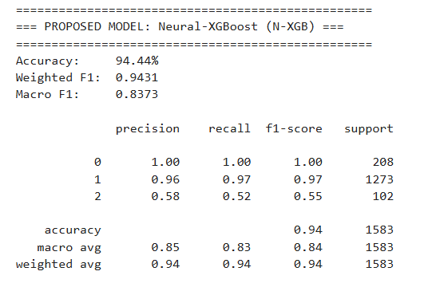
Module 4 - PROPOSED MODEL
N-XGBOOST
from xgboost import XGBClassifier
nxgb_model = XGBClassifier( n_estimators=300, max_depth=7,
learning_rate=0.05, subsample=0.8,
colsample_bytree=0.8,
objective='multi:softprob', num_class=3,
random_state=42, eval_metric='mlogloss',
use_label_encoder=False)
nxgb_model.fit(
train_embeddings,
y_train_balanced_arr,
eval_set=[(test_embeddings, y_test.values)],
verbose=False)

Slide 30
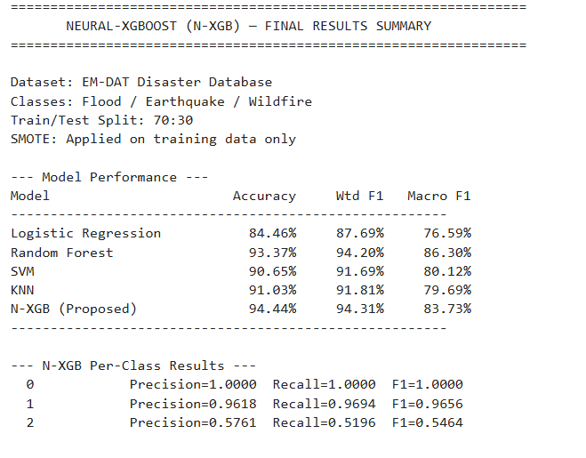
Module 5
MODAL SUMMARY

Slide 31
Module 6
Explainability & Risk Scoring
SHAP is used to explain model predictions
Identifies important features influencing disasters
Disaster Risk Score Index (DRSI) is calculated
Combines probability, SHAP values, and confidence
Provides risk levels (Low, Moderate, High, Critical)

Slide 32
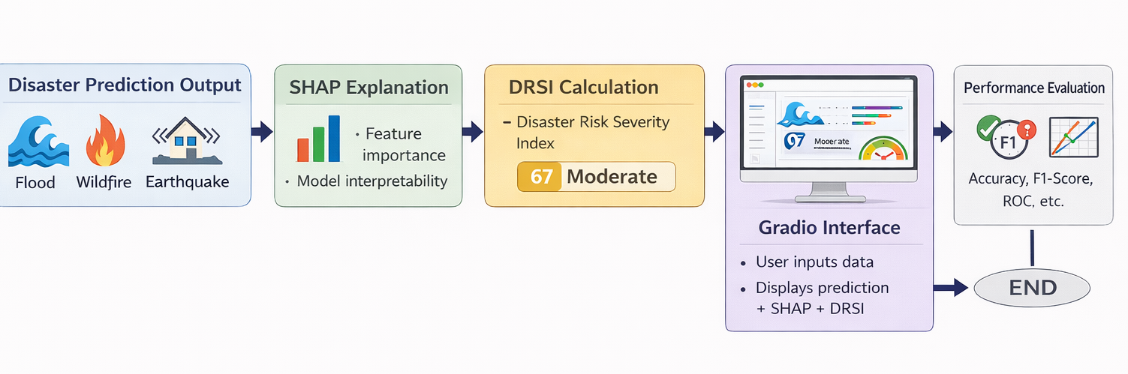
Flowdiagram
Enhanced System with Explainability & Risk Scoring

Slide 33
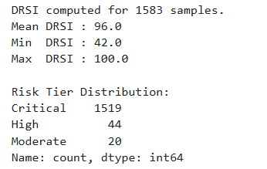
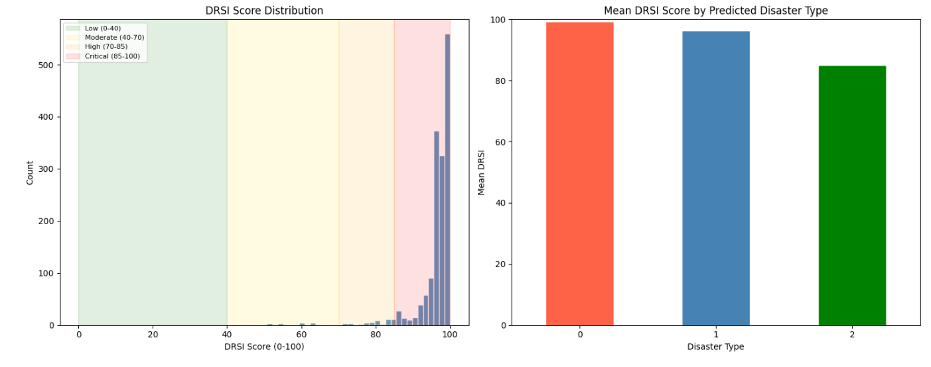
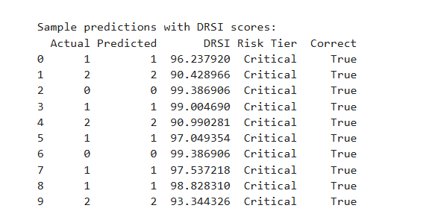
Disaster Risk Score Index (DRSI)

Slide 34
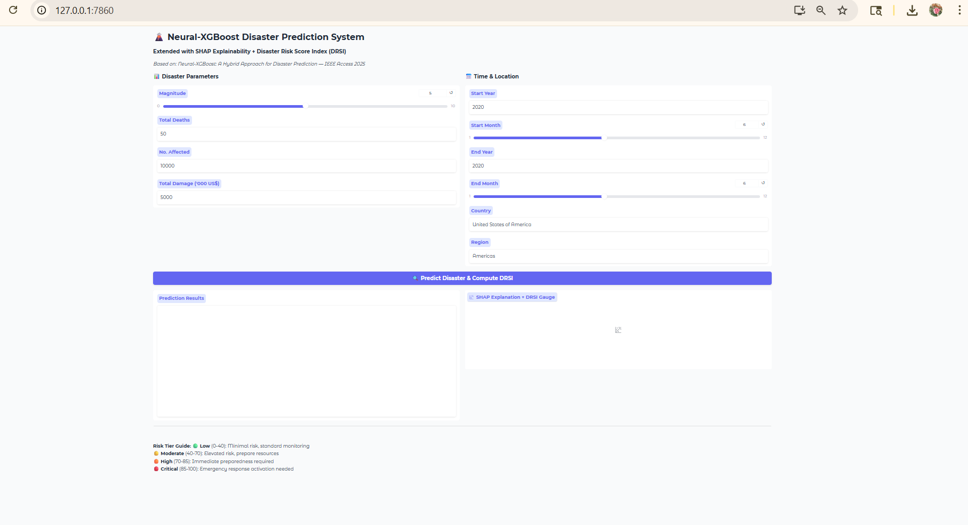
Gradio Interface
Extended with SHAP Explainability + Disaster Risk Score Index (DRSI)

Slide 35
Expected Outcome
Accurate prediction of floods, wildfires, and earthquakes
Better performance than traditional ML models
Handles imbalanced data using SMOTE
Improved feature learning using Neural + XGBoost
Reduced prediction error and higher reliability
Supports disaster management and risk assessment
Helps in better decision-making and resource allocation
Scalable model for other disaster datasets
Can be extended to real-time systems
Shows effectiveness of hybrid learning models
Provides explainable predictions using SHAP
Introduces DRSI for risk scoring

Slide 36
Work Plan
Review Period | Work Particulars | % of Work Completed
Zeroth Review | Base paper confirmation (Neural-XGBoost disaster prediction model) Problem identification (Disaster prediction and impact analysis) Hardware & Software requirement analysis Detailed literature review on disaster prediction using ML System architecture design (Dataset → ML Model → Prediction) Module identification (5-module structure) | 20%
First Review | Dataset collection from EM-DAT database Data preprocessing and normalization Handling missing values and SMOTE balancing | 60%

Slide 37
Work Plan
Review Period | Work Particulars | % of Work Completed
First Review | Neural Network implementation for feature extraction XGBoost model development and initial training | 60%
Second Review | Complete hybrid model implementation Disaster prediction and classification (Flood, Wildfire, Earthquake) Performance evaluation (Accuracy, Precision, Recall, F1-score) Comparative analysis with traditional ML models Result visualization and analysis Adding the novelty include s explainable predictions using SHAP. Introduces a new risk scoring system (DRSI). | 100%

Slide 38
References
M. A. Saleem, W. Benjapolakul, W. Srisiri, S. Chaitusaney, and P. Kaewplung, “A hybrid prediction model integrating artificial intelligence and geospatial analysis for disaster management,” IEEE Access, vol. 13, pp. 43716–43727, 2025.
J. T. Thirukrishna, “An enhanced discovery of multiple natural disasters using machine learning model,” Earth Sci. Informat., vol. 18, no. 3, p. 324, Sep. 2025.
C. I. Donatti, K. Nicholas, G. Fedele, D. Delforge, N. Speybroeck, P. Moraga, J. Blatter, R. Below, and A. Zvoleff, “Global hotspots of climate-related disasters,” Int. J. Disaster Risk Reduction, vol. 108, Jun. 2024, Art. no. 104488.

Slide 39
THANK YOU !

