Slide 1

Bapatla Engineering College :: Bapatla, (Autonomous)
Department of Computer Science and Engineering
A NEURAL IMAGE CAPTION GENERATOR
Batch C1:
S. Sai Sree (Y20ACS553)
Y. Pravallika (Y20ACS591)
Y. Santhoshini (Y20ACS592)
Guide:
Dr. Nagalla Sudhakar

Slide 2
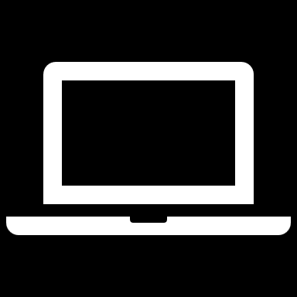
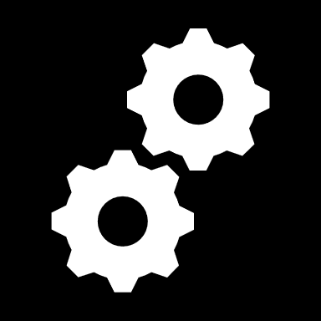


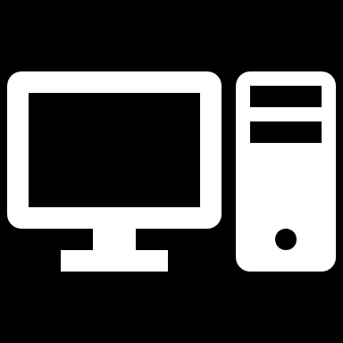

Problem
Statement
Knowledge on the problem domain
Existing System
Proposed System
Design Methodology
CONTENTS
Implementation
Result
Conclusion

Slide 3
Abstract
The aim of image captioning is to generate textual description of a given image.​
From images humans can understand the information accurately.
In the same way creating a generative model with the help of computer vision and natural language processing that can generate natural language sentences describing the given image.

Slide 4
Existing Methodology
Techniques of Pre-trained Convolutional Neural Networks and a type of Recurrent Neural Network are combined together for image captioning.
CNN acts as an encoder that maps input images to a fixed-length feature vector.
The feature vector combined with the caption text which is fed to the RNN are passed through fully connected layers.
RNN acts as a decoder to decode the fixed-length vector into a caption.

Slide 5
Existing Methodology
RNN has some drawbacks:
Vanishing Gradient Problem and Limited Short-Term Memory, it makes challenging for RNNs to capture long-range dependencies in sequential data.
To over come this problems we use LSTM and GRU.
These have gated architecture that allows the network to selectively remember or forget information over long sequences.

Slide 6
Proposed System
Performing neural image captioning using different pre-trained CNN models combined with different NLP models and analyzing the perform of each of the combinations.
Pretrained models like VGG16, Xception, Densenet.
NLP models like LSTM and GRU.
Further, we worked on Attention Mechanism.

Slide 7
Proposed System
CNN Pre-trained models:
VGG16
Xception
DenseNet
NLP models:
LSTM
GRU
Attention + GRU

Slide 8
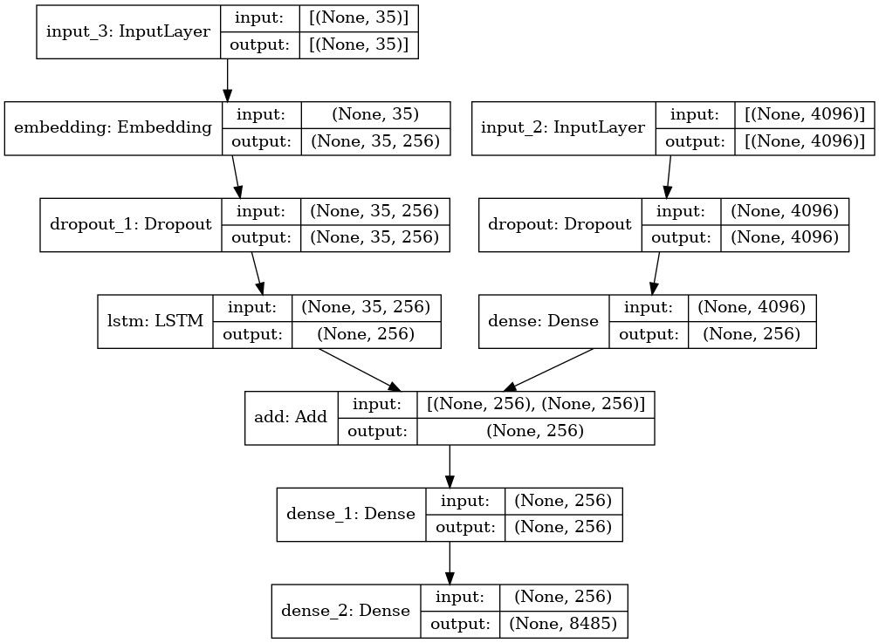
Proposed System
Pretrained CNN model and NLP model are used.
The caption text is fed to the LSTM.
The feature vector combined with the words from LSTM are passed through fully connected layers.
CNN+LSTM Structure

Slide 9
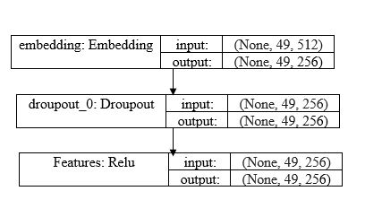
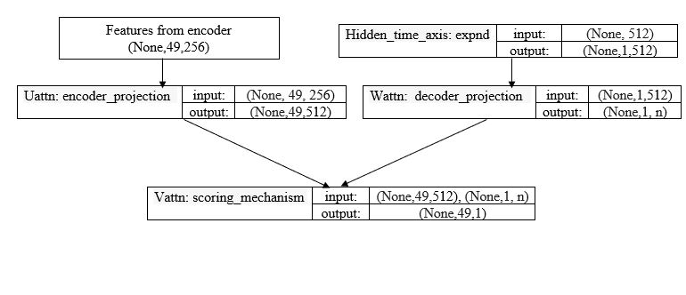
Proposed System
The encoder will extract the features from the image.
That features are fed to the attention layer Uattn and the Wattn takes the word from hidden layer.
The Vattn performs addition of Uattn and Wattn outputs.
The Vattn gives the scores and by applying softmax function to its output we get Attention weights.
Features from encoder
Attention Layers

Slide 10
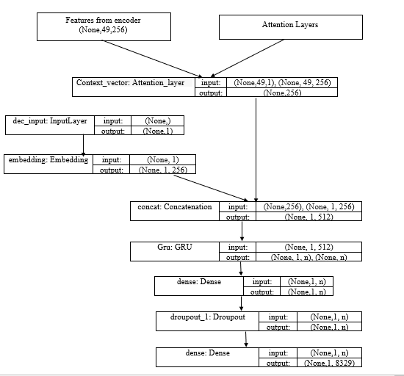
Proposed System
That features and attention weights are multiplied giving context vector.
The context vector and words from decoder are concatenated and fed to GRU followed by fully connected layers.
Finally it generates a word in each time step.
CNN+Attention+GRU

Slide 11
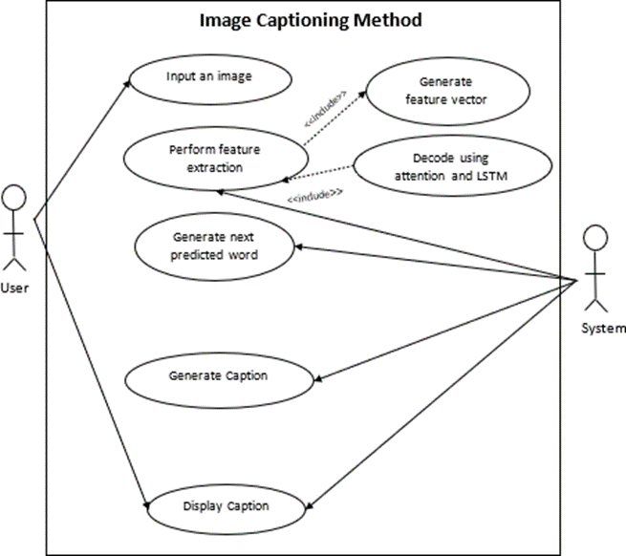
Design Methodology
UseCase Diagram

Slide 12
Implementation
Import all the necessary packages
Getting and performing data cleaning
Identifying Length of Descriptions and Vocabulary
Extracting the feature vector from all images
Loading dataset for Training the mode
Tokenizing the vocabulary
Creating Data generator
Training Section
Testing the model
https://github.com/Saisree5/A-neural-image-caption-generator.git

Slide 13
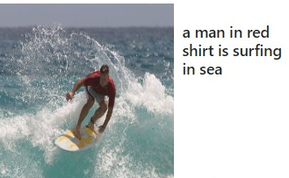
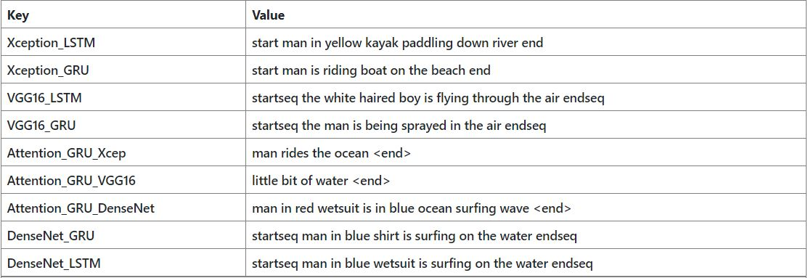
RESULT
For consideration, various images have been subjected to testing, and the results can be seen in the following image.

Slide 14
It generates captions for any image in 9 different methods and provides which one is best.
In this Attention+GRU+DenseNet gives relevant caption, based on human evaluation.
To Assess the performance of model prediction , there are various metrics.
BLEU (Bilingual evaluation understudy)
METEOR(Metric for Evaluation of Translation with Explicit Ordering)
Bleu Score is a metric for automatically evaluating machine-translated text , and to see which one provides maximum accuracy ,the Bleu score is number between 0 and 1.
Meteor score is a metric used to evaluate machine translation by comparing it to human translations.it takes both accuracy and fluency of the translation , as well as the order in which words appear.it ranges from 0 to 1 .

Slide 15
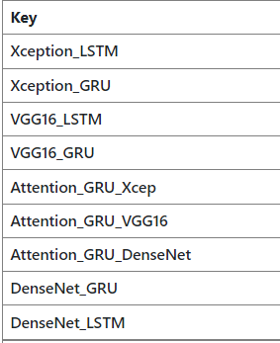
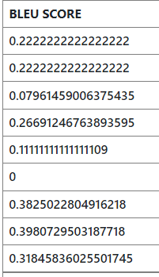
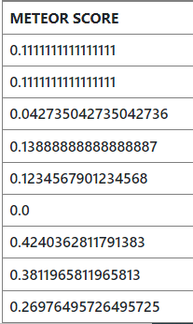
Performance Scores on above Image:
When compared to other models , Attention_GRU_DenseNet gives more relevant caption based on its performance metrics.

Slide 16
Conclusion
From our experiments and their evaluation with the help of performance metrics we conclude that.
In NLP Models Attention + GRU gives best caption , And in pretrained models DenseNet give better performance.
So the method with Attention+GRU+DenseNet gives more relevant caption compared to other methods in most of the cases.

Slide 17
Future Scope
As we generate captions for images, we can further explore on generating captions from videos when the speech is not clearly and from the audios to help non-native speakers of a language.

Slide 18
Thank you

