Slide 1

NAME: SAJJA SAI SREE
REGNO: Y20ACS553
BRANCH: CSE
SECTION: C

Slide 2
ABSTRACT
This paper discusses the often overlooked issues and key vulnerabilities evident in Web facing technologies. The process of uncovering these issues and vulnerabilities is known as footprinting. As the part of internship, I choose a random website for my project “FOOTPRINTING”. We can only perform hacking only the website having loop holes or vulnerabilities. Through the process of checking for the website having open ports, I got the restaurant website of WEEBLY ONLINE SHOPPING COMPANY. To find vulnerabilities we use Sam Spade, nslookup, traceroute, Nmap and neotrace tools.
Keywords:
Reconnaissance, Whois Tool, Nmap Tool, Sam Spade Tool , Trace route , Scanning

Slide 3
Existing Systems:
Footprinting websites:
google.com
netcraft.com
whois.net
technicalinfo.net
archive.org
networktools.com
mailtracking.com
whoreadme.com
Software of footprinting:
Dns Data View
Domain hosting View
Samspade
ID Serve
IP2coountry
Path Analyzer Pro
Email Tracker Pro
Web Data Exractor

Slide 4
Tools and Techniques:
TOOLS
Sam Spade
neotrace
nslookup
traceroute
Nmap
TECHNIQUES
DNS queries
Network enumeration
Network queries
Operating system identification

Slide 5
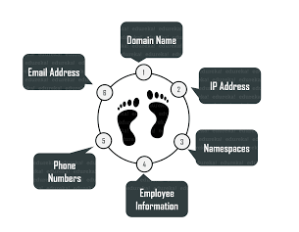
PROPOSED SYSTEMS
Objectives of Foot Printing:
To gather information about
The domain name of an organization
IP Address of servers
Operataing System of the server
Applications used on the server
Location of the servers
Employee details of the organization
Email ID,contact number & social network profiles of key employees etc.

Slide 6
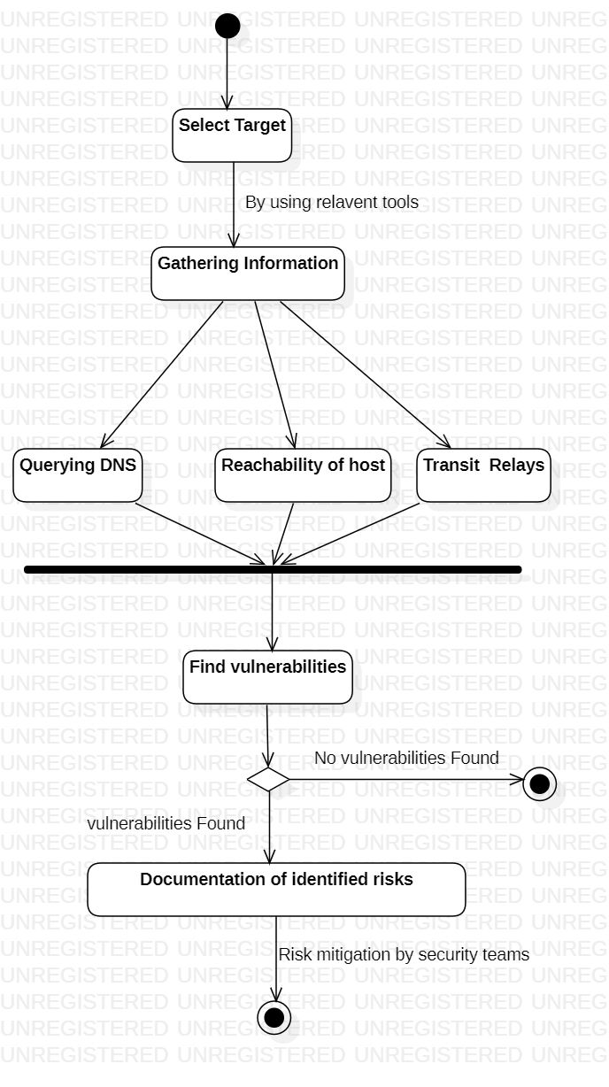
HIGH LEVEL DESIGN

Slide 7
TARGET: WEEBLY ONLINE SHOPPING COMPANY
Name of the TARGET weebly.com
IP Address 74.115.50.109
IP Location United States – California – San Francisco – Weebly Inc.

Slide 8
CODE
Z:\>ping 74.115.50.109
Pinging 74.115.50.109 with 32 bytes of data:
Reply from 74.115.50.109: bytes=32 time=235ms TTL=49
Reply from 74.115.50.109: bytes=32 time=234ms TTL=49
Reply from 74.115.50.109: bytes=32 time=239ms TTL=49
Reply from 74.115.50.109: bytes=32 time=234ms TTL=49
Ping statistics for 74.115.50.109:
Packets: Sent = 4, Received = 4, Lost = 0 (0% loss),
Approximate round trip times in milli-seconds:
Minimum = 234ms, Maximum = 239ms, Average = 235ms

Slide 9
Z:\>tracert www.weebly.com
Tracing route to weebly.com [74.115.50.110]
over a maximum of 30 hops:
1 <1 ms <1 ms <1 ms 172.16.0.1
2 1 ms 1 ms 1 ms 117.239.150.74
3 11 ms 11 ms 12 ms 117.216.207.214
4 * * * Request timed out.
5 248 ms 248 ms 256 ms xe-4-4-3-0.a04.lsanca07.us.bb.gin.ntt.net [168.143.105.232]
6 * * * Request timed out.
7 270 ms 257 ms 255 ms ae-3.r24.snjsca04.us.bb.gin.ntt.net [129.250.4.150]
8 258 ms 258 ms 258 ms ae-3.r05.plalca01.us.bb.gin.ntt.net [129.250.4.43]

Slide 10
9 228 ms 228 ms 228 ms xe-0-1-0-2-7.r05.plalca01.us.ce.gin.ntt.net [129.250.197.218]
10 228 ms 228 ms 228 ms core1-a-edge1-a.sf2p.weebly.net [74.115.50.158]
11 231 ms 231 ms 231 ms www.weebly.com [74.115.50.110]
Trace complete.
Z:\>nslookup
Default Server: win2012.win2k18.local
Address: 10.2.2.22
> set type=a
> www.weebly.com

Slide 11
Server: win2012.win2k18.local
Address: 10.2.2.22
Non-authoritative answer:
Name: weebly.com
Addresses: 74.115.50.110
74.115.50.109
Aliases: www.weebly.com
> exit

Slide 12
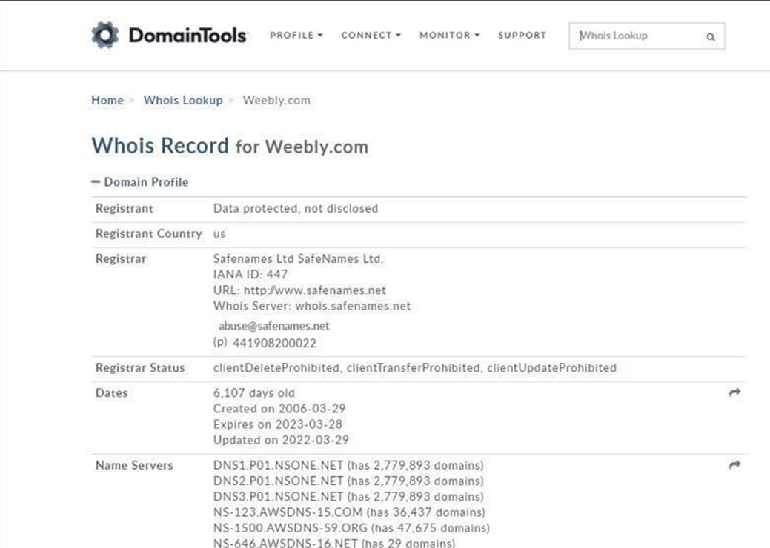
WHOIS
Location: US
Name Servers
Dates:
Creation
Expired
Updated

Slide 13
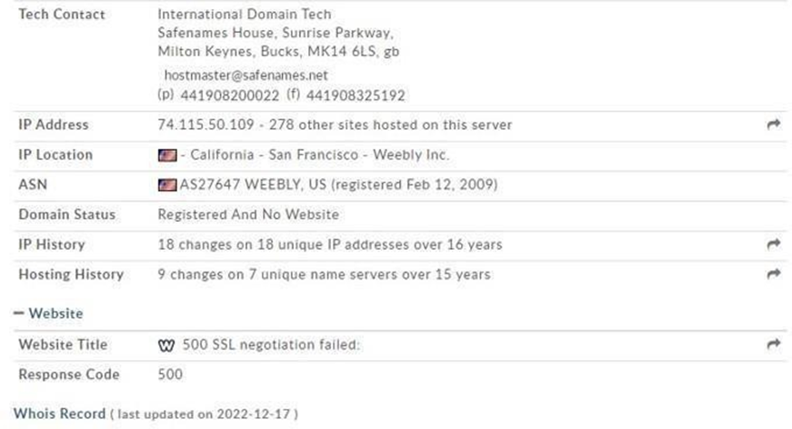
IP Address
IP Location
IP History
Hosting History

Slide 14
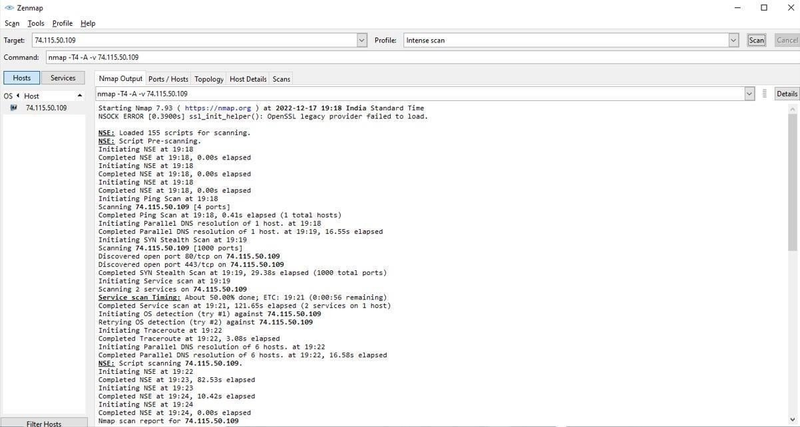
NMAP
Pre-Scanning
Service Scan
NSE

Slide 15
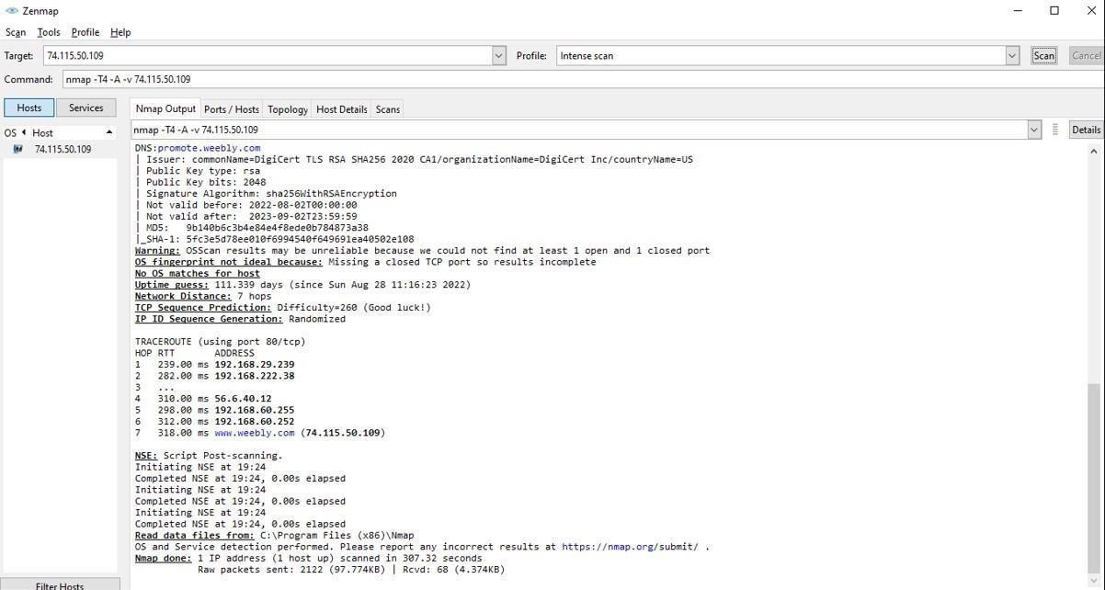
DNS
Trace Route

Slide 16
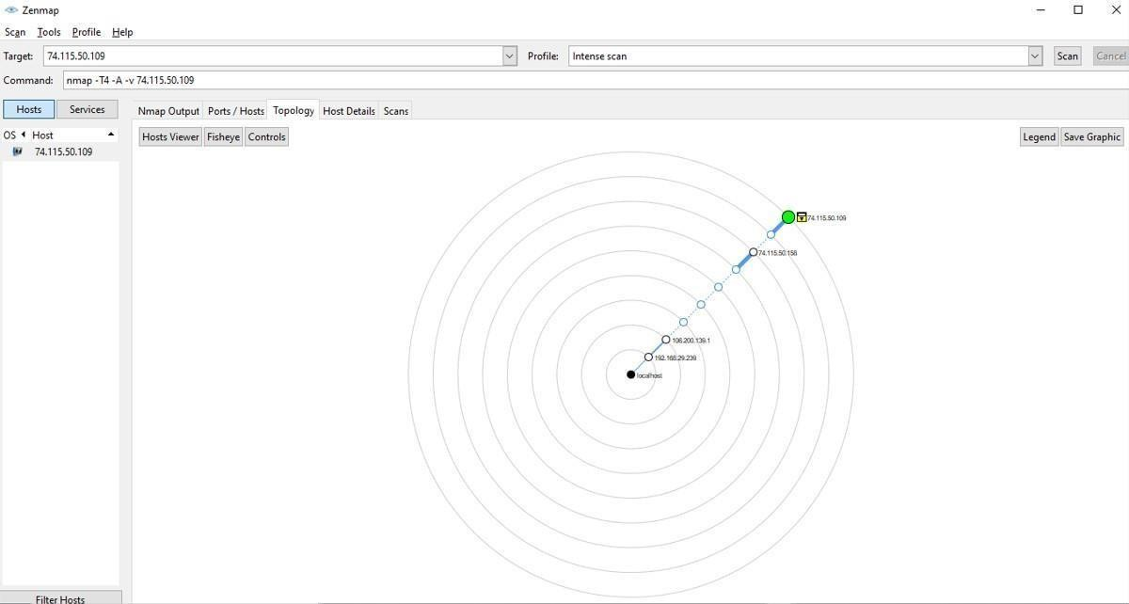
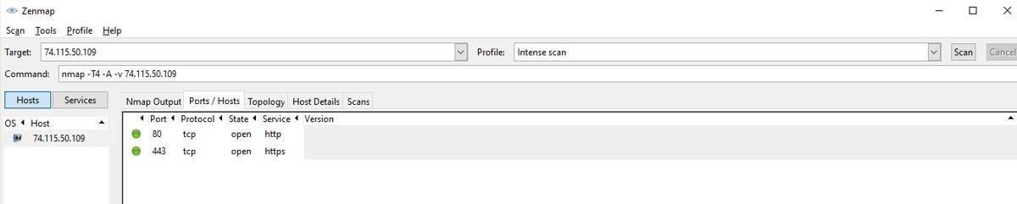
Topology
Ports/Hosts:

Slide 17
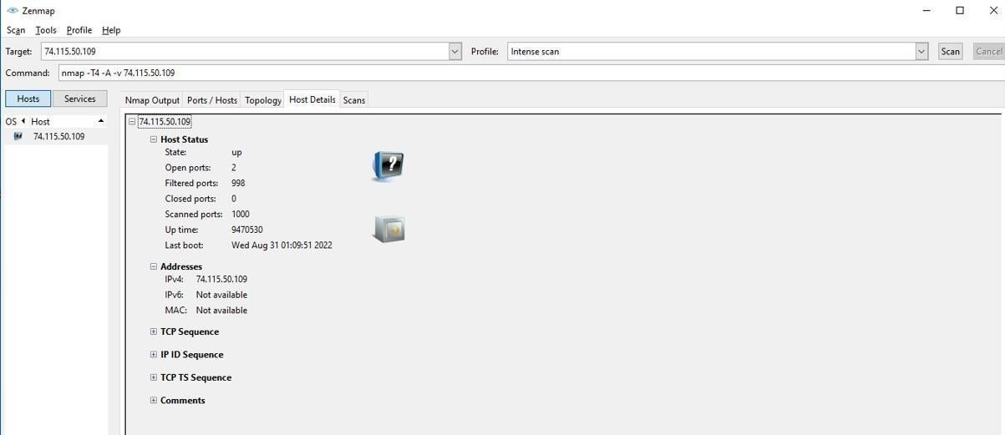
Host Details:

Slide 18
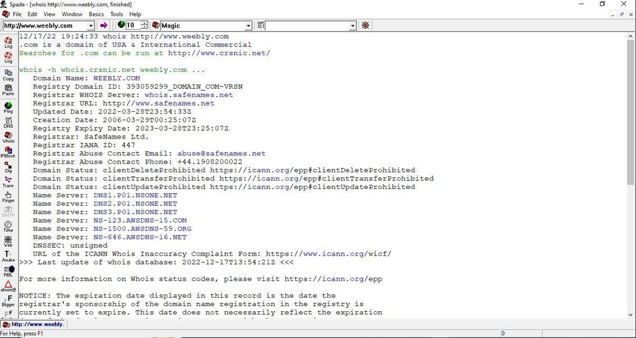
SamSpade
WHOIS :

Slide 19
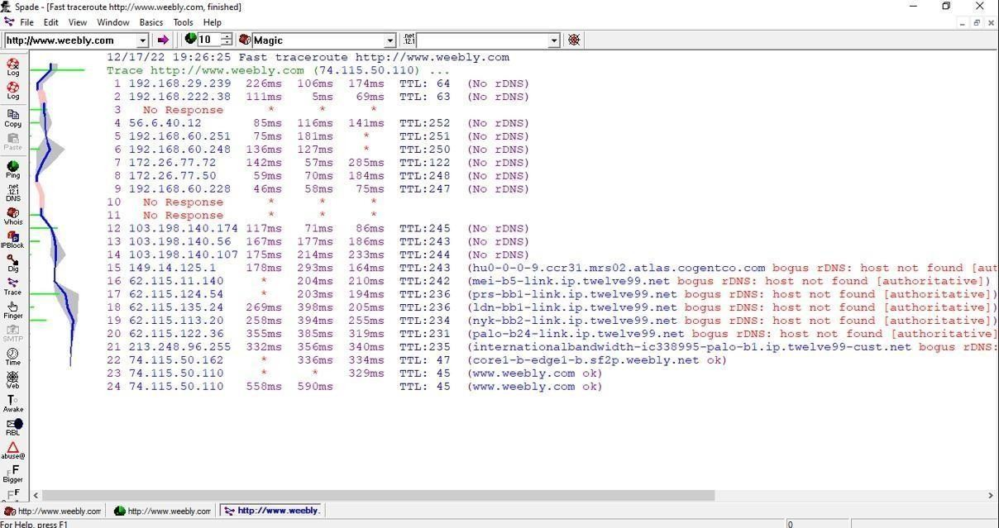
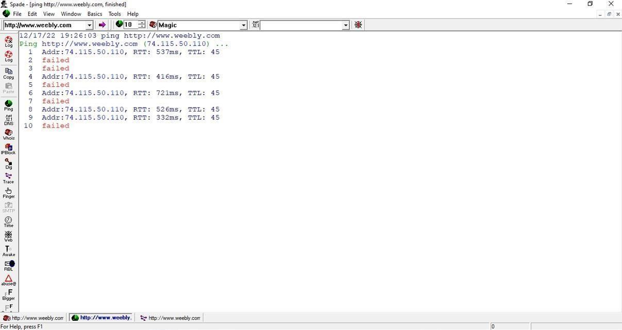
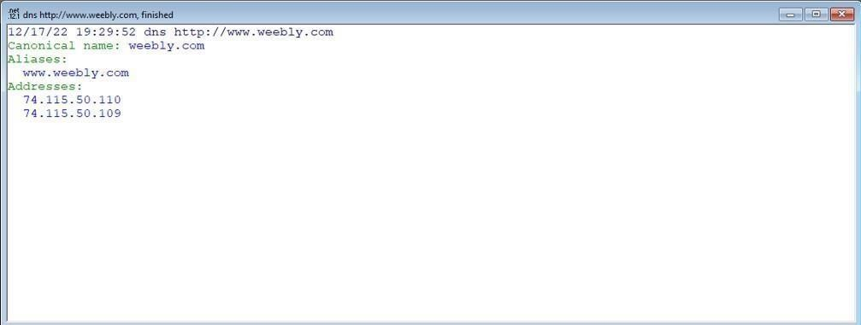
Ping
Trace
DNS

Slide 20
COnclusion
In conclusion, footprinting is an important process in cybersecurity that involves gathering information about a target system or network. It helps assess vulnerabilities, identify potential attack surfaces.During the footprinting process, we use search engines, social media platforms, WHOIS databases, DNS enumeration, and web archive services to gather information about the target. These systems provide valuable insights and publicly available data that can be analyzed to understand the target's digital footprint.
The footprint analysis is used to guide decision-making and risk mitigation strategies and it is important to note that footprinting should always be conducted ethically and legally.

Slide 21
References
GeeksforGeeks. (2021, October 20). Ethical hacking | Footprinting. https://www.geeksforgeeks.org/ethical-hacking-footprinting/
Ghahrai, A. (2019, July 9). Footprinting and reconnaissance. DevQA.
https://devqa.io/footprinting-overview/
Github:https://github.com/Samsar4/Ethical-Hacking-Labs/blob/master/1-Footprinting-and-Reconnaissance/1-Windows-CommandLine.md

Slide 22
THANK YOU

