Slide 1

Multi-Agent AI Business Assistant for Intelligent Enterprise Workflow Automation
Major Project Review - 1
Batch ID:AIML- C05
Project Guide
Project Batch Members
Dr. Nuthi Raju
Professor, AIML, VVIT
Thulluru Sai Sree – 23BQ1A61D8
Regalagadda Bhanu Prakash – 23BQ1A61B8
Sowdagar Thabasum – 23BQ1A61D3
Vankodoth Bhagavan Naik – 23BQ1A61E7

Slide 2
Multi-Agent AI Business Assistant for Intelligent Enterprise Workflow Automation
Guide: Dr. Nuthi Raju
Batch ID: C05
Regd No:23BQ1A61D8, Regd No:23BQ1A61B8 Regd No:23BQ1A61D3, Regd No:23BQ1A61E7
Content:
Problem Statement
Proposed Method
Real-World Example
Literature Review
  Ref 01 – DeCoAgent: LLM Empowered Decentralized Collaboration Agents
  Ref 02 – An Explainable AI Multi-Agent Recommender System
  Ref 03 – Hybrid Multi-Agent GraphRAG for E-Government
Literature Review Summary
Conclusion

Slide 3
Multi-Agent AI Business Assistant for Intelligent Enterprise Workflow Automation
Guide: Dr. Nuthi Raju
Batch ID: C05
Regd No:23BQ1A61D8, Regd No:23BQ1A61B8 Regd No:23BQ1A61D3, Regd No:23BQ1A61E7
Problem statement:
Most of the tasks performed within an organization involve collaboration across multiple departments within an organization. But current automation and AI solutions fail to solve this problem since traditional automation solutions are inflexible, single AI assistants are not aware of the business context, and multi-agent AI solutions do not offer the necessary security and compliance capabilities for enterprises. Thus, most organizations still use manual coordination, which results in low efficiency and waste of resources.
Example: Employee Onboarding
In case of onboarding a new employee, there are several teams that should cooperate:
The HR department prepares contracts and manages the employee records.
The IT department creates an email account and configures the device and access to software.
The finance department deals with payroll and banking information.
Nowadays, such operations require managers to coordinate them manually via emails and follow-ups, since the existing automation solutions cannot handle this operation securely and efficiently enough. Our architecture provides a solution to this problem through collaboration across departments.

Slide 4
Multi-Agent AI Business Assistant for Intelligent Enterprise Workflow Automation
Guide: Dr. Nuthi Raju
Batch ID: C05
Regd No:23BQ1A61D8, Regd No:23BQ1A61B8 Regd No:23BQ1A61D3, Regd No:23BQ1A61E7
Proposed Method
Rather than attempting to create one generalized AI chatbot that is prone to becoming confused and overwhelmed by a complex request, our proposed solution operates precisely in the same way as a typical corporate workforce.
We are developing a network of collaborative AI systems. Once the user posts his or her complex task, the Intent Routing Engine, which plays the role of a dispatcher, will break the complex task into simple subtasks. There is the Coordinator Agent, which will play the role of a project manager and assign the subtasks to Six Specialized AI Agents (HR Agent, Finance Agent, Coding Agent).
All the agents will perform their tasks in parallel and communicate via a secure "message bus." Since this solution is intended to be used by enterprises, the agents will not have unlimited access to all the information but only to their specialized tools. Finally, the Execution Logger will record every action of the agents.

Slide 5
Multi-Agent AI Business Assistant for Intelligent Enterprise Workflow Automation
Guide: Dr. Nuthi Raju
Batch ID: C05
Regd No:23BQ1A61D8, Regd No:23BQ1A61B8 Regd No:23BQ1A61D3, Regd No:23BQ1A61E7
The Real-World Example
Consider how the architecture works when applied to a real enterprise task, which is Employee Onboarding.
For example, consider the prompt from the manager that sounds like "Initiate the process of onboarding of our new developer Alice."
Decomposition: The Intent Routing Engine gets the prompt and understands that the process involves multiple departments.
Parallel Execution: The Coordinator assigns the tasks to the specific agents simultaneously.
HR Agent checks the employment information of Alice in the HR database.
Finance Agent uses a special payroll application to create the salary profile of the employee.
Coding Agent signs into the IT system to establish Alice's AWS and GitHub accounts.
Synchronization: The Coordinator gets reports from the agents as soon as they finish their jobs.
Final Action: Once HR, Finance, and IT processes are done, the Coordinator triggers the Email Agent to compose and send an email with the credentials of Alice and a welcome note.
The Outcome: The human manager receives one simple prompt saying "Alice is onboarded" with a log of all actions that the AI completed.

Slide 6
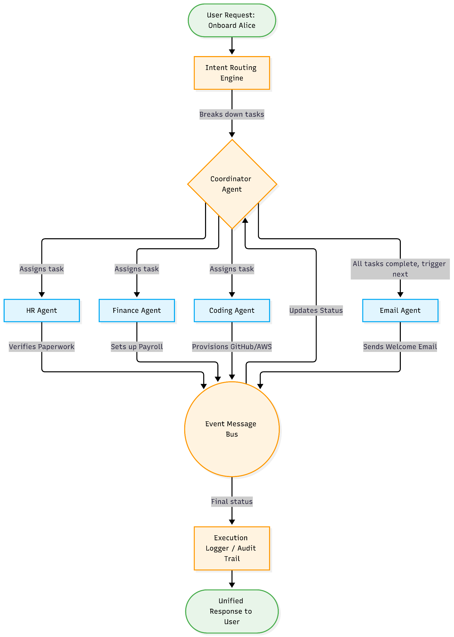
Multi-Agent AI Business Assistant for Intelligent Enterprise Workflow Automation
Guide: Dr. Nuthi Raju
Batch ID: C05
Regd No:23BQ1A61D8, Regd No:23BQ1A61B8 Regd No:23BQ1A61D3, Regd No:23BQ1A61E7
Fig : Workflow for The Real-World Example

Slide 7
Multi-Agent AI Business Assistant for Intelligent Enterprise Workflow Automation
Guide: Dr. Nuthi Raju
Batch ID: C05
Regd No:23BQ1A61D8, Regd No:23BQ1A61B8 Regd No:23BQ1A61D3, Regd No:23BQ1A61E7
Literature Review
Ref 01 – DeCoAgent: LLM Empowered Decentralized Collaboration Agents
Jin et al., 2024 | IEEE Access
| Proposed Method | Data & Setup | key Results | Strengths & Limitations | Relevance to my research |
The Core Concept
In DeCoAgent, the process of interaction is decentralized multi-agent and involves cooperation of AI agents via blockchain and smart contracts rather than centralized controller. It aims at achieving secure and autonomous cooperation of AI agents under conditions of low trust between participants.
Process of Work:
User provides a task to the system.
Task is announced using blockchain via smart contract.
AI agents find out about the task and choose tasks to perform based on their competencies.
Agents perform their tasks and return results.
Results are verified by other agents, and all actions are written to the blockchain.
Result is permanently saved.

Slide 8
Multi-Agent AI Business Assistant for Intelligent Enterprise Workflow Automation
Guide: Dr. Nuthi Raju
Batch ID: C05
Regd No:23BQ1A61D8, Regd No:23BQ1A61B8 Regd No:23BQ1A61D3, Regd No:23BQ1A61E7
Literature Review
Ref 01 – DeCoAgent: LLM Empowered Decentralized Collaboration Agents
Jin et al., 2024 | IEEE Access
| Proposed Method | Data & Setup | key Results | Strengths & Limitations | Relevance to my research |
Strengths
Limitations
No Single Point of Failure: Since the system is fully decentralized through the blockchain, even if one node fails, the system continues to work.
Immutably Transparent: All actions carried out by agents are logged immutably into the blockchain.
High Cost & Delay: Blockchain transactions and smart contracts can slow down task execution and increase operational costs.
Less Flexible: Updating workflows is difficult because smart contracts are not easily modified after deployment.
Privacy Concerns: Storing workflow information on a decentralized ledger may pose risks for sensitive enterprise data.
No Central Coordinator: Without a dedicated orchestrator, managing complex multi-step workflows can become inefficient and lead to delays.

Slide 9
Multi-Agent AI Business Assistant for Intelligent Enterprise Workflow Automation
Guide: Dr. Nuthi Raju
Batch ID: C05
Regd No:23BQ1A61D8, Regd No:23BQ1A61B8 Regd No:23BQ1A61D3, Regd No:23BQ1A61E7
Literature Review
Ref 02 – An Explainable AI Multi-Agent Recommender System
Toudas et al., 2026 | Information Systems Frontiers
| Proposed Method | Data & Setup | key Results | Strengths & Limitations | Relevance to my research |
The Core Concept
The key concept of this paper is the development of an Explainable AI Multi-Agent System for making secure and transparent document access-control decisions in the financial sector. In contrast to the usual design, which involves the usage of one AI model, the proposed system employs multiple AI agents designed to perform different tasks and make decisions.
Process of Work:
Financial document submission to the system.
All three specialist AI agents process the input document separately.
They predict the level of document sensitivity (Public, Internal, Confidential, or Restricted).
All predictions are collected by the orchestrator, and it reasons about them.
It makes the final decision on document classification.
What is more important, it makes the explainable reasoning about the decision made.

Slide 10
Multi-Agent AI Business Assistant for Intelligent Enterprise Workflow Automation
Guide: Dr. Nuthi Raju
Batch ID: C05
Regd No:23BQ1A61D8, Regd No:23BQ1A61B8 Regd No:23BQ1A61D3, Regd No:23BQ1A61E7
Literature Review
Ref 02 – An Explainable AI Multi-Agent Recommender System
Toudas et al., 2026 | Information Systems Frontiers
| Proposed Method | Data & Setup | key Results | Strengths & Limitations | Relevance to my research |
Strengths
Limitations
High Transparency: Provides clear, human-readable explanations for every access-control decision.
Supports Compliance: Helps organizations meet regulatory and auditing requirements.
Collaborative Decision-Making: Multiple AI agents work together, improving decision reliability.
Reduces Black-Box Decisions: Auditors and managers can understand and verify the reasoning behind classifications.
Improved Accuracy: Combines outputs from multiple models to make more trustworthy decisions.
Domain-Specific: Designed only for financial document classification and access control.
No Cross-Department Collaboration: Cannot coordinate tasks across HR, Finance, IT, Email, or other departments.
Recommendation-Based: Suggests decisions but does not execute tasks automatically.
Limited Enterprise Automation: Not suitable for managing complete business workflows from start to finish.
Restricted Scope: Focuses on access-control decisions rather than general business operations.

Slide 11
Multi-Agent AI Business Assistant for Intelligent Enterprise Workflow Automation
Guide: Dr. Nuthi Raju
Batch ID: C05
Regd No:23BQ1A61D8, Regd No:23BQ1A61B8 Regd No:23BQ1A61D3, Regd No:23BQ1A61E7
Literature Review
Ref 03 – Hybrid Multi-Agent GraphRAG for E-Government
Papageorgiou et al., 2025 | Applied Sciences
| Proposed Method | Data & Setup | key Results | Strengths & Limitations | Relevance to my research |
The Core Concept
This system is a combination of GraphRAG (Knowledge Graphs + Retrieval-Augmented Generation) along with many AI agents that generate accurate and explainable answers for complex policy and government-related questions. The difference between our system and existing retrieval-based approaches is that instead of searching documents only, we use knowledge graphs that understand connections between entities, policies, and regulations to generate an answer.
Process of Work:
A user submits a complex policy or government-related query.
Retrieval agents search for relevant information from government documents, knowledge graphs, and web sources.
Graph-based reasoning identifies relationships between entities, regulations, and policies.
Verification agents validate and cross-check the retrieved information.
The system combines the collected evidence and generates a response.
The final answer is provided with source references and explanations to ensure transparency and reliability.

Slide 12
Multi-Agent AI Business Assistant for Intelligent Enterprise Workflow Automation
Guide: Dr. Nuthi Raju
Batch ID: C05
Regd No:23BQ1A61D8, Regd No:23BQ1A61B8 Regd No:23BQ1A61D3, Regd No:23BQ1A61E7
Literature Review
Ref 03 – Hybrid Multi-Agent GraphRAG for E-Government
Papageorgiou et al., 2025 | Applied Sciences
| Proposed Method | Data & Setup | key Results | Strengths & Limitations | Relevance to my research |
Strengths
Limitations
Highly Accurate Information Retrieval through GraphRAG and multi-source verification.
Reduced Hallucinations by grounding responses in retrieved evidence.
Explainable and Traceable Answers with source-linked reasoning.
Supports Complex Multi-Hop Reasoning across interconnected data sources.
Improved Trustworthiness for domains requiring factual accuracy and transparency
Read-Only System: Designed mainly for information retrieval and question answering.
No Task Execution: Can provide guidance but cannot perform business operations automatically.
No Enterprise Workflow Automation: Does not coordinate HR, Finance, IT, or other departments.
Limited Operational Capability: Focuses on finding and explaining information rather than taking actions based on it.
Not Designed for End-to-End Business Processes: Lacks workflow orchestration for enterprise tasks.

Slide 13
Multi-Agent AI Business Assistant for Intelligent Enterprise Workflow Automation
Guide: Dr. Nuthi Raju
Batch ID: C05
Regd No:23BQ1A61D8, Regd No:23BQ1A61B8 Regd No:23BQ1A61D3, Regd No:23BQ1A61E7
Literature Review - Summary
Reference | Year | Main Idea | Strengths | Limitations
Jin et al. | 2024 | LLM agents collaborate autonomously using decentralized blockchain smart contracts. | No single point of failure; creates immutable and transparent audit logs. | High latency, rigid logic, and presents privacy risks for sensitive corporate data.
Papageorgiou et al. | 2025 | Uses multi-agent GraphRAG to answer complex e-government queries via knowledge graphs. | Highly accurate relationship mapping; drastically reduces AI hallucinations. | Read-only system; limited to fetching information rather than executing workflows.
Toudas et al. | 2026 | Multi-agent system using Explainable AI (XAI) to securely manage financial document access. | Excellent compliance; provides human-readable, transparent decision logic. | Narrowly focused; acts only as a recommender, not an active workflow executor.

Slide 14
Multi-Agent AI Business Assistant for Intelligent Enterprise Workflow Automation
Guide: Dr. Nuthi Raju
Batch ID: C05
Regd No:23BQ1A61D8, Regd No:23BQ1A61B8 Regd No:23BQ1A61D3, Regd No:23BQ1A61E7
Conclusion:
The modern organization needs flawless integration between HR, Finance, and IT departments. However, neither the existing automation nor the single-agent AI can provide such integration. Moreover, we found out from our studies that although there are more advanced multi-agent systems available today, their major drawback is either slow execution and public accessibility (like decentralized blockchain agents), or inability to perform any actions other than answering questions (like GraphRAG).
Our solution of the Multi-Agent AI Business Assistant is capable of closing those gaps through enabling AI to act from the passive recommendation tool to the active executioner. With the help of Intent Routing Engine and a central Coordinator agent, the system divides the requests into smaller pieces and distributes them between various domain-specific agents. They perform actions autonomously and securely with the help of integrated enterprise tools, such as payrolls and APIs, through asynchronous communication on an event-driven message bus. With an Execution Logger, this approach provides the speed, traceability, and autonomy of the digital workforce.

Slide 15
Multi-Agent AI Business Assistant for Intelligent Enterprise Workflow Automation
Guide:
Batch ID:
Regd No#1 (TL), Regd No#2,
Regd No#3, Regd No#4
Thankyou
?

