Slide 1
DEPARTMENT OF COMPUTER SCIENCE AND ENGINEERING
ARTIFICIAL INTELLIGENCE AND MACHINE LEARNING
By
Malireddy Sai Sri Lakshmi (20A91A0534)
Internship Coordinator:
Dr. T. Prabhakara Rao ,M.tech,Ph.D
Associate professor
Depatment of Computer Science and Engineering

Slide 2
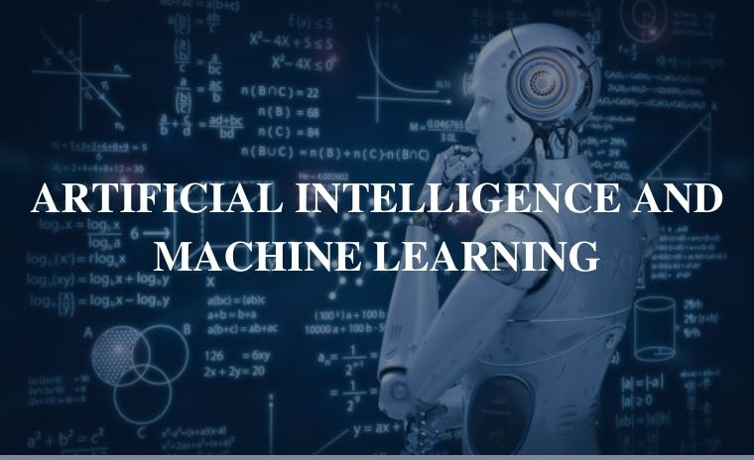
TABLE OF CONTENTS
1. Abstract
2.Introduction
3.Project
4.Concepts Implemented
5.Conclusion

Slide 3
ABSTRACT
Artificial intelligence (AI) refers to the ability of machines to perform intelligent tasks, and machine learning (ML) is a subset of AI describing the ability of machines to learn independently and make accurate predictions.
Artificial Intelligence (AI) is when a computer algorithm does intelligent work. On the other hand, Machine Learning is a part of AI that learns from the data that also involves the information gathered from previous experiences and allows the computer program to change its behavior accordingly. Artificial Intelligence is the superset of Machine Learning i.e. all Machine Learning is Artificial Intelligence but not all AI is Machine Learning.
Machine Learning and Artificial Intelligence are creating a huge buzz worldwide. The plethora of applications in Artificial Intelligence has changed the face of technology. The terms Machine Learning and Artificial Intelligence are often used interchangeably. However, there is a stark difference between the two that is still unknown to the industry professionals.

Slide 4
INTRODUCTION
Artificial Intelligence is a technique for building systems that mimic human behavior or decision-making.
Machine Learning is a subset of AI that uses data to solve tasks. These solvers are trained models of data that learn based on the information provided to them. This information is derived from probability theory and linear algebra. ML algorithms use our data to learn and automatically solve predictive tasks.
Deep Learning is a subset of machine learning which relies on multilayered neural networks to solve these tasks.
Forms of machine learning
There are three kinds of machine learning: supervised, unsupervised, and reinforcement learning. Each form solves problems differently.
Supervised Machine Learning
In supervised machine learning, we know about the data and the problem. Think of it as, “given a set of features x, we know the value of y,” and so in supervised learning, we create a function that approximates results based on some set of data.
There are two kinds of supervised learning: classification and regression. In a classification problem, we assign data to categories. For example, given a client’s medical information, they test positive or negative for diabetes. In classifications, our trained models, known as classifiers, classify data points into different groups.

Slide 5
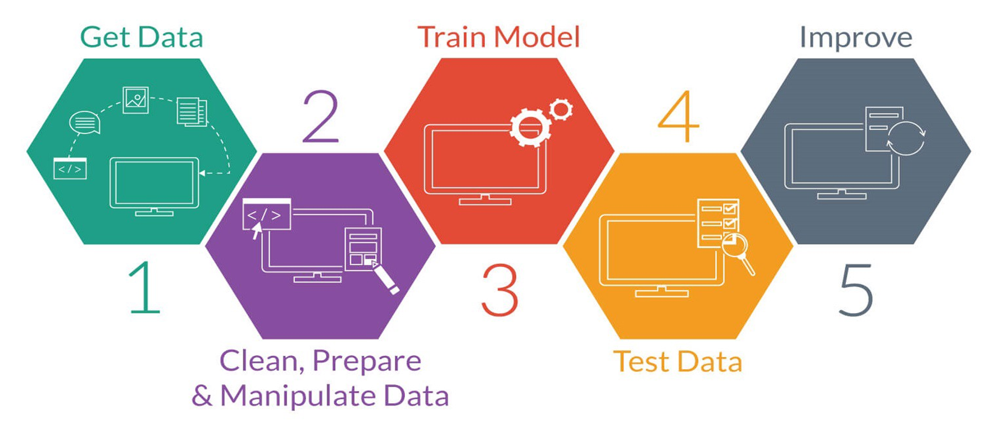
Unsupervised Machine Learning
In unsupervised machine learning, our data is unlabelled. There are two forms of unsupervised machine learning: clustering and dimension reduction.
In clustering, we learn more about data points as they are clustered, or grouped together. This allows learned models to understand a data set, detect anomalies, and assign relationships between points, often allowing users to develop new categories or features about the data set.
Stages in machine learning

Slide 6
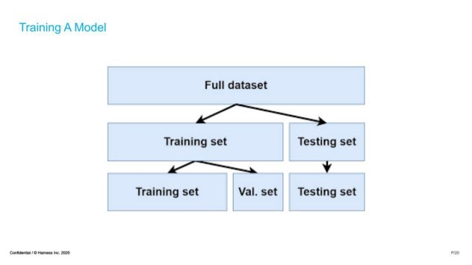
Training an ML model
After data is cleaned and ready to be processed, the entire data set is split into a training set and a testing set. Validation sets are used in the training process to ensure a model does not overfit on data. Overfitting can cause issues like poor performance on data that hasn’t been seen outside of the training set.

Slide 7
Machine Learning Algorithms
The algorithms we have learnt in our training:
Classification:
The Classification algorithm is a Supervised Learning technique that is used to identify the category of new observations on the basis of training data. In Classification, a program learns from the given dataset or observations and then classifies new observation into a number of classes or groups. Such as, Yes or No, 0 or 1, Spam or Not Spam, cat or dog, etc. Classes can be called as targets/labels or categories.
Algorithms under classification:
KNN(k Nearest Neighbours)
Naive bayes
Decision Tree algorithm
Regression:
Regression is a machine learning technique where the model predicts the output as a continuous numerical value.
Algorithms under regression:
Linear Regression
Clustering:
Clustering is a process of grouping the similar items as one cluster
Algorithms under the clustering :
K Means

Slide 8
Iris flower classification using KNN Algorithm
PROJECT
-Iris flower classification is to predict flowers based on their specific features using knn algorithm

Slide 9
Algorithm used in project
- KNN Algorithm
KNN algorithm:
K-Nearest Neighbour is one of the simplest Machine Learning algorithms based on Supervised Learning technique.
K-NN algorithm assumes the similarity between the new case/data and available cases and put the new case into the category that is most similar to the available categories.
K-NN algorithm stores all the available data and classifies a new data point based on the similarity. This means when new data appears then it can be easily classified into a well suite category by using K- NN algorithm.
KNN algorithm at the training phase just stores the dataset and when it gets new data, then it classifies that data into a category that is much similar to the new data.
The K-NN working can be explained on the basis of the below algorithm:
Step-1: Select the number K of the neighbors
Step-2: Calculate the Euclidean distance of K number of neighbors
Step-3: Take the K nearest neighbors as per the calculated Euclidean distance.
Step-4: Among these k neighbors, count the number of the data points in each category.
Step-5: Assign the new data points to that category for which the number of the neighbor is maximum.
Step-6: Our model is ready.

Slide 10
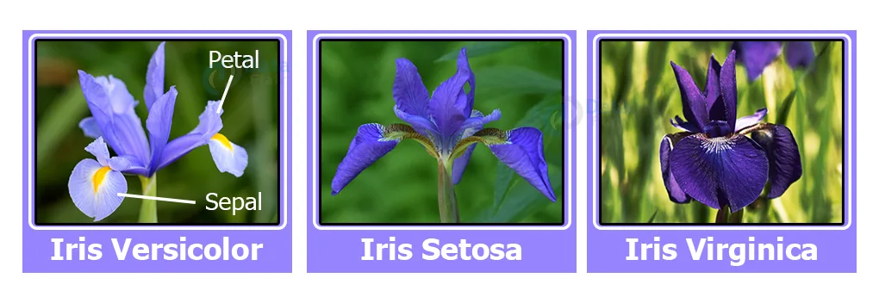
Classification Project – Classification of Iris Data set.
Iris flower classification is a very popular machine learning project. The iris dataset contains three classes of flowers, Versicolor, Setosa, Virginica, and each class contains 4 features, ‘Sepal length’, ‘Sepal width’, ‘Petal length’, ‘Petal width’. The aim of the iris flower classification is to predict flowers based on their specific features.

Slide 11
Steps to Classify Iris Flower:
1. Load the data
Numpy will be used for any computational operation. Pandas help to load data from various sources like local
storage, database, excel file, CSV file, etc.Next, we load the data using pd. read_csv () and set the column
name as per the iris data information.Pd.read_csv reads CSV files. CSV stands for comma separated value.
df.head() only shows the first 5 rows from the data set table.
2.Analyze the dataset
Some basic statistical analysis about the data df. describe ( ) and df.info ( )Analyzation is used for
collecting useful information from the dataset
3.Model training.
Using train_test_split we split the whole data into training and testing datasets. Later we’ll use the testing dataset
to check the accuracy of the model.Here we imported a KNeighborsClassifier from the scikit-learn support vector
machine.Then, we created an object and named it model.After that, we feed the training dataset into the algorithm
by using the model.fit() method

Slide 12
4.Model Evaluation.
Now we predict the classes from the test dataset using our trained model.
Then we check the accuracy score of the predicted classes.
accuracy_score() takes true values and predicted values and returns the percentage of accuracy.
The classification report gives a detailed report of the prediction
5. Testing the model.
Prediction of Species: [‘Iris-setosa’ ‘Iris-versicolor’ ‘Iris-virginica’]
And again, load the model in any other program using pickle and use it using model.predict to predict the iris data.
Summary:
In this project, learned to train our own supervised machine learning model using Iris Flower Classification Project with Machine Learning. Through this project, we learned about machine learning, data analysis, data visualization, model creation, etc.

Slide 13
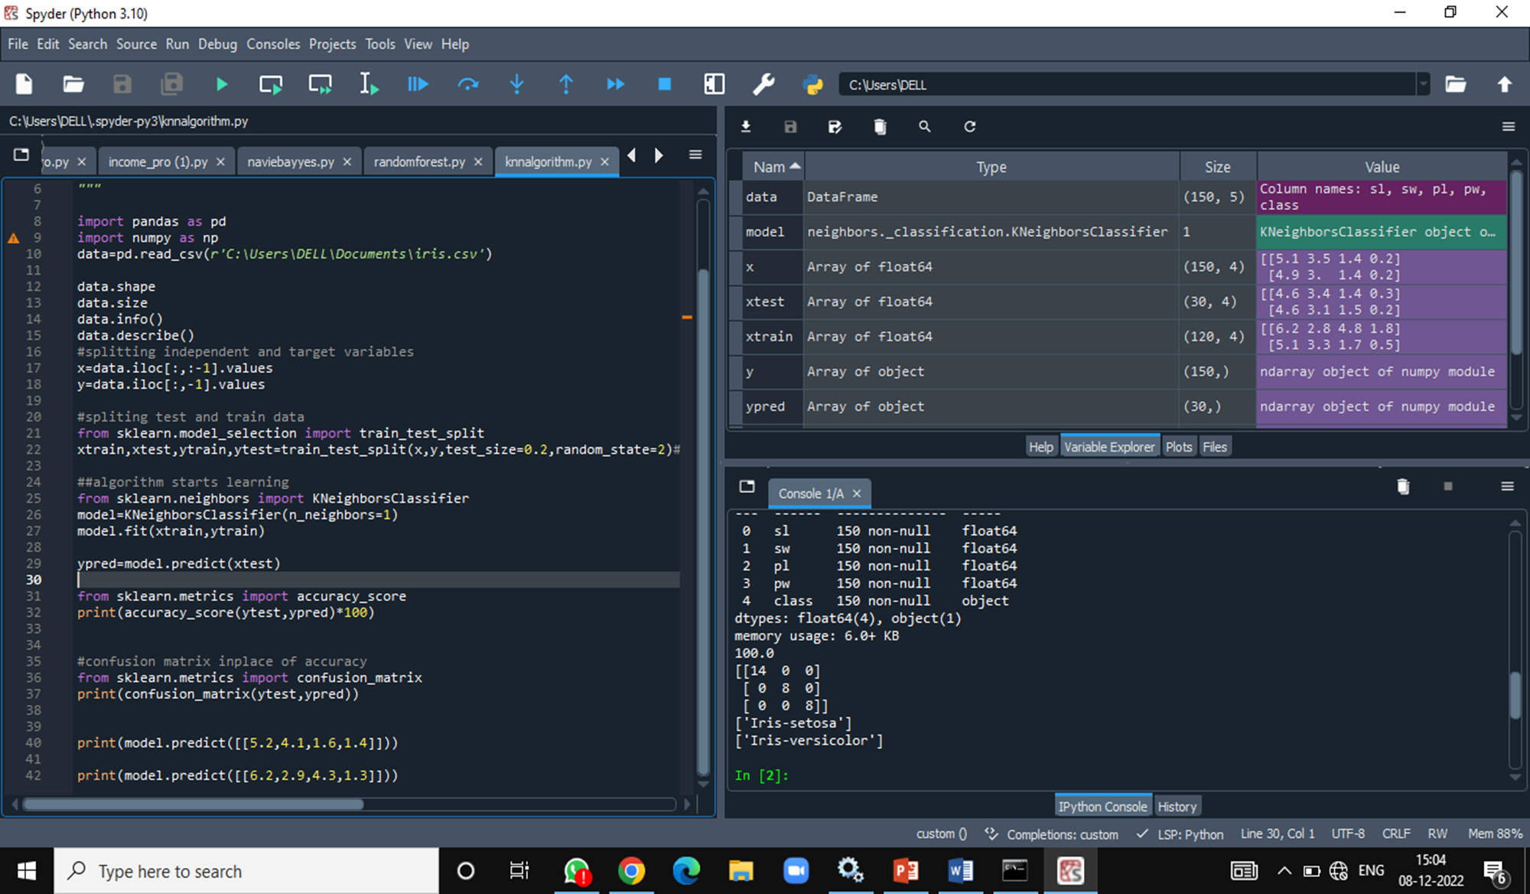
Source code

Slide 14
CONCEPTS IMPLEMENTED
DATA PRE PROCESSING | Data Cleaning Data Transformation Data Reduction Data Integration Data Visualization
DATA ANALYSIS | Descriptive Statistics Classification and Categorization Cluster Analysis
MODEL BUILDING | Feature Selection Model Selection Model Training
MODEL EVALUATION | Evaluation Metrics Overfitting and Underfitting Cross-Validation

Slide 15
CONCLUSION
In conclusion, our four-week internship in ARTIFICIAL INTELLIGENCE AND MACHINE LEARNING has been a transformative experience. I've had the opportunity to work on meaningful projects, deepen my knowledge of Artificial Intelligence and Machine Learning concepts, and acquire valuable skills. I want to express my sincere gratitude to my mentors and colleagues for their guidance and support. This internship has not only expanded my horizons but has also reaffirmed my passion for Artificial Intelligence and Machine Learning. As I move forward, I'm excited to apply the knowledge and skills I've gained and continue my journey in this dynamic and promising field.

Slide 16
THANK YOU

