Slide 1
Presentation Of MiniCapstoneProject
K.Saisrikar

Slide 2
Overview
I have performed data analysis on maven movies dataset by using MySQL, SQL scripts, Excel, Pivot tables, Visualizations and made a final report in a PPT file
Objective: To analyze rental trends, identify popular films, and assess store performance using the MavenMovies Sakila database.
Tasks:
1. Rental Trends:
Analyze the monthly rental trends over the available data period.
Determine the peak rental hours in a day based on rental transactions.
2. Film Popularity:
Identify the top 10 most rented films.
Determine which film categories have the highest number of rentals.
3. Store Performance:
Identify which store generates the highest rental revenue.
Determine the distribution of rentals by staff members to assess performance.
I used the following SQL scripts to extract the required data from the maven-movies dataset.

Slide 3
SELECT count(rental.rental_id) as Total_rentals,DATE_FORMAT(rental.rental_date, '%Y - %m') as Monthly_Rentals, sum(payment.amount) as Total_Revenue from rental left join payment on payment.rental_id = rental.rental_id group by Monthly_Rentals order by Total_Revenue desc;
SQL Code to Retrive Montly Trends

Slide 4
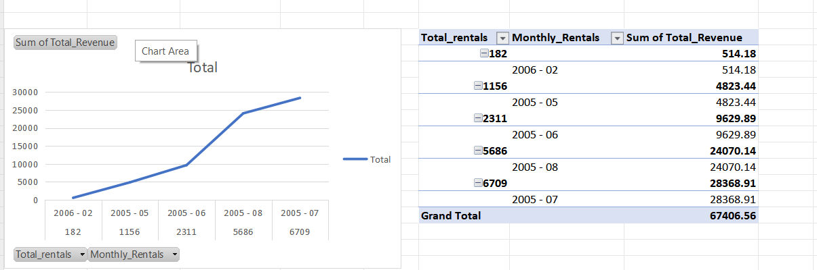
Monthly Trend

Slide 5
Report
From the line chart, we can understand that the rental payments are increasing from May,2005 to July, 2005 and there is a decrease in the count from December

Slide 6
sql Code to retrieve Peak Rental Hour
SELECT HOUR(rental_date) AS rental_hour,
COUNT(*) AS total_rentals
FROM rental
GROUP BY rental_hour
ORDER BY total_rentals DESC,rental_hour asc;

Slide 7
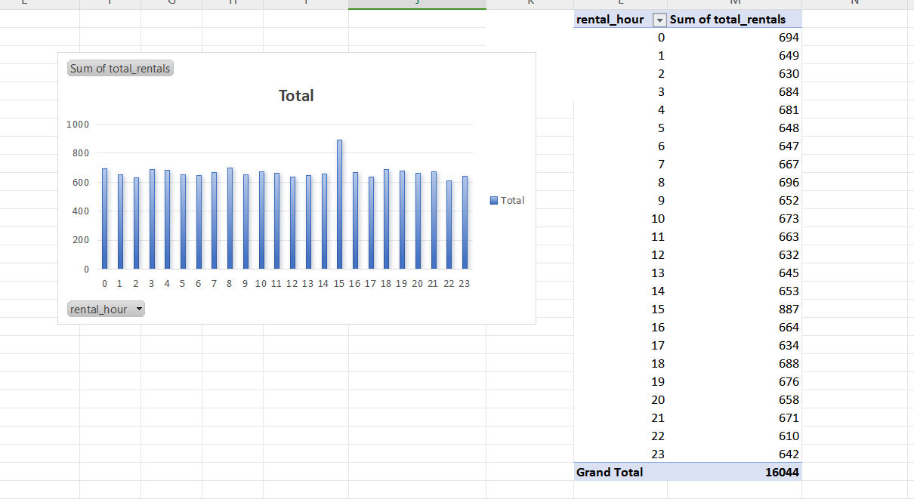
Peak rental hours

Slide 8
Report
From the following visualization, we can understand that the count of payments done are almost the same every hour, however at 3 PM the count is at the peak stage.

Slide 9
Sql code to retrieve top 10 films
select film.film_id,title,count(rental_id) as rental_count from film
inner join inventory on film.film_id=inventory.film_id
inner join rental
on inventory.inventory_id=rental.inventory_id
group by film_id,title
order by rental_count desclimit 10;

Slide 10
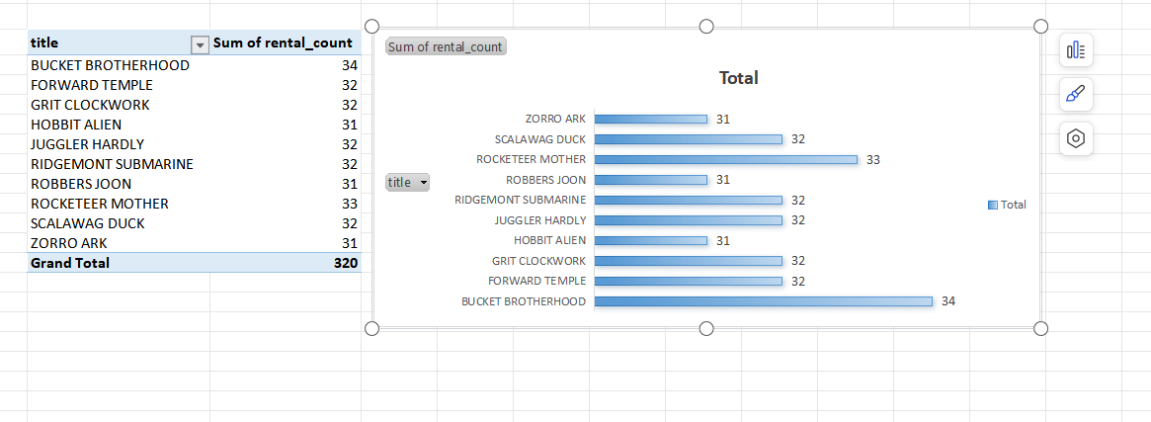
Excel Data(Top 10 films)

Slide 11
Report
From the following visualization, we can see that the top 10 movies that had been rented are rented more than 30 times. The top most rented movie is ‘Bucket Brotherhood’ with a count of 34

Slide 12
Sql code to find most rented category
select name,count(rental_id) as rental_count from category
inner join film_category
on category.category_id=film_category.category_id
inner join inventory
on film_category.film_id=inventory.film_id
inner join rental
on inventory.inventory_id=rental.inventory_id
group by name
order by rental_count desc;

Slide 13
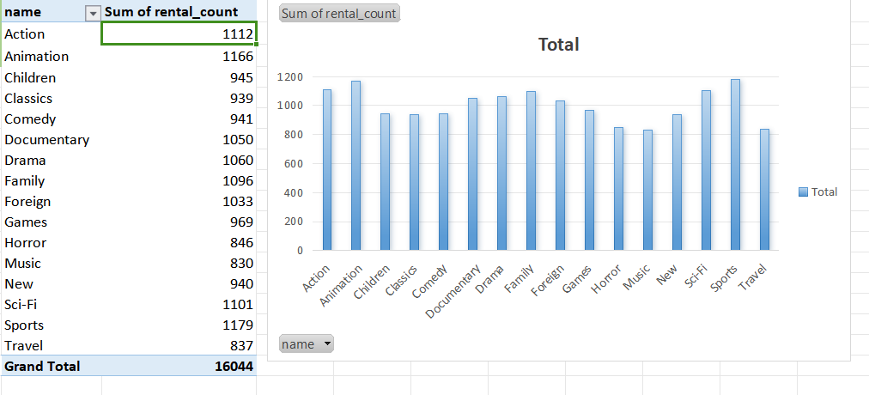
Excel data (Most rented category)

Slide 14
Report
From the following visualization, we can observe that the most rented category is ‘Sports’ with a total count of 1179. Other rental counts of rest of the categories 837 to 1166.

Slide 15
SQL code to retrieve total incomes of stores
select store.store_id,sum(amount) from store
inner join inventory
on store.store_id=inventory.store_id
inner join rental
on inventory.inventory_id=rental.inventory_id
inner join payment
on rental.rental_id=payment.rental_id
group by store_id

Slide 16
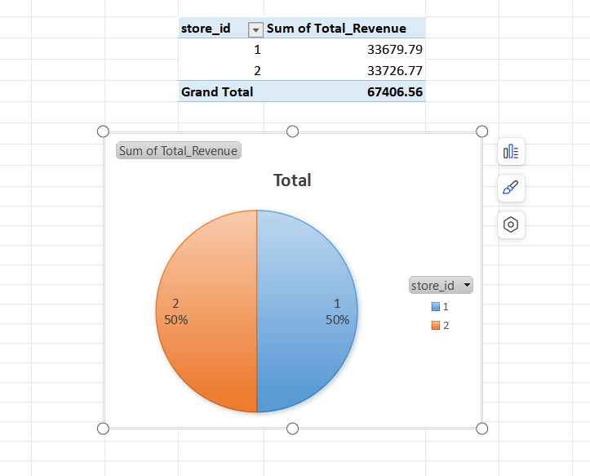
Excel Data(Highest store income)

Slide 17
Report
From the following graph, store-2 sales are 33679.79 ranking top where as store-1 sales are 33726.77

Slide 18
SQL Code for retrieving staff rental distribution
select rental.staff_id,count(rental.rental_id) from rental
inner join payment
on rental.rental_id=payment.rental_id
group by staff_id

Slide 19
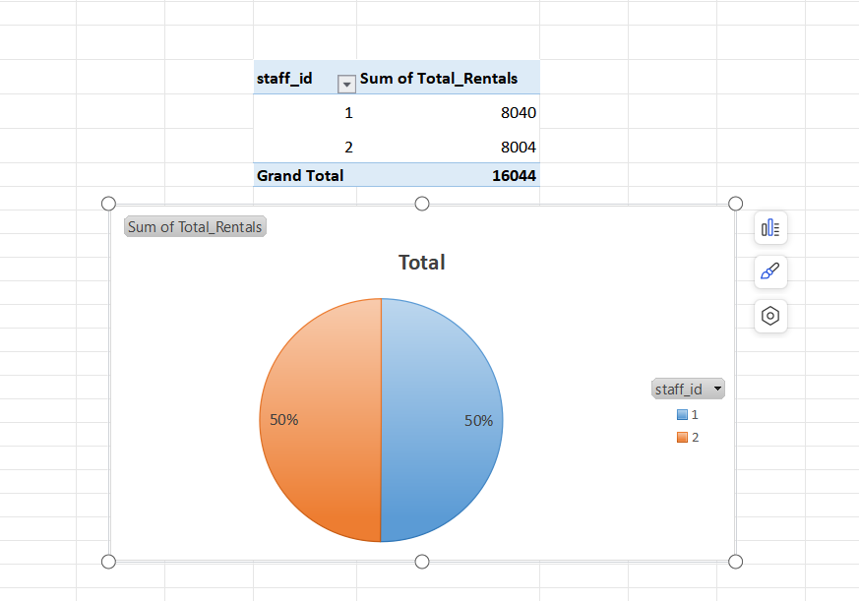
Excel data (staff rental distribution)

Slide 20
Report
8040 rentals has been done by staff_id 1, where as 8004 rentals are done by staff_id 2

